Slide 1
Spectral Processing and Analysis in NMRPipe
Special Cases
Key Steps of Spectral Processing
Gradient-Enhanced Data
Interleaved Experiments and Spectral Series
Non-Uniform Sampling and Alternatives to Fourier Transform
Correction of Bad Points
Window function and first point scaling
Zero Fill
Fourier Transform
Phase Correction
Post-Processing
Other Common Spectral Processing Tasks
Generating 2D Projections from 3D or 4D Spectra
Viewing 2D Strips from 3D Spectra
Peak Detection and Modeling (Quantification) of Spectra and Spectral Series
Extracting Chemical Shift Evolutions from Spectral Series
Multivariate Analysis of Spectral Series
Extracting Structural Data from Chemical Shifts and Dipolar Couplings
Solvent Subtraction
Baseline Correction
Linear Prediction
Hilbert Transform and Inverse Processing
NMRbox.org
frank.delaglio@nist.gov
www.nmrpipe.com
frank.delaglio@nist.gov
Updated Aug 5 2019

Slide 2
Acknowledgements
Karen Allen ● Amanda Altieri ● Luke Arbogast ● Yves Aubin ● Andrew Baldwin ● Joseph Barchi
Ad Bax ● Paul Bowyer ● Robert Brinson ● James Chou ● Gabriel Cornilescu ● Stefano Ciurli
Brian Coggins ● Kathleen Farley ● David Fushman ● Michelle Gill ● George Gray ● Alex Grishaev Stephan Grzesiek ● Jeff Hoch ● Sven Hyberts ● Brad Jordan ● Lewis Kay ● Georg Kontaxis
Krish Krishnamurthy ● John Kuszewski ● Dong Long ● Massimo Lucci ● Mark Maciejewski
John Marino ● Ryan McKay ● Leszek Poppe ● John Pfeiffer ● Ben Ramirez ● David Rovnyak
Dave Russell ● Michael Shapiro ● Adam Schuyler ● Evgeny Tishchenko ● Desi Tsao ● Tobias Ulmer Gerteen Vuister ● Greg Walker ● Gerard Weatherby ● Justin Wu ● Shen Yang ● Jinfa Ying
Edward Zartler ● Guang Zhu ● Markus Zweckstetter
NMRbox.org
frank.delaglio@nist.gov
www.nmrpipe.com

Slide 3
Spectral Processing and Analysis in NMRPipe
Some Related Online Resources:
www.ibbr.umd.edu/nmrpipe NMRPipe Installation and Demo Files
www.youtube.com/watch?v=U268HggjRKE Lecture about Non-Uniform Sampling Concepts
www.youtube.com/watch?v=kAni_LOXWZA NMRPipe Conversion and Processing Demo
NMRbox.org
frank.delaglio@nist.gov
www.nmrpipe.com

Slide 4
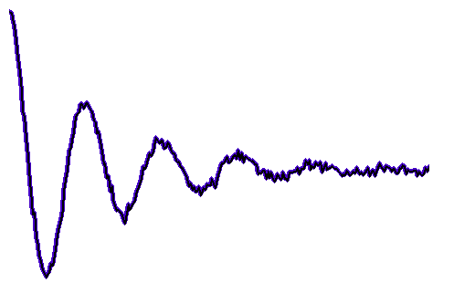
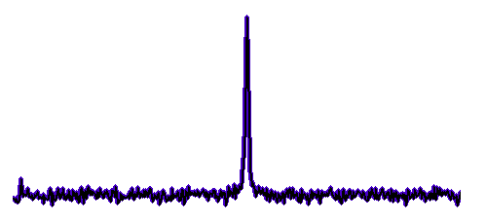
One-Dimensional NMR
Fourier
Transform
f = 0
t = 0
Time
Frequency
By convention we re-arrange the spectrum with zero frequency in the middle. For discrete data, the zero frequency is at point 1 + N/2 of 1 … N.

Slide 5
The Time Domain and Frequency Domain Have
the Same Information Content … But Some Things are Easier to See or Do in One Domain
Signal Extends Over All Points
Signal is Mostly Localized in One Region
Noise Level is Easily Identified
Time
Frequency

Slide 6
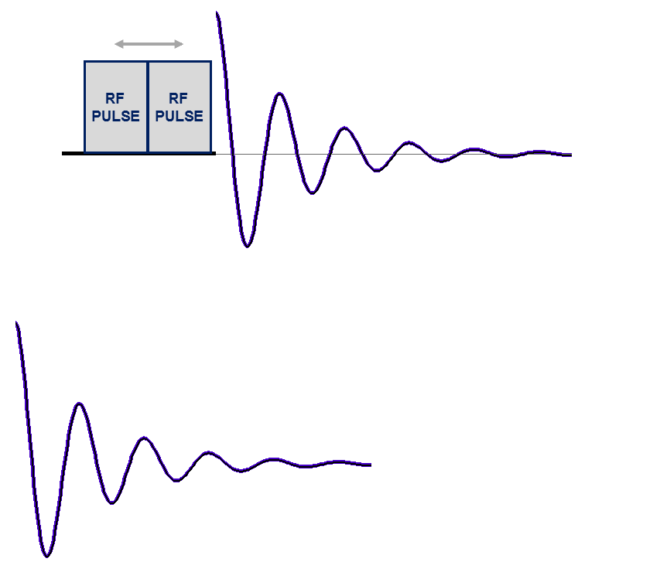
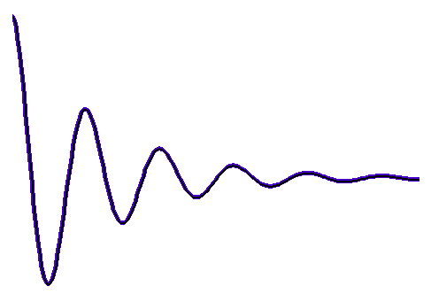
The Direct Dimension
The Indirect Dimension
Resolution in the Direct Dimension is Determined by Max Sampling Time t2
Acquire 1D Data at Each Evolution Time
Evolution Time
Incremented by Δ _{t1}
RF
PULSE
Measurement Time in the Direct Dimension is Also Determined by Max Sampling Time t2 …
It is Not Determined by the Number of Samples

Slide 7
The Indirect Dimension
Resolution in the Indirect Dimension is Determined by Max Evolution Time t1
Measurement Time is Determined by the Number of Increments Measured in the Indirect Dimension
RF PULSE
RF PULSE
2D Spectrum
Time-Domain
Interferogram
Fourier Transform Rows
Fourier Transform Columns

Slide 8
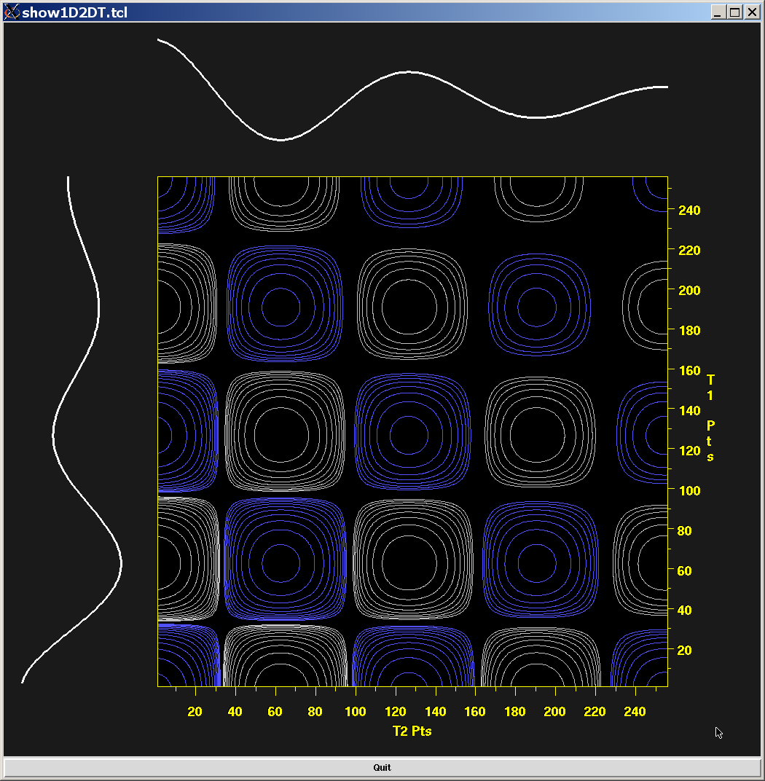
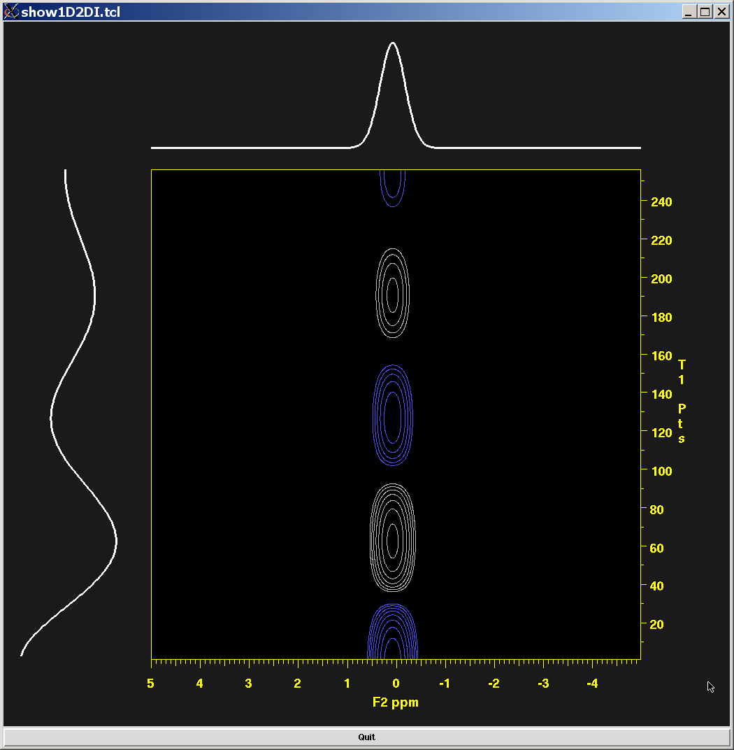
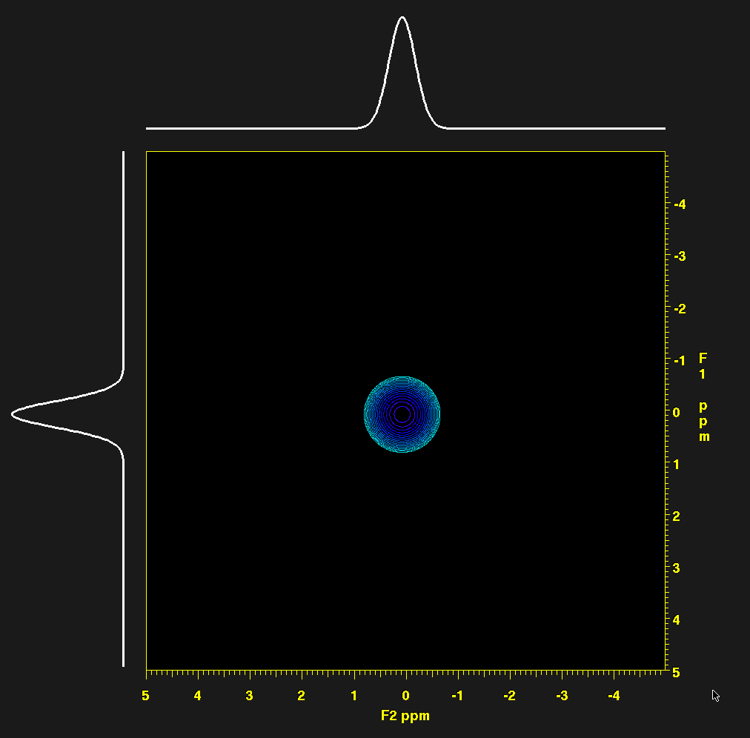
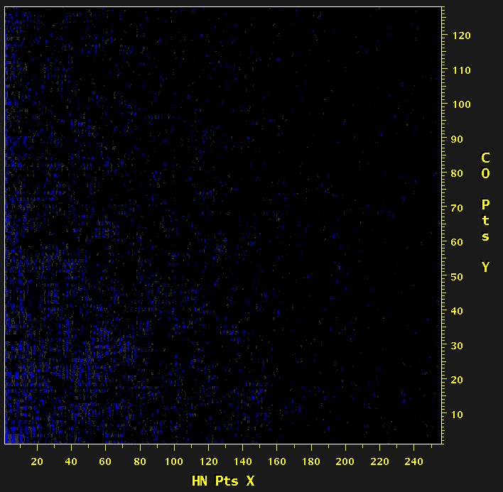
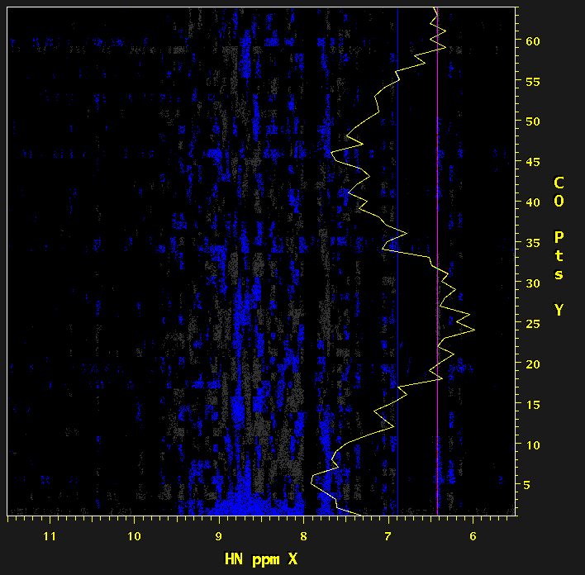
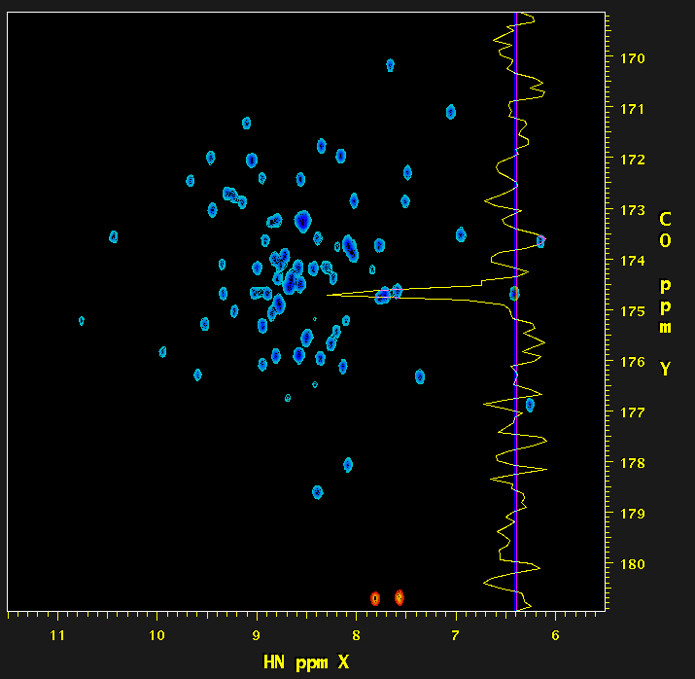
Points in a Multidimensional NMR Spectrum are Not Independent
Time-Domain Interferogram Frequency Domain
=
=

Slide 9
Sampling and Resolution
As a general rule, spectral width will be proportional to 1/dT, and resolution will be inversely proportional to the largest time coordinate acquired (that is, the greater the largest time, the better the resolution).
dT
N uniformly spaced samples, each separated by dT.
The time difference between first and last samples determines the spectral resolution. The time difference between adjacent samples determines the spectral width.

Slide 10
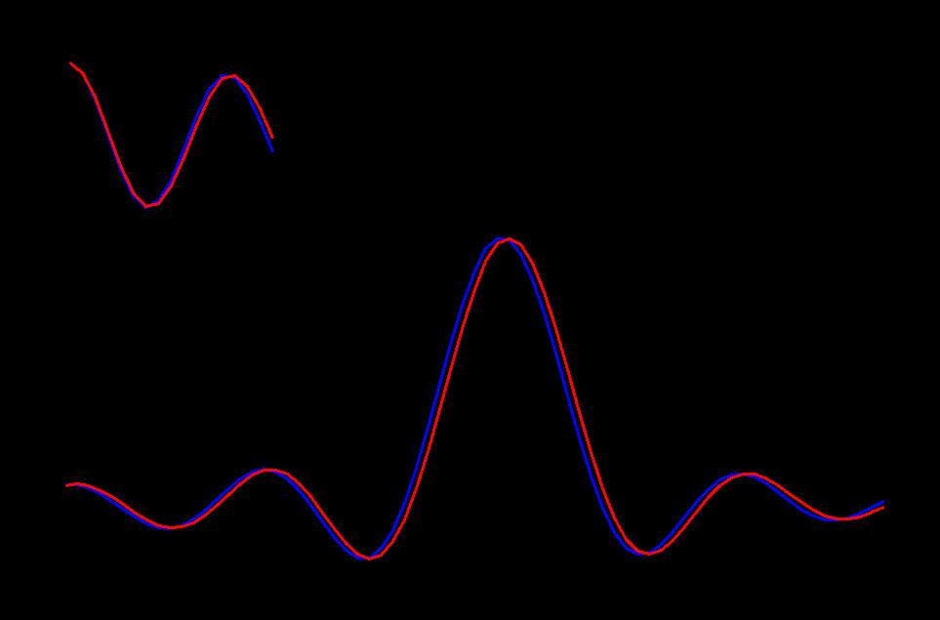
Sampling and Resolution
Time-Domain Data
Fourier Transform (Excerpt)

Slide 11
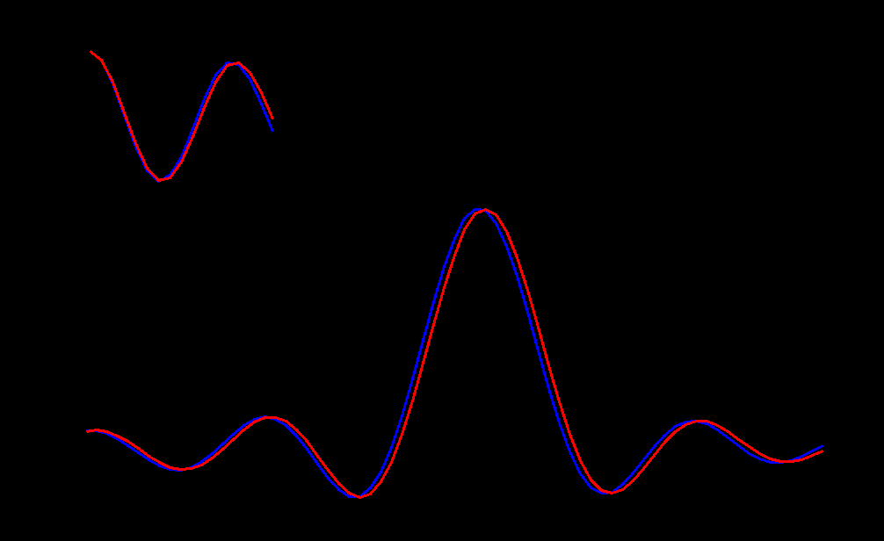
Sampling and Resolution
Time-Domain Data
Fourier Transform (Excerpt)

Slide 12
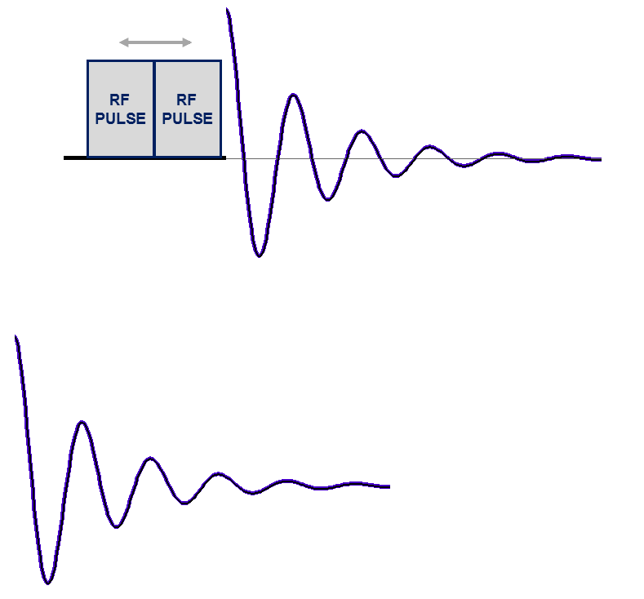
Two-Dimensional NMR with Non-Uniform Sampling (NUS)
Acquire 1D Data at Each Evolution Time …
But Only for Selected Increments …
Evolution Time
Incremented by Δ _{t1}
NUS retains resolution, and since fewer increments acquired, measurement time is reduced, but signal-to-noise is typically (but not always) decreased.

Slide 13
Fourier Transform is not Suitable for Non-Uniformly Sampled Data … Other Reconstruction Methods are Needed

Slide 14
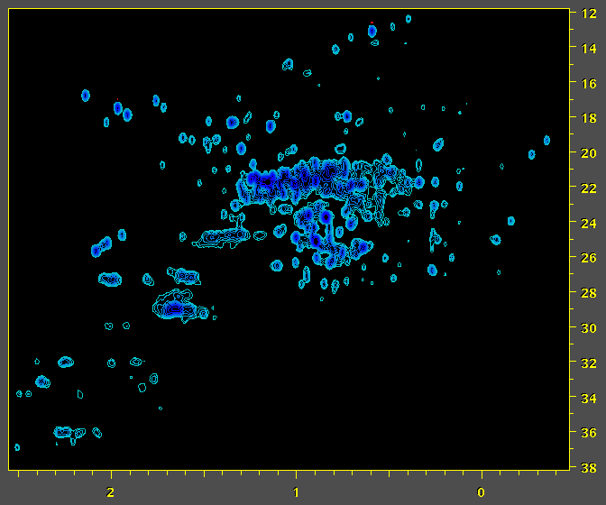
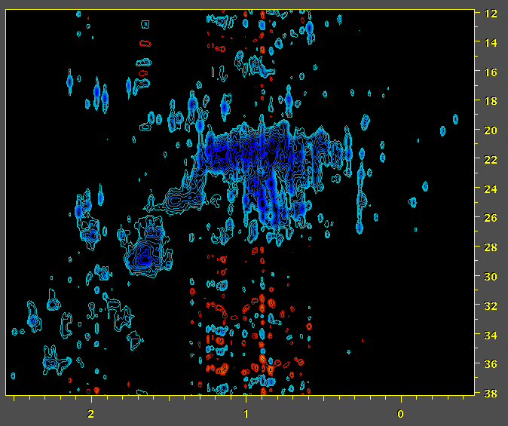
Fourier Transform is not Suitable for Non-Uniformly Sampled Data … Other Reconstruction Methods are Needed
NISTmAb – Natural Abundance ¹H / ¹³C
Conventional Uniformly Sampled (US) Data Fourier Spectrum
NISTmAb
50% Non-Uniformly Sampled (NUS) Data
Fourier Spectrum
Luke Arbogast
¹³C ppm
¹H ppm
¹H ppm
LW Arbogast, RG Brinson, and JP Marino: Mapping Monoclonal Antibody Structure by 2D 13C NMR at Natural Abundance. Anal. Chem., 87,3556–3561 (2015).

Slide 15
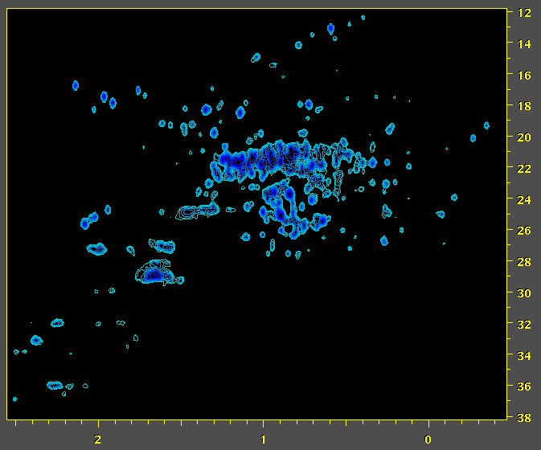
Fourier Transform is not Suitable for Non-Uniformly Sampled Data … Other Reconstruction Methods are Needed
NISTmAb – Natural Abundance ¹H / ¹³C
Conventional Uniformly Sampled (US) Data Fourier Spectrum
NISTmAb
50% Non-Uniformly Sampled (NUS) Data
IST Reconstruction – 2x Faster Measurement
Luke Arbogast
¹³C ppm
¹H ppm
¹H ppm
LW Arbogast, RG Brinson, and JP Marino: Mapping Monoclonal Antibody Structure by 2D 13C NMR at Natural Abundance. Anal. Chem., 87,3556–3561 (2015).

Slide 16
Sampling and Resolution
In a NUS experiment, some fraction of the intermediate increments in the indirect dimensions are skipped, which means that the measurement time will be shorter if other details are kept the same.
dT
M non-uniformly spaced samples, on a grid with positions separated by dT. The time difference between first and last samples is the same as for the fully sampled case, so that the spectral resolution is retained.

Slide 17
NUS Reconstruction
Conventional Uniformly Sampled Data
Zero Fill

Slide 18
NUS Reconstruction
X
X
X
X
X
X
X
X
Non-Uniformly Sampled Data
Zero Fill

Slide 19
NUS Reconstruction
X
X
X
X
X
X
X
X
NUS Reconstruction
Directly or indirectly, NUS reconstruction replaces (interpolates) the missing values.

Slide 20
NUS Reconstruction
Missing Points are Interpolated During Reconstruction
Zero Fill Points are Extrapolated During Reconstruction
NUS Reconstruction
NUS reconstruction replaces (interpolates) missing values.
It can also replace zero-filled data, as an alternative to extrapolation methods such as Linear Prediction. The extrapolated values provide higher resolution.

Slide 21
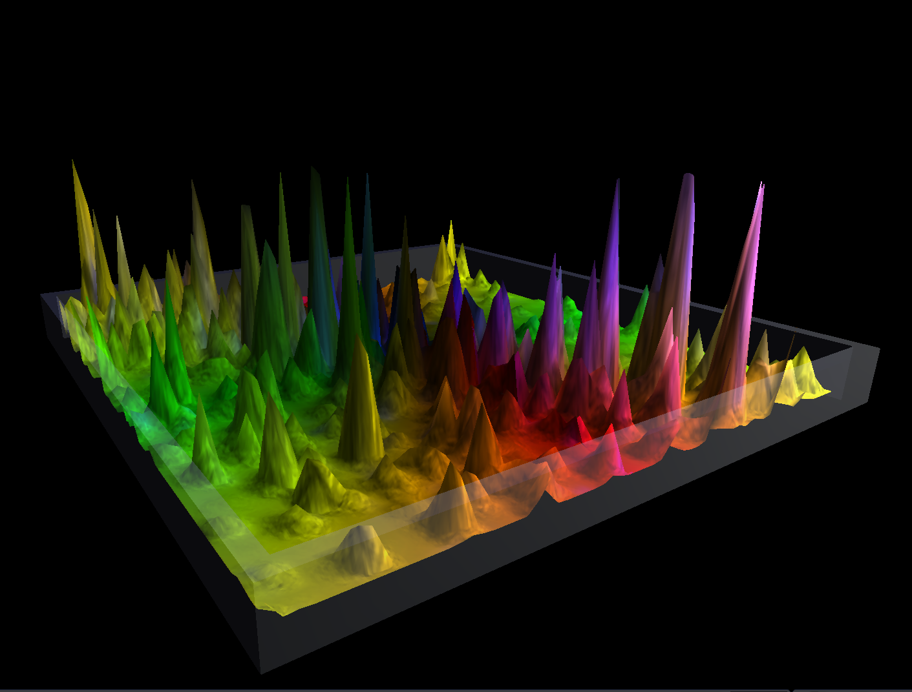
The Fourier Transform

Slide 22
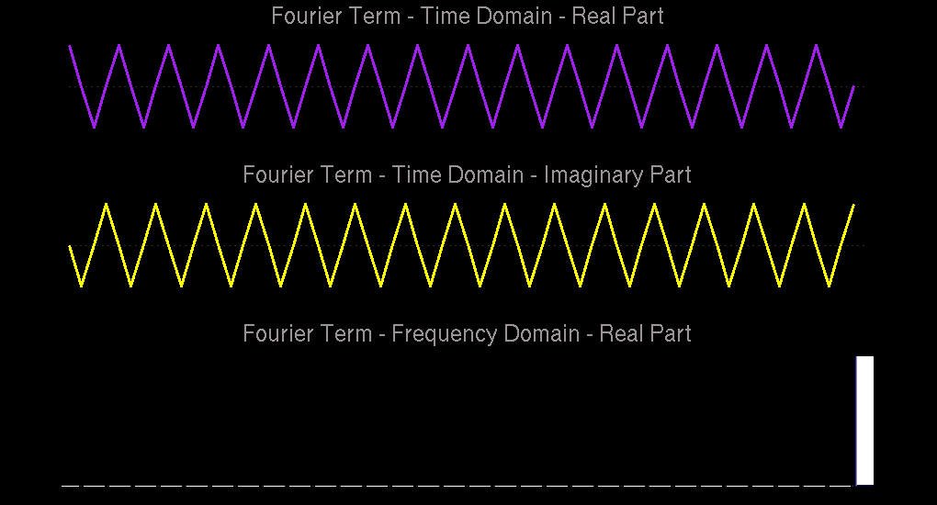
^{X( f ) =} Σ x( t ) [ cos( 2πft / N ) - i sin( 2πft / N ) ]
Each Fourier term corresponds to a point in the spectrum.

Slide 23
The Forward and Inverse Fourier Transform are “the Same”
X(f) =
x(t) e – ^{2π i f t} dt
x(t) =
X(f) e ^{2π i f t} df
For Forward FT:
exp( -2πift ) = cos( 2πft ) - i sin( 2πft )
For Inverse FT:
exp( 2πift ) = cos( 2πft ) + i sin( 2πft )
The position of a point in one domain represents the frequency of a sinusoid in the other domain.
The amplitude of a point in one domain represents the amplitude of a sinusoid in the other domain.

Slide 24
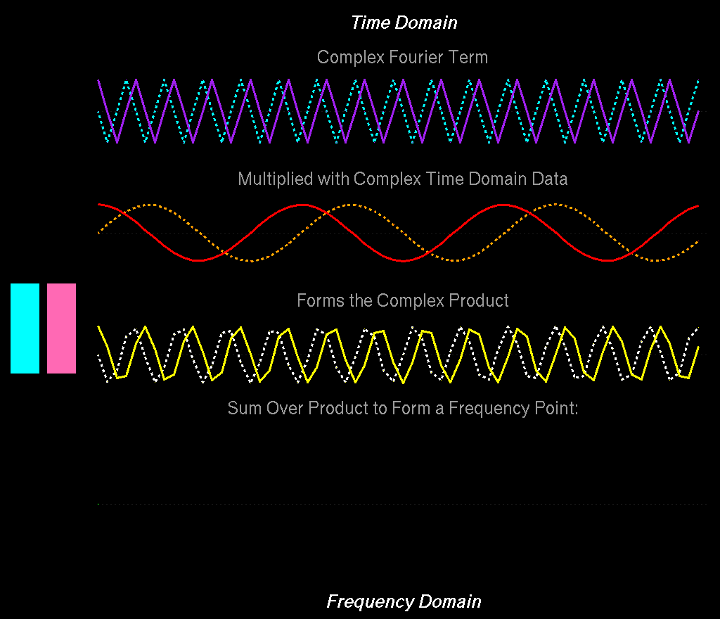
Σ+
Σ-

Slide 25
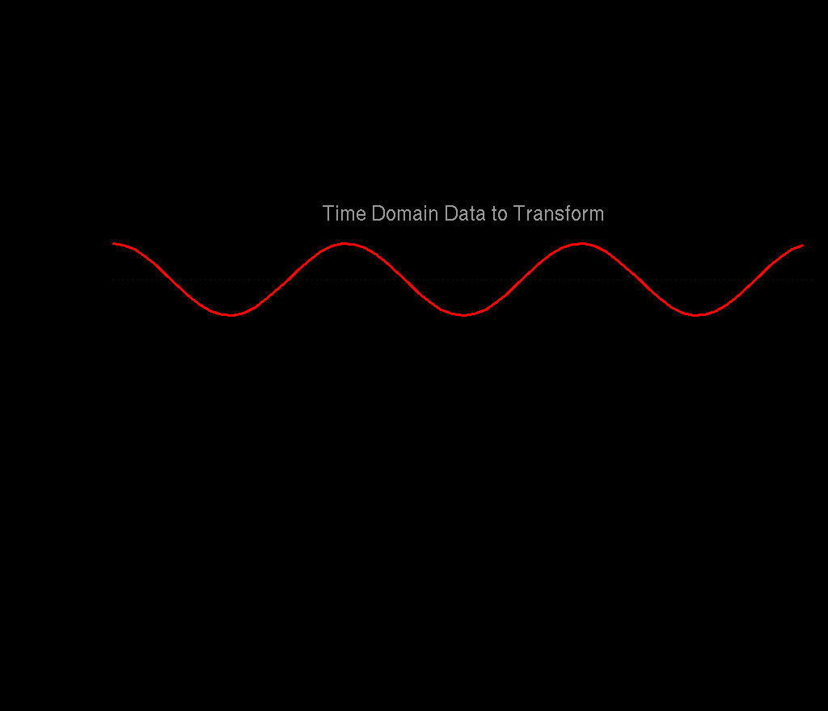
The Fourier Transform (with the Imaginary Parts Hidden)

Slide 26
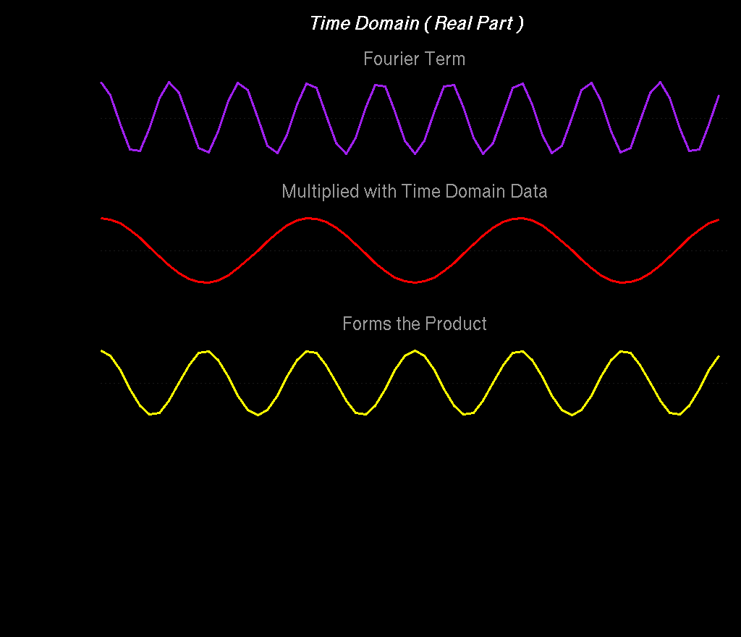

Slide 27
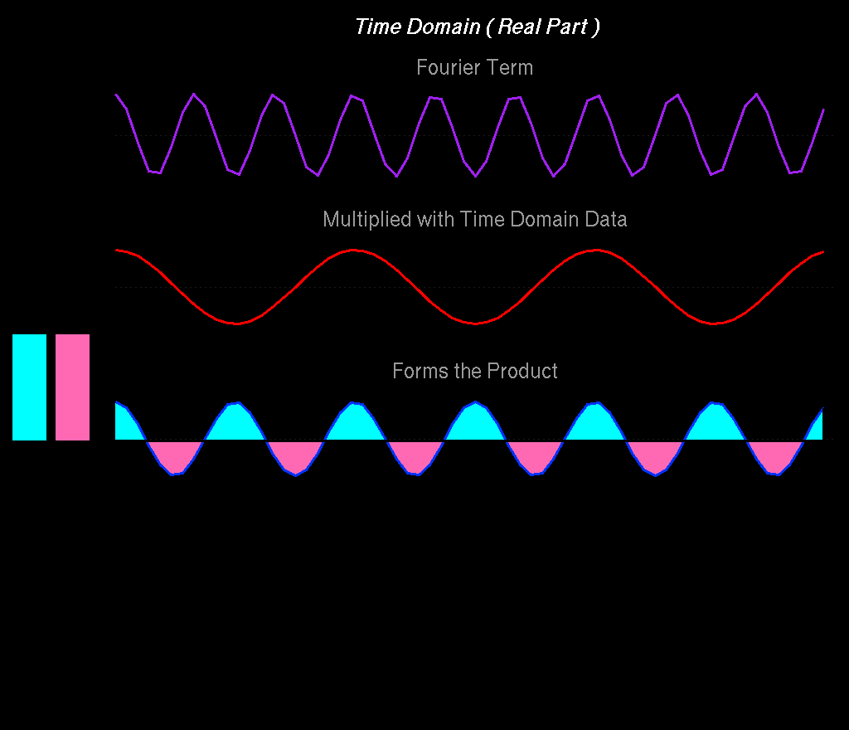
Σ+
Σ-
When the Fourier term does not match any frequency in the data, the product has balanced amounts of positive and negative intensity, and sums to zero.

Slide 28
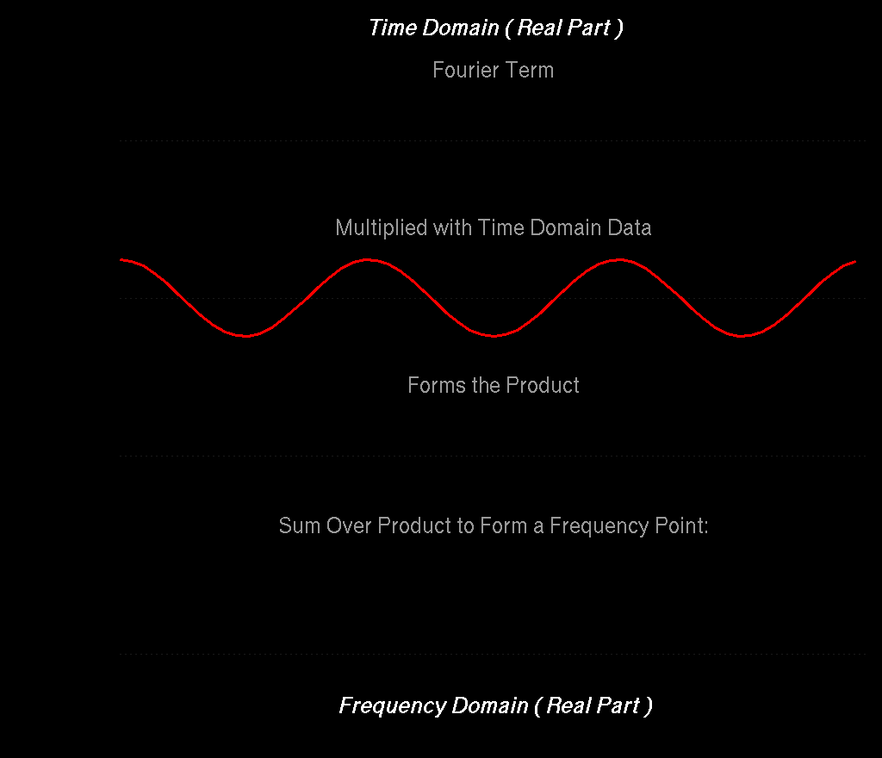
Σ+
Σ-

Slide 29
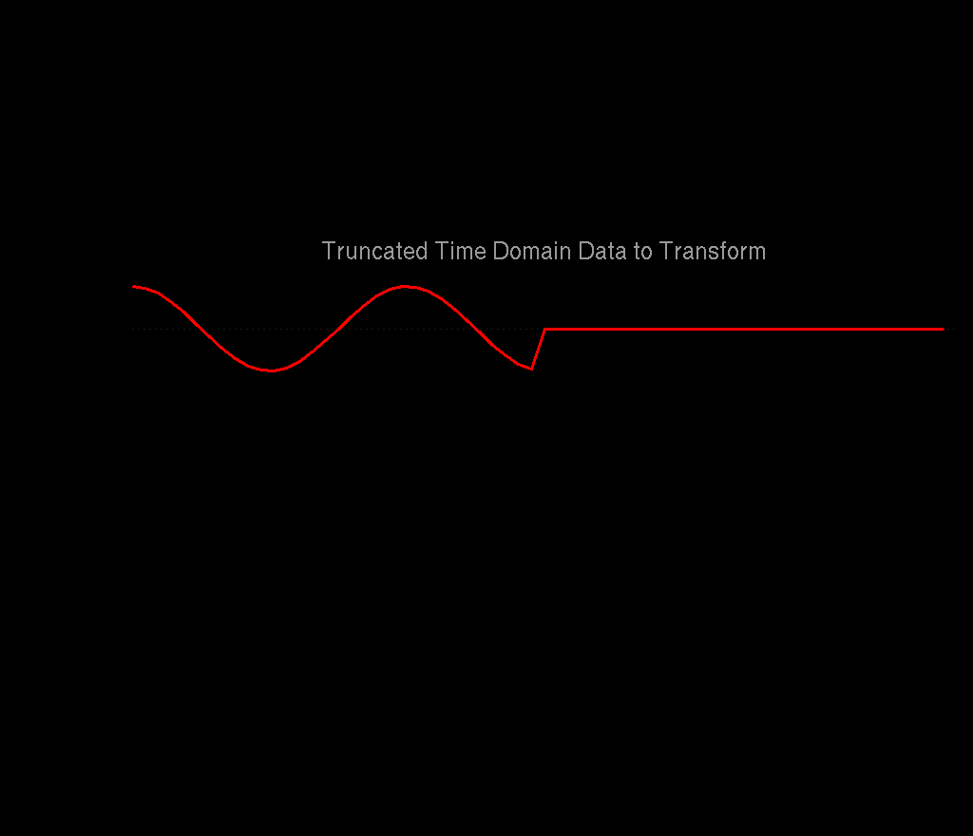
In Biomolecular NMR, Indirect Dimensions are Often Truncated and Have Limited Numbers of Points …

Slide 30
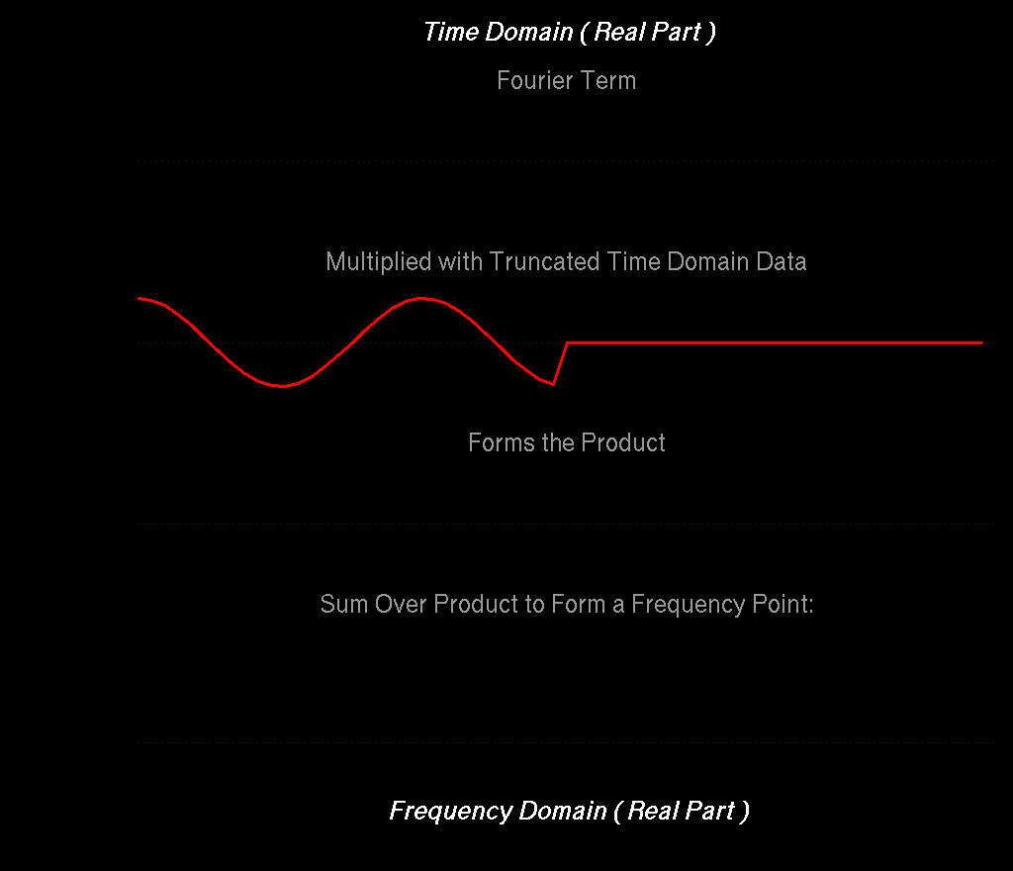
Σ+
Σ-
Since the Fourier product is truncated, there is no longer ideal cancelation of positive and negative intensities, giving broad lines and artifacts

Slide 31
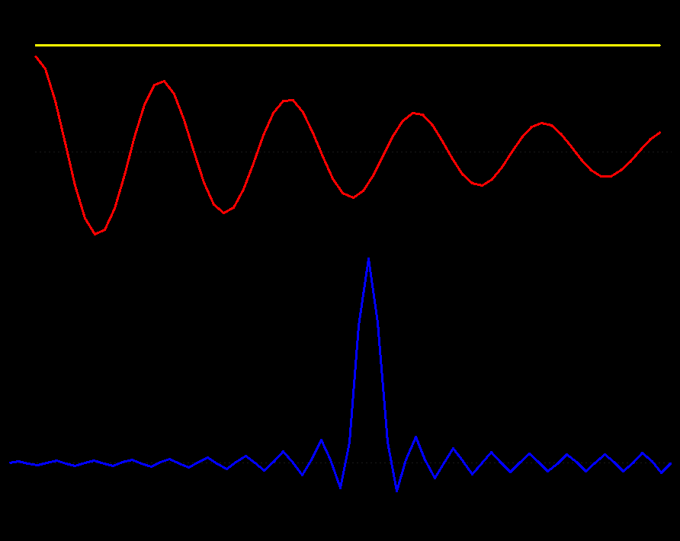
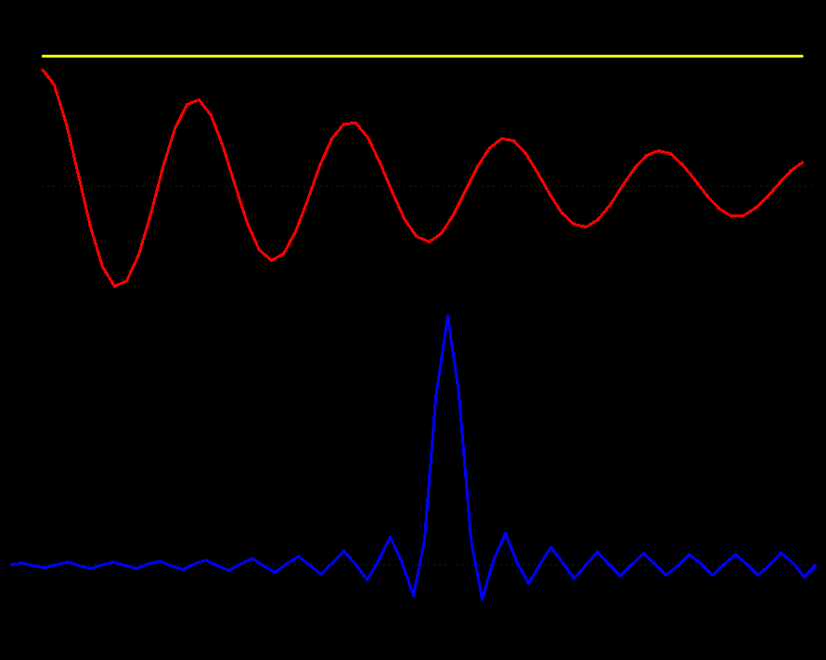
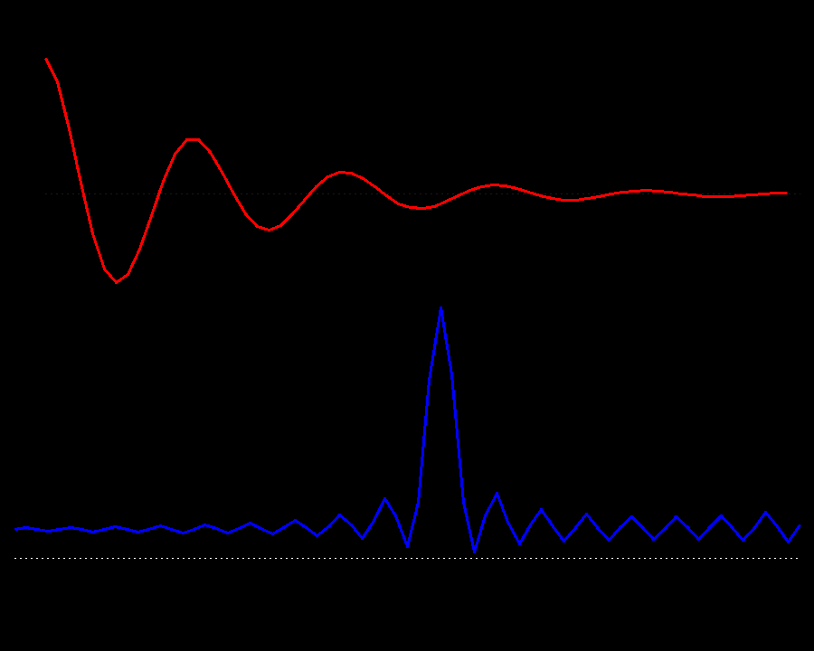
Line Broadening Window
Line Sharpening Window
First Point Scaling
Scaling the first point in the time-domain is equivalent to adding a constant in the frequency domain

Slide 32
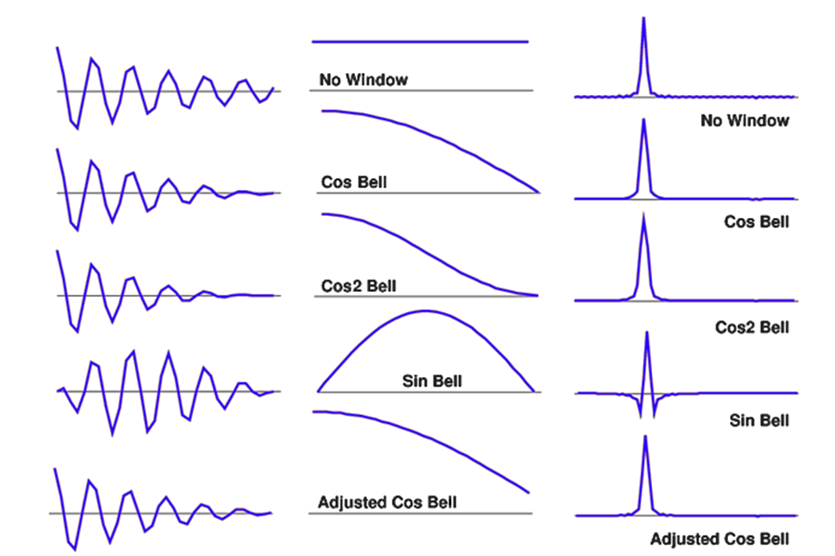
Apodization: Convolution of the Spectrum with the Fourier Transform of the Window Function
Window Functions are a Compromise Between Artifact Reduction and Resolution

Slide 33
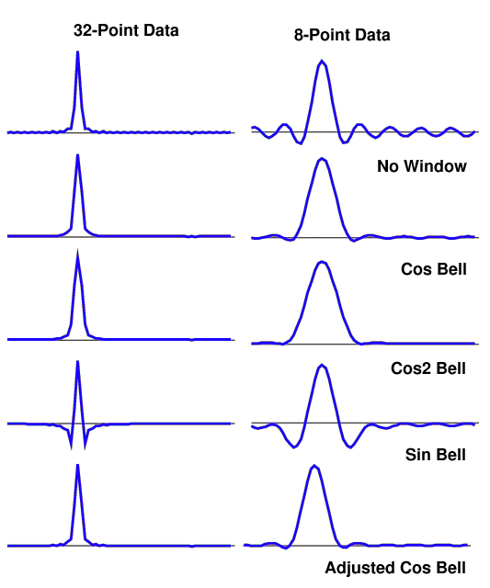
Even though the underlying signal is the same in all of these examples, and noise-free, Fourier transforms with small numbers of points give very broad lines and large artifacts.

Slide 34
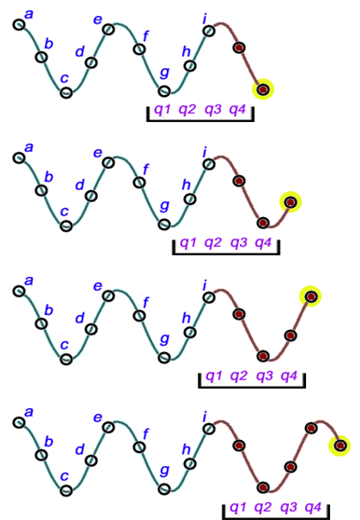
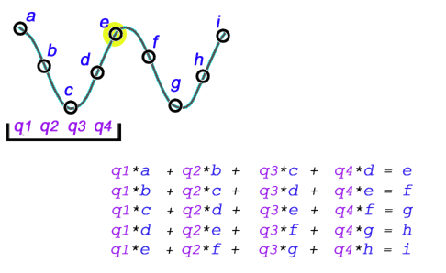
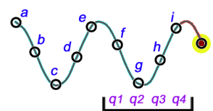
Linear Prediction (LP) – Build an LP Model, Use the LP Model Coefficients to Extrapolate the Time-Domain Data
Predict next point in series
Each LP Coefficient Can Model One Exponentially Decaying Sinusoid

Slide 35
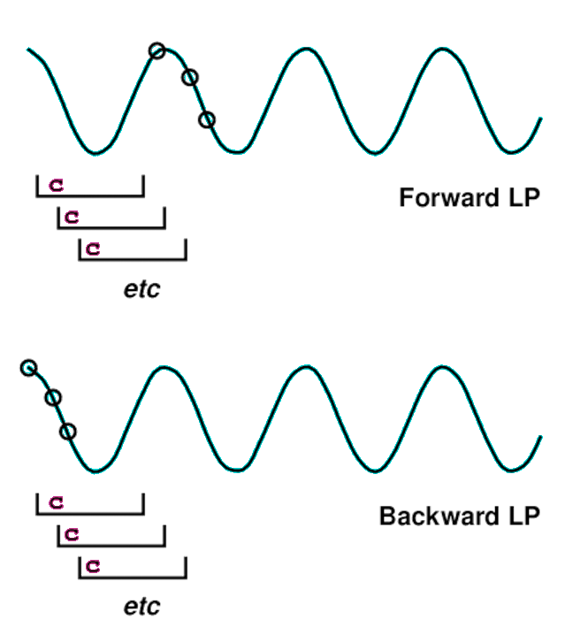
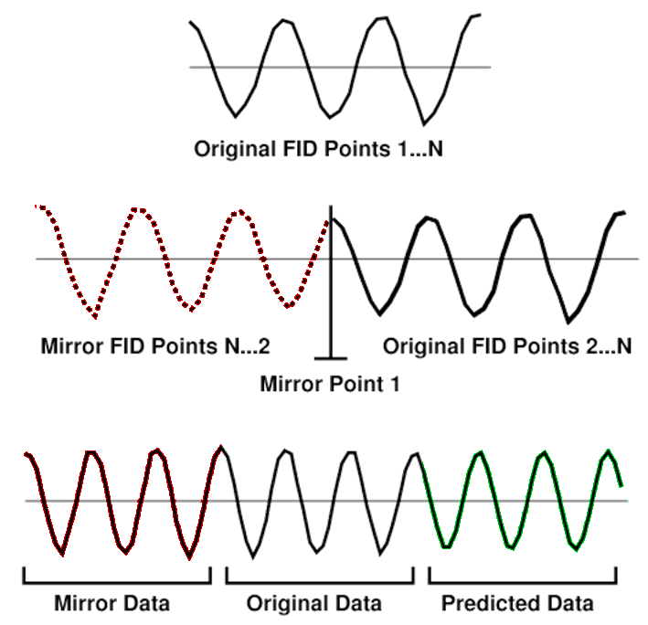
Forward Backward and Mirror Image Linear Prediction
Mirror Image LP
Zero Delay Data with No Decay
Predict next point in series
Predict previous point in series
Extending the Length of the Input Data Allows More LP Coefficients, Hence More Signals
Forward and Backward Coefficients Can be Averaged for Stability

Slide 36
Mirror Image LP Requires Non-Decaying Data with P0 = 0 or 180
Mixed Forward/Backward LP is Suitable for All Data
Predict next point in series
Mirror Image LP
Zero Delay Data with No Decay
Predict previous point in series
Forward/Backward LP is Suitable for All Data
Mirror Image LP is Only Suitable for Constant Time (No Decay) Data, with Phase P1=0 or P1=180

Slide 37
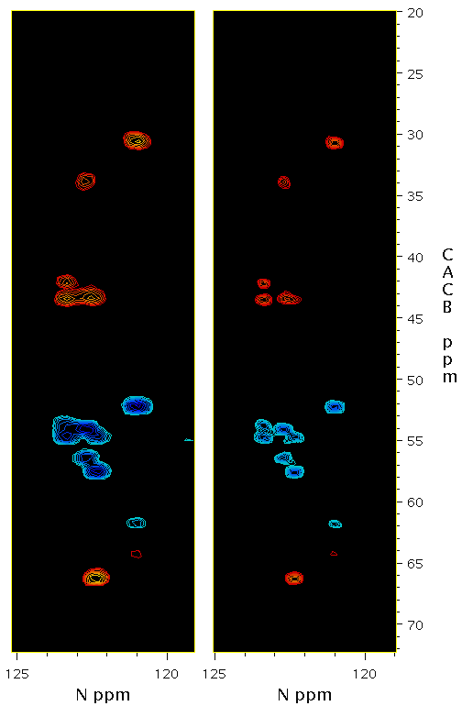
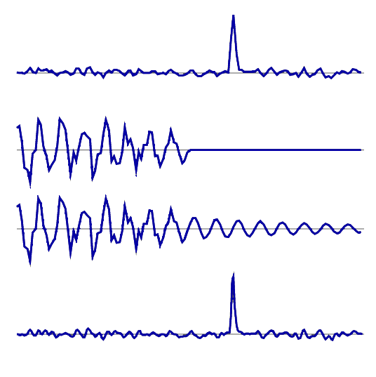
Linear Prediction (LP)
FT
LP
Original Spectrum
Inverse Transform
LP Extrapolated
Reprocessed

Slide 38
Fourier Transforming One Dimension Makes Significant Signal Content in the Remaining Dimensions More Sparse
So … Only Apply Linear Prediction When All Other
Dimensions Have Been Transformed …

Slide 39
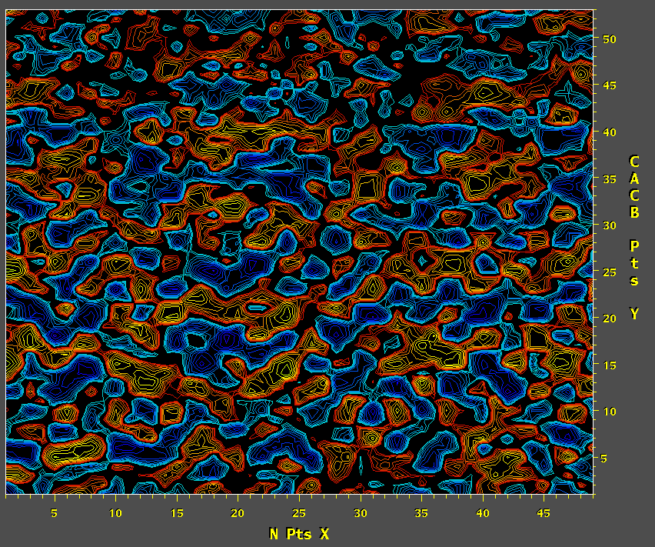
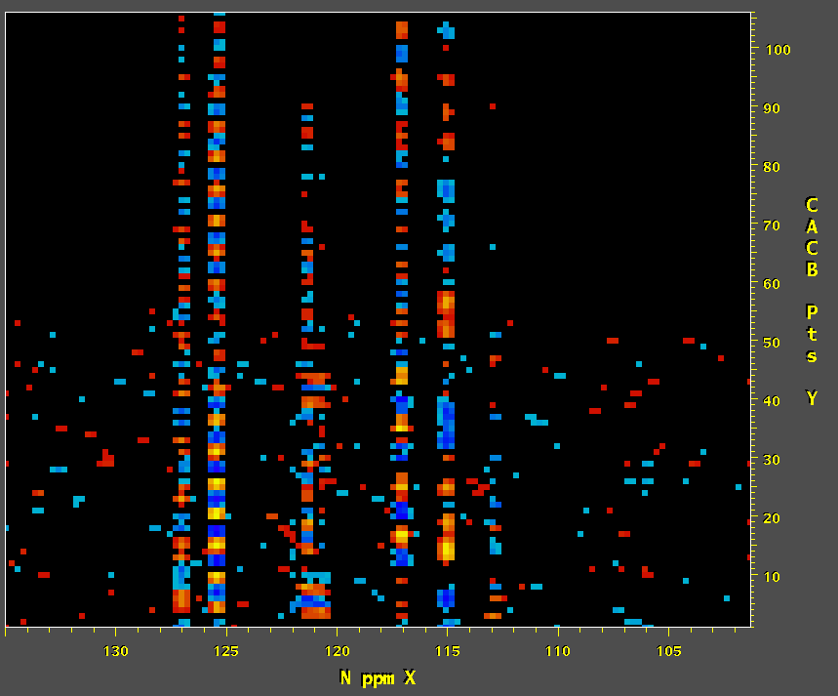
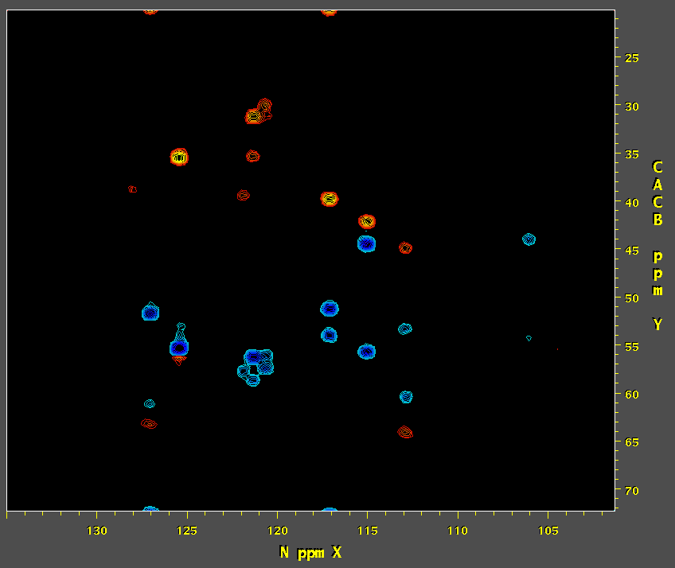
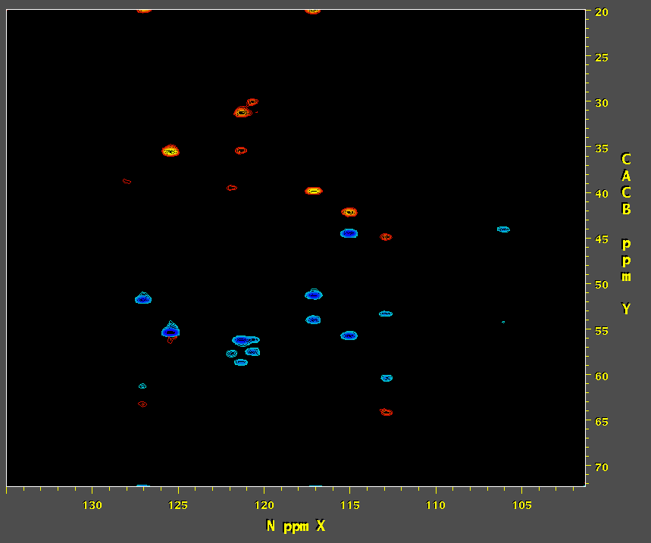
Process X and Y
Linear Predict and Process Z
Inverse Process, Linear Predict, and Reprocess Y
¹³C Time
Extrapolated ¹³C Time
¹⁵N Time
¹⁵N Freq
FT
LP in ¹³C
LP in ¹³C and ¹⁵N

Slide 40
Reconstruction of Non-Uniformly Sampled Data

Slide 41
NUS Software from Our Friends
SMILE spin.niddk.nih.gov/bax/software/smile
NESTA nestanmr.com
SCRUB coggins.biochem.duke.edu/scrub
hmsIST gwagner.med.harvard.edu/intranet/istHMS
RNMRTK MaxEnt nmrbox.org
Find these methods and more on NMRbox
NMRbox.org

Slide 42
Some NUS Reconstruction Methods
Compressed Sensing Reconstruction Methods
IST, IRLS, NESTA
Matrix Decomposition (Spectra as Product of 1D Vectors)
Principal Component Analysis (PCA), MDD
Parametric Methods (Model of Spectral Signals)
SMILE
Artifact Subtraction Methods (Transform of Sampling Schedule)
CLEAN, SCRUB
Inverse Methods (Inverse Transform of “Ideal” Spectrum)
Maximum Entropy Reconstruction

Slide 43
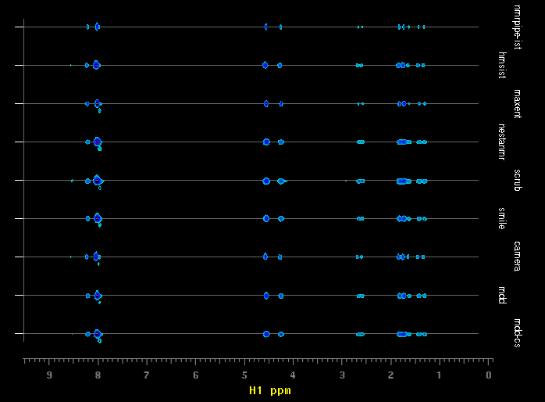
NUS Software from Our Friends
NMRPipe IST
hmsIST
MaxEnt
NESTA
SCRUB
SMILE
CAMERA
MDD
MDD-CS
Ubiquitin
3D 15N-NOE
Strips at:
8.02ppm HN
121.95ppm 15N
1H PPM
Find these methods and more on NMRbox
NMRbox.org

Slide 44
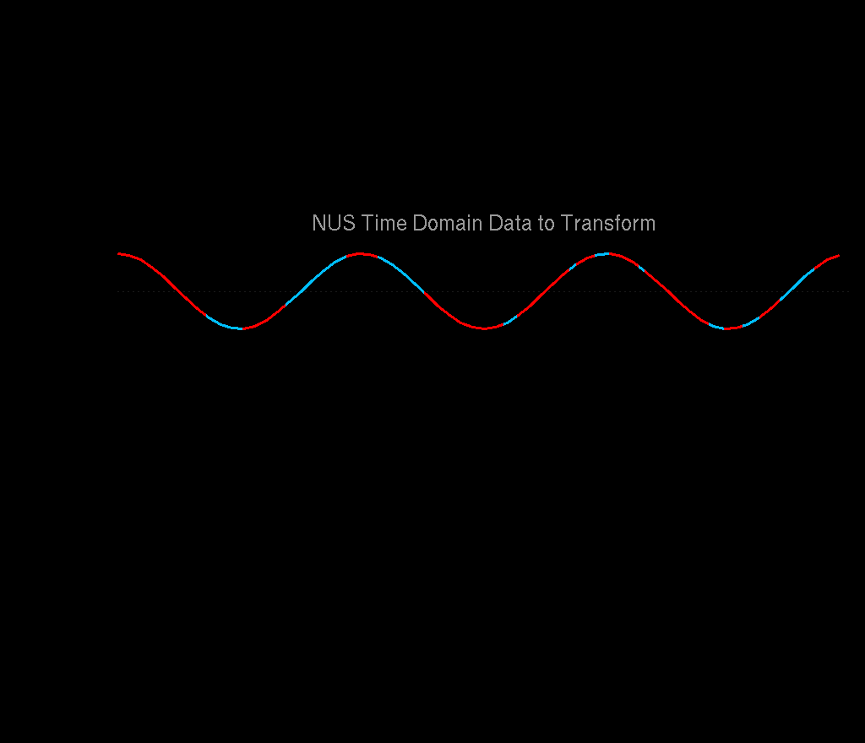
Reconstruction of NUS Data

Slide 45
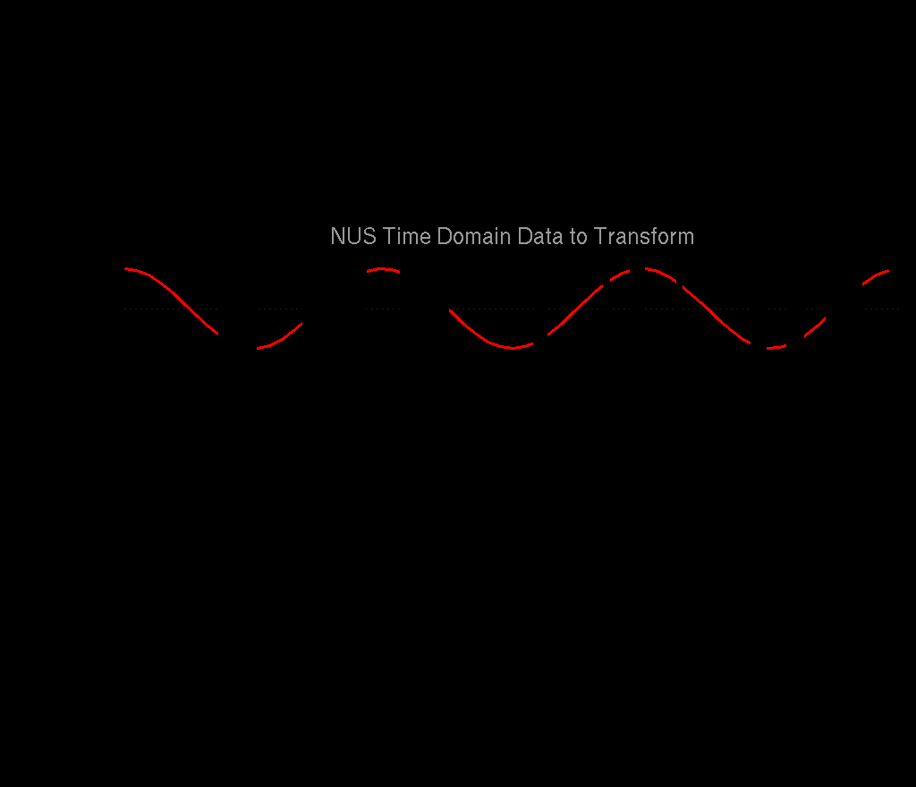

Slide 46
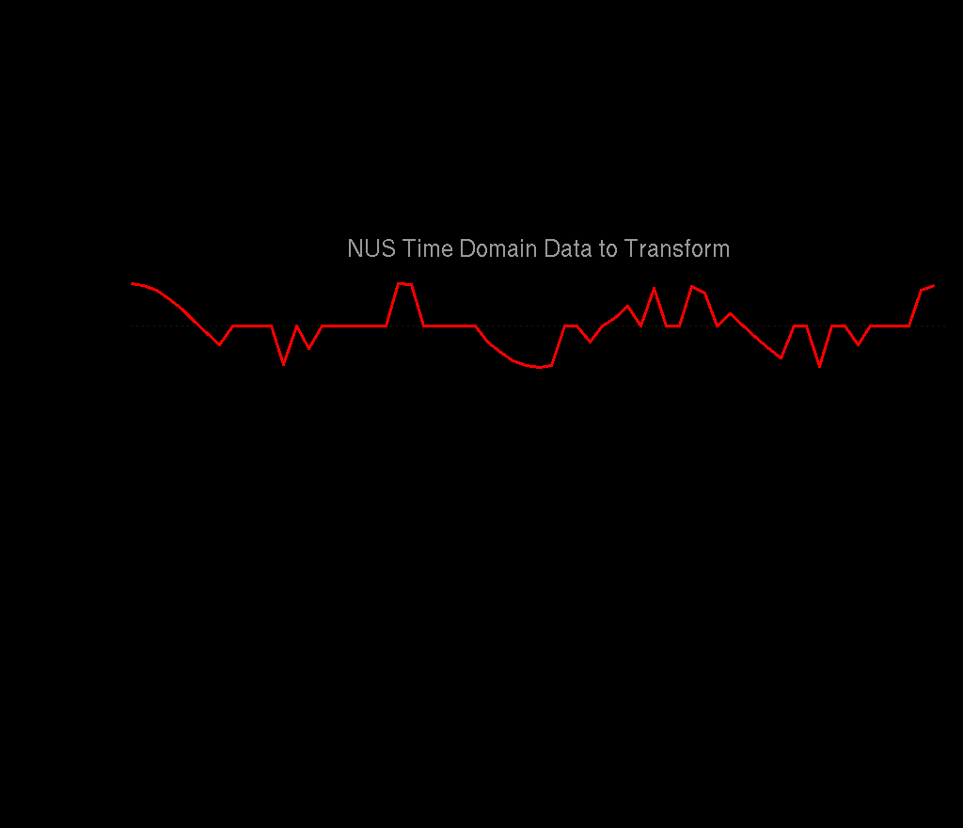
Non-Uniform Sampling: for Fourier Transform, Replace Missing Points with Zeros

Slide 47
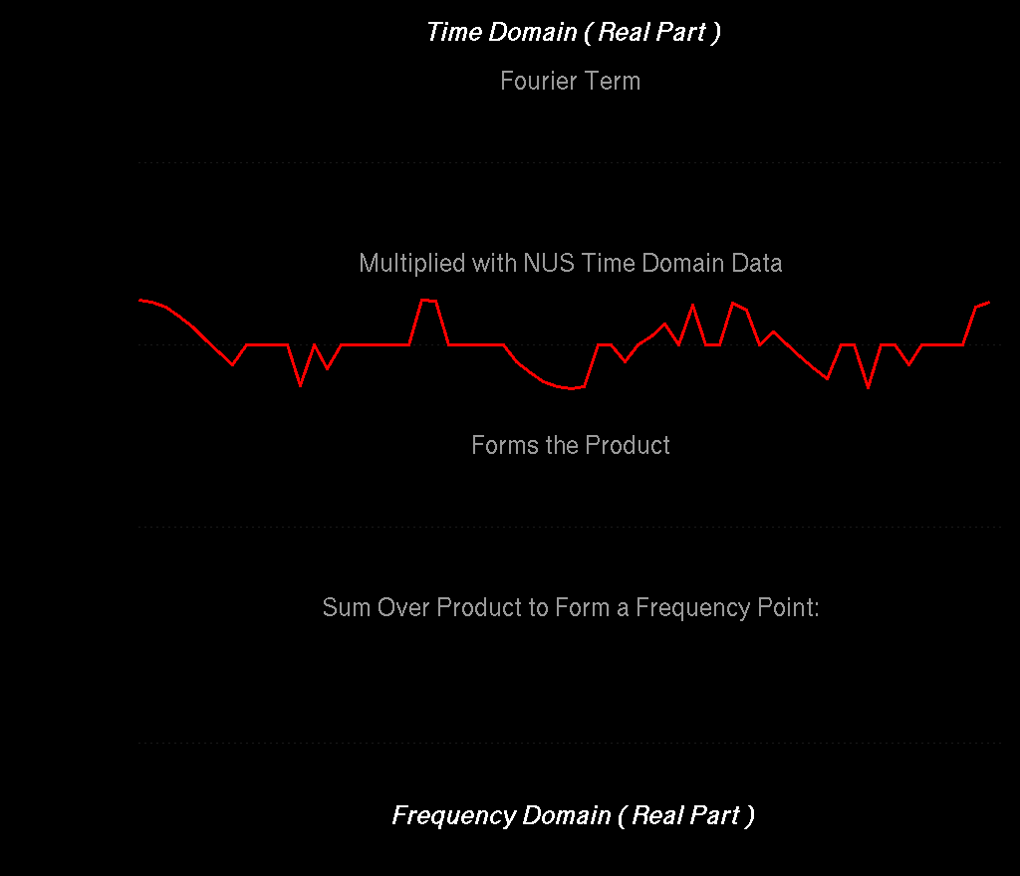
Σ+
Σ-
Σ+
Σ-
For both truncated Uniform Sampling schedules and NUS, there is no longer ideal cancelation of positive and negative intensities. They both give rise to artifacts.

Slide 48
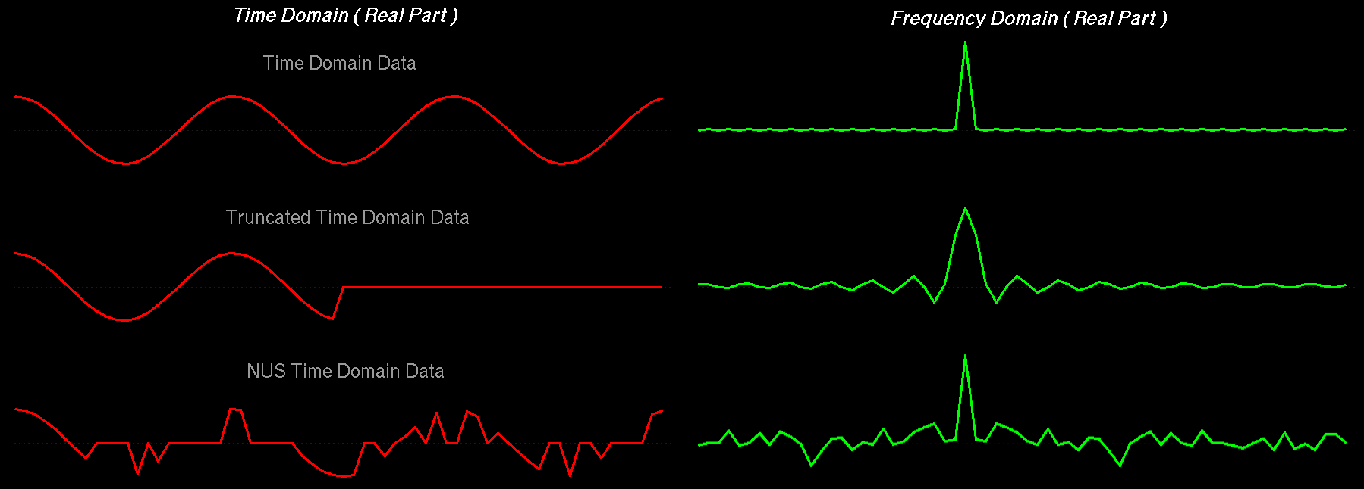
Fourier transform of Uniform versus Non-Uniform Sampling Schedules
Uniform Sampling Schedule:
Broad lines and periodic truncation wiggle artifacts
Non Uniform Sampling Schedule:
Narrow lines and random-noise-like artifacts
All peaks for a given schedule have the same artifacts, and the size of the artifacts is proportional to the size of the peaks.

Slide 49
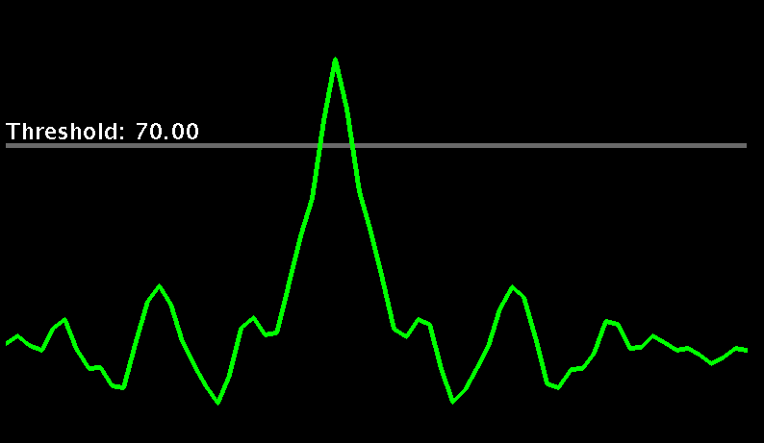
NUS Reconstruction:
IST – Iterative Soft Thresholding
IST takes advantage of the fact that the size of sampling schedule artifacts is proportional to the size of the peaks.

Slide 50
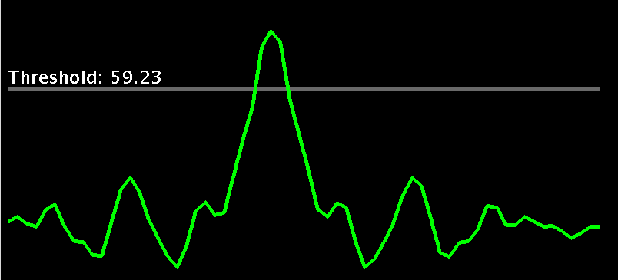
NUS Reconstruction:
IST – Iterative Soft Thresholding
IST works by gradually moving intensity from the tops of the largest signals remaining and accumulating them in a reconstruction.

Slide 51
NUS Reconstruction:
IST – Iterative Soft Thresholding
At each iteration, the reduced spectrum is inverse transformed, and the parts that were originally skipped in the sampling schedule are set to zero again.

Slide 52
NUS Reconstruction:
IST – Iterative Soft Thresholding
Fourier Spectrum
IST Spectrum
At each IST iteration, the largest signals in the residual get smaller, and so do the corresponding artifacts.
Iterations conclude when the largest point remaining in the residual is below a target value.
When the IST iterations conclude, any remaining residual can be added to the reconstruction.

Slide 53
Adam Schuyler, UCONN Health
Mark Maciejewski, UConn Health
Sponsored by a Donation from David Donoho
Best in Show: Jinfa Ying
Fidelity: Scott Robson
Detection: Sven Hyberts
Innovation: Flemming Hansen
Founding Contestant: Mark Bostock
Founding Contestant: Frank Delaglio
Founding Contestant: Bruce Johnson
Founding Contestant: Hengfa Lu
Founding Contestant: Mark Maciejewski
Founding Contestant: Vladislav Orekhov
Founding Contestant: Xiaobo Qu
Founding Contestant: Matt Zambrello

Slide 54
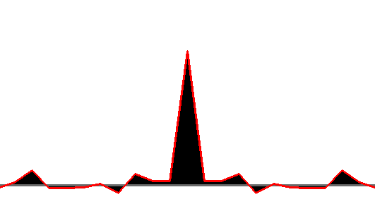
Jinfa Ying: SMILE - Sparse Multidimensional Iterative Lineshape Enhanced NUS Reconstruction
5Hz
Establish Relationship Between Decay and Observed Linewidth
Multiply by Sampling Schedule and
Fourier Transform
10Hz
15Hz
Sampling Schedule, Pts
20Hz

Slide 55
SMILE:
Each Iteration Models the Largest Remaining Signals

Slide 56
Uniformly Sampled Data and 33% NUS Reconstructed by NMRPipe’s IST and By SMILE
Uniformly Sampled
NUS IST
NUS RIST
NUS IST + Extrapolation
NUS RIST + Extrapolation
NUS SMILE + Extrapolation

Slide 57
Extrapolation of Conventional Data as an Alternative to Linear Prediction (LP)
LP
SMILE

Slide 58
NUS Zero Fill as an Alternative to Linear Prediction for Conventional NMR Data (15N-NOE)
Conventional FT
4 sec
Linear Prediction
2 min 30 sec
NUS Zero Fill via NMRPipe-IST
20 min 21 sec
HN
8.929 ppm
N
122.2 ppm
HN
9.138 ppm
N
121.9 ppm

Slide 59
NUS Zero Fill as an Alternative to Linear Prediction for Conventional NMR Data (4D Methyl-Methyl NOE)
FT
LP
IST

Slide 60
Linearity of NMRPipe’s IST Reconstruction
FT vs NUS IST
Expanded View
FT vs FT
Scaled Intensity
Scaled Intensity
Scaled Intensity

Slide 61
An Example of NUS Applied to Small Molecule NMR
F. Delaglio, G.S. Walker, K.A. Farley, R. Sharma, J.C. Hoch, L.W. Arbogast, R.G. Brinson, and J.P. Marino: Non-Uniform Sampling for All: More NMR Spectral Quality, Less Measurement Time. American Pharmaceutical Review, 20, 56-60 (2017).

Slide 62
G-UDCA,Glycoursodeoxycholic acid
Formula: C26H43NO5
Sample Mass: ~6 mg
Solvent: 0.04 ml DMSO
Concentration: 333 mM
NMR Tube: 1.7mm
Console: Bruker Avance 600 MHz
NMR Probe: 1.7 mm TCI Cryoprobe.
Spectral Width 1H: 6600 Hz
Spectral Width 13C: 25000 Hz
Spectral Points 1H: 512 Complex
Spectral Points 13C: 1024 Complex
Total Recycle Time: ~7 s.
Measurement Time: 3 hours 43 min
600 MHz, US 1024 Complex Increments, Noise RMS 0.012%
G-UDCA Data Courtesy of Greg Walker and Kathleen Farley, Pfizer

Slide 63
G-UDCA, Conventional Uniformly-Sampled
1024 Complex Increments
G-UDCA, Conventional Uniformly-Sampled
128 Complex Increments
Measurement Time: 3 hours 43 min
Measurement Time: 28 min
Noise RMS 0.012%
Noise RMS 0.028%

Slide 64
G-UDCA, Conventional Uniformly-Sampled
1024 Complex Increments
G-UDCA, NUS Uniform Random
122 Complex Increments, IST and NUS Zero Fill
Processing Time: 3 min 40 sec
Measurement Time: 3 hours 43 min
Measurement Time: 27 min
Noise RMS 0.012%
Noise RMS 0.003%
Bruker Default NUST2 = 1

Slide 65
G-UDCA, Conventional Uniformly-Sampled
1024 Complex Increments
G-UDCA, NUS Uniform Random
122 Complex Increments, SMILE and NUS Zero Fill
Processing Time: 7 sec
Measurement Time: 3 hours 43 min
Measurement Time: 27 min
Noise RMS 0.012%
Noise RMS 0.039%
Bruker Default NUST2 = 1

Slide 66
G-UDCA, NUS HMS Poisson Gap 1
(Dense at Ends) 123 Complex Increments, IST and NUS Zero Fill
G-UDCA, Conventional Uniformly-Sampled
1024 Complex Increments
Measurement Time: 3 hours 43 min
Measurement Time: 27 min
Noise RMS 0.012%
Noise RMS 0.003%
gwagner.med.harvard.edu/intranet/hmsIST/gensched_new.html

Slide 67
G-UDCA, NUS HMS Poisson Gap 2
(Dense at Start) 122 Complex Increments
IST and NUS Zero Fill
G-UDCA, Conventional Uniformly-Sampled
1024 Complex Increments
Measurement Time: 3 hours 43 min
Measurement Time: 27 min
Noise RMS 0.012%
Noise RMS 0.004%
gwagner.med.harvard.edu/intranet/hmsIST/gensched_new.html

Slide 68
Why are the Results for Different NUS Schedules Qualitatively Similar for the G-UDCA Example?
}
~66%
The indirect dimension does not decay much, and the signal to noise is high for this concentrated sample. So, all of the NUS schedules capture a sufficient amount of signal, with more than enough points to account for the number of peaks.

Slide 69
16 Uniformly Random Schedules

Slide 70
16 Poisson Gap Schedules

Slide 71
Reproducibility of Peak Volumes for G-UDCA Example
Linear Prediction RMS 2.4%
HMS Type 1 NUS IST RMS 3.0%
HMS Type 2 NUS IST RMS 1.4%
Random NUS IST RMS 3.1%
Random NUS SMILE RMS 2.5%
Relative Peak Volume in Related Spectrum
Relative Peak Volume in Uniformly Sampled Spectrum, 1024 Complex Increments

Slide 72
Reproducibility of Peak Positions for G-UDCA Example
¹H ppm Peak Position in Related Spectrum
¹³C ppm Peak Position in Related Spectrum
Linear Prediction RMS 0.001 ppm
Linear Prediction RMS 0.01 ppm
HMS Type 1 NUS RMS 0.003 ppm
HMS Type 1 NUS RMS 0.02 ppm
HMS Type 2 NUS RMS 0.002 ppm
HMS Type 2 NUS RMS 0.01 ppm
Random NUS RMS 0.003 ppm
Random NUS RMS 0.02 ppm
¹H ppm Peak Position
Uniformly Sampled Spectrum 1024 Complex Increments
¹³C ppm Peak Position
Uniformly Sampled Spectrum 1024 Complex Increments

Slide 73
How Many Increments Should I Measure?
What’s the max number of signals expected in a band from the spectrum? The number of increments should be at least several times this number for any schedule, conventional or NUS. In the G-UDCA examples, which have ~8 signals in the most crowded bands, there were ~16x8 increments.

Slide 74
For NUS, the Signal Needs to be “Sparse” (More Empty Space Than Signal) 50% Sampling Density Requires ~5 to 10 x more Samples than Signals
Conventional Compressed Sensing
2D NMR
Ratio of Number of Signals to Final Size
For Example:
128 Points Sampled at 50% Density
(64 Samples) Allows for ~12 Signals Max per Column
Bad Reconstruction
Good Reconstruction
NUS Sampling Density
Adapted from: Analysis of Undersampled Measurement Schemes, with Application to Magnetic Resonance Spectroscopy, Hatef Monajemi PhD Defense, Stanford University 2016

Slide 75
Other Applications of NUS Reconstruction Methods

Slide 76
Baseline Distortion: Replace Points in the Time Domain
Distortion Localized in Early Points of Time Domain
cos( 2πft ) f = 0
cos( 2πft ) f = 1
cos( 2πft ) f = 2
Time
Frequency

Slide 77
Baseline Distortion: Replace Points in the Time Domain
Baseline Distortion Extends Over All Points in the Frequency Domain
Distortion Localized in Early Points of Time Domain
Time
Frequency

Slide 78
Baseline Distortion Repaired with IST
¹³C Metabolomics Data courtesy of Prof. Art Edison

Slide 79
SIERRA Pulse Sequence for Excipient Signal Suppression
Residual Excipient Signal Modeled and Subtracted by SMILE
LW Arbogast, F Delaglio, J Tolman, and JP Marino: Selective suppression of excipient signals in 2D 1H–13C methyl spectra of biopharmaceutical products. J. Biomol NMR (2018) doi:10.1007/s10858-018-0214-1
https://www.ibbr.umd.edu/sierra/home

Slide 80
Formulation of Protein Therapeutics
Most biologics are taken intravenously, and are provided as either solution or lyophilized (freeze dried) powder. Solutions may be viscous, in concentrations exceeding 100 mg/mL. Excipients are used to maintain stability during freeze drying, extend the shelf life of the biologic, and improve its half-life in the blood.
Excipients can include:
Other proteins
Polymers
Amino Acids
Surfactants
Preservatives
Salts
Histidine
Polysorbate
Polyethylene Glycol
Benzyl Alcohol
Bovine Serum Albumin
Trehalose

Slide 81
Original Spectrum with Polysorbate and Histidine Excipient Peaks

Slide 82
Original Spectrum with Polysorbate and Histidine Excipient Peaks
Histidine:
Not Included in Suppression

Slide 83
Original SIERRA Spectrum with Polysorbate Excipient Peaks Reduced
Histidine:
Not Included in Suppression

Slide 84
SIERRA Spectrum with Excipient Signals Subtracted by SMILE
Histidine:
Not Included in Suppression

Slide 85
SMILE Excipient Signal Model

Slide 86
Original SIERRA Spectrum with Polysorbate Excipient Peaks Reduced

Slide 87
SIERRA Spectrum with Excipient Signals Subtracted by SMILE

Slide 88
SMILE Excipient Signal Model Components
Measured
Model
Residual
Individual Signals Components at 5x Lower Contours

Slide 89
SMILE Excipient Signal Model Components
Measured
Model
Residual
Individual Signals Components at 5x Lower Contours

Slide 90
Comments and Conclusions
We’ve been living with the effects of sampling schedules for a long time. NUS gives us sampling schedules with different strengths and challenges.
NUS reconstruction provides options to enhance conventionally sampled data, by extrapolation, repair of bad or distorted points, or modeling and subtraction of unwanted signals.
Sampling density is a misleading measure. Density should be considered relative to the number of signals in the indirect dimensions. The number of increments must be sufficient for the number of signals. The measurement time must be sufficient to capture the desired signal to noise.
Within the above constraints, NUS gives us the opportunity to set the number of increments independently of the desired resolution. This means we can improve resolution with a given amount of measurement time or retain resolution with a shorter measurement time.
There are many NUS sampling schemes and reconstruction methods, but the differences between them are often more critical for extreme cases: high dynamic range, low signal to noise, high complexity, large size.

Slide 92
Spectral Series Characterization by
Principal Component Analysis (PCA)
Each spectrum is represented exactly as a single object in a multidimensional space.
The coordinates of the object are all of the spectral intensities. This means that the spectra are used directly, with no need for peak analysis or assignments.
In this multidimensional space, similar spectra cluster together.
Spectra with some features in common lie along lines and curves in the multidimensional space.
PCA projects this space to a small number of dimensions along directions of maximum variance, so that it can be readily viewed and characterized. This corresponds to fitting a series of multidimensional straight lines to the data in perpendicular directions.
PCA results can be displayed in the form of 2D or 3D PCA scatterplots, or as synthetic PCA spectra corresponding to each component.
The first component corresponds to an average spectrum which best represents the series in a least-squares sense. The next component describes how spectra differ from this average, and so on for subsequent components.

Slide 93
Principal Component Analysis (PCA) of Spectral Series
Exploratory Analysis of 11 Varieties of Tea
Notes:
93

Slide 94
Principal Component Analysis: The NISTmAb Interlaboratory NMR Study ¹H / ¹³C Spectra
Robert Brinson NIST
375 Spectra - Direct PCA on ¹H 2.0 ppm to -0.8ppm ¹³C 27.5 ppm to 7.0ppm
Component 2 vs 3 Colored by Sample Type
System Suitability Sample
NISTmAb Fab

Slide 95
Principal Component Spectra of Pseudo-3D Series
Relaxation Series, J-Modulated Series, CEST
PCA 1:
Signals with Similar Evolution
PCA 2:
Reveals Signals with Other Evolution Behavior

Slide 96
Conventional and NUS Conversion and Processing Workflows in NMRPipe

Slide 97
Spectral Processing and Analysis in NMRPipe
Special Cases
Key Steps of Spectral Processing
Gradient-Enhanced Data
Interleaved Experiments and Spectral Series
Non-Uniform Sampling and Alternatives to Fourier Transform
Correction of Bad Points
Window function and first point scaling
Zero Fill
Fourier Transform
Phase Correction
Post-Processing
Other Common Spectral Processing Tasks
Generating 2D Projections from 3D or 4D Spectra
Viewing 2D Strips from 3D Spectra
Peak Detection and Modeling (Quantification) of Spectra and Spectral Series
Extracting Chemical Shift Evolutions from Spectral Series
Multivariate Analysis of Spectral Series
Extracting Structural Data from Chemical Shifts and Dipolar Couplings
Solvent Subtraction
Baseline Correction
Linear Prediction
Hilbert Transform and Inverse Processing
NMRbox.org
frank.delaglio@nist.gov
www.nmrpipe.com

Slide 98
Key Steps of Spectral Processing
Window function and first point scaling
Zero Fill
Fourier Transform
Phase Correction
Spectral Processing Function as a UNIX Filter
nmrPipe –fn FT < test.fid > test.ft1
… or …
nmrPipe –fn FT –in test.fid –out test.ft1
FT

Slide 99
Spectral Processing Scheme as a UNIX Pipeline
nmrPipe –in test.fid –fn SP | nmrPipe –fn FT –out test.ft1
… or …
nmrPipe –in test.fid \
| nmrPipe –fn SP \
| nmrPipe –fn FT \
-out test.ft1
SP
FT

Slide 100
Key Steps of Spectral Processing
Window function and first point scaling
Zero Fill
Fourier Transform
Phase Correction
nmrPipe –fn SP –off 0.5 –end 0.95 –pow 2 –c 0.5
nmrPipe –fn ZF –zf 2 -auto
nmrPipe –fn FT
nmrPipe –fn PS –p0 -90 –p1 180 -di

Slide 101
Other Important Functions in NMRPipe
Solvent Subtraction
Linear Prediction
Hilbert Transform (Restores Imaginary Part)
Extraction of a Region
Matrix Transpose (Exchange X and Y Dimensions)
Baseline Correction (Automated Version)
nmrPipe –fn SOL
nmrPipe –fn POLY -time
nmrPipe –fn LP –fb –ord …
nmrPipe –fn HT
nmrPipe –fn EXT
nmrPipe –fn TP
nmrPipe –fn POLY -auto

Slide 102
Multidimensional Spectral Processing Schemes as a UNIX Pipelines

Slide 103
Typical NMRPipe 3D Spectral Processing Scheme
Commonly Adjusted Parameters / X-Axis Processing / Y-Axis Processing / Z-Axis Processing
The Script Provides Reproducible Processing
#!/bin/csh
xyz2pipe -in fid/test%03d.fid -x -verb \ Read vectors from X-Axis
| nmrPipe -fn SOL \ Solvent Subtraction
| nmrPipe -fn SP -off 0.5 -end 0.98 -pow 2 -c 0.5 \ Window and First Point Scale
| nmrPipe -fn ZF \ Zero Fill
| nmrPipe -fn FT \ Fourier Transform
| nmrPipe -fn PS -p0 43.0 -p1 0.0 -di \ Phase Correction
| nmrPipe -fn EXT –x1 10.5ppm –xn 5.7ppm -sw \ Extract PPM Range
| nmrPipe -fn TP \ X/Y Transpose
| nmrPipe -fn SP -off 0.5 -end 0.98 -pow 1 -c 1.0 \ Window and First Point Scale
| nmrPipe -fn ZF \ Zero Fill
| nmrPipe -fn FT \ Fourier Transform
| nmrPipe -fn PS -p0 -90.0 -p1 180.0 -di \ Phase Correction
| nmrPipe -fn TP \ X/Y Transpose
| nmrPipe -fn POLY -auto \ Baseline Correction
| pipe2xyz -out ft/test%03d.ft2 –x Write vectors to X-Axis
xyz2pipe -in ft/test%03d.ft2 -z -verb \ Read vectors from Z-Axis
| nmrPipe -fn SP -off 0.5 -end 0.98 -pow 1 -c 0.5 \ Window and First Point Scale
| nmrPipe -fn ZF \ Zero Fill
| nmrPipe -fn FT \ Fourier Transform
| nmrPipe -fn PS -p0 0.0 -p1 0.0 -di \ Phase Correction
| pipe2xyz -out ft/test%03d.ft3 -z Write vectors to Z-Axis

Slide 104
NMRDraw Graphical Interface
Interactive Processing, Phasing and Peak Detection
1D-4D Data

Slide 105
Graphical Interface for Processing Script Generation

Slide 106
Typical NMRPipe Spectra Processing Workflow:
Format Conversion and Processing Performs by Shell Scripts
Prepare a conversion script, which converts spectrometer format data to NMRPipe format, establishing chemical shift calibration information. Commands:
bruker / varian / delta
Inspect the time-domain data. Choose processing parameters such as phase correction values:
nmrDraw
Create and execute a spectral processing script, either manually via a text editor, or using a graphical interface. Commands:
vi, gedit, etc / nmrDraw –process –fid … / basicFT2.com …
Inspect the processed result. In the case of 3D or 4D data, inspect the ordinary Fourier transform result by preparing projections. Commands:
nmrDraw / proj3D.tcl / proj4D.tcl
As needed, adjust the processing scheme and parameters, repeating steps 3 and 4.

Slide 107
NMRPipe Command-Line Workflow for NUS Data
Prepare a conversion script with the usual tools, including options which sort and expand the NUS time-domain data with zeros. Commands:
bruker -nus / varian –nus / delta -nus
Perform ordinary Fourier processing on the NUS fid, to confirm phase correction values, Fourier transform options, etc. This can be done via the new general-purpose processing scripts:
basicFT2.com / basicFT3.com / basicFT4.com
In the case of 3D or 4D data, inspect the ordinary Fourier transform result by preparing projections. Commands:
proj3D.tcl / proj4D.tcl
Use NMRPipe’s IST reconstruction scripts to generate a final spectrum:
ist2D.com / ist3D.com / ist4D.com

Slide 108
Converting and Processing Data with NMRPipe

Slide 109
Typical NMRPipe Command Line Workflow
The typical NMRPipe processing workflow involves frequent alternation between the UNIX command line and the nmrDraw graphical interface (as an alternative, an interactive graphical processing interface is available in NMRDraw, as described later).
Prepare a script to convert spectrometer format data to NMRPipe format via an interactive interface. Commands: bruker / varian / delta
Execute the conversion script, and inspect the result via the nmrDraw graphical interface. Use the Proc/Auto Process 1D menu option to process the first 1D vector, and use the graphical interface to find a phase correction value.
At the UNIX command-line, use a text editor to create or adjust a processing script containing the needed phase corrections etc. Commonly, the processing script is copied from a previous case. Processing scripts can also be created via new general-purpose scripts: basicFT2.com / basicFT3.com / basicFT4.com.
Execute the processing script and read the processed result with nmrDraw. View vectors from any of the dimensions, and choose new phase correction values as needed.
Repeat steps 3 and 4 to adjust processing parameters as needed.
In the case of 3D data, create and inspect projections and view strips plots of the 3D data to confirm that the data is processed and phased properly. For example:
proj3D.tcl -in ft/test%03d.ft3 -abs
peakHN.tcl -in ft/test%03d.ft3 -out hn.proj.tab -proj -hi Full
scroll.tcl -in ft/test%03d.ft3 -tab hn.proj.tab -pair -hi 8%

Slide 110
How to Convert Data in NMRPipe
In a terminal window, cd to the data directory and type bruker or varian.
cd demo/nus/bruker_nus/vd_format/std/cbcanh_std
bruker
Select the binary input, usually ser or fid.
Click Read Parameters.
Check the Temperature.
If an indirect dimension is gradient enhanced, set Acquisition Mode to Echo-AntiEcho. Set it to Complex otherwise.
The conversion step creates NMRPipe-format time-domain data from a given spectrometer format. During conversion, ppm calibration information for all dimensions is established too.
The NMRPipe conversion tools make a best guess about parameters, and the results have to be adjusted by hand. In particular, you’ll have to know which dimension of the experiment corresponds to which channel of the spectrometer (1H, 13C, 15N).
For indirect dimensions, adjust the Observe Freq MHz from the menu if needed.
Click Save Script.
Click Execute Script.

Slide 111
Chemical Shift Calibration According to H2O and Temperature
When the interface starts, Temperature is set to From File and Center Position for the X-Axis is set to H2O.
Click Read Parameters. This will update Temperature and Center Position values.
If the Temperature value is not correct, manually enter the correct value and perform the following steps …
The default NMRPipe ppm calibration scheme assumes that the directly-detected dimension is 1H and is centered on the H2O resonance. It uses the known chemical shift of H2O at the given temperature to establish ppm values for the direct dimension, and propagates this information to the other dimensions.
Sometimes, the temperature extracted from the spectrometer parameter file is not correct, and has to be adjusted by hand. In these cases, the ppm calibration information has to be recomputed as described here.
Set the Center Position for the X-Axis back to H2O using the menu.
Click Read Parameters a second time. This will update Center Position values according to the manually-entered temperature.

Slide 112
How to Convert NUS Data in NMRPipe
Start the conversion interface with NUS Options; NUS Options are Automatically Used if a NUS Sampling Schedule File Such as “nuslist” is found:
bruker -nus
varian –nus
Options only adjustable from the command-line:
-nouseMask Suppress creation of mask files when not using
NMRPipe NUS reconstruction tools
-vdlist … Specify an additional sampling schedule file required
for older Bruker NUS formats

Slide 113
How to Convert NUS Data in NMRPipe
Select the binary spectrometer-format input data as usual.
Select the NUS Sampling Schedule Input File.
Choose options for best baseline.
Read Parameters
This will also read the NUS schedule, and extract information about sample count, dimension sizes, etc.

Slide 114
How to Convert NUS Data in NMRPipe
Reduce the NUS sample count for experiments stopped before completion.
Set Offset to 0 if the NUS increment values start at zero for the first increment.
Set Offset to 1 if the NUS increment values start at one instead.
Important: Set Reverse checkbox ON for 3D or 4D NUS schedules that list the Y-axis increment values last on each line rather than first.
Important: After changing any NUS parameter, use Read Parameters to update other values accordingly.

Slide 115
Rules of Thumb for Spectral Processing
If there is no acquisition delay (first order phase is zero), scale the first point of the time-domain data by 0.5 (nmrPipe window function option –c 0.5). In all other cases, leave the first point unchanged (nmrPipe window function option –c 1.0).
Set up the delays in your experiment carefully so that they are either zero, ½ point, or one point (first order phase of 0, 180 or 360). Any other case will lead to baseline distortion, phase distortion of folded peaks, and distortion of data if inverse processing.
If you don’t know the phase correction values, try to process with zero-order phase only. If first-order phase correction is needed, try values of P1 = 180 or 360 at first.
Always apply at least one zero fill. For speed, if desired, round up to a power of two:
nmrPipe –fn ZF –auto
If a spectral dimension is reversed, negate the imaginary part (nmrPipe –fn FT –neg). If a spectral dimension has the first and second parts rotated, negate alternating points (nmrPipe –fn FT –alt). Use FT options –neg and –alt together if needed.
When applying baseline correction, try to use a scheme where two of the dimensions are already Fourier transformed. Avoid baseline correction if it is not needed.
Try basic Fourier processing first, and confirm processing details such as phase correction before proceeding to special methods such as Linear Prediction.
When applying Linear Prediction, try to use a scheme where all other dimensions are Fourier transformed. For 3D and 4D, this means using schemes with inverse processing.

Slide 116
First Point Scaling in the Time-Domain – Same as Adding a Constant in the Frequency Domain
-c 1.0
-c 0.5
| nmrPipe -fn SP -off 0.5 -end 0.98 -pow 1 –c 0.5 \
| nmrPipe -fn ZF -auto \
| nmrPipe -fn FT \
| nmrPipe -fn PS -p0 0 -p1 0 -di \

Slide 117
Zero Filling – Always Zero Fill at Least Once
Append Zeros to Give 2N Real Points + 2N Imaginary Points
N Real Points + N Imaginary Points = 2N Total Points

Slide 118
Zero Filling – Always Zero Fill at Least Once
Append Zeros to Give 2N Real Points + 2N Imaginary Points
N Real Points + N Imaginary Points = 2N Total Points
Fourier Transform
2N Real Points + 2N Imaginary Points
Delete
Imaginary Part
Real-Only Spectrum, 2N Total Points

Slide 119
Zero Filling – Always Zero Fill at Least Once
Append Zeros to Give 2N Real Points + 2N Imaginary Points
N Real Points + N Imaginary Points = 2N Total Points
Fourier Transform
2N Real Points + 2N Imaginary Points
For Inverse Processing, Restore
Imaginary Part
Via Hilbert Transform
Delete
Imaginary Part
Real-Only Spectrum, 2N Total Points

Slide 120
Some General Points on Using nmrDraw
cd demo/nus/bruker_nus/vd_format/std/cbcanh_std
fid.com
basicFT2.com -xP0 -82
nmrDraw
The top window border lists what the LEFT MIDDLE and RIGHT mouse buttons can do. They generally perform one set of actions when the mouse pointer is inside the spectral graphics area, and another set of actions when the mouse pointer is outside, where the axis labels are drawn.
The Command Panel has menu buttons. Hold the RIGHT mouse button to display the menu. Click the LEFT mouse button to select the default option (the first menu item) without displaying the menu. Each menu entry also lists a single letter keyboard shortcut.
Use the mouse Scroll Wheel outside the graphics area to adjust the contour levels and redraw the data. Use the wheel inside the graphics area to change the plane being viewed for 3D or 4D data.
The Mouse Menu turns on interactive modes like drawing 1D traces or performing 2D Zooming.

Slide 121
Some Examples of Processing:
Starting Point with a Correctly Processed Spectrum
cd demo/nus/bruker_nus/vd_format/std/cbcanh_std
fid.com
basicFT2.com -xP0 -82 -xEXTX1 10.4ppm -xEXTXN 5.4ppm -list > test.com
chmod a+rx test.com
test.com
nmrDraw
#!/bin/csh
#
# Generated by basicFT2.com Version 2016.263.13.16
nmrPipe -in fid/test001.fid \
| nmrPipe -fn SOL \
| nmrPipe -fn SP -off 0.50 -end 0.95 -pow 2 -c 0.5 \
| nmrPipe -fn ZF -zf 1 -auto \
| nmrPipe -fn FT -verb \
| nmrPipe -fn PS -p0 -82 -p1 0 -di \
| nmrPipe -fn EXT -x1 10.4ppm -xn 5.4ppm -sw \
| nmrPipe -fn TP \
| nmrPipe -fn SP -off 0.50 -end 0.95 -pow 1 -c 0.5 \
| nmrPipe -fn ZF -zf 1 -auto \
| nmrPipe -fn FT -verb \
| nmrPipe -fn PS -p0 0.0 -p1 0.0 -di \
| nmrPipe -fn TP \
| nmrPipe -fn POLY -auto -verb \
-out test.ft2 -ov

Slide 122
Some Examples of Processing:
Appearance if Acquisition Mode is not Specified Correctly
If an indirect dimension is gradient enhanced, set Acquisition Mode to Echo-AntiEcho. Set it to Complex otherwise.
If this is set incorrectly, the given dimension will contain “mirror image” signals.

Slide 123
Some Examples of Processing:
Comment out Region Extraction
#!/bin/csh
nmrPipe -in fid/test001.fid \
| nmrPipe -fn SOL \
| nmrPipe -fn SP -off 0.50 -end 0.95 -pow 2 -c 0.5 \
| nmrPipe -fn ZF -zf 1 -auto \
| nmrPipe -fn FT -verb \
| nmrPipe -fn PS -p0 -82 -p1 0 -di \
#| nmrPipe -fn EXT -x1 10.4ppm -xn 5.4ppm -sw \
| nmrPipe -fn TP \
| nmrPipe -fn SP -off 0.50 -end 0.95 -pow 1 -c 0.5 \
| nmrPipe -fn ZF -zf 1 -auto \
| nmrPipe -fn FT -verb \
| nmrPipe -fn PS -p0 0.0 -p1 0.0 -di \
| nmrPipe -fn TP \
| nmrPipe -fn POLY -auto -verb \
-out test.ft2 -ov
For many kinds of spectra, only a limited chemical shift range of the directly-detected dimension will contain useful signals. In these cases, we commonly extract a smaller range of chemical shifts immediately after the directly-detected dimension has been Fourier processed.
When practical, we choose region limits that avoid the solvent signal, and contain “extra space” so that no peaks lie along the edges of the selected region.

Slide 124
Some Examples of Processing:
X-Axis Phase Correction not Set Properly
#!/bin/csh
nmrPipe -in fid/test001.fid \
| nmrPipe -fn SOL \
| nmrPipe -fn SP -off 0.50 -end 0.95 -pow 2 -c 0.5 \
| nmrPipe -fn ZF -zf 1 -auto \
| nmrPipe -fn FT -verb \
| nmrPipe -fn PS -p0 0 -p1 0 -di \
| nmrPipe -fn EXT -x1 10.4ppm -xn 5.4ppm -sw \
| nmrPipe -fn TP \
| nmrPipe -fn SP -off 0.50 -end 0.95 -pow 1 -c 0.5 \
| nmrPipe -fn ZF -zf 1 -auto \
| nmrPipe -fn FT -verb \
| nmrPipe -fn PS -p0 0.0 -p1 0.0 -di \
| nmrPipe -fn TP \
| nmrPipe -fn POLY -auto -verb \
-out test.ft2 -ov

Slide 125
Some Examples of Processing:
Y-Axis 90 Degrees out of Phase
#!/bin/csh
nmrPipe -in fid/test001.fid \
| nmrPipe -fn SOL \
| nmrPipe -fn SP -off 0.50 -end 0.95 -pow 2 -c 0.5 \
| nmrPipe -fn ZF -zf 1 -auto \
| nmrPipe -fn FT -verb \
| nmrPipe -fn PS -p0 82 -p1 0 -di \
| nmrPipe -fn EXT -x1 10.4ppm -xn 5.4ppm -sw \
| nmrPipe -fn TP \
| nmrPipe -fn SP -off 0.50 -end 0.95 -pow 1 -c 0.5 \
| nmrPipe -fn ZF -zf 1 -auto \
| nmrPipe -fn FT -verb \
| nmrPipe -fn PS -p0 90 -p1 0.0 -di \
| nmrPipe -fn TP \
| nmrPipe -fn POLY -auto -verb \
-out test.ft2 -ov

Slide 126
Some Examples of Processing:
Y-Axis First-Point Time Domain Scaling Not Set Properly
#!/bin/csh
nmrPipe -in fid/test001.fid \
| nmrPipe -fn SOL \
| nmrPipe -fn SP -off 0.50 -end 0.95 -pow 2 -c 0.5 \
| nmrPipe -fn ZF -zf 1 -auto \
| nmrPipe -fn FT -verb \
| nmrPipe -fn PS -p0 82 -p1 0 -di \
| nmrPipe -fn EXT -x1 10.4ppm -xn 5.4ppm -sw \
| nmrPipe -fn TP \
| nmrPipe -fn SP -off 0.50 -end 0.95 -pow 1 -c 1.0 \
| nmrPipe -fn ZF -zf 1 -auto \
| nmrPipe -fn FT -verb \
| nmrPipe -fn PS -p0 0 -p1 0.0 -di \
| nmrPipe -fn TP \
| nmrPipe -fn POLY -auto -verb \
-out test.ft2 -ov
If the first point of the time-domain data is not adjusted properly, it will result in constant-offset baseline distortions in the corresponding spectrum, here shown as a vertical streak.
The rule for adjustment is simple:
If the dimension needs first order phase of zero (PS -p1 0) scale the first point in the time domain by half (window function –c 0.5).
In all other cases, do not adjust the first point (window function –c 1.0).

Slide 127
Some Examples of Processing:
Solvent Filter and Baseline Correction Commented Out
#!/bin/csh
nmrPipe -in fid/test001.fid \
#| nmrPipe -fn SOL \
| nmrPipe -fn SP -off 0.50 -end 0.95 -pow 2 -c 0.5 \
| nmrPipe -fn ZF -zf 1 -auto \
| nmrPipe -fn FT -verb \
| nmrPipe -fn PS -p0 82 -p1 0 -di \
| nmrPipe -fn EXT -x1 10.4ppm -xn 5.4ppm -sw \
| nmrPipe -fn TP \
| nmrPipe -fn SP -off 0.50 -end 0.95 -pow 1 -c 0.5 \
| nmrPipe -fn ZF -zf 1 -auto \
| nmrPipe -fn FT -verb \
| nmrPipe -fn PS -p0 0 -p1 0.0 -di \
| nmrPipe -fn TP \
#| nmrPipe -fn POLY -auto -verb \
-out test.ft2 -ov

Slide 128
Some Examples of Processing:
Fourier Transform with Negation of Imaginaries
#!/bin/csh
nmrPipe -in fid/test001.fid \
| nmrPipe -fn SOL \
| nmrPipe -fn SP -off 0.50 -end 0.95 -pow 2 -c 0.5 \
| nmrPipe -fn ZF -zf 1 -auto \
| nmrPipe -fn FT -verb \
| nmrPipe -fn PS -p0 82 -p1 0 -di \
| nmrPipe -fn EXT -x1 10.4ppm -xn 5.4ppm -sw \
| nmrPipe -fn TP \
| nmrPipe -fn SP -off 0.50 -end 0.95 -pow 1 -c 0.5 \
| nmrPipe -fn ZF -zf 1 -auto \
| nmrPipe -fn FT –neg -verb \
| nmrPipe -fn PS -p0 0 -p1 0.0 -di \
| nmrPipe -fn TP \
| nmrPipe -fn POLY -auto -verb \
-out test.ft2 -ov
Some pulse sequences will give data that when transformed, will have the frequencies of a given dimension reversed. In these cases, the corresponding dimension should be Fourier transformed with the option nmrPipe –fn FT –neg (or basicFT2.com –yFTARG neg).

Slide 129
Some Examples of Processing:
Fourier Transform with Sign Alternation
#!/bin/csh
nmrPipe -in fid/test001.fid \
| nmrPipe -fn SOL \
| nmrPipe -fn SP -off 0.50 -end 0.95 -pow 2 -c 0.5 \
| nmrPipe -fn ZF -zf 1 -auto \
| nmrPipe -fn FT -verb \
| nmrPipe -fn PS -p0 82 -p1 0 -di \
| nmrPipe -fn EXT -x1 10.4ppm -xn 5.4ppm -sw \
| nmrPipe -fn TP \
| nmrPipe -fn SP -off 0.50 -end 0.95 -pow 1 -c 0.5 \
| nmrPipe -fn ZF -zf 1 -auto \
| nmrPipe -fn FT –alt -verb \
| nmrPipe -fn PS -p0 0 -p1 0.0 -di \
| nmrPipe -fn TP \
| nmrPipe -fn POLY -auto -verb \
-out test.ft2 -ov
Some pulse sequences will give data that when transformed, will have the two halves of a given dimension rotated. In these cases, the corresponding dimension should be Fourier transformed with the sign-alternation option:
nmrPipe –fn FT –alt (or basicFT2.com –yFTARG alt).
Sometimes, sign alternation must be used together with negation of imaginaries described previously:
nmrPipe –fn FT –alt -neg (or basicFT2.com –yFTARG alt,neg).

Slide 130
New NMRPipe Commands for General Purpose Spectral Processing and Script Generation

Slide 131
New General-Purpose Processing and Script Generation: basicFT2.com basicFT3.com basicFT4.com
The latest version of NMRPipe includes several new general-purpose commands for automated script generation:
Default input file is based on the contents of the current directory, so you can get a quick and easy trial result just with a command like:
basicFT2.com –xP0 43
Default parameters change automatically for amide-detected data.
There are options for Linear Prediction and NUS Zero Fill (IST or SMILE reconstruction applied to extrapolate conventional data, described later).
First-point time-domain scaling is adjusted automatically according to first-order phase correction.
The commands can perform processing directly, or generate the NMRPipe script so that you can edit it yourself.
Command basicFT2.com can process a 2D spectrum, a 2D XY or XZ plane from 3D or 4D data, a 2D XA plane from 4D data, or a process an entire pseudo-3D series of 2D spectra.
basicFT3.com and basicFT4.com process 3D and 4D spectra.

Slide 132
New General-Purpose Processing and Script Generation: basicFT2.com basicFT3.com basicFT4.com
This:
basicFT2.com -xP0 13 -xP1 0 -xEXTX1 10.4ppm -xEXTXN 5.4ppm -yP0 -90 -yP1 180
Input (-in) determined automatically
takes the place of this:
nmrPipe -in fid/test001.fid \
| nmrPipe -fn SOL \
| nmrPipe -fn SP -off 0.5 -end 0.98 -pow 2 -c 0.5 \
| nmrPipe -fn ZF -auto \
| nmrPipe -fn FT \
| nmrPipe -fn PS -p0 13 -p1 0.0 -di \
| nmrPipe -fn EXT -x1 10.4ppm -xn 5.4ppm -sw \
| nmrPipe -fn TP \
| nmrPipe -fn SP -off 0.5 -end 0.98 -pow 1 -c 1.0 \
| nmrPipe -fn ZF -auto \
| nmrPipe -fn FT \
| nmrPipe -fn PS -p0 -90 -p1 180 -di \
| nmrPipe -fn TP \
| nmrPipe -fn POLY -auto \
-out test.ft2 -verb -ov
SOL default for HN data
First-Point Scale Factors (-c values) automatically calculated from P1
POLY -auto default for HN data
Output (-out) set by default

Slide 133
New: 3D Spectral Processing Scheme via a Single Command
basicFT3.com \
-xP0 43 -xP1 0 -xEXTX1 10.5ppm -xEXTXN 5.7ppm \
-yP0 -90 -yP1 180

Slide 134
New: 3D Spectral Processing Scheme via a Single Command
Adding P0 Autophasing in the Directly-Detected Dimension
basicFT3.com \
-xP0 Auto -xP1 0 -xEXTX1 10.5ppm -xEXTXN 5.7ppm \
-yP0 -90 -yP1 180

Slide 135
New: 3D Spectral Processing Scheme via a Single Command
Adding Linear Prediction with Inverse Processing
basicFT3.com \
-xP0 43 -xP1 0 -xEXTX1 10.5ppm -xEXTXN 5.7ppm \
-yP0 -90 -yP1 180 –yLP fb,ord=12 –zLP fb -inv

Slide 136
New: 3D Spectral Processing Scheme via a Single Command
This:
basicFT3.com -in fid/test%03d.fid -out lp/test%03d.ft3 \
-xP0 43 -xP1 0 -yP0 -135 -yP1 180 \
-yLP fb,ord=12 -zLP fb -inv
takes the place of this:
xyz2pipe -in fid/test%03d.fid -x -verb \
| nmrPipe -fn SOL \
| nmrPipe -fn SP -off 0.5 -end 0.95 -pow 2 -c 0.5 \
| nmrPipe -fn ZF -zf 1 -auto \
| nmrPipe -fn FT \
| nmrPipe -fn PS -p0 43 -p1 0 -di \
| nmrPipe -fn EXT -x1 3% -xn 47% -sw \
| nmrPipe -fn TP \
| nmrPipe -fn SP -off 0.50 -end 0.95 -pow 1 -c 1.0 \
| nmrPipe -fn ZF -zf 1 -auto \
| nmrPipe -fn FT \
| nmrPipe -fn PS -p0 -135 -p1 180 -di \
| nmrPipe -fn TP \
| nmrPipe -fn POLY -auto \
| pipe2xyz -out ft2/test%03d.ft2 -x –ov
xyz2pipe -in ft2/test%03d.ft2 -z -verb \
| nmrPipe -fn LP -fb \
| nmrPipe -fn SP -off 0.50 -end 0.95 -pow 1 -c 0.5 \
| nmrPipe -fn ZF -zf 1 -auto \
| nmrPipe -fn FT \
| nmrPipe -fn PS -p0 0.0 -p1 0.0 -di \
| pipe2xyz -out lp1/test%03d.lp1 -z -ov
xyz2pipe -in lp1/test%03d.lp1 -y -verb \
| nmrPipe -fn HT -auto \
| nmrPipe -fn PS -inv -hdr \
| nmrPipe -fn FT -inv \
| nmrPipe -fn ZF -inv \
| nmrPipe -fn SP -inv -hdr \
| nmrPipe -fn LP -fb -ord 12 \
| nmrPipe -fn SP -hdr \
| nmrPipe -fn ZF -zf 1 -auto \
| nmrPipe -fn FT \
| nmrPipe -fn PS -hdr -di \
| pipe2xyz -out lp/test%03d.ft3 -y -ov

Slide 137
New: 3D Spectral Processing Scheme via a Single Command
Conventional Uniformly-Sampled Data with
NUS-Style Extrapolation via IST
basicFT3.com \
-xP0 43 -xP1 0 -xEXTX1 10.5ppm -xEXTXN 5.7ppm \
-yP0 -90 -yP1 180 –nusZF -ist

Slide 138
New: 3D Spectral Processing Scheme via a Single Command
Conventional Uniformly-Sampled Data with
NUS-Style Extrapolation via SMILE
basicFT3.com \
-xP0 43 -xP1 0 -xEXTX1 10.5ppm -xEXTXN 5.7ppm \
-yP0 -90 -yP1 180 –nusZF -smile

Slide 139
New: 3D Spectral Processing Scheme via a Single Command
Process NUS Data with IST
(Includes Extrapolation by Default)
ist3D.com \
-xP0 43 -xP1 0 -xEXTX1 10.5ppm -xEXTXN 5.7ppm \
-yP0 -90 -yP1 180

Slide 140
New: 3D Spectral Processing Scheme via a Single Command
Process NUS Data with RIST*
(Includes Extrapolation by Default)
ist3D.com \
-xP0 43 -xP1 0 -xEXTX1 10.5ppm -xEXTXN 5.7ppm \
-yP0 -90 -yP1 180 -retain
*
By default, NMRPipe’s IST generates a spectrum directly, which “replaces” all of the original time-domain data. This generally gives the sharpest peaks.
The –retain option will generate a result which restores the original time-domain data, so that only the parts of the data which were not sampled are replaced. This can give slightly broader but more regular lineshapes. In NMRPipe, we call this option RIST.

Slide 141
New: 3D Spectral Processing Scheme via a Single Command
Process NUS Data with SMILE
(Includes Extrapolation by Default)
smile3D.com \
-xP0 43 -xP1 0 -xEXTX1 10.5ppm -xEXTXN 5.7ppm \
-yP0 -90 -yP1 180

Slide 143
Spectral Processing and Analysis in NMRPipe
Special Cases
Key Steps of Spectral Processing
Gradient-Enhanced Data
Interleaved Experiments and Spectral Series
Non-Uniform Sampling and Alternatives to Fourier Transform
Correction of Bad Points
Window function and first point scaling
Zero Fill
Fourier Transform
Phase Correction
Post-Processing
Other Common Spectral Processing Tasks
Generating 2D Projections from 3D or 4D Spectra
Viewing 2D Strips from 3D Spectra
Peak Detection and Modeling (Quantification) of Spectra and Spectral Series
Extracting Chemical Shift Evolutions from Spectral Series
Multivariate Analysis of Spectral Series
Extracting Structural Data from Chemical Shifts and Dipolar Couplings
Solvent Subtraction
Baseline Correction
Linear Prediction
Hilbert Transform and Inverse Processing
NMRbox.org
frank.delaglio@nist.gov
www.nmrpipe.com

Slide 144
Apply for an NMRbox Account Right Now
NMRbox is a cloud computing environment with over 100 NMR software packages already installed.
Accounts for academic use are available at no cost.
Once you have an NMRbox account (this takes about one business day), you can connect to the NMRbox server via RealVNC on a Windows, Mac,
or Linux Computer.
NMRbox.org
For Tonight’s Class:
cd
cp –R /ms/data/delaglio/csdemo demo
www.ibbr.umd.edu/nmrpipe/demo.html

Slide 145
Conventional NMR Structure Determination

Slide 146
Conventional NMR Structure Determination
Identify many H-H short range NOE distances
Supplement with torsions from J-Coupling values
Assume standard peptide geometry
Use simulated annealing to find a structure which matches distances

Slide 147
Conventional NMR Structure Determination
Identify many H-H short range NOE distances
Supplement with torsions from J-Coupling values
Assume standard peptide geometry
Use simulated annealing to find a structure which matches distances
The network of distances is complicated, likewise the NOE spectra are complicated
NOE distances are usually only qualitative
A given peak might be the only evidence of an interaction
A mis-assigned peak can be similarly problematic

Slide 148
Peptide Geometry and NMR
Cβ
O
35Hz
CO
Cα
N
15Hz
11Hz
55Hz
Cα
N
φ
ψ
CO
ω
140Hz
Hα
95Hz
7Hz
Cβ
HN
O
φ CO_{i-1} N_{i} Ca_{i} CO_{i}
ψ N_{i} Ca_{i} Co_{i} N_{i+1}
ω Ca_{i-1} CO_{i-1} N_{i} Ca_{i}

Slide 149
Alternative Protein Structural Data from NMR
Φ
Φ
Ψ
Beta Sheet
Ψ
Alpha Helix
Protein Folds Can Be Characterized by Φ,Ψ Backbone Angles
Φ
Notes:
149

Slide 150
Chemical Shift: Distribution of Electron Density at the Nucleus
Magnetic Field

Slide 151
Chemical Shift: Distribution of Electron Density at the Nucleus
Magnetic Field

Slide 152
Chemical Shift: Distribution of Electron Density at the Nucleus
Magnetic Field
In the solution state, chemical shifts are isotropically averaged to a single value.
Chemical shifts are influenced by:
Bonding Partner
Covalent Geometry
Hydrogen Bonds
Solvent
pH
Temperature
Nearby Aromatic Groups (Ring Currents)
Structural Dynamics

Slide 153
¹H Chemical Shift Ranges for Amino Acids

Slide 154
CA vs CB Chemical Shift Colored by Amino Acid Type

Slide 155
CA vs CB Secondary Shift Colored by Amino Acid Type

Slide 156
CA vs CB Secondary Shift Colored by Structure Type
ψ
φ

Slide 157
Chemical Shift and Backbone Structure Motif
Match database triplet with target, based on sum-of squares difference in chemical shifts, plus residue type homology term.
Use central residue as predictor of phi and psi.

Slide 158
The Original TALOS, with a 20 Protein Database

Slide 159
The Original TALOS, with a 20 Protein Database
When the φ,ψ angles of the 10 best database matches are plotted, if there is a clear consensus, the results are classified as good.
If there is no consensus, the results are ambiguous, and not used for prediction.

Slide 160
Yang Shen, and Ad Bax, J. Biomol. NMR, 56, 227-241(2013).

Slide 161
The TALOS-N database contains 580 proteins.
On average, TALOS-N makes consistent predictions for about 90% of the residues.
About 3.5% of the unambiguous predictions made by TALOS-N differ from the crystal structure.
On average, the RMSD as reported by TALOS-N for the consensus predictions was 8.7 degrees for φ, and 8.5 degrees for ψ.
The actual RMSD of the "correct" predictions relative to the crystal structures was 12.3 degrees for φ, and 12.1 degrees for ψ (which includes the uncertainty in the X-ray derived angles).
TALOS-N can identify the chemical shift signature of a given χ1 rotamer for about 50% of the residues, all corresponding to cases where no extensive rotamer averaging is taking place.
http://spin.niddk.nih.gov/bax/nmrserver/talosn
Y Shen and A Bax: Protein backbone and sidechain torsion angles predicted from NMR chemical shifts using artificial neural networks. J. Biomol. NMR, 56, 227-241 (2013).

Slide 162
ΣΠΑΡΤΑ+
http://spin.niddk.nih.gov/bax/nmrserver/sparta
Y Shen and A Bax: SPARTA+: a modest improvement in empirical NMR chemical shift prediction by means of an artificial neural network. J. Biomol. NMR, 48, 13-22 (2010).

Slide 163
Consistent blind protein structure generation from NMR chemical shift data
Proc Natl Acad Sci USA, (2008) 105, 4685-4690
Yang Shen
Oliver Lange
Frank Delaglio
Paolo Rossi
James M. Aramini
Gaohua Liu
Alexander Eletsky
Yibing Wu
Kiran K. Singarapu
Alexander Lemak
Alexandr Ignatchenko
Cheryl H. Arrowsmith
Thomas Szyperski
Gaetano T. Montelione
David Baker
Ad Bax

Slide 164
Using SPARTA Chemical Shift Prediction to Improve ROSETTA Scoring Function

Slide 165
0.57
0.64
0.60
0.70
0.69
0.66
2.07
1.10
2.03

Slide 166
Structures of Two Designed Proteins with High Sequence Identity
NMR structures of Ga88 and Gb88
NMR structures vs csRosetta models
Patrick A. Alexander, Yanan He, Yihong Chen, John Orban, and Philip N. Bryan
PNAS, 2007, 104:11963-11968
PNAS, 2008, 105:14412-14417
Mean-to-mean backbone RMSD
1.31A
1.07A

Slide 167
https://www.rosettacommons.org
Video from Grant Murphy: www.princeton.edu/~grantm

Slide 168
NMR Structure
CS-Rosetta Structure
https://csrosetta.bmrb.wisc.edu/csrosetta?key=6106ea029d9c

Slide 169
Dipolar Couplings in Weakly Aligned Systems
Dmax = -μ0(h/2π) γiγj/(4πr2r3ij)

Slide 170
Dipolar Couplings (DC)
Dab = Dmax [ (s1)*0.5*(3.0*zIJ*zIJ - 1.0)
+ (s2)*0.5*(xIJ*xIJ - yIJ*yIJ)
+ (s3)*2.0*xIJ*yIJ
+ (s4)*2.0*xIJ*zIJ
+ (s5)*2.0*yIJ*zIJ ]
Dipolar Couplings can be calculated exactly for rigid molecules, given the alignment tensor.
The alignment tensor can be visualized as an ellipsoid.
Tensor parameters can be derived by linear least squares fitting of measured DC values to a proposed structure.
DC values provide long range orientation information, complementary to usual short range NMR structural information.

Slide 172
Dipolar Couplings Can be Used to Validate Structure
DC Fit to Structure 1
DC Fit for Actual Bent Helix in Structure 1
DC Fit to Structure 2
DC Fit to an Ideal Helixc

Slide 173
Molecular Fragment Replacement (MFR)
Search PDB for small fragments whose simulated dipolar couplings and shifts match the observed values.
Use the fragment information to reconstitute larger structural elements.
Also: Sequential NOEs, J values, etc.
Nucleic Acid Applications
Notes:
MFR on ubiq 2-17

Slide 174
MFR: Overlapping Bundles of 7-Residue Fragments for Ubiquitin

Slide 175
MFR: Find the 10 Best 7-Residue Fragments for Each Position in Sequence
Backbone RMS of Fragment Bundle (Angstroms)
Fragment Position in Sequence

Slide 176
MFR Estimation of Tensor Parameters
Each Fragment Provides an
Independent Estimate of:
Magnitude
Rhombicity
Relative Orientation (for Two Media)
Fragment Estimate of Tensor Dr Value
Fragment Estimate of Tensor Da Value

Slide 177
MFR: Fragment Tensor Magnitudes Reveal Dynamics
Flexible Hinge

Slide 178
Conduct MFR Search with SVD (free tensor)
Conduct second MFR Search with fixed tensor Da, Rh, and relative orientation
Refine all fragments with fixed tensor Da, Rh to yield Phi and Psi for 90% of residues; 50% have better than 5 degree RMS consenus; 33% are 3 degree RMS or better.

Slide 179
MFR Torsions Preserve Secondary Structure During High Temperature Phase
During Cooling, MFR Torsion Restraint Force Constant is Decreased
DC Force Constant is Increased as Ideal Fold is Approached
dynReadGMC -gmc $gmcDir -pdb $pdbName
for {set i 1} {$i <= $count} {incr i} \
{
dynSimulateAnnealing -graph -print 50 -rasmol 500 \
-sa stepCount init 100 \
stepCount high 24000 \
stepCount cool 8000 \
timeStep all 3 \
temperature all 4000 \
temperature coolEnd 0 \
-fc dc coolEnd 2.0 \
torsion all 50 \
torsion coolEnd 10 \
noe all 25 \
noe coolEnd 100 \
radGyr all 0.0
set outName [format $outTemplate $i]
dynWrite -pdb -src $dynInfo(gmc,pdb) -out $outName –rem $dynInfo(energyText)
dynRead -pdb -src $dynInfo(gmc,pdb) -in $pdbName
incr iseed 111
srand $iseed
}

Slide 180
γS-crystallin NMR Structure by Molecular Fragment Replacement
177 Residues, two similar domains, structures with ~50% sequence identity (for example, γB crystallin) are known.
179 Amide-Amide NOEs, 70 Methyl-Methyl NOEs, including 6 inter-domain
DC Medium 1: 144 HN-N, 111 CA-CB, 150 CA-C’, 134 N-C’
DC Medium 2: 147 HN-N, 135 CA-CB, 153 CA-C’, 139 N-C’
Side-chain χ1 angles from ³JNCγ and ³JC′Cγ couplings, χ2 from ³JCγCδ

Slide 181
Backbone RMSD γS(NMR) and γB-crystallin (X-ray)
C-terminal domain: 1.09 A N-terminal domain: 0.63 A

Slide 182
Thank You

