Slide 1
Spectral Processing of Conventional and Non-Uniformly Sampled NMR Data
Key Steps of Spectral Processing
Window Function and First Point Scaling
Zero Fill
Fourier Transform
Phase Correction
Other Common Spectral Processing Tasks
Solvent Subtraction
Baseline Correction
Linear Prediction
Hilbert Transform and Inverse Processing
www.nmrpipe.com
Special Cases
Gradient-Enhanced Data
Interleaved Experiments and Spectral Series
Non-Uniform Sampling and Alternatives to Fourier Transform
Correction of Bad Points
Post-Processing
Generating Projections and Extracts from 3D or 4D Spectra
Viewing 2D Strips from 3D Spectra
Peak Detection and Fitting of Spectra and Spectral Series
Extracting Chemical Shift Evolutions from Spectral Series
Backbone Structure from Chemical Shifts and Dipolar Couplings
Multivariate Analysis of Spectral Series
Structure Manipulation and Analysis
frank.delaglio@nist.gov
Dec 5 2017 v2

Slide 2
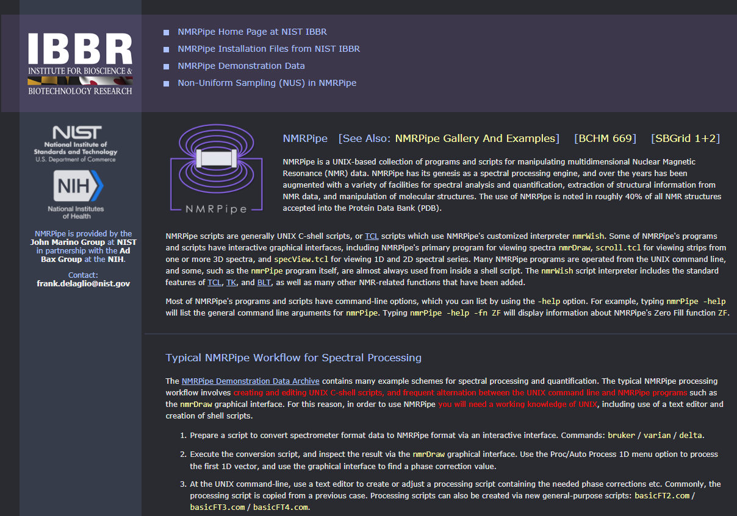
www.nmrpipe.com
www.ibbr.umd.edu/nmrpipe

Slide 3
Sampling and Resolution
As a general rule, spectral width will be proportional to 1/dT, and resolution will be inversely proportional to the largest time coordinate acquired (that is, the greater the largest time, the better the resolution).
dT
N uniformly spaced samples, each separated by dT.
The time difference between first and last samples determines the spectral resolution. The time difference between adjacent samples determines the spectral width.

Slide 4
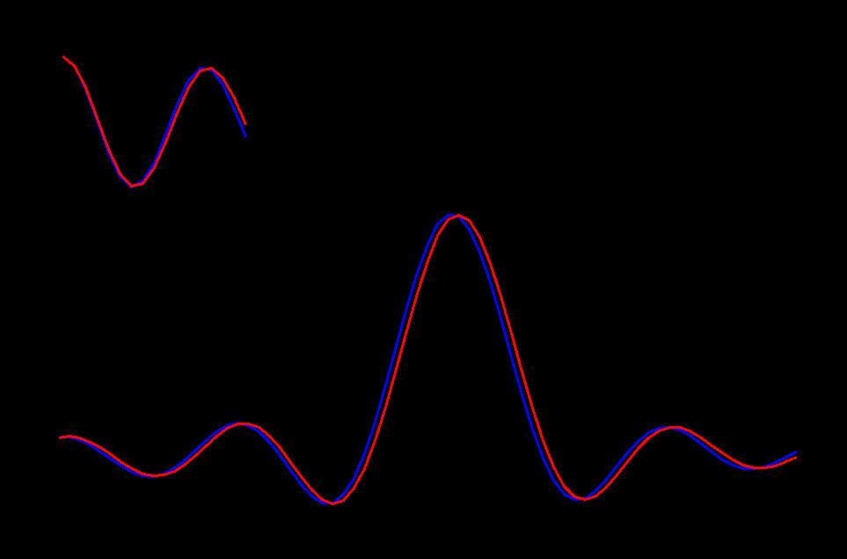
Sampling and Resolution
Time-Domain Data
Fourier Transform (Excerpt)

Slide 5
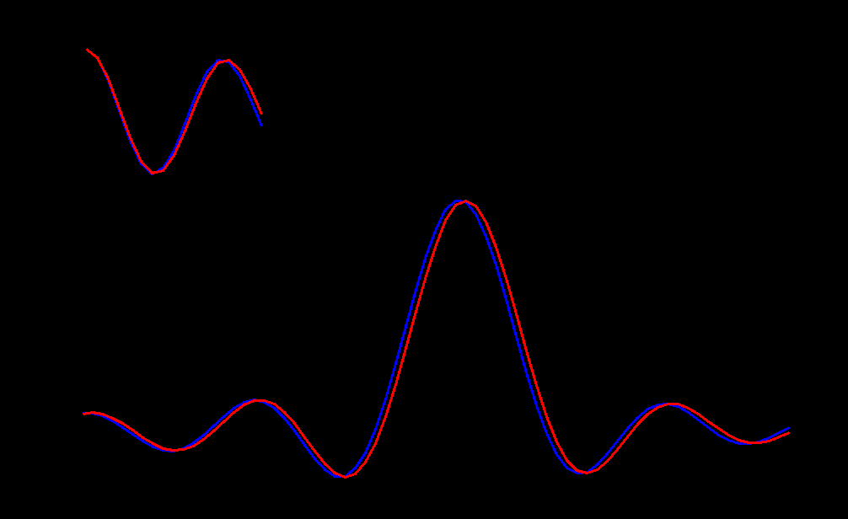
Sampling and Resolution
Time-Domain Data
Fourier Transform (Excerpt)

Slide 6
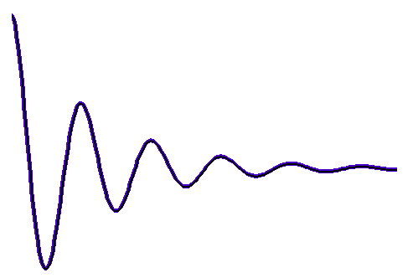
The Direct Dimension
Resolution in the Direct Dimension is Determined by Max Sampling Time t2
RF
PULSE
Measurement Time in the Direct Dimension is Also Determined by Max Sampling Time t2 …
It is Not Determined by the Number of Samples

Slide 7
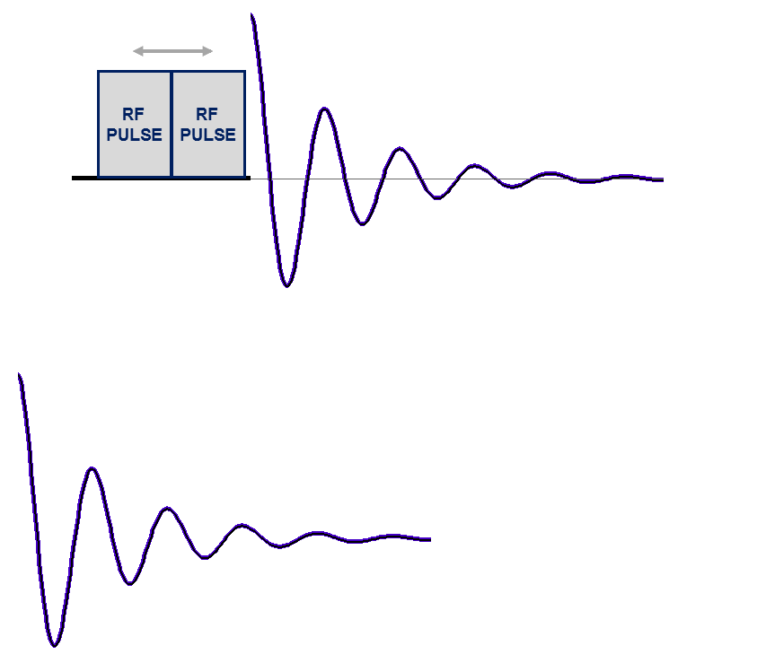
Two-Dimensional NMR
Evolution Time
Incremented by Δ _{t1}
Acquire 1D Data at Each Evolution Time

Slide 8
Two-Dimensional NMR
Evolution Time
Incremented by Δ _{t1}
RF PULSE
RF PULSE
Acquire 1D Data at Each Evolution Time
2D Spectrum
Time-Domain
Interferogram
Fourier Transform Rows
Fourier Transform Columns

Slide 9
The Indirect Dimension
Resolution in the Indirect Dimension is Determined by Max Evolution Time t1
RF PULSE
RF PULSE
Time-Domain
Interferogram
Measurement Time is Determined by the Number of Increments Measured in the Indirect Dimension

Slide 10
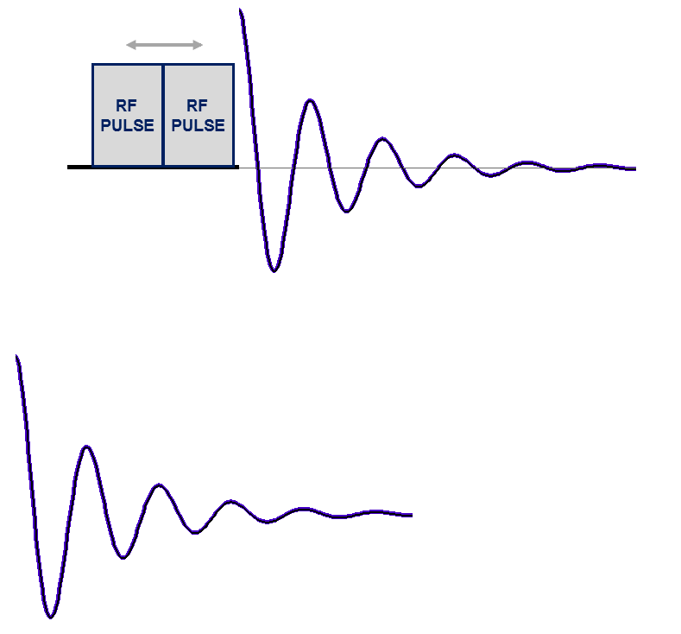
Two-Dimensional NMR with Non-Uniform Sampling (NUS)
Evolution Time
Incremented by Δ _{t1}
Acquire 1D Data at Each Evolution Time …
But Only for Selected Increments …
NUS retains resolution, and since fewer increments acquired, measurement time is reduced (but signal-to-noise is decreased).

Slide 11
Sampling and Resolution
In a NUS experiment, some fraction of the intermediate increments in the indirect dimensions are skipped, which means that the measurement time will be shorter if other details are kept the same.
dT
M non-uniformly spaced samples, on a grid with positions separated by dT. The time difference between first and last samples is the same as for the fully sampled case, so that the spectral resolution is retained.

Slide 12
Fourier Transform is not Suitable for Non-Uniformly Sampled Data … Other Reconstruction Methods are Needed

Slide 13
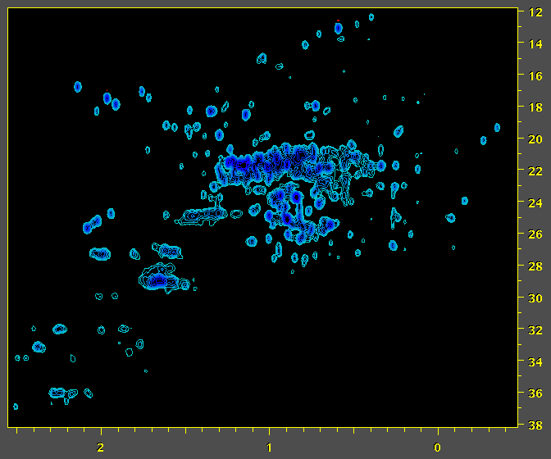
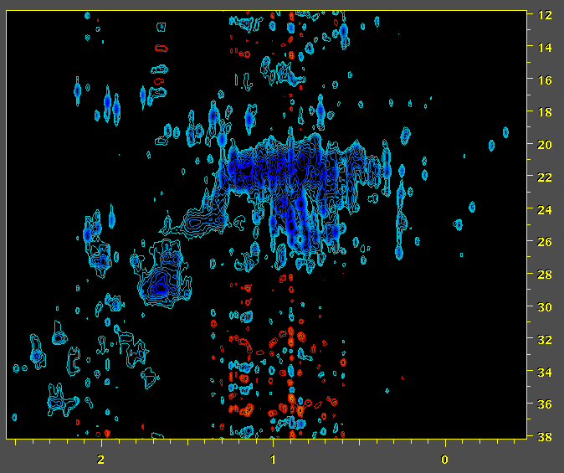
Fourier Transform is not Suitable for Non-Uniformly Sampled Data … Other Reconstruction Methods are Needed
NISTmAb
Conventional Uniformly Sampled (US) Data Fourier Spectrum
NISTmAb
Non-Uniformly Sampled (NUS) Data
Fourier Spectrum
¹³C ppm
¹H ppm
¹H ppm

Slide 14
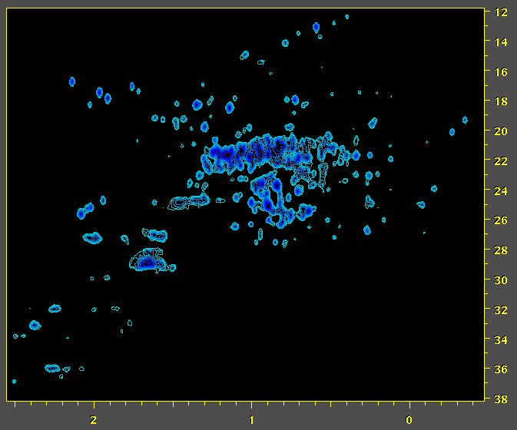
Methods Such as Iterative Soft Thresholding (IST) are Used to Reconstruct NUS Spectra
NISTmAb
Conventional Uniformly Sampled (US) Data Fourier Spectrum
NISTmAb
Non-Uniformly Sampled (NUS) Data
IST Reconstruction – 2x Faster Measurement
¹³C ppm
¹H ppm
¹H ppm

Slide 15
NUS Reconstruction
Conventional Uniformly Sampled Data
Zero Fill

Slide 16
NUS Reconstruction
X
X
X
X
X
X
X
X
Non-Uniformly Sampled Data
Zero Fill

Slide 17
NUS Reconstruction
X
X
X
X
X
X
X
X
NUS Reconstruction
NUS Reconstruction replaces (interpolates) the missing values.
It can also replace zero-filled data, as an alternative to extrapolation methods such as Linear Prediction.

Slide 18
NUS Reconstruction
Extrapolated Data
Higher Resolution
Interpolated Data
NUS Reconstruction replaces (interpolates) the missing values.
It can also replace zero-filled data, as an alternative to extrapolation methods such as Linear Prediction.

Slide 19
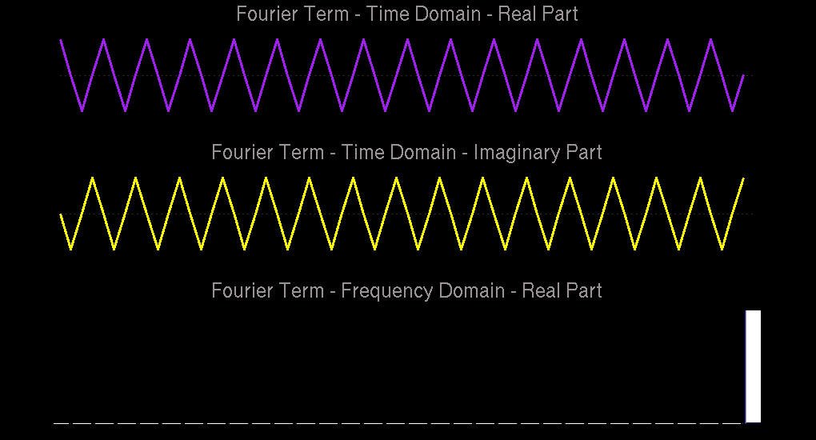
^{X( f ) =} Σ x( t ) [ cos( 2πft / N ) - i sin( 2πft / N ) ]
Each Fourier term corresponds to a point in the spectrum.

Slide 20
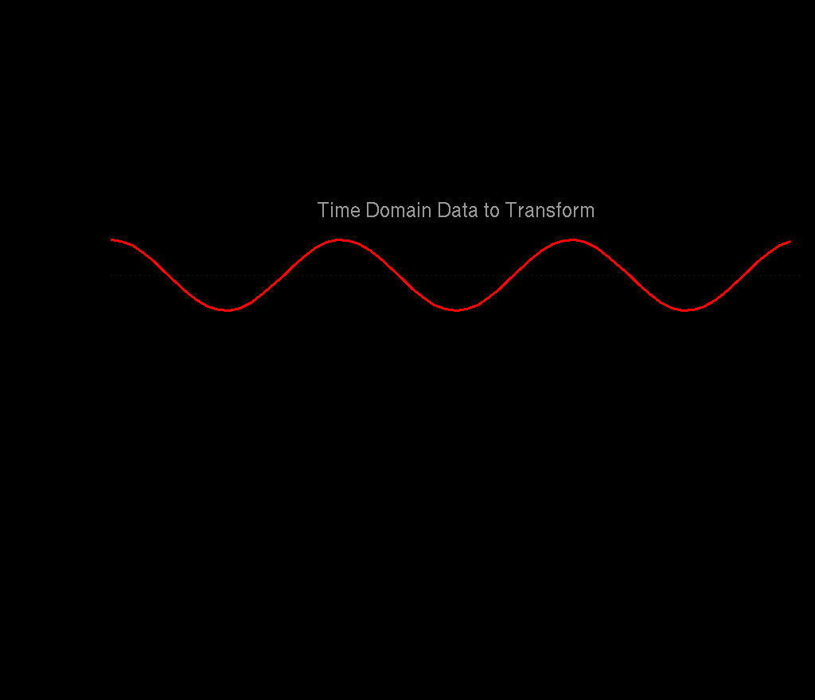
The Fourier Transform (with the Imaginary Parts Hidden) …

Slide 21
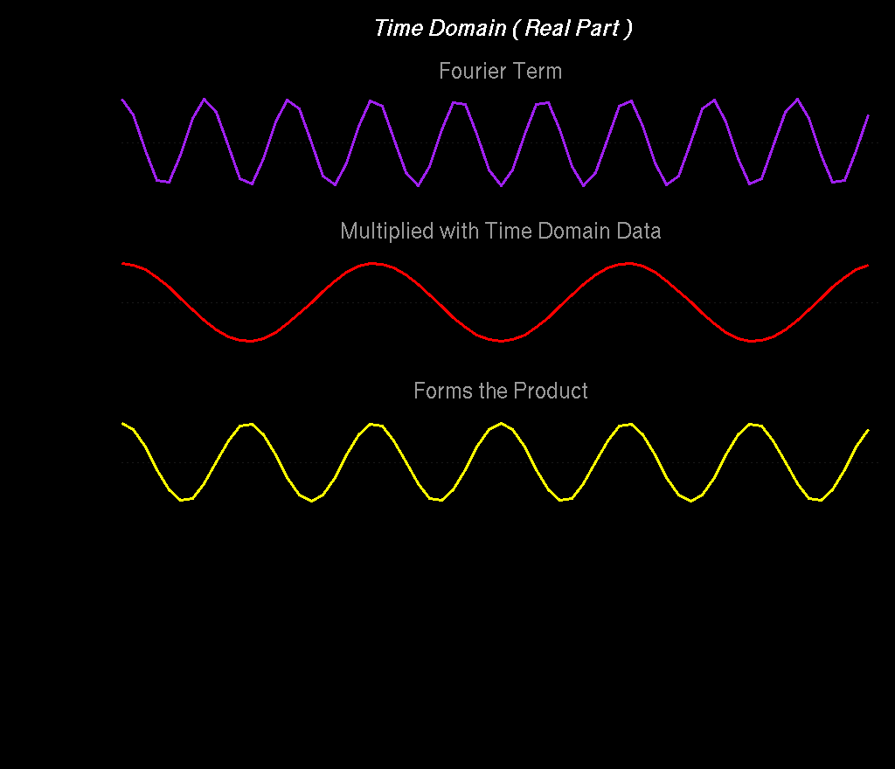

Slide 22
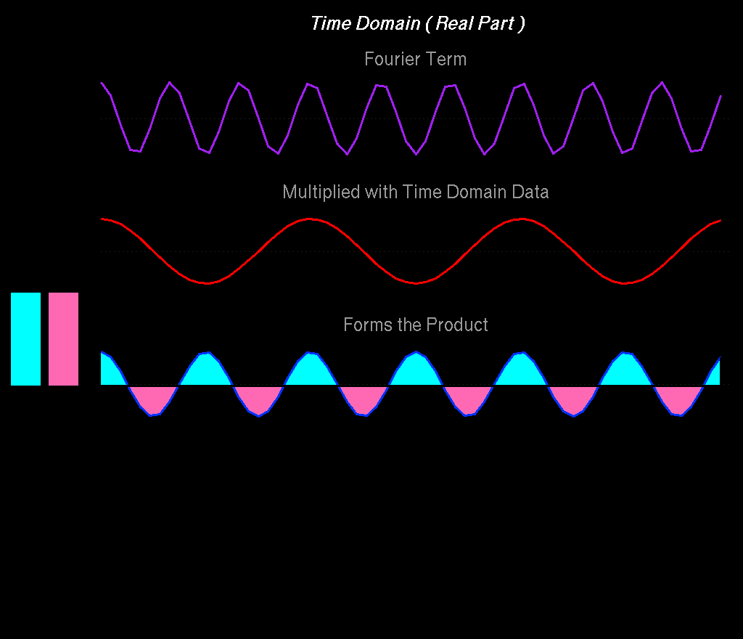
Σ+
Σ-
When the Fourier term does not match any frequency in the data, the product has balanced amounts of positive and negative intensity, and sums to zero.

Slide 23
Σ+
Σ-

Slide 24
In Biomolecular NMR, Indirect Dimensions are Often Truncated and Have Limited Numbers of Points …

Slide 25
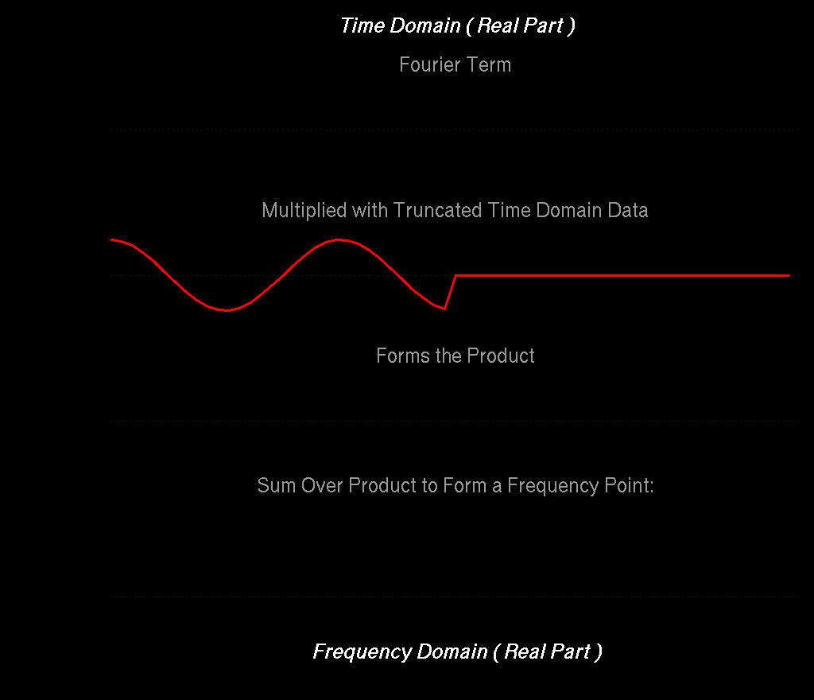
Σ+
Σ-
Since the Fourier product is truncated, there is no longer ideal cancelation of positive and negative intensities, giving broad lines and artifacts

Slide 26
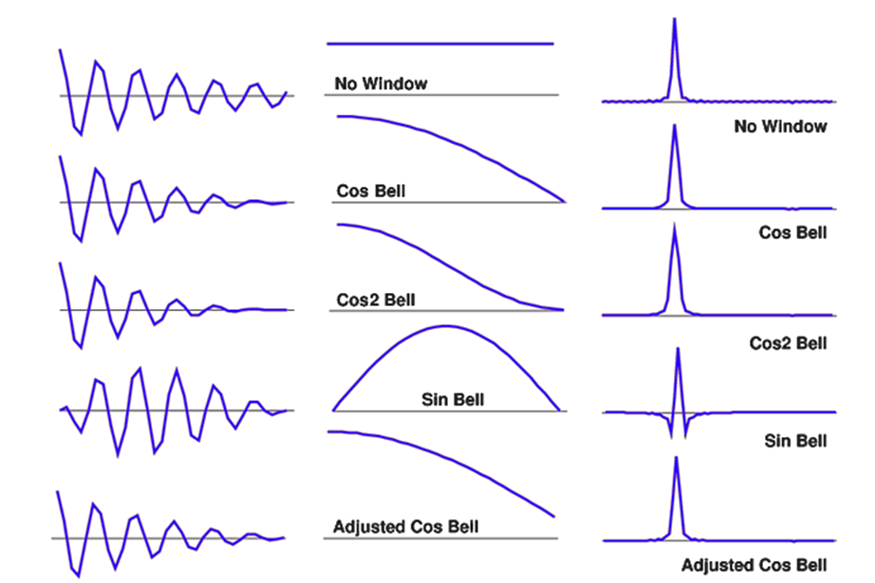

Slide 27
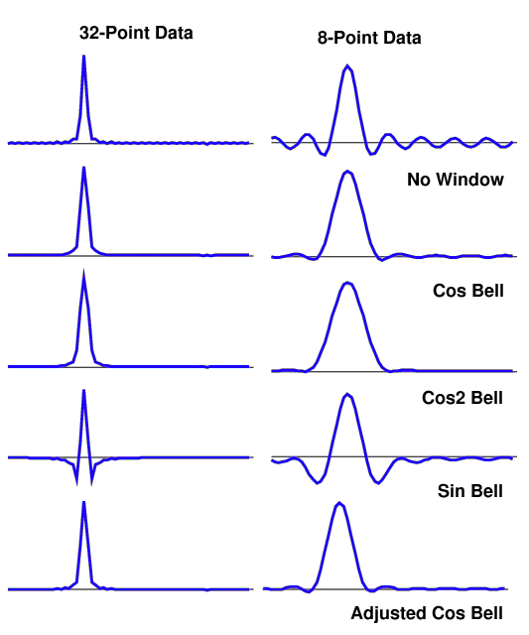
Even though the underlying signal is the same in all of these examples, and noise-free, Fourier transforms with small numbers of points give very broad lines and large artifacts.

Slide 28
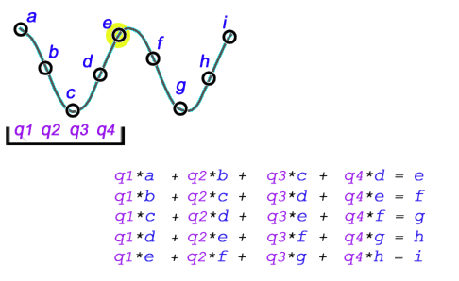
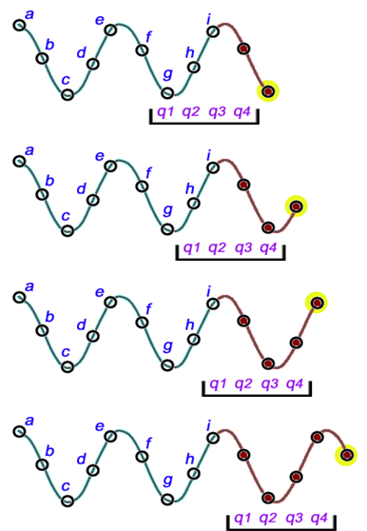
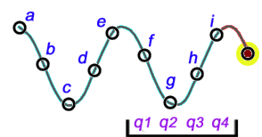
Linear Prediction (LP) Extrapolation
Form a Linear Combination of Points to Predict the Next Point
Each complex LP coefficient describes a signal.
The number of LP coefficients is limited to size/2.

Slide 29
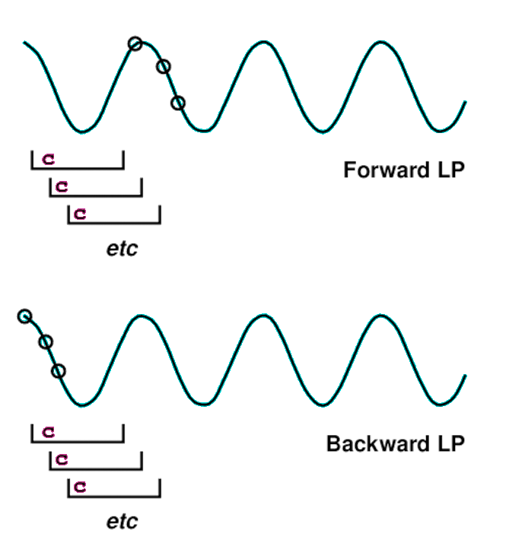
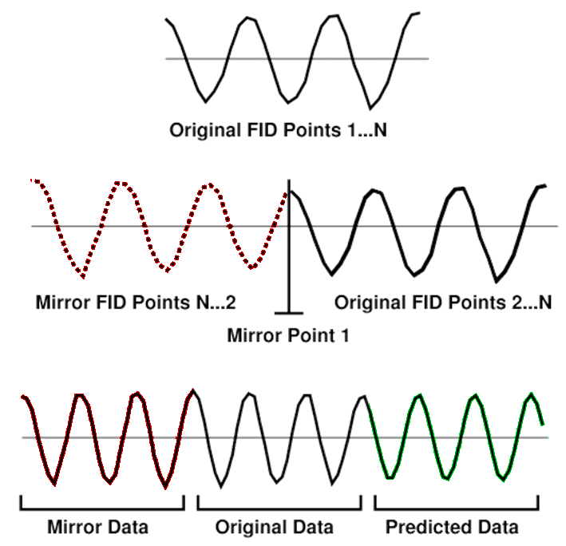
Forward Backward and Mirror Image Linear Prediction
Predict next point in series
Mirror Image LP
Zero Delay Data with No Decay
Predict previous point in series
Forward and Backward Coefficients Can be Averaged for Stability
Extending the Length of the Input Data Allows More LP Coefficients, Hence More Signals

Slide 30
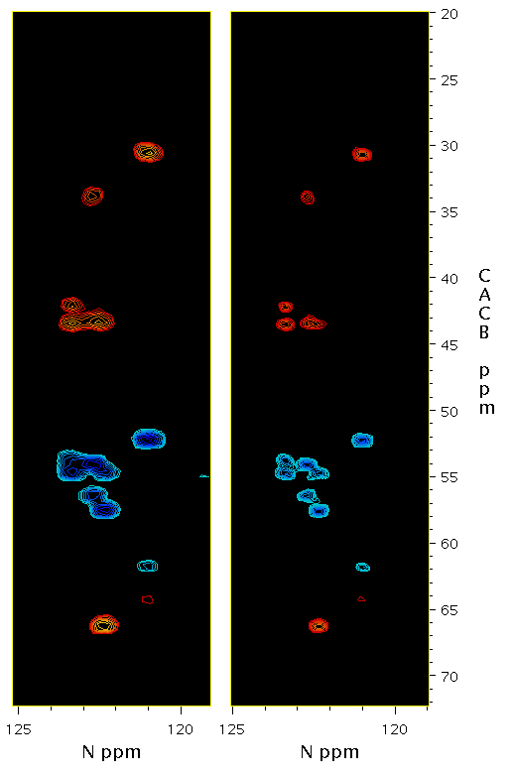
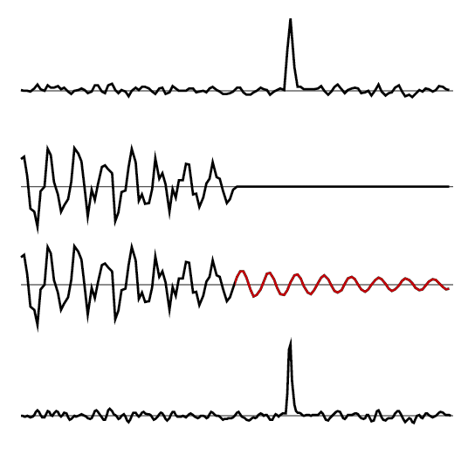
Linear Prediction (LP) Extrapolation
FT
LP
Original Spectrum
Original Time-Domain
Extrapolated Time-Domain
Final Spectrum

Slide 31
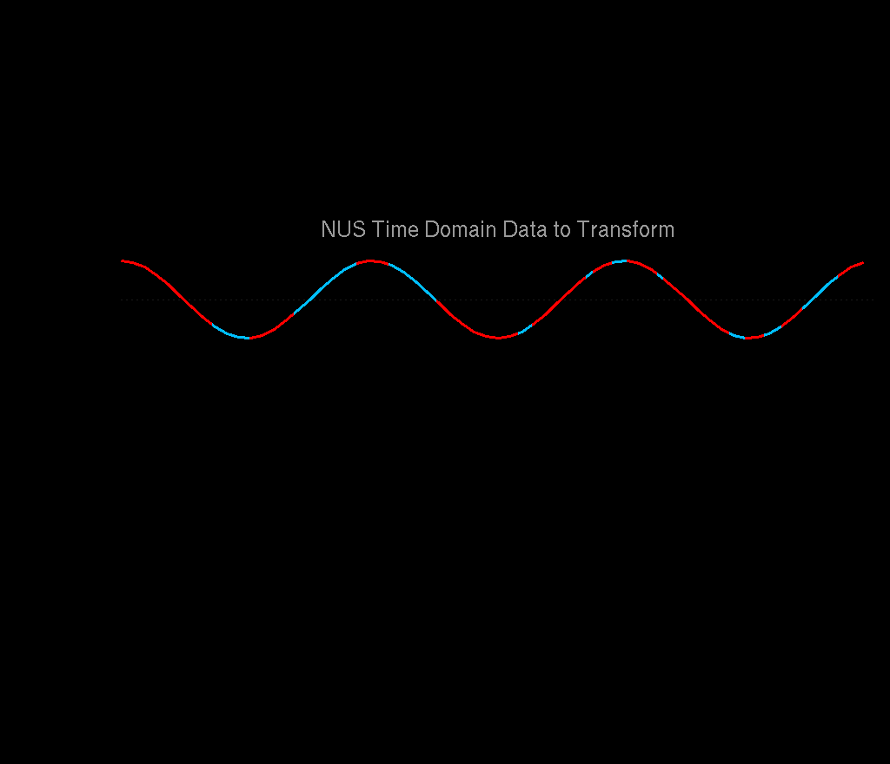
Reconstruction of NUS Data

Slide 32
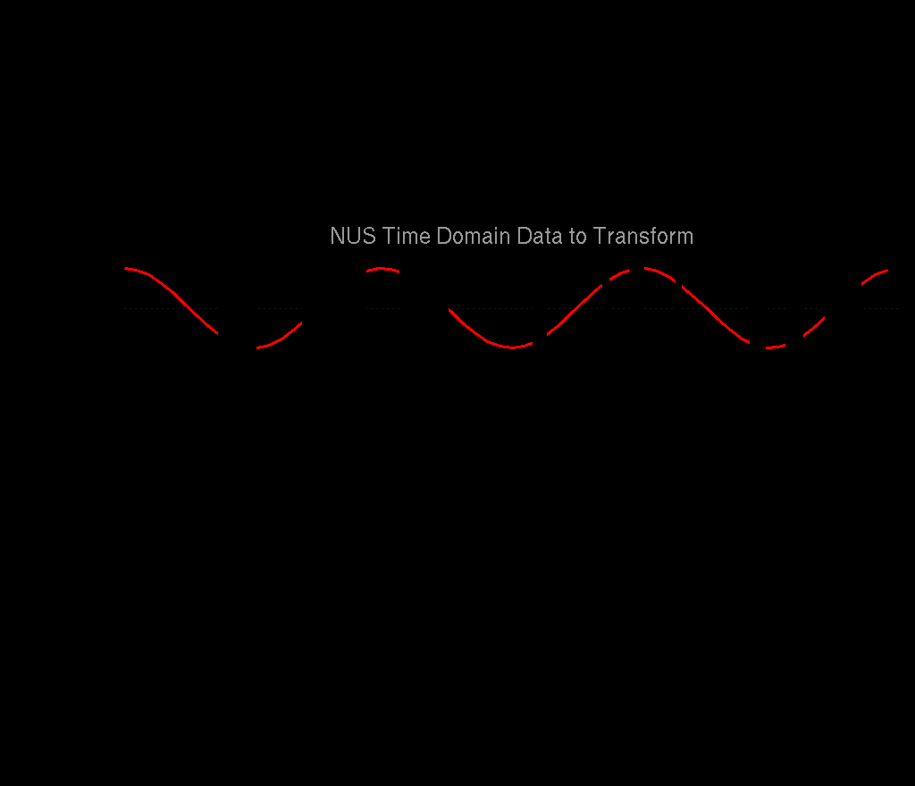

Slide 33
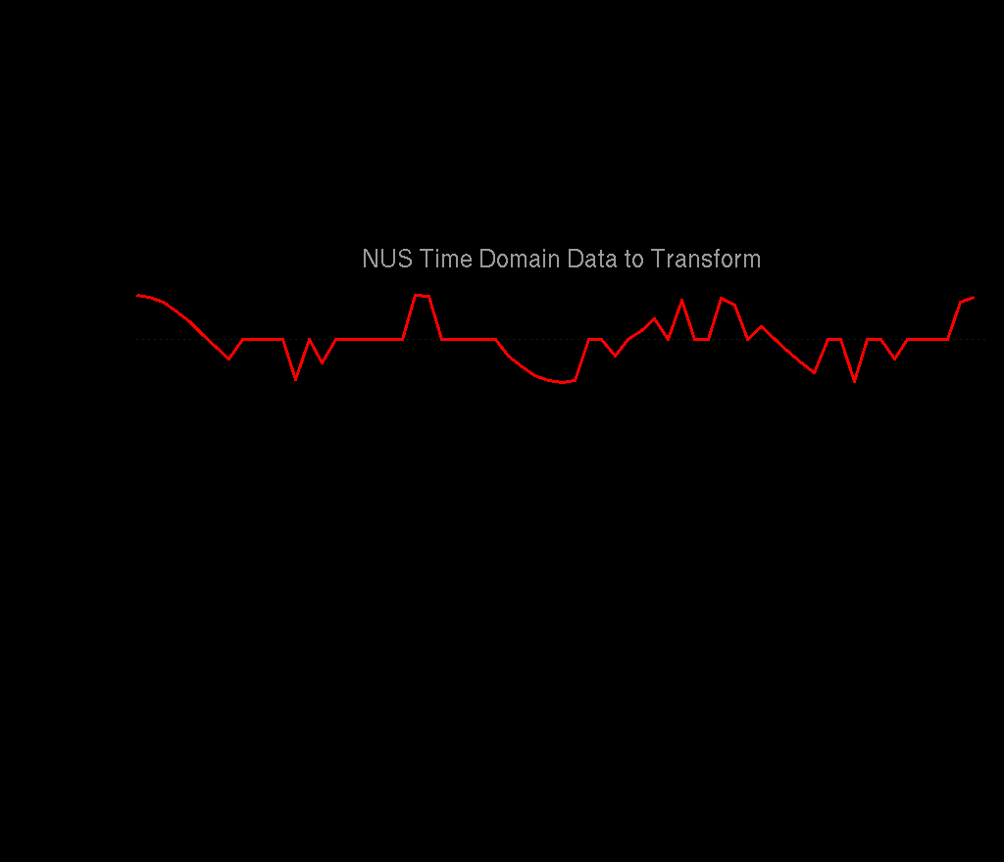
Non-Uniform Sampling: for Fourier Transform, Replace Missing Points with Zeros

Slide 34
Σ+
Σ-
Since the product has “random” points zeroed, there is no longer ideal cancelation of positive and negative intensities, giving noise-like artifacts

Slide 35
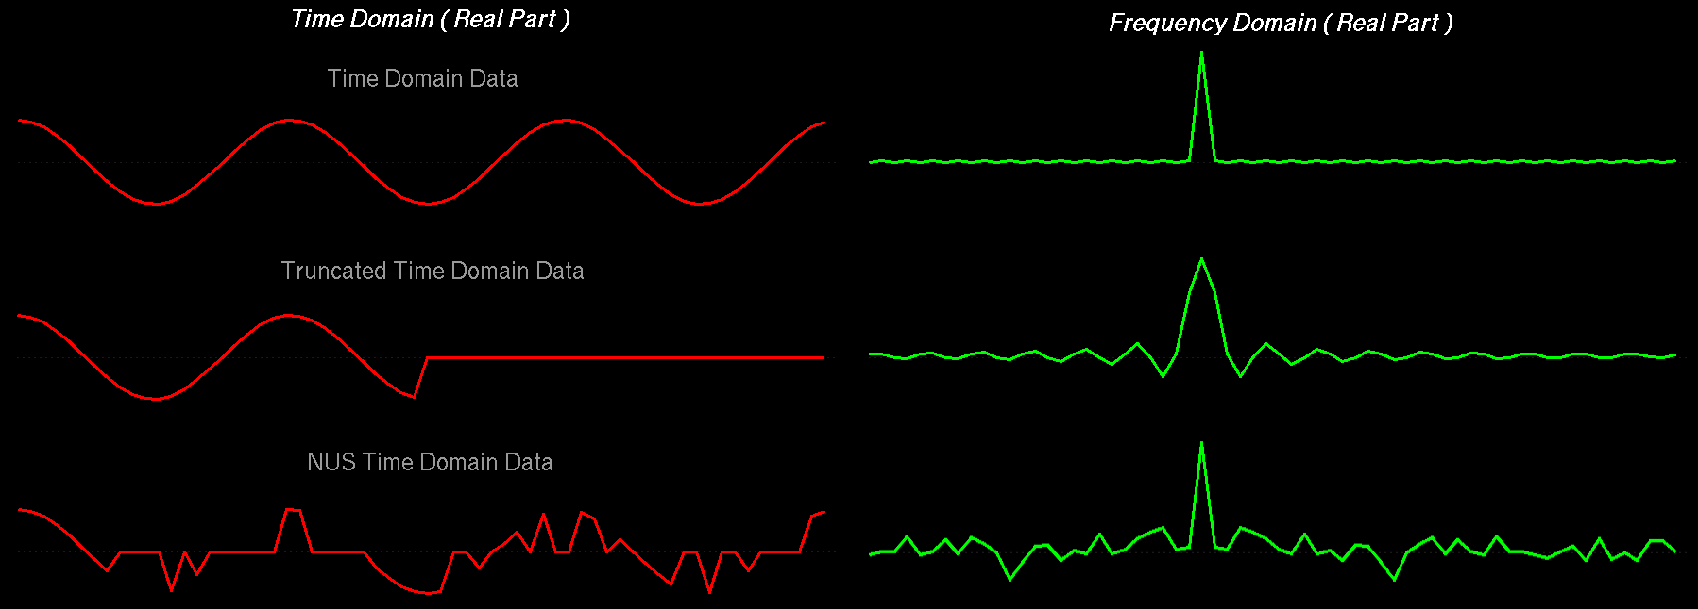
Fourier transform of Uniform versus Non-Uniform Sampling Schedules
Uniform Sampling Schedule:
Broad lines and periodic truncation wiggle artifacts
Non Uniform Sampling Schedule:
Narrow lines and random-noise-like artifacts
All peaks for a given schedule have the same artifacts, and the size of the artifacts is proportional to the size of the peaks.

Slide 36
NUS Software from Our Friends
Many NUS Reconstruction Systems Use NMRPipe Workflows
SMILE spin.niddk.nih.gov/bax/software/smile
NESTA nestanmr.com
SCRUB coggins.biochem.duke.edu/scrub
hmsIST gwagner.med.harvard.edu/intranet/istHMS
Find these methods and more on NMRbox
NMRbox.org

Slide 37
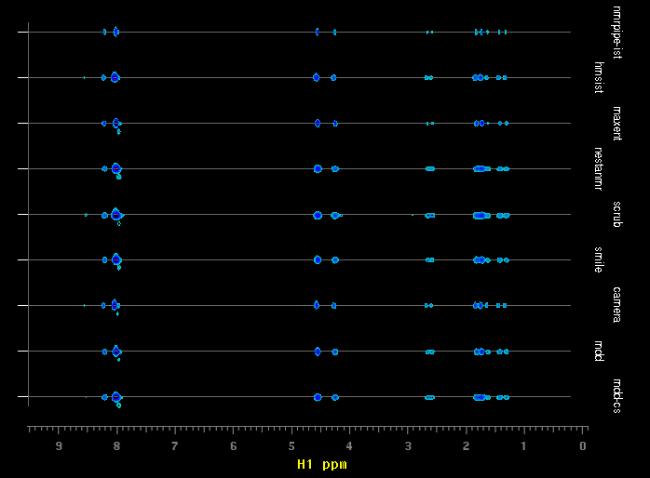
NUS Software from Our Friends
NMRPipe IST
hmsIST
MaxEnt
NESTA
SCRUB
SMILE
CAMERA
MDD
MDD-CS
Ubiquitin
3D 15N-NOE
Strips at:
8.02ppm HN
121.95ppm 15N
1H PPM
Find these methods and more on NMRbox
NMRbox.org

Slide 38
Some Related References
AS Stern, DL Donoho, and JC Hoch: NMR data processing using iterative thresholding and minimum l(1)-norm reconstruction. J Magn Reson., 188, 295-300 (2007).
SG Hyberts, K Takeuchi, and G Wagner: Poisson-gap sampling and forward maximum entropy reconstruction for enhancing the resolution and sensitivity of protein NMR data. J Am Chem Soc., 132, 2145-2147 (2010).
V Orekhov and VA Jaravine: Analysis of non-uniformly sampled spectra with Multi-Dimensional Decomposition. Progress in Nuclear Magnetic Resonance Spectroscopy, 59, 271-292 (2011).
BE Coggins, JW Werner-Allen, A Yan, and P Zhou: Rapid Protein Global Fold Determination Using Ultrasparse Sampling, High-Dynamic Range Artifact Suppression, and Time-Shared NOESY. J. Am. Chem. Soc., 134, 18619-18630 (2012).
K Kazimierczuk and V Orekhov: A comparison of convex and non-convex compressed sensing applied to multidimensional NMR. J Magn Reson., 223, 1-10 (2012).
SG Hyberts, AG Milbradt, AB Wagner, H Arthanari, and G Wagner: Application of iterative soft thresholding for fast reconstruction of NMR data non-uniformly sampled with multidimensional Poisson Gap scheduling. J Biomol NMR., 52, 315-27 (2012).
SG Hyberts, H Arthanari, SA Robson, and G Wagner: Perspectives in magnetic resonance: NMR in the post-FFT era. J Magn Reson., 241, 60-73 (2014).
JC Hoch, MW Maciejewski, M Mobli, AD Schuyler, and AS Stern: Nonuniform sampling and maximum entropy reconstruction in multidimensional NMR. Acc Chem Res., 47, 708-17 (2014).
S Sun, M Gill, Y Li, M Huang, and RA Byrd: Efficient and generalized processing of multidimensional NUS NMR data: the NESTA algorithm and comparison of regularization terms. J Biomol NMR., 62, 105-117 (2015).
MR Palmer, CL Suiter, GE Henry, J Rovnyak, JC Hoch, T Polenova, and D Rovnyak: Sensitivity of Nonuniform Sampling NMR. J. Phys. Chem. B, 119, 6502−6515 (2015).
AS Stern and JC Hoch: A new approach to compressed sensing for NMR. Magn Reson Chem., 53, 908-912 (2015).
J Ying, F Delaglio, DA Torchia, and A Bax: Sparse multidimensional iterative lineshape-enhanced (SMILE) reconstruction of both non-uniformly sampled and conventional NMR data. J. Biomol. NMR, doi:10.1007/s10858-016-0072-7 (2016).
K Kosiński, J Stanek, MJ Górka, S Żerko, and W Koźmiński: Reconstruction of non-uniformly sampled five-dimensional NMR spectra by signal separation algorithm. J Biomol NMR doi:10.1007/s10858-017-0095-8 (2017).

Slide 39
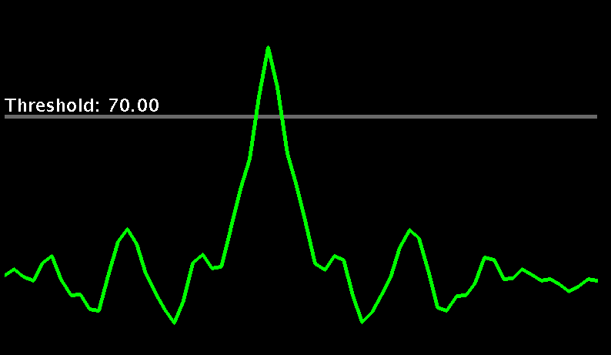
Non Uniform Sampling
IST – Iterative Soft Thresholding
IST takes advantage of the fact that the size of sampling schedule artifacts is proportional to the size of the peaks.

Slide 40
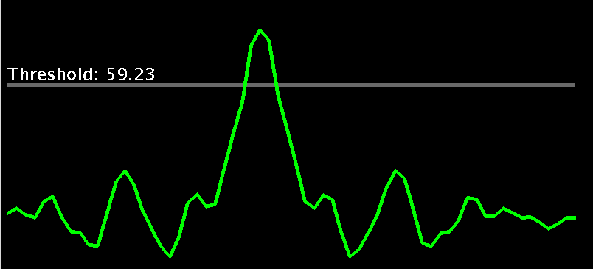
Non Uniform Sampling
IST – Iterative Soft Thresholding
IST works by gradually moving intensity from the tops of the largest signals remaining and accumulating them in a reconstruction.

Slide 41
Non Uniform Sampling
IST – Iterative Soft Thresholding
At each iteration, the reduced spectrum is inverse transformed, and the parts that were originally skipped in the sampling schedule are set to zero again.

Slide 42
Non Uniform Sampling
IST – Iterative Soft Thresholding
Fourier Spectrum
IST Spectrum
At each IST iteration, the largest signals in the residual get smaller, and so do the corresponding artifacts.
Iterations conclude when the largest point remaining in the residual is below a target value.
When the IST iterations conclude, any remaining residual can be added to the reconstruction.

Slide 43
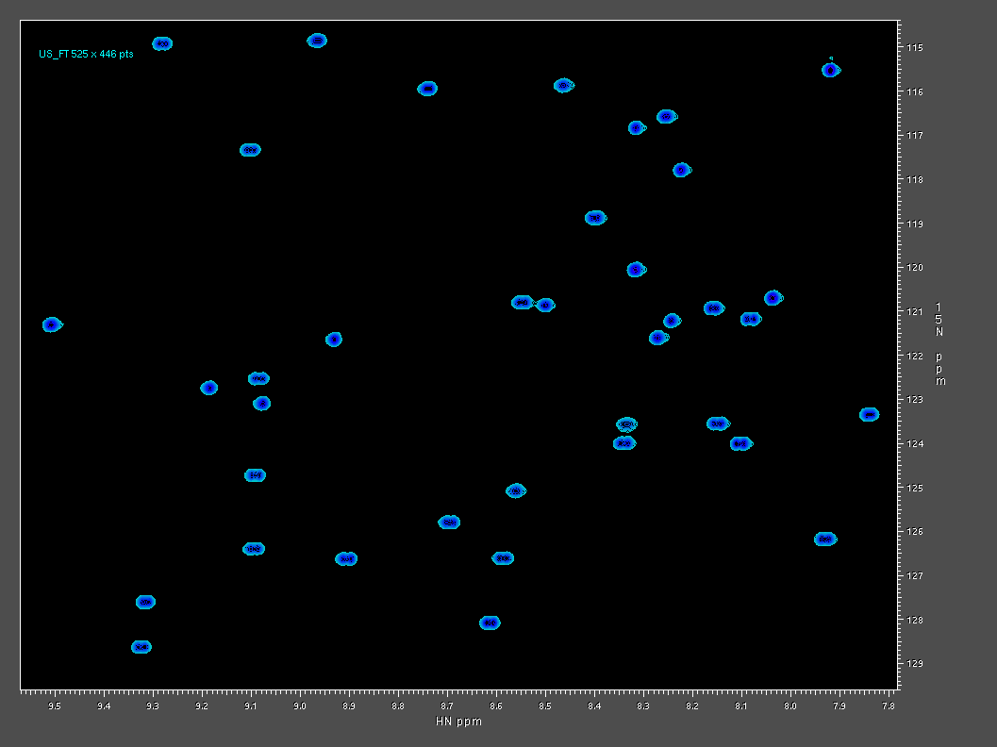
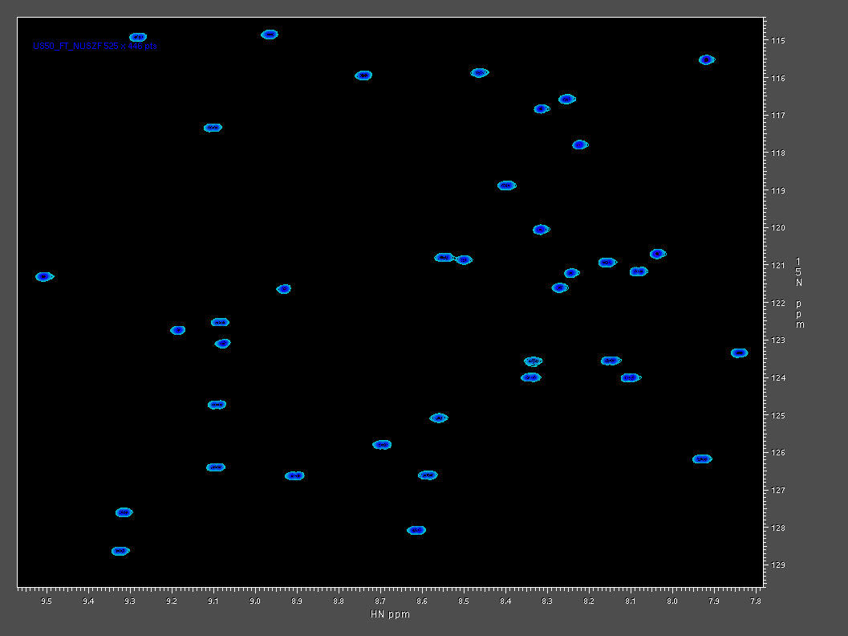
NMRPipe IST Reconstruction of 2D NUS Data
Conventional Data Processed by FT
50% NUS Data Processed by IST and NUS Zero Fill

Slide 44
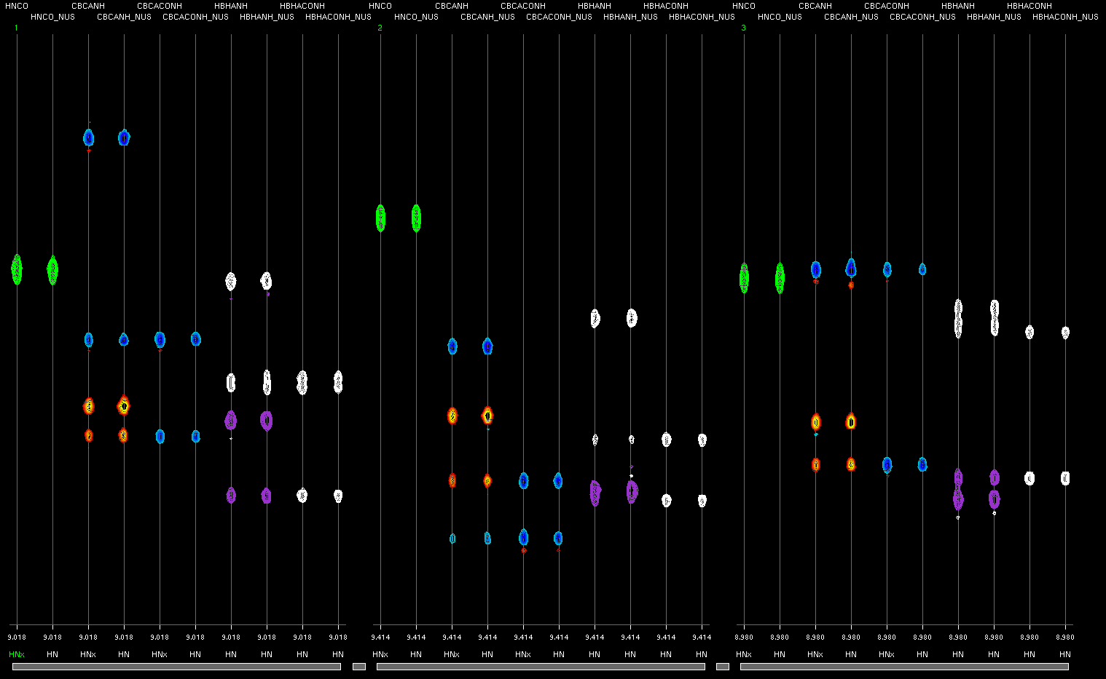
Uniformly Sampled Data and 33% NUS Reconstructed by NMRPipe’s IST

Slide 45
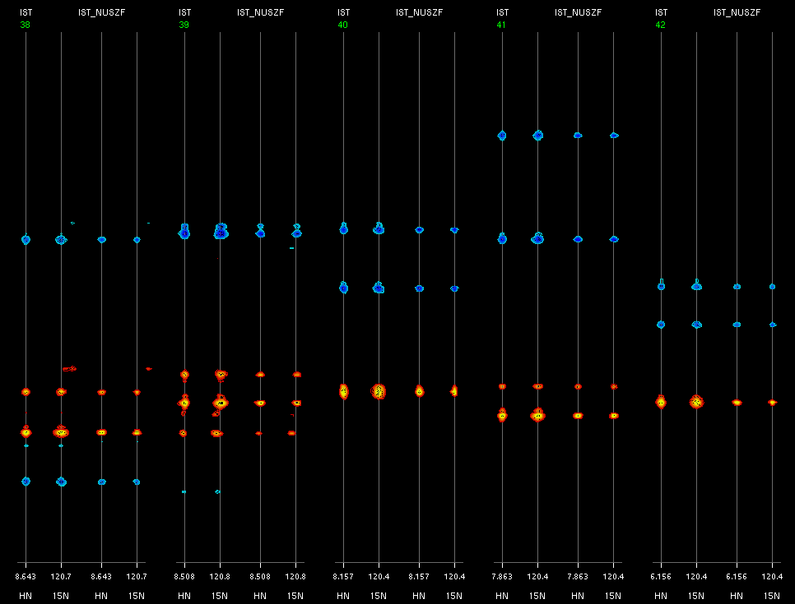
Reconstruction of NUS Data With and Without NUS Zero Fill
IST
IST
NUS ZF
IST
IST
NUS ZF
IST
IST
NUS ZF
IST
IST
NUS ZF
IST
IST
NUS ZF

Slide 46
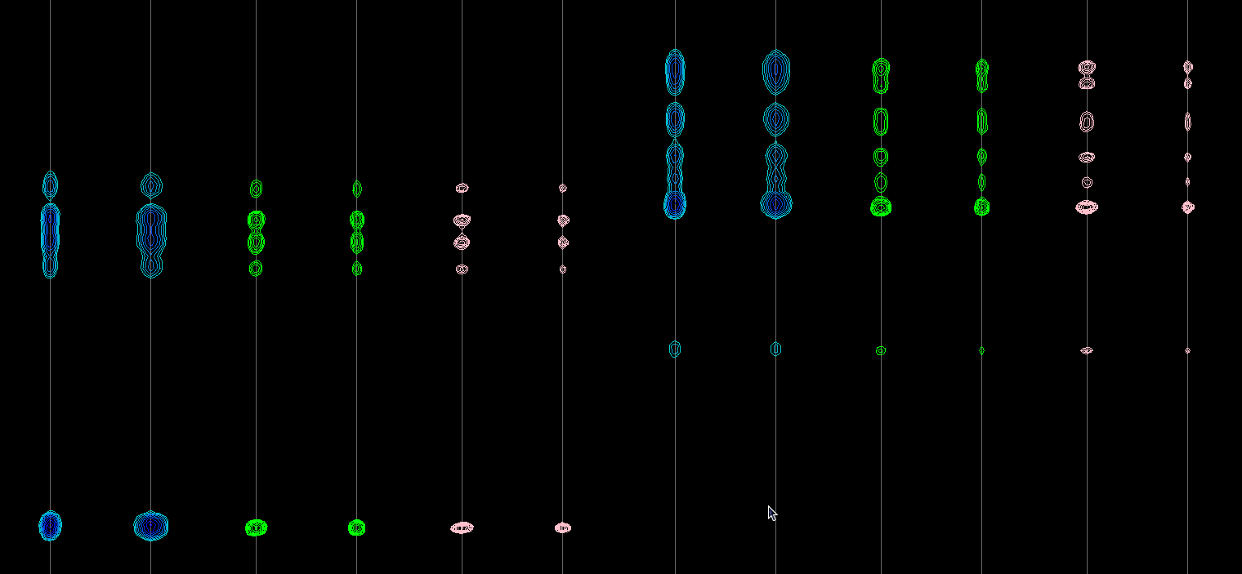
NUS Zero Fill as an Alternative to Linear Prediction for Conventional NMR Data (15N-NOE)
Conventional FT
4 sec
Linear Prediction
2 min 30 sec
NUS Zero Fill via IST
20 min 21 sec
HN
8.929 ppm
N
122.2 ppm
HN
9.138 ppm
N
121.9 ppm

Slide 47
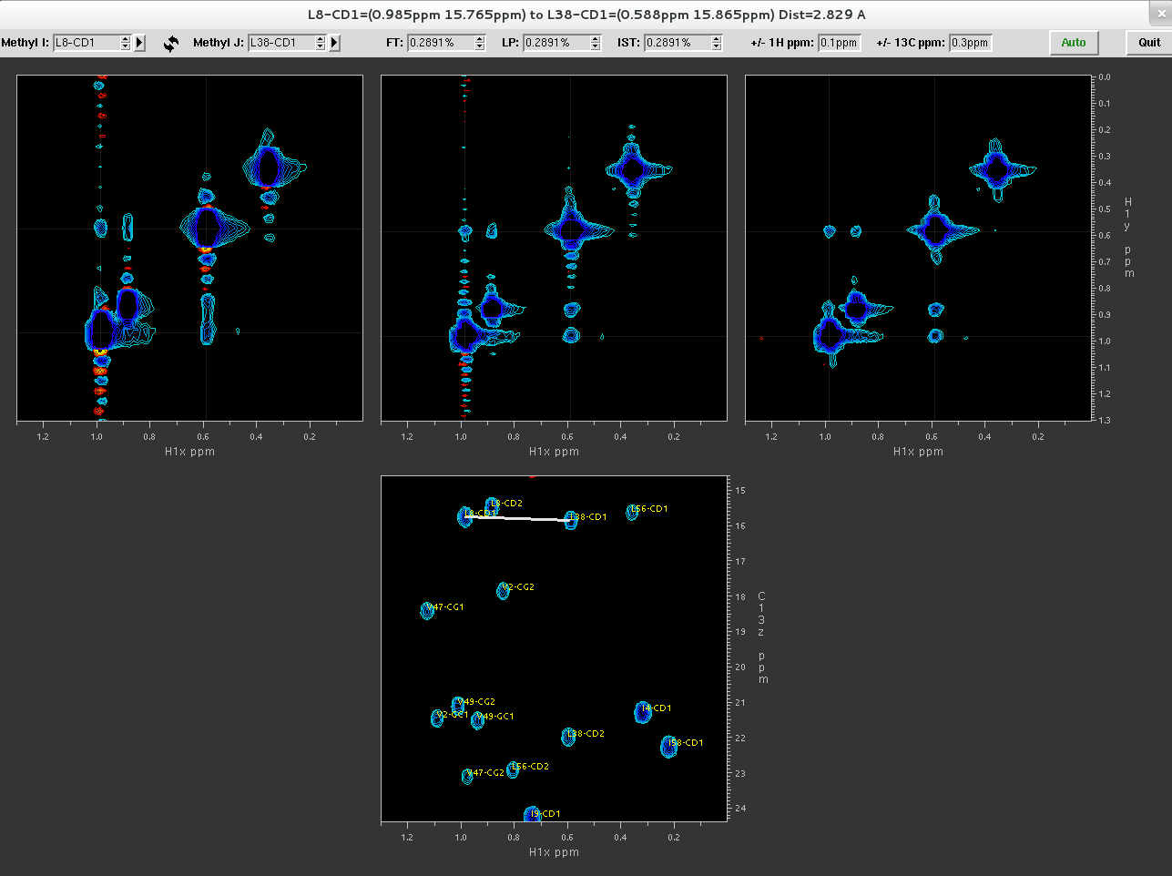
NUS Zero Fill as an Alternative to Linear Prediction for Conventional NMR Data (4D Methyl-Methyl NOE)
FT
LP
IST
3 sec
4 min 33 sec
126 min

Slide 48
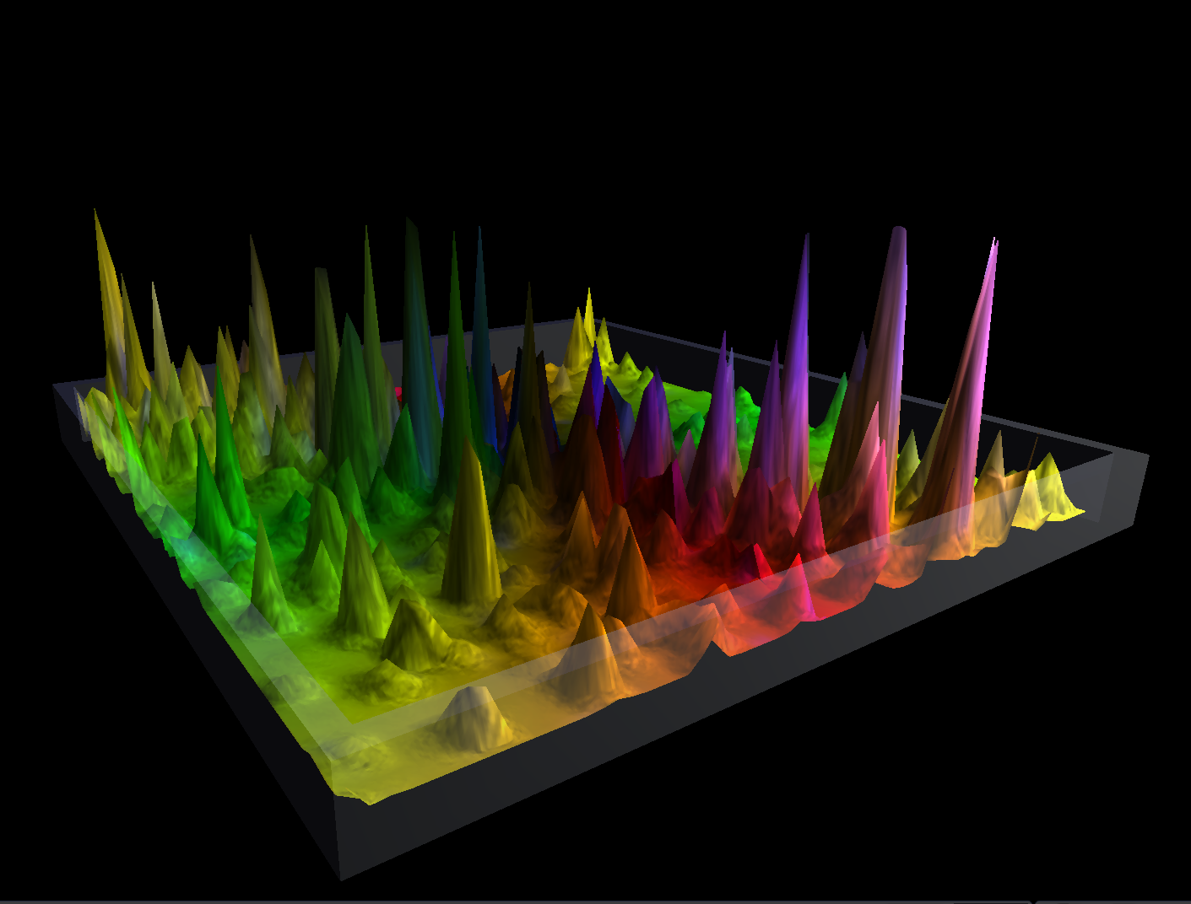
SMILE - Sparse Multidimensional Iterative Lineshape Enhanced NUS Reconstruction
http://spin.niddk.nih.gov/bax/software/smile
Jinfa Ying and Ad Bax

Slide 49
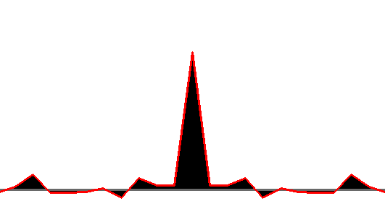
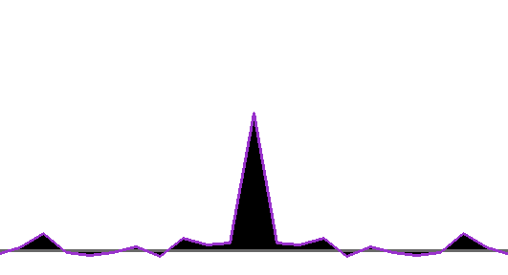
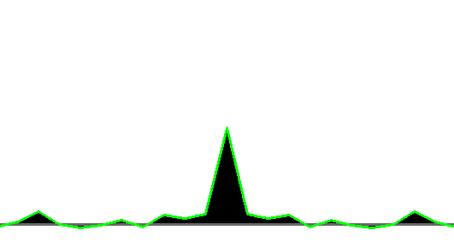
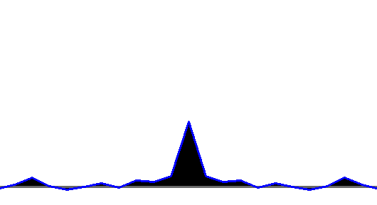
SMILE:
Establish Relationship Between Decay and Observed Linewidth
5Hz
Multiply by Sampling Schedule and
Fourier Transform
10Hz
Sampling Schedule, Pts
15Hz
20Hz

Slide 50
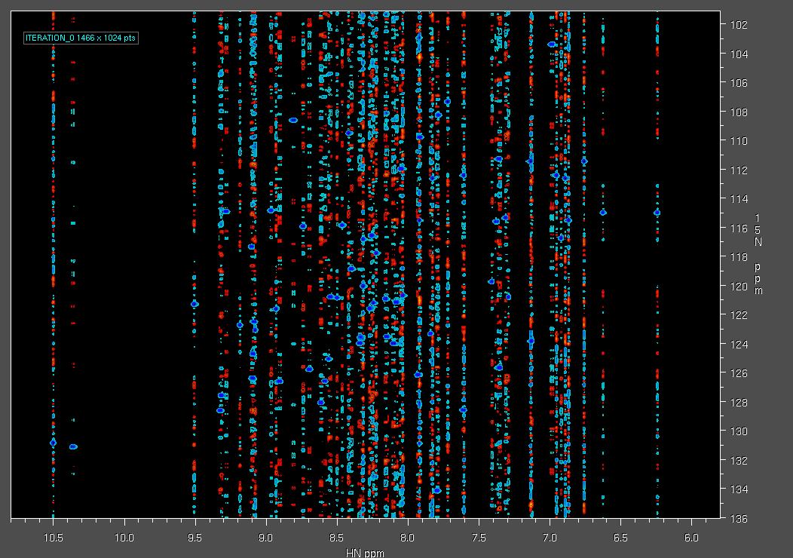
SMILE:
Each Iteration Models the Largest Remaining Signals

Slide 51
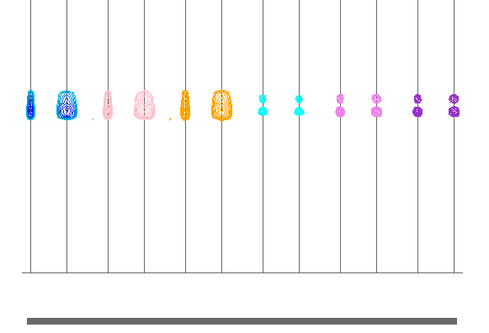
Uniformly Sampled Data and 33% NUS Reconstructed by NMRPipe’s IST and By SMILE
Uniformly Sampled
NUS IST
NUS RIST
NUS IST + Extrapolation
NUS RIST + Extrapolation
NUS SMILE + Extrapolation

Slide 52
Typical NMRPipe 3D Spectral Processing Scheme
Commonly Adjusted Parameters / X-Axis Processing / Y-Axis Processing / Z-Axis Processing
The Script Provides Reproducible Processing
#!/bin/csh
xyz2pipe -in fid/test%03d.fid -x -verb \ Read vectors from X-Axis
| nmrPipe -fn SOL \ Solvent Subtraction
| nmrPipe -fn SP -off 0.5 -end 0.98 -pow 2 -c 0.5 \ Window and First Point Scale
| nmrPipe -fn ZF \ Zero Fill
| nmrPipe -fn FT \ Fourier Transform
| nmrPipe -fn PS -p0 43.0 -p1 0.0 -di \ Phase Correction
| nmrPipe -fn EXT –x1 10.5ppm –xn 5.7ppm -sw \ Extract PPM Range
| nmrPipe -fn TP \ X/Y Transpose
| nmrPipe -fn SP -off 0.5 -end 0.98 -pow 1 -c 1.0 \ Window and First Point Scale
| nmrPipe -fn ZF \ Zero Fill
| nmrPipe -fn FT \ Fourier Transform
| nmrPipe -fn PS -p0 -90.0 -p1 180.0 -di \ Phase Correction
| nmrPipe -fn TP \ X/Y Transpose
| nmrPipe -fn POLY -auto \ Baseline Correction
| pipe2xyz -out ft/test%03d.ft2 –x Write vectors to X-Axis
xyz2pipe -in ft/test%03d.ft2 -z -verb \ Read vectors from Z-Axis
| nmrPipe -fn SP -off 0.5 -end 0.98 -pow 1 -c 0.5 \ Window and First Point Scale
| nmrPipe -fn ZF \ Zero Fill
| nmrPipe -fn FT \ Fourier Transform
| nmrPipe -fn PS -p0 0.0 -p1 0.0 -di \ Phase Correction
| pipe2xyz -out ft/test%03d.ft3 -z Write vectors to Z-Axis

Slide 53
New: 3D Spectral Processing Scheme via a Single Command
basicFT3.com \
-xP0 43 -xP1 0 -xEXTX1 10.5ppm -xEXTXN 5.7ppm \
-yP0 -90 -yP1 180

Slide 54
New: 3D Spectral Processing Scheme via a Single Command
Adding NUS-Style Extrapolation via IST
basicFT3.com \
-xP0 43 -xP1 0 -xEXTX1 10.5ppm -xEXTXN 5.7ppm \
-yP0 -90 -yP1 180 –nusZF -ist

Slide 55
New: 3D Spectral Processing Scheme via a Single Command
Process NUS Data with IST
ist3D.com \
-xP0 43 -xP1 0 -xEXTX1 10.5ppm -xEXTXN 5.7ppm \
-yP0 -90 -yP1 180

Slide 56
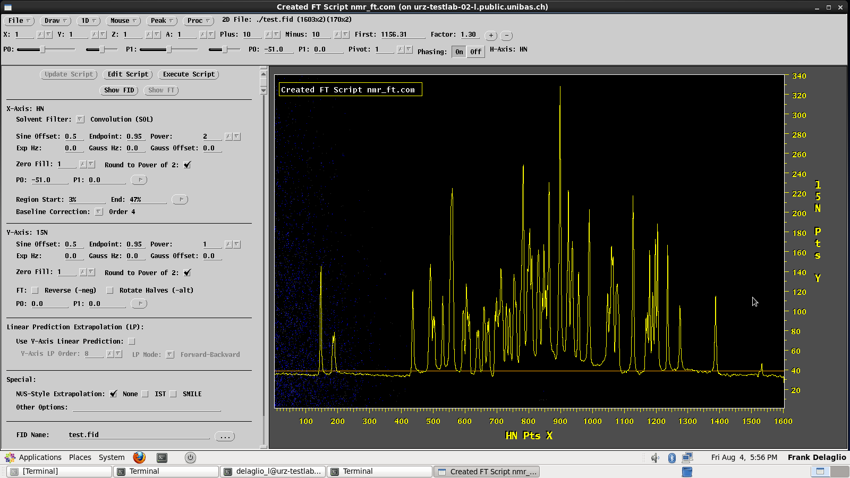
New: Graphical Interface for Processing Script Generation

Slide 57
Spectral Processing of Conventional
and Non-Uniformly Sampled NMR Data Using NMRPipe
Frank Delaglio, Ph.D.
Principal Investigator
Institute for Bioscience and Biotechnology Research
Tuesday, December 12th at 12:00pm EST
Upcoming Webinars:
December 12th: NMRPipe Part 2: Software Tutorial with Frank Delaglio
January: (POSTPONED – PROBABLY MARCH) SIMPLE with Hans Elmund
February: ORCA with Frank Neese
Please let us know what software titles you would like us to feature in future webinars.
Events are posted on SBGrid Google Calendar (to join visit http://sbgrid.org/calendar)

Slide 58
Systems Check

Slide 59
Spectral Processing Using NMRPipe
Key Steps of Spectral Processing
Window Function and First Point Scaling
Zero Fill
Fourier Transform
Phase Correction
Other Common Spectral Processing Tasks
Solvent Subtraction
Baseline Correction
Linear Prediction
Hilbert Transform and Inverse Processing
www.nmrpipe.com
Special Cases
Gradient-Enhanced Data
Interleaved Experiments and Spectral Series
Non-Uniform Sampling and Alternatives to Fourier Transform
Correction of Bad Points
Post-Processing
Generating Projections and Extracts from 3D or 4D Spectra
Viewing 2D Strips from 3D Spectra
Peak Detection and Fitting of Spectra and Spectral Series
Extracting Chemical Shift Evolutions from Spectral Series
Backbone Structure from Chemical Shifts and Dipolar Couplings
Multivariate Analysis of Spectral Series
Structure Manipulation and Analysis
frank.delaglio@nist.gov
Dec 12 2017 v3

Slide 60
www.nmrpipe.com
www.ibbr.umd.edu/nmrpipe

Slide 61
Typical NMRPipe Workflow
The typical NMRPipe processing workflow involves frequent alternation between the UNIX command line and the nmrDraw graphical interface:
Prepare a script to convert spectrometer format data to NMRPipe format via an interactive interface. Commands: bruker / varian / delta
Execute the conversion script, and inspect the result via the nmrDraw graphical interface. Use the Proc/Auto Process 1D menu option to process the first 1D vector, and use the graphical interface to find a phase correction value.
At the UNIX command-line, use a text editor to create or adjust a processing script containing the needed phase corrections etc. Commonly, the processing script is copied from a previous case. Processing scripts can also be created via new general-purpose scripts: basicFT2.com / basicFT3.com / basicFT4.com.
Execute the processing script and read the processed result with nmrDraw. View vectors from any of the dimensions, and choose new phase correction values as needed.
Repeat steps 3 and 4 to adjust processing parameters as needed.
In the case of 3D data, create and inspect projections and view strips plots of the 3D data to confirm that the data is processed and phased properly. For example:
proj3D.tcl -in ft/test%03d.ft3 -abs
peakHN.tcl -in ft/test%03d.ft3 -out hn.proj.tab -proj -hi Full
scroll.tcl -in ft/test%03d.ft3 -tab hn.proj.tab -pair -hi 8%

Slide 62
NMRPipe Workflow for NUS Data
Prepare a conversion script with the usual tools, including options which sort and expand the NUS time-domain data with zeros. Commands:
bruker -nus / varian –nus / delta -nus
Perform ordinary Fourier processing on the NUS fid, to confirm phase correction values, Fourier transform options, etc. This can be done via the usual NMRPipe scripts, or via new general-purpose processing scripts:
basicFT2.com / basicFT3.com / basicFT4.com
In the case of 3D or 4D data, inspect the ordinary Fourier transform result by preparing projections. Commands:
proj3D.tcl / proj4D.tcl
Use NMRPipe’s IST reconstruction scripts to generate a final spectrum:
ist2D.com / ist3D.com / ist4D.com

Slide 63
Key Steps of Spectral Processing
Window function and first point scaling
Zero Fill
Fourier Transform
Phase Correction
Spectral Processing Function as a UNIX Filter
nmrPipe –fn FT < test.fid > test.ft1
… or …
nmrPipe –fn FT –in test.fid –out test.ft1
FT

Slide 64
Spectral Processing Scheme as a UNIX Pipeline
nmrPipe –in test.fid –fn SP | nmrPipe –fn FT –out test.ft1
… or …
nmrPipe –in test.fid \
| nmrPipe –fn SP \
| nmrPipe –fn FT \
-out test.ft1
SP
FT

Slide 65
Typical NMRPipe 3D Spectral Processing Scheme
Commonly Adjusted Parameters / X-Axis Processing / Y-Axis Processing / Z-Axis Processing
The Script Provides Reproducible Processing
#!/bin/csh
xyz2pipe -in fid/test%03d.fid -x -verb \ Read vectors from X-Axis
| nmrPipe -fn SOL \ Solvent Subtraction
| nmrPipe -fn SP -off 0.5 -end 0.98 -pow 2 -c 0.5 \ Window and First Point Scale
| nmrPipe -fn ZF \ Zero Fill
| nmrPipe -fn FT \ Fourier Transform
| nmrPipe -fn PS -p0 43.0 -p1 0.0 -di \ Phase Correction
| nmrPipe -fn EXT –x1 10.5ppm –xn 5.7ppm -sw \ Extract PPM Range
| nmrPipe -fn TP \ X/Y Transpose
| nmrPipe -fn SP -off 0.5 -end 0.98 -pow 1 -c 1.0 \ Window and First Point Scale
| nmrPipe -fn ZF \ Zero Fill
| nmrPipe -fn FT \ Fourier Transform
| nmrPipe -fn PS -p0 -90.0 -p1 180.0 -di \ Phase Correction
| nmrPipe -fn TP \ X/Y Transpose
| nmrPipe -fn POLY -auto \ Baseline Correction
| pipe2xyz -out ft/test%03d.ft2 –x Write vectors to X-Axis
xyz2pipe -in ft/test%03d.ft2 -z -verb \ Read vectors from Z-Axis
| nmrPipe -fn SP -off 0.5 -end 0.98 -pow 1 -c 0.5 \ Window and First Point Scale
| nmrPipe -fn ZF \ Zero Fill
| nmrPipe -fn FT \ Fourier Transform
| nmrPipe -fn PS -p0 0.0 -p1 0.0 -di \ Phase Correction
| pipe2xyz -out ft/test%03d.ft3 -z Write vectors to Z-Axis

Slide 66
New: 3D Spectral Processing Scheme via a Single Command
basicFT3.com \
-xP0 43 -xP1 0 -xEXTX1 10.5ppm -xEXTXN 5.7ppm \
-yP0 -90 -yP1 180

Slide 67
Key Steps of Spectral Processing
Window function and first point scaling
Zero Fill
Fourier Transform
Phase Correction
nmrPipe –fn SP –off 0.5 –end 0.95 –pow 2 –c 0.5
nmrPipe –fn ZF –zf 2 -auto
nmrPipe –fn FT
nmrPipe –fn PS –p0 -90 –p1 180 -di

Slide 68
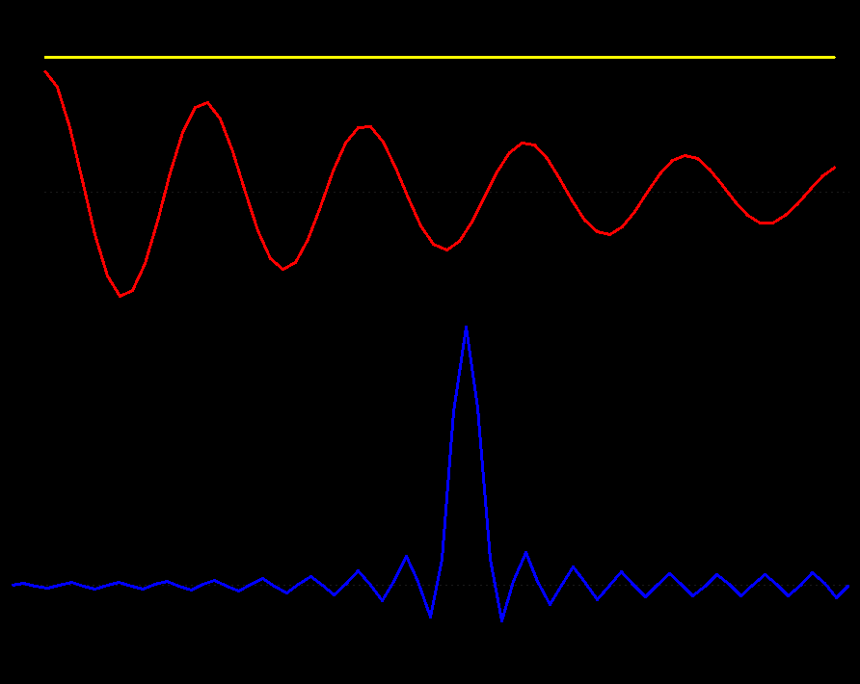
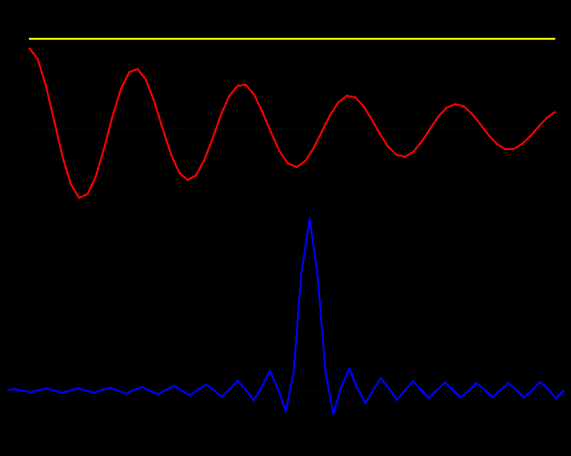
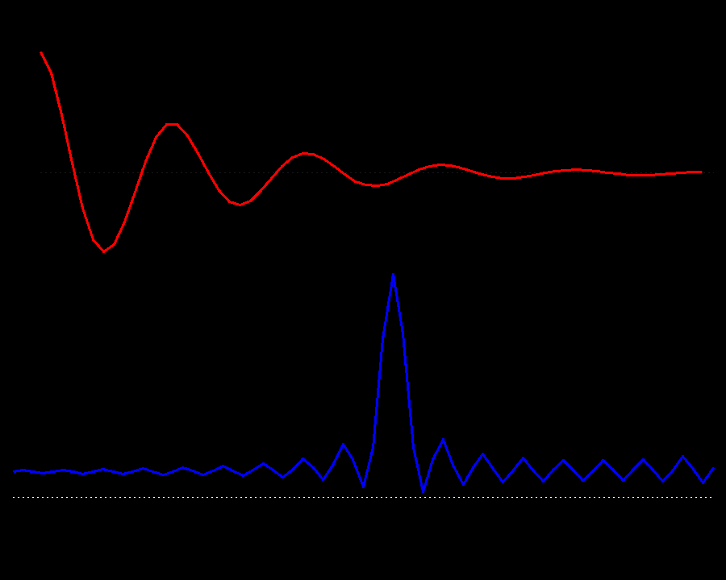
Line Broadening Window
Line Sharpening Window
First Point Scaling
Scaling the first point in the time-domain is equivalent to adding a constant in the frequency domain

Slide 69
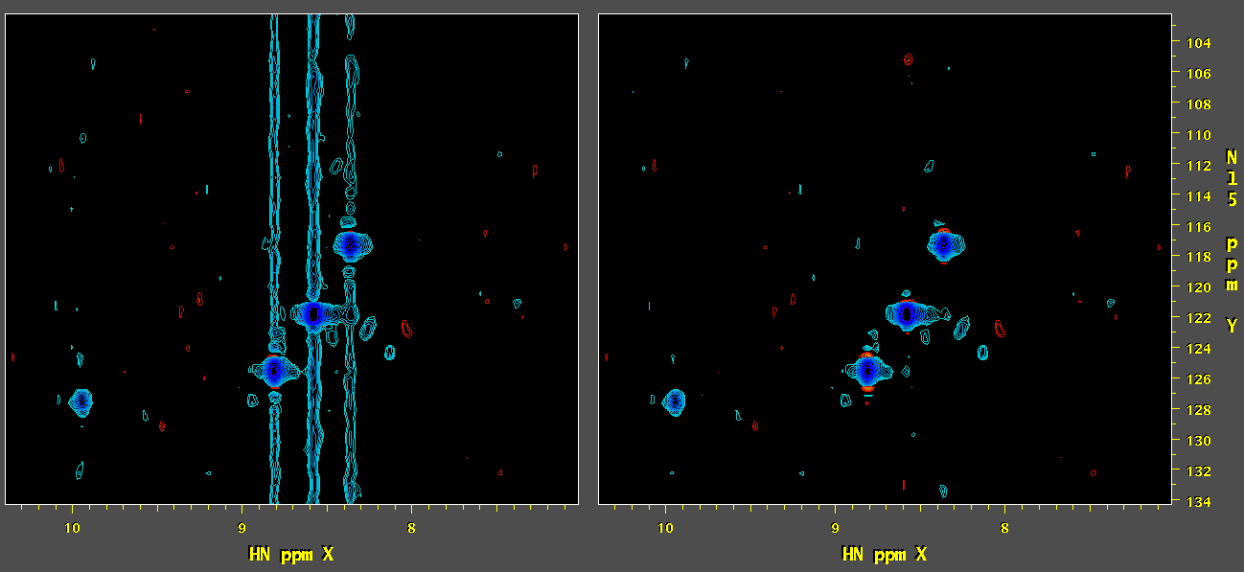
First Point Scaling in the Time-Domain – Same as Adding a Constant in the Frequency Domain – Scale by 0.5 if P1 = 0
-c 1.0
-c 0.5
| nmrPipe -fn SP -off 0.5 -end 0.98 -pow 1 –c 0.5 \
| nmrPipe -fn ZF -auto \
| nmrPipe -fn FT \
| nmrPipe -fn PS -p0 0 -p1 0 -di \

Slide 70
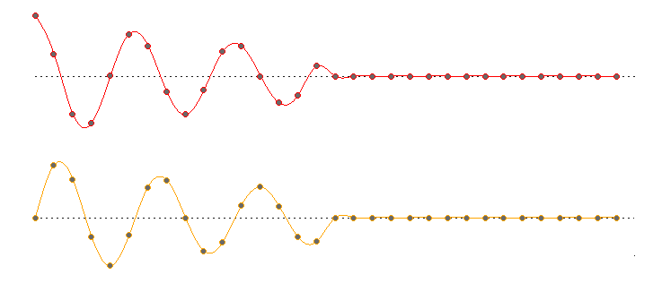
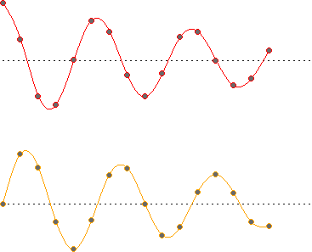
Zero Filling – Always Zero Fill at Least Once
Append Zeros to Give 2N Real Points + 2N Imaginary Points
N Real Points + N Imaginary Points = 2N Total Points

Slide 71
Zero Filling – Always Zero Fill at Least Once
Append Zeros to Give 2N Real Points + 2N Imaginary Points
N Real Points + N Imaginary Points = 2N Total Points
Fourier Transform
2N Real Points + 2N Imaginary Points
Delete
Imaginary Part
Real-Only Spectrum, 2N Total Points

Slide 72
Zero Filling – Always Zero Fill at Least Once
Append Zeros to Give 2N Real Points + 2N Imaginary Points
N Real Points + N Imaginary Points = 2N Total Points
Fourier Transform
2N Real Points + 2N Imaginary Points
For Inverse Processing, Restore
Imaginary Part
Via Hilbert Transform
Delete
Imaginary Part
Real-Only Spectrum, 2N Total Points

Slide 73
Rules of Thumb for Spectral Processing
If there is no acquisition delay (first order phase is zero), scale the first point of the time-domain data by 0.5 (nmrPipe window function option –c 0.5). In all other cases, leave the first point unchanged (nmrPipe window function option –c 1.0).
Set up the delays in your experiment carefully so that they are either zero, ½ point, or one point (first order phase of 0, 180 or 360). Any other case will lead to baseline distortion, phase distortion of folded peaks, and distortion of data if inverse processing.
If you don’t know the phase correction values, try to process with zero-order phase only. If first-order phase correction is needed, try values of P1 = 180 or 360 at first.
Always apply at least one zero fill. For speed, if desired, round up to a power of two:
nmrPipe –fn ZF –auto
If a spectral dimension is reversed, negate the imaginary part (nmrPipe –fn FT –neg). If a spectral dimension has the first and second parts rotated, negate alternating points (nmrPipe –fn FT –alt). Use FT options –neg and –alt together if needed.
When applying baseline correction, try to use a scheme where two of the dimensions are already Fourier transformed. Avoid baseline correction if it is not needed.
Try basic Fourier processing first, and confirm processing details such as phase correction before proceeding to special methods such as Linear Prediction.
When applying Linear Prediction, try to use a scheme where all other dimensions are Fourier transformed. For 3D and 4D, this means using schemes with inverse processing.

Slide 74
Some Examples of Processing:
Starting Point with a Correctly Processed Spectrum
cd demo/nus/bruker_nus/vd_format/std/cbcanh_std
fid.com
basicFT2.com -xP0 -82 -xEXTX1 10.4ppm -xEXTXN 5.4ppm -list > test.com
chmod a+rx test.com
test.com
nmrDraw
#!/bin/csh
#
# Generated by basicFT2.com Version 2016.263.13.16
nmrPipe -in fid/test001.fid \
| nmrPipe -fn SOL \
| nmrPipe -fn SP -off 0.50 -end 0.95 -pow 2 -c 0.5 \
| nmrPipe -fn ZF -zf 1 -auto \
| nmrPipe -fn FT -verb \
| nmrPipe -fn PS -p0 -82 -p1 0 -di \
| nmrPipe -fn EXT -x1 10.4ppm -xn 5.4ppm -sw \
| nmrPipe -fn TP \
| nmrPipe -fn SP -off 0.50 -end 0.95 -pow 1 -c 0.5 \
| nmrPipe -fn ZF -zf 1 -auto \
| nmrPipe -fn FT -verb \
| nmrPipe -fn PS -p0 0.0 -p1 0.0 -di \
| nmrPipe -fn TP \
| nmrPipe -fn POLY -auto -verb \
-out test.ft2 -ov

Slide 75
Some Examples of Processing:
Fourier Transform with Negation of Imaginaries
#!/bin/csh
nmrPipe -in fid/test001.fid \
| nmrPipe -fn SOL \
| nmrPipe -fn SP -off 0.50 -end 0.95 -pow 2 -c 0.5 \
| nmrPipe -fn ZF -zf 1 -auto \
| nmrPipe -fn FT -verb \
| nmrPipe -fn PS -p0 82 -p1 0 -di \
| nmrPipe -fn EXT -x1 10.4ppm -xn 5.4ppm -sw \
| nmrPipe -fn TP \
| nmrPipe -fn SP -off 0.50 -end 0.95 -pow 1 -c 0.5 \
| nmrPipe -fn ZF -zf 1 -auto \
| nmrPipe -fn FT –neg -verb \
| nmrPipe -fn PS -p0 0 -p1 0.0 -di \
| nmrPipe -fn TP \
| nmrPipe -fn POLY -auto -verb \
-out test.ft2 -ov
Some pulse sequences will give data that when transformed, will have the frequencies of a given dimension reversed. In these cases, the corresponding dimension should be Fourier transformed with the option nmrPipe –fn FT –neg (or basicFT2.com –yFTARG neg).

Slide 76
Some Examples of Processing:
Fourier Transform with Sign Alternation
#!/bin/csh
nmrPipe -in fid/test001.fid \
| nmrPipe -fn SOL \
| nmrPipe -fn SP -off 0.50 -end 0.95 -pow 2 -c 0.5 \
| nmrPipe -fn ZF -zf 1 -auto \
| nmrPipe -fn FT -verb \
| nmrPipe -fn PS -p0 82 -p1 0 -di \
| nmrPipe -fn EXT -x1 10.4ppm -xn 5.4ppm -sw \
| nmrPipe -fn TP \
| nmrPipe -fn SP -off 0.50 -end 0.95 -pow 1 -c 0.5 \
| nmrPipe -fn ZF -zf 1 -auto \
| nmrPipe -fn FT –alt -verb \
| nmrPipe -fn PS -p0 0 -p1 0.0 -di \
| nmrPipe -fn TP \
| nmrPipe -fn POLY -auto -verb \
-out test.ft2 -ov
Some pulse sequences will give data that when transformed, will have the two halves of a given dimension rotated. In these cases, the corresponding dimension should be Fourier transformed with the sign-alternation option:
nmrPipe –fn FT –alt (or basicFT2.com –yFTARG alt).
Sometimes, sign alternation must be used together with negation of imaginaries described previously:
nmrPipe –fn FT –alt -neg (or basicFT2.com –yFTARG alt,neg).

Slide 77
New: 3D Spectral Processing Scheme via a Single Command
basicFT3.com \
-xP0 43 -xP1 0 -xEXTX1 10.5ppm -xEXTXN 5.7ppm \
-yP0 -90 -yP1 180

Slide 78
New: 3D Spectral Processing Scheme via a Single Command
Adding Linear Prediction
basicFT3.com \
-xP0 43 -xP1 0 -xEXTX1 10.5ppm -xEXTXN 5.7ppm \
-yP0 -90 -yP1 180 –yLP fb –zLP fb,ord=12 -inv

Slide 79
New: 3D Spectral Processing Scheme via a Single Command
Adding NUS-Style Extrapolation via IST
basicFT3.com \
-xP0 43 -xP1 0 -xEXTX1 10.5ppm -xEXTXN 5.7ppm \
-yP0 -90 -yP1 180 –nusZF -ist

Slide 80
New: 3D Spectral Processing Scheme via a Single Command
Adding NUS-Style Extrapolation via SMILE
basicFT3.com \
-xP0 43 -xP1 0 -xEXTX1 10.5ppm -xEXTXN 5.7ppm \
-yP0 -90 -yP1 180 –nusZF -smile

Slide 81
New: 3D Spectral Processing Scheme via a Single Command
Process NUS Data with IST
ist3D.com \
-xP0 43 -xP1 0 -xEXTX1 10.5ppm -xEXTXN 5.7ppm \
-yP0 -90 -yP1 180

Slide 82
New: 3D Spectral Processing Scheme via a Single Command
Process NUS Data with SMILE
smile3D.com \
-xP0 43 -xP1 0 -xEXTX1 10.5ppm -xEXTXN 5.7ppm \
-yP0 -90 -yP1 180

Slide 83
New: Graphical Interface for Processing Script Generation

Slide 84
With Thanks to Our NMRPipe Collaborators
frank.delaglio@nist.gov
Karen Allen ● Luke Arbogast ● Yves Aubin ● Andrew Baldwin
Joseph Barchi ● Ad Bax ● Paul Bowyer ● Robert Brinson
James Chou ● Gabriel Cornilescu ● Stefano Ciurli ● Brian Coggins
Kathleen Farley ● David Fushman ● Michelle Gill ● George Gray
Alex Grishaev ● Stephan Grzesiek ● Jeff Hoch ● Sven Hyberts
Brad Jordan ● Lewis Kay Georg Kontaxis ● Krish Krishnamurthy
John Kuszewski ● Dong Long Massimo Lucci ● Mark Maciejewski
John Marino ● Ryan McKay ● Leszek Poppe ● John Pfeiffer
Ben Ramirez ● David Rovnyak ● Dave Russell ● Michael Shapiro
Adam Schuyler ● Evgeny Tishchenko ● Desi Tsao ● Tobias Ulmer
Gerteen Vuister ● Greg Walker ● Gerard Weatherby ● Justin Wu
Shen Yang ● Jinfa Ying ● Edward Zartler
Guang Zhu ● Markus Zweckstetter

Slide 85
How to Convert Data in NMRPipe
In a terminal window, cd to the data directory and type bruker or varian.
cd pipe_class/cbcaconh
bruker
Select the binary input, usually ser or fid.
Click Read Parameters.
Check the Temperature.
If an indirect dimension is gradient enhanced, set Acquisition Mode to Echo-AntiEcho. Set it to Complex otherwise.
The conversion step creates NMRPipe-format time-domain data from a given spectrometer format. During conversion, ppm calibration information for all dimensions is established too.
The NMRPipe conversion tools make a best guess about parameters, and the results have to be adjusted by hand. In particular, you’ll have to know which dimension of the experiment corresponds to which channel of the spectrometer (1H, 13C, 15N).
For indirect dimensions, adjust the Observe Freq MHz from the menu if needed.
Click Save Script.
Click Execute Script.

Slide 86
Chemical Shift Calibration According to H2O and Temperature
When the interface starts, Temperature is set to From File and Center Position for the X-Axis is set to H2O.
Click Read Parameters. This will update Temperature and Center Position values.
If the Temperature value is not correct, manually enter the correct value and perform the following steps …
Set the Center Position for the X-Axis back to H2O using the menu.
The default NMRPipe ppm calibration scheme assumes that the directly-detected dimension is 1H and is centered on the H2O resonance. It uses the known chemical shift of H2O at the given temperature to establish ppm values for the direct dimension, and propagates this information to the other dimensions.
Sometimes, the temperature extracted from the spectrometer parameter file is not correct, and has to be adjusted by hand. In these cases, the ppm calibration information has to be recomputed as described here.
Click Read Parameters a second time. This will update Center Position values according to the manually-entered temperature.

Slide 87
Script Created via the bruker Command
#!/bin/csh
bruk2pipe -in ./ser \
-bad 0.0 -aswap -AMX -decim 1680 -dspfvs 20 -grpdly 67.9866027832031 \
-xN 2048 -yN 64 -zN 320 \
-xT 1024 -yT 32 -zT 160 \
-xMODE DQD -yMODE Echo-AntiEcho -zMODE Complex \
-xSW 11904.762 -ySW 3846.154 -zSW 11904.762 \
-xOBS 950.204 -yOBS 96.294 -zOBS 950.204 \
-xCAR 4.773 -yCAR 118.579 -zCAR 4.773 \
-xLAB HN -yLAB 15N -zLAB 1H \
-ndim 3 -aq2D States \
-out ./fid/test%03d.fid -verb -ov

Slide 88
How to Convert NUS Data in NMRPipe
Select the binary spectrometer-format input data as usual.
Select the NUS Sampling Schedule Input File.
Choose options for best baseline.
Read Parameters
This will also read the NUS schedule, and extract information about sample count, dimension sizes, etc.

Slide 89
Script Created via bruker -nus
#!/bin/csh
nusExpand.tcl -mode bruker -sampleCount 2048 -off 0 \
-in ./ser -out ./ser_full -sample ./nuslist
bruk2pipe -in ./ser_full \
-bad 0.0 -aswap -AMX -decim 1680 -dspfvs 20 -grpdly 67.9866027832031 \
-xN 2048 -yN 64 -zN 320 \
-xT 1024 -yT 32 -zT 160 \
-xMODE DQD -yMODE Echo-AntiEcho -zMODE Complex \
-xSW 11904.762 -ySW 3846.154 -zSW 11904.762 \
-xOBS 950.204 -yOBS 96.294 -zOBS 950.204 \
-xCAR 4.773 -yCAR 118.579 -zCAR 4.773 \
-xLAB HN -yLAB 15N -zLAB 1H \
-ndim 3 -aq2D States \
-out ./fid/test%03d.fid -verb -ov
xyz2pipe -in ./fid/test%03d.fid \
| nusExpand.tcl -mask -noexpand -mode pipe -sampleCount 2048 -off 0 \
-in stdin -out ./mask/test%03d.fid -sample ./nuslist
Expand the Spectrometer-format Data / Convert Expanded Data / Create Mask

Slide 90
Script Created via varian -nus
#!/bin/csh
nusExpand.tcl -mode varian -sampleCount 455 -off 0 \
-in ./fid -out ./fid_full -sample ./sampling.sch
var2pipe -in ./fid_full \
-noaswap -aqORD 1 \
-xN 2404 -yN 140 -zN 52 \
-xT 1202 -yT 70 -zT 26 \
-xMODE Complex -yMODE Complex -zMODE Rance-Kay \
-xSW 12019.231 -ySW 7000.000 -zSW 1320.000 \
-xOBS 599.422 -yOBS 599.422 -zOBS 60.746 \
-xCAR 4.770 -yCAR 4.770 -zCAR 118.178 \
-xLAB HN -yLAB 1H -zLAB N15 \
-ndim 3 -aq2D States \
-out ./data/test%03d.fid -verb -ov
xyz2pipe -in ./data/test%03d.fid \
| nusExpand.tcl -mask -noexpand -mode pipe -sampleCount 455 -off 0 \
-in stdin -out ./mask/test%03d.fid -sample ./sampling.sch
Expand the Spectrometer-format Data / Convert Expanded Data / Create Mask

Slide 91
Output of NMRPipe NUS Conversion
Sorted, expanded time-domain data, arranged like conventional data but with the increments that were skipped filled in with zeros
Corresponding mask of ones and zeros, used as additional input for NMRPipe reconstruction tools

Slide 92
How to Process NUS Data in NMRPipe
It is recommended to apply trial processing of the expanded time-domain NUS data using ordinary Fourier transform (FT) schemes, to confirm details such as phase correction before more time-consuming reconstruction is used. General-purpose scripts basicFT2.com … are provided to help with this step, and for convenience, the IST scripts ist2D.com … use similar arguments. For 3D and 4D NUS data, viewing 2D projections of the trial FT result is helpful for evaluating processing parameters.
Trial Fourier processing of complete NUS 3D:
basicFT3.com \
-in fid/test%03d.fid -out ft/test%03d.ft3 \
-xP0 -75 -xP1 0 -xEXTX1 10.4ppm -xEXTXN 5.4ppm \
-zFTARG alt
Generate and inspect 2D projections from 3D FT to confirm processing parameters:
proj3D.tcl -in ft/test%03d.ft3 -abs
Process with IST using the verified processing parameters:
ist3D.com –istMaxRes Auto \
-in fid/test%03d.fid -mask mask/test%03d.fid -out ist/test%03d.ft3 \
-xP0 -75 -xP1 0 -xEXTX1 10.4ppm -xEXTXN 5.4ppm \
-zFTARG alt

Slide 93
Some Examples of Processing:
Y-Axis First-Point Time Domain Scaling Not Set Properly
#!/bin/csh
nmrPipe -in fid/test001.fid \
| nmrPipe -fn SOL \
| nmrPipe -fn SP -off 0.50 -end 0.95 -pow 2 -c 0.5 \
| nmrPipe -fn ZF -zf 1 -auto \
| nmrPipe -fn FT -verb \
| nmrPipe -fn PS -p0 82 -p1 0 -di \
| nmrPipe -fn EXT -x1 10.4ppm -xn 5.4ppm -sw \
| nmrPipe -fn TP \
| nmrPipe -fn SP -off 0.50 -end 0.95 -pow 1 -c 1.0 \
| nmrPipe -fn ZF -zf 1 -auto \
| nmrPipe -fn FT -verb \
| nmrPipe -fn PS -p0 0 -p1 0.0 -di \
| nmrPipe -fn TP \
| nmrPipe -fn POLY -auto -verb \
-out test.ft2 -ov
If the first point of the time-domain data is not adjusted properly, it will result in constant-offset baseline distortions in the corresponding spectrum, here shown as a vertical streak.
The rule for adjustment is simple:
If the dimension needs first order phase of zero (PS -p1 0) scale the first point in the time domain by half (window function –c 0.5).
In all other cases, do not adjust the first point (window function –c 1.0).

Slide 94
Some Examples of Processing:
Comment out Region Extraction
#!/bin/csh
nmrPipe -in fid/test001.fid \
| nmrPipe -fn SOL \
| nmrPipe -fn SP -off 0.50 -end 0.95 -pow 2 -c 0.5 \
| nmrPipe -fn ZF -zf 1 -auto \
| nmrPipe -fn FT -verb \
| nmrPipe -fn PS -p0 -82 -p1 0 -di \
#| nmrPipe -fn EXT -x1 10.4ppm -xn 5.4ppm -sw \
| nmrPipe -fn TP \
| nmrPipe -fn SP -off 0.50 -end 0.95 -pow 1 -c 0.5 \
| nmrPipe -fn ZF -zf 1 -auto \
| nmrPipe -fn FT -verb \
| nmrPipe -fn PS -p0 0.0 -p1 0.0 -di \
| nmrPipe -fn TP \
| nmrPipe -fn POLY -auto -verb \
-out test.ft2 -ov
For many kinds of spectra, only a limited chemical shift range of the directly-detected dimension will contain useful signals. In these cases, we commonly extract a smaller range of chemical shifts immediately after the directly-detected dimension has been Fourier processed.
When practical, we choose region limits that avoid the solvent signal, and contain “extra space” so that no peaks lie along the edges of the selected region.

Slide 95
Some Examples of Processing:
X-Axis Phase Correction not Set Properly
#!/bin/csh
nmrPipe -in fid/test001.fid \
| nmrPipe -fn SOL \
| nmrPipe -fn SP -off 0.50 -end 0.95 -pow 2 -c 0.5 \
| nmrPipe -fn ZF -zf 1 -auto \
| nmrPipe -fn FT -verb \
| nmrPipe -fn PS -p0 0 -p1 0 -di \
| nmrPipe -fn EXT -x1 10.4ppm -xn 5.4ppm -sw \
| nmrPipe -fn TP \
| nmrPipe -fn SP -off 0.50 -end 0.95 -pow 1 -c 0.5 \
| nmrPipe -fn ZF -zf 1 -auto \
| nmrPipe -fn FT -verb \
| nmrPipe -fn PS -p0 0.0 -p1 0.0 -di \
| nmrPipe -fn TP \
| nmrPipe -fn POLY -auto -verb \
-out test.ft2 -ov

Slide 96
Some Examples of Processing:
Y-Axis 90 Degrees out of Phase
#!/bin/csh
nmrPipe -in fid/test001.fid \
| nmrPipe -fn SOL \
| nmrPipe -fn SP -off 0.50 -end 0.95 -pow 2 -c 0.5 \
| nmrPipe -fn ZF -zf 1 -auto \
| nmrPipe -fn FT -verb \
| nmrPipe -fn PS -p0 82 -p1 0 -di \
| nmrPipe -fn EXT -x1 10.4ppm -xn 5.4ppm -sw \
| nmrPipe -fn TP \
| nmrPipe -fn SP -off 0.50 -end 0.95 -pow 1 -c 0.5 \
| nmrPipe -fn ZF -zf 1 -auto \
| nmrPipe -fn FT -verb \
| nmrPipe -fn PS -p0 90 -p1 0.0 -di \
| nmrPipe -fn TP \
| nmrPipe -fn POLY -auto -verb \
-out test.ft2 -ov

Slide 97
Solvent Subtraction
Polynomial Subtraction: nmrPipe –fn POLY –time
Original Data
Polynomial Fit (4th Order)
Corrected Result
Convolution Difference: nmrPipe –fn SOL
Original Data
Moving Average
Corrected Result
Polynomial solvent subtraction (POLY –time) is only suitable for “simple” solvent signals.
SOL is general-purpose, but often gives worse baseline near the residual solvent signal.
Both functions require the solvent signal to be in the center of the spectrum.
If needed, the solvent position can be moved by temporarily shifting the data.

Slide 98
Some Examples of Processing:
Solvent Filter and Baseline Correction Commented Out
#!/bin/csh
nmrPipe -in fid/test001.fid \
#| nmrPipe -fn SOL \
| nmrPipe -fn SP -off 0.50 -end 0.95 -pow 2 -c 0.5 \
| nmrPipe -fn ZF -zf 1 -auto \
| nmrPipe -fn FT -verb \
| nmrPipe -fn PS -p0 82 -p1 0 -di \
| nmrPipe -fn EXT -x1 10.4ppm -xn 5.4ppm -sw \
| nmrPipe -fn TP \
| nmrPipe -fn SP -off 0.50 -end 0.95 -pow 1 -c 0.5 \
| nmrPipe -fn ZF -zf 1 -auto \
| nmrPipe -fn FT -verb \
| nmrPipe -fn PS -p0 0 -p1 0.0 -di \
| nmrPipe -fn TP \
#| nmrPipe -fn POLY -auto -verb \
-out test.ft2 -ov

Slide 99
Some General Points on Using nmrDraw
cd demo/nus/bruker_nus/vd_format/std/cbcanh_std
fid.com
basicFT2.com -xP0 -82
nmrDraw
The top window border lists what the LEFT MIDDLE and RIGHT mouse buttons can do. They generally perform one set of actions when the mouse pointer is inside the spectral graphics area, and another set of actions when the mouse pointer is outside, where the axis labels are drawn.
The Command Panel has menu buttons. Hold the RIGHT mouse button to display the menu. Click the LEFT mouse button to select the default option (the first menu item) without displaying the menu. Each menu entry also lists a single letter keyboard shortcut.
Use the mouse Scroll Wheel outside the graphics area to adjust the contour levels and redraw the data. Use the wheel inside the graphics area to change the plane being viewed for 3D or 4D data.
The Mouse Menu turns on interactive modes like drawing 1D traces or performing 2D Zooming.

Slide 100
Some Examples of Processing:
Appearance if Acquisition Mode is not Specified Correctly
If an indirect dimension is gradient enhanced, set Acquisition Mode to Echo-AntiEcho. Set it to Complex otherwise.
If this is set incorrectly, the given dimension will contain “mirror image” signals.

Slide 101
Convolution: a Moving Average

Slide 102
Convolution: the Kernel is a Sum of Impulses

Slide 103
^{X( f ) =} Σ x( t ) [ cos( 2πft / N ) - i sin( 2πft / N ) ]
Each Fourier term corresponds to a point in the spectrum.

Slide 104
Convolution: Each Impulse in the Kernel is a Fourier Term

Slide 106
Even though the underlying signal is the same in all of these examples, and noise-free, Fourier transforms with small numbers of points give very broad lines and large artifacts.

Slide 107
Linear Prediction (LP)
Form a Linear Combination of Points to Predict the Next Point
Each complex LP coefficient describes a signal.
The number of LP coefficients is limited to size/2.

Slide 108
Fourier Transforming One Dimension Makes Significant Signal Content in the Remaining Dimensions More Sparse
So … Only Apply Linear Prediction When All Other Dimensions Have Been Transformed …

Slide 109
Process X and Y
Linear Predict and Process Z
Inverse Process, Linear Predict, and Reprocess Y
13C Time
13C Time
15N Time
15N Freq
FT
LP in 13C
LP in 13C and 15N

Slide 110
Multidimensional Spectral Processing Schemes as a UNIX Pipelines

Slide 111
Other Important Functions in NMRPipe
Solvent Subtraction
Linear Prediction
Hilbert Transform (Restores Imaginary Part)
Extraction of a Region
Matrix Transpose (Exchange X and Y Dimensions)
Baseline Correction (Automated Version)
nmrPipe –fn SOL
nmrPipe –fn POLY -time
nmrPipe –fn LP –fb –ord …
nmrPipe –fn HT
nmrPipe –fn EXT
nmrPipe –fn TP
nmrPipe –fn POLY -auto

Slide 112
Processing Functions for nmrPipe –fn …
SOL Time-domain Solvent Subtraction by Convolution and Subtraction
POLY –time Time-domain Solvent Subtraction by Polynomial Fitting and Subtraction
SP Window Function and First Point Scaling (-c 0.5 or –c 1.0)
ZF Zero Fill (-auto rounds to power of two)
FT Fourier Transform
PS Phase Correction (-di deletes imaginaries after)
EXT Extraction of a Chemical Shift Range
POLY -auto Automated Baseline Correction by Polynomial Fitting and Subtraction
HT Hilbert Transform (reconstruct previously deleted imaginary data)
TP Exchange X-Axis and Y-Axis (also called YTP) for 2D, 3D, or 4D Data
ZTP Exchange X-Axis and Z-Axis for 3D and 4D Data
ATP Exchange X-Axis and A-Axis for 4D Data
LP Linear Prediction (extend or replace time-domain data)
MEM Maximum Entropy Reconstruction
ML Maximum Likelihood Frequency Map
SMILE SMILE Reconstruction
COADD Weighted Co-Addition of Adjacent Vectors for Interleaved Data
MAC NMRPipe’s Macro Language for Simple Custom Processing Functions

Slide 113
Listing Command Line Options: nmrPipe –help –fn …
% nmrPipe -help -fn ZF
ZF: Extend By Zero Filling;
Use only one of the following:
-zf zfCnt [1] Number of Times to Double the Size.
-pad padCnt Zeros to Add.
-size finSize Final Size.
Other Flags:
-mid Zero Fill in Middle.
-inter Zero Fill by zfCount Between Points.
-auto Round Final Size to Power of 2.
Removing Previous Zero Filling:
-inv Extract Original Time Domain.
Set Time-Domain Size for Zero Fill Extrapolation:
-td Set Time-Domain Size to Zero Fill Size.
-notd Do Not Change Time-Domain Size (Default).

Slide 114
Rearrangement of Dimensions
Transpose Functions Exchange Dimensions
nmrPipe –fn TP
X Y Z A
Y X Z A
Exchange X and Y
nmrPipe –fn ZTP
X Y Z A
Z Y X A
Exchange X and Z
nmrPipe –fn ATP
Exchange X and A
(usually not practical because of memory requirements)
X Y Z A
A Y Z X

Slide 115
Rearrangement of Dimensions
xyz2pipe Shifts the Order of Dimensions
xyz2pipe –x
X Y Z A
X Y Z A
No change
xyz2pipe –y
X Y Z A
Y X Z A
Same as TP
xyz2pipe –z
X Y Z A
Z X Y A
Not Same as ZTP
xyz2pipe –a
X Y Z A
A X Y Z
Not Same as ATP

Slide 116
Rearrangement of Dimensions
pipe2xyz Shifts the Order of Dimensions, Complementary to xyz2pipe
pipe2xyz –x
X Y Z A
X Y Z A
pipe2xyz –y
X Y Z A
Y X Z A
pipe2xyz –z
X Y Z A
Y Z X A
pipe2xyz –a
X Y Z A
Y Z A X

Slide 117
Rearrangement of Dimensions
xyz2pipe | pipe2xyz to Conserve the Order of Dimensions
xyz2pipe –x |
pipe2xyz –x
Final Order:
X Y Z A
X Y Z A
X Y Z A
xyz2pipe –y |
pipe2xyz –y
X Y Z A
Y X Z A
X Y Z A
xyz2pipe –z |
pipe2xyz –z
X Y Z A
Z X Y A
X Y Z A
xyz2pipe –a |
pipe2xyz –a
X Y Z A
A X Y Z
X Y Z A

Slide 118
New General-Purpose Processing and Script Generation: Linear Prediction Options
This:
basicFT3.com -in fid/test%03d.fid -out lp/test%03d.ft3 \
-xP0 43 -xP1 0 -yP0 -135 -yP1 180 \
-yLP fb,ord=12 -zLP fb -inv
takes the place of this:
xyz2pipe -in fid/test%03d.fid -x -verb \
| nmrPipe -fn SOL \
| nmrPipe -fn SP -off 0.5 -end 0.95 -pow 2 -c 0.5 \
| nmrPipe -fn ZF -zf 1 -auto \
| nmrPipe -fn FT \
| nmrPipe -fn PS -p0 43 -p1 0 -di \
| nmrPipe -fn EXT -x1 3% -xn 47% -sw \
| nmrPipe -fn TP \
| nmrPipe -fn SP -off 0.50 -end 0.95 -pow 1 -c 1.0 \
| nmrPipe -fn ZF -zf 1 -auto \
| nmrPipe -fn FT \
| nmrPipe -fn PS -p0 -135 -p1 180 -di \
| nmrPipe -fn TP \
| nmrPipe -fn POLY -auto \
| pipe2xyz -out ft2/test%03d.ft2 -x –ov
xyz2pipe -in ft2/test%03d.ft2 -z -verb \
| nmrPipe -fn LP -fb \
| nmrPipe -fn SP -off 0.50 -end 0.95 -pow 1 -c 0.5 \
| nmrPipe -fn ZF -zf 1 -auto \
| nmrPipe -fn FT \
| nmrPipe -fn PS -p0 0.0 -p1 0.0 -di \
| pipe2xyz -out lp1/test%03d.lp1 -z -ov
xyz2pipe -in lp1/test%03d.lp1 -y -verb \
| nmrPipe -fn HT -auto \
| nmrPipe -fn PS -inv -hdr \
| nmrPipe -fn FT -inv \
| nmrPipe -fn ZF -inv \
| nmrPipe -fn SP -inv -hdr \
| nmrPipe -fn LP -fb -ord 12 \
| nmrPipe -fn SP -hdr \
| nmrPipe -fn ZF -zf 1 -auto \
| nmrPipe -fn FT \
| nmrPipe -fn PS -hdr -di \
| pipe2xyz -out lp/test%03d.ft3 -y -ov

Slide 119
The Mystery of First Point Scaling Explained Vaguely

Slide 120
Forward Fourier Transform: exp( -i 2πft ) = cos( 2πft ) - i sin( 2πft )
Inverse Fourier Transform: exp( i 2πft ) = cos( 2πft ) + i sin( 2πft )
t = 0
f = 0

Slide 121
The Discrete Fourier Transform is Cyclic …

Slide 122
The Discrete Fourier Transform is Cyclic …
As Signals Get Faster Than The Sampling Frequency …

Slide 123
The Discrete Fourier Transform is Cyclic …
As Signals Get Faster Than the Sampling Frequency …
They Look Like Low Frequencies Again

Slide 124
t = 0
f = 0

Slide 125
t = 0
. . .
. . .
. . .
. . .
f = 0

Slide 126
First Order Phase Correction (P1)

Slide 127
First Order Phase Correction (P1)

Slide 128
Delay Relative to Interval Between Samples (dT)
No Delay
P1 = 0
½ dT Delay
P1 = 180
¼ dT Delay
P1 = 90

Slide 129
No Delay
P1 = 0: All the intervals are dT, but the t=0 point occurs twice. Remedy: scale the t=0 point by ½.
½ dT Delay
P1 = 180: All the intervals are dT, and t = ½ matches its partner t = -½. All is well!
Other Delay, for example ¼ dT
One interval is ½ dT, but the others are dT. Baseline distortion results. Hilbert transform is imperfect.

Slide 130
First Point Scaling in the Time-Domain – Same as Adding a Constant in the Frequency Domain
-c 1.0
-c 0.5
| nmrPipe -fn SP -off 0.5 -end 0.98 -pow 1 –c 0.5 \
| nmrPipe -fn ZF -auto \
| nmrPipe -fn FT \
| nmrPipe -fn PS -p0 0 -p1 0 -di \

Slide 131
NIST Disclaimer: Certain commercial equipment, instruments, and materials are identified in this presentation in order to specify the experimental procedure. Such identification does not imply recommendation or endorsement by the National Institute of Standards and Technology, nor does it imply that the material or equipment identified is necessarily the best available for the purpose.

Slide 132
NMRPipe is Provided by the National Institute of Standards and Technology in Partnership with the National Institutes of Health
www.nmrpipe.com
NMRPipe: a multidimensional spectral processing system based on UNIX pipes. Frank Delaglio, Stephan Grzesiek, Geerten. W. Vuister, Guang Zhu, John Pfeifer, and Ad Bax, J. Biomol. NMR. 6, 277-293 (1995).

Slide 133
Thank You

Slide 134
Systems Check

Slide 135
The Fourier Transform with the Both the Real and Imaginary Parts Shown …

Slide 136
Σ+
Σ-

Slide 137
Σ+
Σ-

Slide 138
Σ+
Σ-

Slide 139
Combined, the Real and Imaginary Parts Distinguish Between Positive and Negative Frequencies …
+
=

Slide 140
Important Attributes of the Fourier Transform
F( a_{t} ) = A_{f}
the Fourier Transform of a_{t} is A_{f}
F( b_{t} ) = B_{f}
the Fourier Transform of b_{t} is B_{f}
F( a_{t}+ b_{t} ) = A_{f} + B_{f}
Linearity
F( c ● a_{t} ) = c ● A_{f}
Scaling
F( a_{t = 0} ) = ΣA_{f}
First Point Theorem
Σ| a_{t}|² ∝ Σ| A_{f} |²
Parseval’s Theorem
F( a_{t+Δ} ) = exp( -i 2πΔ ) A_{f}
Shift Theorem (Phasing)
F( a_{t} ● b_{t} ) = A_{f} * B_{f}
Convolution Theorem

Slide 141
Important Attributes of the Fourier Transform
The Sum of the Fourier Transforms is the Fourier Transform of the Sum
F( a_{t} ) = A_{f}
The Fourier Transform of a_{t} is A_{f}
F( b_{t} ) = B_{f}
The Fourier Transform of b_{t} is B_{f}
F( a_{t}+ b_{t} ) = A_{f} + B_{f}
Linearity
F( c ● a_{t} ) = c ● A_{f}
Scaling
N - 1
X(f) =
Σ
x(t) e ^{–2π i f t / N}
f = 0
x(t) = a(t) + b(t)
x(t) = c ● a(t)

Slide 142
Important Attributes of the Fourier Transform
The First Point in the Time Domain is Equal to the Sum of Points in the Frequency Domain
F( a_{t = 0} ) = ΣA_{f}
First Point Theorem
N - 1
Σ
X(f) [ cos( 2π f t / N ) + i sin( 2π f t / N ) ]
x(t) =
f = 0
N - 1
Σ
X(f) [ cos( 0 ) + i sin( 0) ]
x(0) =
f = 0
N - 1
Σ
X(f)
x(0) =
f = 0

Slide 143
Important Attributes of the Fourier Transform
The Total Magnitude of the Time Domain is Proportional to the Total Magnitude of the Frequency Domain
Σ| a_{t}|² ∝ Σ| A_{f}|²
Parseval’s Theorem
N - 1
X(f) =
Σ
x(t) [ cos( 2π f t / N ) - i sin( 2π f t / N ) ]
f = 0
Every term added together to give X(f) in the FT is of this form.
c [ cos( r ) - i sin( r ) ]
| c² | |[ cos( r ) - i sin( r ) ] |²
The squared absolute value of these Fourier terms will always be 1.

Slide 144
Important Attributes of the Fourier Transform
The Fourier Transform of a Product of Two Series is the Convolution of the Fourier Transforms of the Two Series
F( a_{t} ) = A_{f}
the Fourier Transform of a_{t} is A_{f}
F( b_{t} ) = B_{f}
the Fourier Transform of b_{t} is B_{f}
Convolution Theorem:
Forming a product in one domain is equivalent to forming a convolution in the other.
F( a_{t} ● b_{t} ) = A_{f} * B_{f}
N - 1
Σ
A_{f} B_{(f-m) mod N}
A_{f} * B_{f} =
m = 0
Each point in the convolution is a sum over a product of the entire series, with one series shifted with respect to the other. The shifted series is often called the convolution kernel.

Slide 145
Spectral Matrix Decomposition

Slide 146
Thank You

Slide 147
Spectral Matrix Decomposition: Each Multidimensional NMR Signal is the Product of 1D Vectors
=
=
+
=

Slide 148
Spectral Matrix Decomposition by Principal Component Analysis (PCA)
Find the 1D vectors that minimize the least squares difference between their 2D product and the original data.

Slide 149
Spectral Matrix Decomposition by Principal Component Analysis (PCA)
=
+
Find the 1D vectors that minimize the least squares difference between their 2D product and the original data.
Compute the residual and repeat.

Slide 150
Spectral Matrix Decomposition Example: 2D 15N/13C Plane from a 3D CBCA(CO)NH Spectrum
Original Data

Slide 151
Spectral Matrix Decomposition Example: 2D 15N/13C Plane from a 3D CBCA(CO)NH Spectrum
Residual After 1 Component

Slide 152
Spectral Matrix Decomposition Example: 2D 15N/13C Plane from a 3D CBCA(CO)NH Spectrum
Residual After 2 Components

Slide 153
Spectral Matrix Decomposition Example: 2D 15N/13C Plane from a 3D CBCA(CO)NH Spectrum
Residual After 3 Components

Slide 154
Spectral Matrix Decomposition Example: 2D 15N/13C Plane from a 3D CBCA(CO)NH Spectrum
Residual After 4 Components

Slide 155
Spectral Matrix Decomposition Example: 2D 15N/13C Plane from a 3D CBCA(CO)NH Spectrum
Residual After 5 Components

Slide 156
Spectral Matrix Decomposition Example: 2D 15N/13C Plane from a 3D CBCA(CO)NH Spectrum
Residual After 6 Components

Slide 157
Spectral Matrix Decomposition Example: 2D 15N/13C Plane from a 3D CBCA(CO)NH Spectrum
Residual After 7 Components

Slide 158
Spectral Matrix Decomposition Example: 2D 15N/13C Plane from a 3D CBCA(CO)NH Spectrum
Residual After 8 Components

Slide 159
Spectral Matrix Decomposition Example: 2D 15N/13C Plane from a 3D CBCA(CO)NH Spectrum
Original Data
Sum of Components 1 to 8

Slide 160
NMRPipe is Provided by the National Institute of Standards and Technology in Partnership with the National Institutes of Health
www.nmrpipe.com
NMRPipe: a multidimensional spectral processing system based on UNIX pipes. Frank Delaglio, Stephan Grzesiek, Geerten. W. Vuister, Guang Zhu, John Pfeifer, and Ad Bax, J. Biomol. NMR. 6, 277-293 (1995).

Slide 161
1980
About Frank . . .
1985
1990
1995
2000
2005
2010
2015 ...

