Slide 1

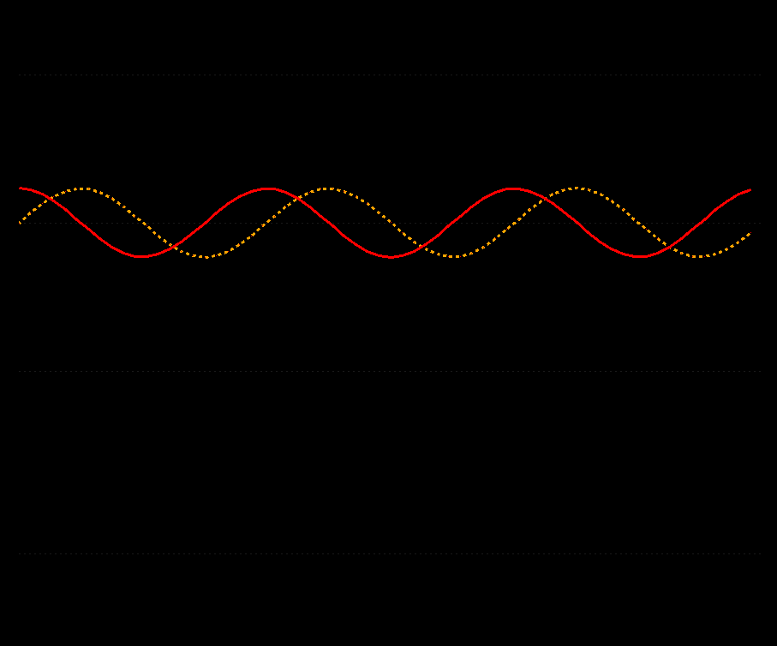



Spectral Processing of Conventional and Non-Uniformly Sampled NMR Spectra
frank.delaglio@nist.gov
NMRbox.org
N M R P i p e
www.nmrpipe.com
frank.delaglio@nist.gov
Updated 10/2/2021 v48

Slide 2





Acknowledgements
Karen Allen ● Amanda Altieri ● Luke Arbogast ● Dimitris Argyropoulos ● Yves Aubin ● Andrew Baldwin
Joseph Barchi ● Ad Bax ● Niksa Blonder ● Paul Bowyer ● Robert Brinson ● Andrew Byrd ● James Chou
Gabriel Cornilescu ● Stefano Ciurli ● Brian Coggins ● David Donoho ● Kyle East ● Art Edison ● Korth Elliott
Ryan Evans ● Kathleen Farley ● David Fushman ● Michelle Gill ● George Gray ● Alex Grishaev
Stephan Grzesiek ● Jeff Hoch ● Sven Hyberts ● Brad Jordan ● Lewis Kay ● Anthony Kearsley
Georg Kontaxis ● Krish Krishnamurthy ● John Kuszewski ● George Lisi ● Dong Long ● Massimo Lucci
Mark Maciejewski ● John Marino ● Ryan McKay ● Parker Nichols ● Liz O’Day ● Vardan Papyan ● Leszek Poppe
John Pfeiffer ● Yulia Pustovalova ● Ben Ramirez ● David Rovnyak ● Dave Russell ● Michael Shapiro
Chris Schanzle ● Adam Schuyler ● David Sheen ● Vincent Shen ● Evgeny Tishchenko ● Desi Tsao
Tobias Ulmer ● Jeff Ventrella ● Beat Vogeli ● Gerteen Vuister ● Greg Walker ● Gerard Weatherby
Mats Wikstroem ● Waltraud Wolfson ● Justin Wu ● Shen Yang ● Jinfa Ying ● Edward Zartler ● Guang Zhu Markus Zweckstetter
NMRbox.org
frank.delaglio@nist.gov
www.nmrpipe.com

Slide 3
Spectral Processing and Analysis in NMRPipe
Some Related Online Resources:
www.ibbr.umd.edu/nmrpipe NMRPipe Installation and Demo Files
www.youtube.com/watch?v=U268HggjRKE Lecture about Non-Uniform Sampling Concepts
www.youtube.com/watch?v=kAni_LOXWZA NMRPipe Conversion and Processing Demo
nmrbox.org/pages/workshop-2019 NMRbox Workshop (Lecture and Software Demo)
NMRbox.org
frank.delaglio@nist.gov
www.nmrpipe.com

Slide 4
Spectral Processing and Analysis in NMRPipe
Special Cases
Key Steps of Spectral Processing
Gradient-Enhanced Data
Interleaved Experiments and Spectral Series
Non-Uniform Sampling and Alternatives to Fourier Transform
Correction of Bad Points
Window function and first point scaling
Zero Fill
Fourier Transform
Phase Correction
Post-Processing
Other Common Spectral Processing Tasks
Generating 2D Projections from 3D or 4D Spectra
Viewing 2D Strips from 3D Spectra
Peak Detection and Modeling (Quantification) of Spectra and Spectral Series
Extracting Chemical Shift Evolutions from Spectral Series
Multivariate Analysis of Spectral Series
Extracting Structure from Chemical Shifts and Dipolar Couplings
Solvent Subtraction
Baseline Correction
Linear Prediction
Hilbert Transform and Inverse Processing
NMRbox.org
frank.delaglio@nist.gov
www.nmrpipe.com

Slide 5
About Non-Uniform Sampling
Non-Uniform Sampling (NUS) is an acquisition method for multidimensional NMR spectra that works by skipping some fraction of the data that would be acquired in a conventional measurement, which is uniformly sampled (US).
The goal of NUS is to improve the spectral resolution (or other metric of spectral quality) obtained with a given amount of measurement time.
In any sampling scheme, conventional or NUS, the number of increments must be sufficient for the number of signals, and the measurement time must be sufficient to capture the desired signal to noise.
Within the above constraints, NUS gives us the opportunity to set the number of increments measured independently of the desired resolution. This means we can improve resolution with a given amount of measurement time or retain resolution with a shorter measurement time.
In cases of indirect dimensions with decaying signals, it may be also be possible to use NUS to sample more densely during the early, more intense parts of the signal, leading to signal-to-noise improvements.
Because some of the data is skipped in a NUS acquisition, the usual Fourier transform processing used for conventional data is not ideal, and so other reconstruction methods are required to take best advantage of NUS.

Slide 6
About Non-Uniform Sampling
As mentioned, there are many tools for reconstructing NUS data, including Matrix Decomposition (MDD software, Orekhov et al.), Maximum Entropy (RNMRTK, Hoch et al.), Iterative Soft Thresholding (IST) (hmsIST, Hyberts and Wagner, and also applications from Stern, Donoho, Hoch et al.), SCRUB (Coggins and Zhou), NESTA (Sun, Gill, Byrd et al.), SSA (Kosiński, Koźmiński, et al.) and SMILE (Ying and Bax). Most of these tools use NMRPipe as part of the reconstruction workflow.
NMRPipe includes its own implementation of IST, so that it is easy to perform all the steps needed for reconstruction of 2D, 3D, and 4D data.
This presentation explains NUS, and the reconstruction methods IST and SMILE that are implemented in NMRPipe.
This presentation also shows how to use NMRPipe to convert and process NUS NMR data, and how to apply NUS reconstruction methods to conventional data as an alternative to Linear Prediction.
In addition, NMRPipe includes tools for resampling conventionally measured data according to a NUS schedule for demonstration and evaluation purposes. This presentation shows how use these tools to create NUS data from conventional data.

Slide 7
Some Related References
AS Stern, DL Donoho, and JC Hoch: NMR data processing using iterative thresholding and minimum l(1)-norm reconstruction. J Magn Reson., 188, 295-300 (2007).
SG Hyberts, K Takeuchi, and G Wagner: Poisson-gap sampling and forward maximum entropy reconstruction for enhancing the resolution and sensitivity of protein NMR data. J Am Chem Soc., 132, 2145-2147 (2010).
V Orekhov and VA Jaravine: Analysis of non-uniformly sampled spectra with Multi-Dimensional Decomposition. Progress in Nuclear Magnetic Resonance Spectroscopy, 59, 271-292 (2011).
BE Coggins, JW Werner-Allen, A Yan, and P Zhou: Rapid Protein Global Fold Determination Using Ultrasparse Sampling, High-Dynamic Range Artifact Suppression, and Time-Shared NOESY. J. Am. Chem. Soc., 134, 18619-18630 (2012).
K Kazimierczuk and V Orekhov: A comparison of convex and non-convex compressed sensing applied to multidimensional NMR. J Magn Reson., 223, 1-10 (2012).
SG Hyberts, AG Milbradt, AB Wagner, H Arthanari, and G Wagner: Application of iterative soft thresholding for fast reconstruction of NMR data non-uniformly sampled with multidimensional Poisson Gap scheduling. J Biomol NMR., 52, 315-27 (2012).
SG Hyberts, H Arthanari, SA Robson, and G Wagner: Perspectives in magnetic resonance: NMR in the post-FFT era. J Magn Reson., 241, 60-73 (2014).
JC Hoch, MW Maciejewski, M Mobli, AD Schuyler, and AS Stern: Nonuniform sampling and maximum entropy reconstruction in multidimensional NMR. Acc Chem Res., 47, 708-17 (2014).
S Sun, M Gill, Y Li, M Huang, and RA Byrd: Efficient and generalized processing of multidimensional NUS NMR data: the NESTA algorithm and comparison of regularization terms. J Biomol NMR., 62, 105-117 (2015).
MR Palmer, CL Suiter, GE Henry, J Rovnyak, JC Hoch, T Polenova, and D Rovnyak: Sensitivity of Nonuniform Sampling NMR. J. Phys. Chem. B, 119, 6502−6515 (2015).
AS Stern and JC Hoch: A new approach to compressed sensing for NMR. Magn Reson Chem., 53, 908-912 (2015).
J Ying, F Delaglio, DA Torchia, and A Bax: Sparse multidimensional iterative lineshape-enhanced (SMILE) reconstruction of both non-uniformly sampled and conventional NMR data. J. Biomol. NMR, doi:10.1007/s10858-016-0072-7 (2016).
K Kosiński, J Stanek, MJ Górka, S Żerko, and W Koźmiński: Reconstruction of non-uniformly sampled five-dimensional NMR spectra by signal separation algorithm. J Biomol NMR doi:10.1007/s10858-017-0095-8 (2017).

Slide 8
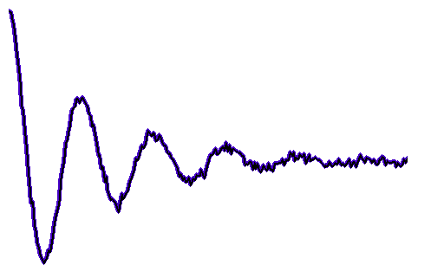
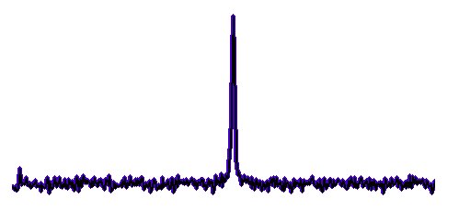
One-Dimensional NMR
Fourier
Transform
f = 0
t = 0
Time
Frequency
By convention we re-arrange the spectrum with zero frequency in the middle. For discrete data, the zero frequency is at point 1 + N/2 of 1 … N.

Slide 9
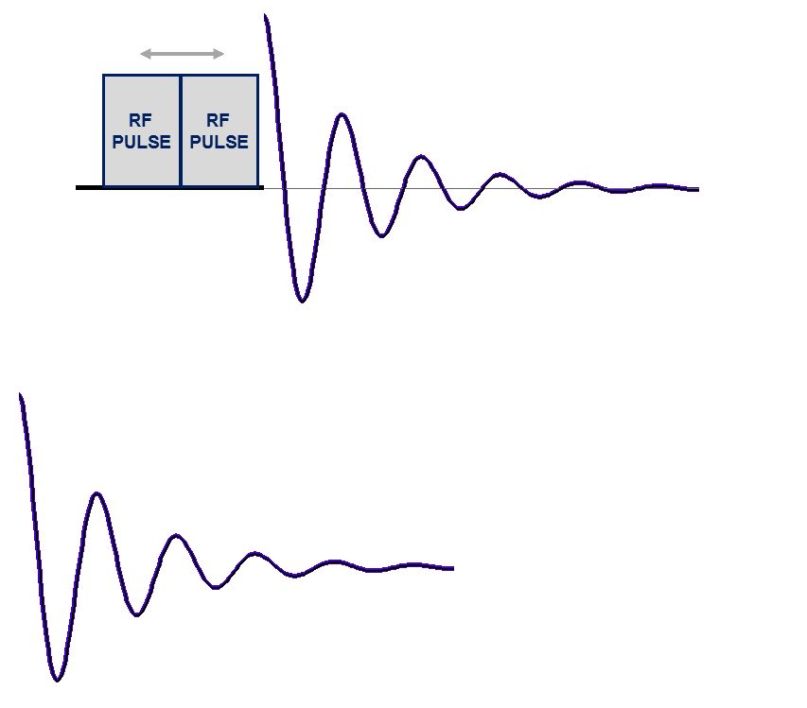
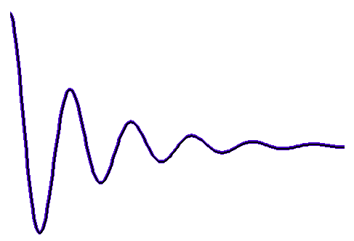
The Direct Dimension
The Indirect Dimension
Resolution in the Direct Dimension is Determined by Max Sampling Time t2
Acquire 1D Data at Each Evolution Time
Evolution Time
Incremented by Δ _{t1}
RF
PULSE
Measurement Time in the Direct Dimension is Also Determined by Max Sampling Time t2 …
It is Not Determined by the Number of Samples

Slide 10
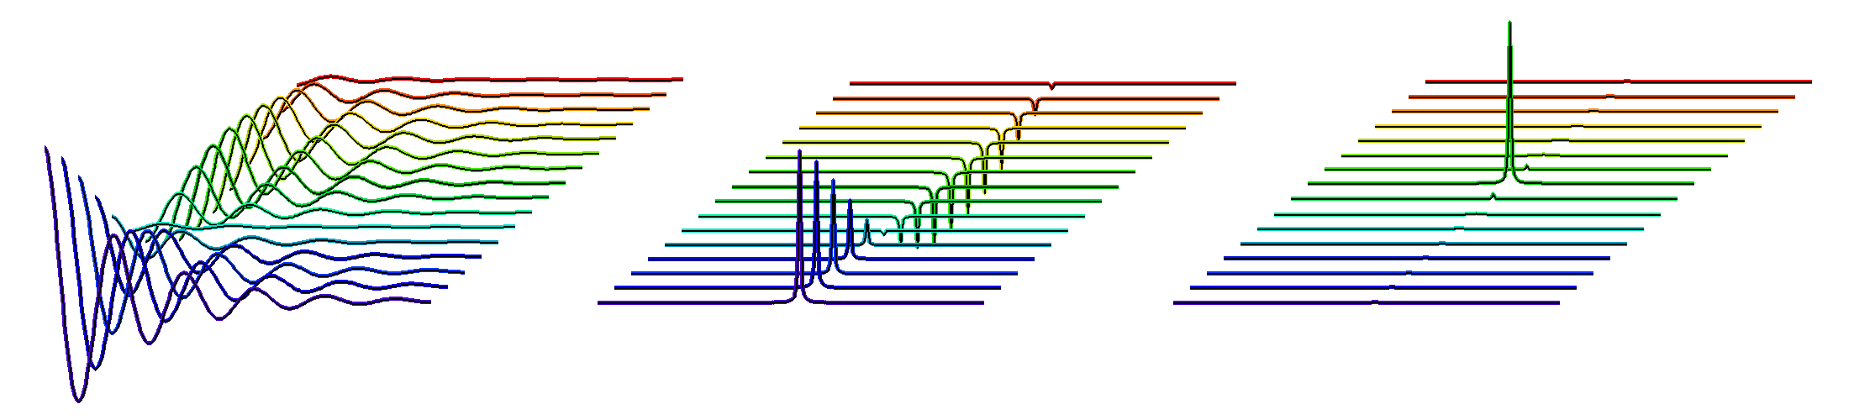
The Indirect Dimension
Resolution in the Indirect Dimension is Determined by Max Evolution Time t1
Measurement Time is Determined by the Number of Increments Measured in the Indirect Dimension
RF PULSE
RF PULSE
2D Spectrum
Time-Domain
Interferogram
Fourier Transform Rows
Fourier Transform Columns

Slide 11
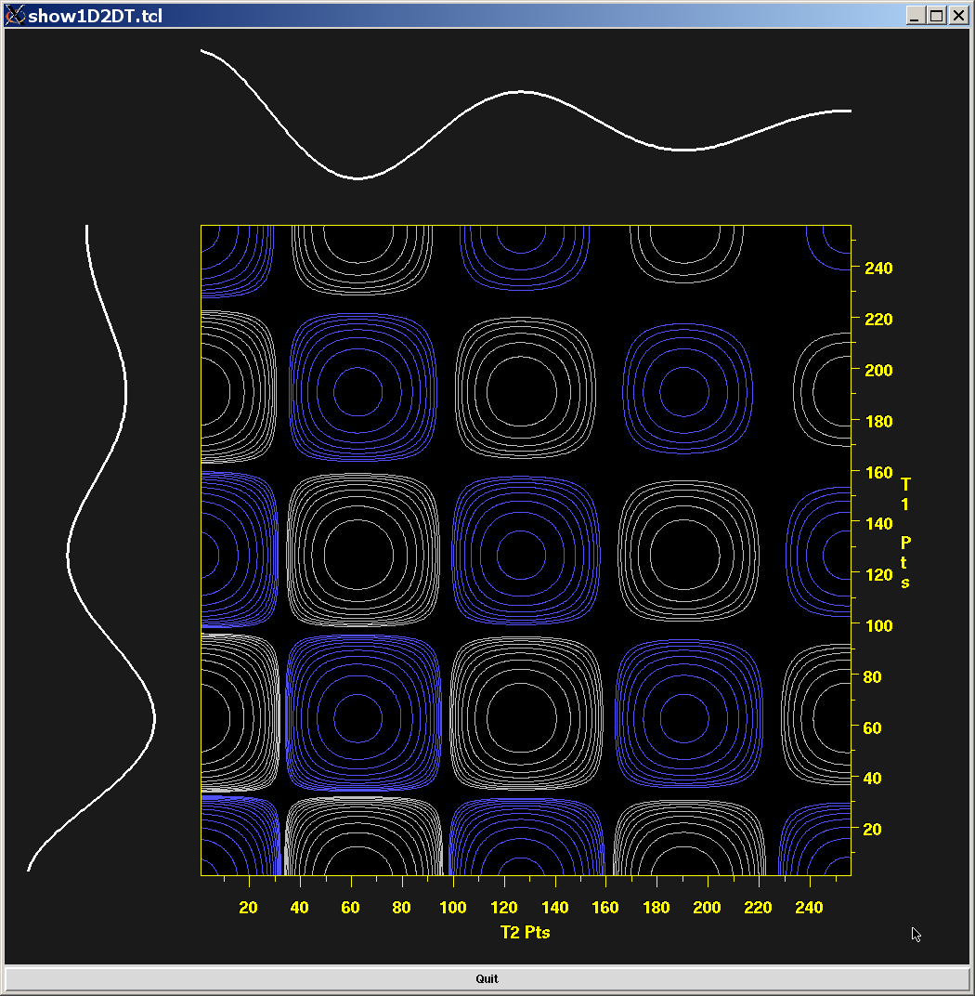
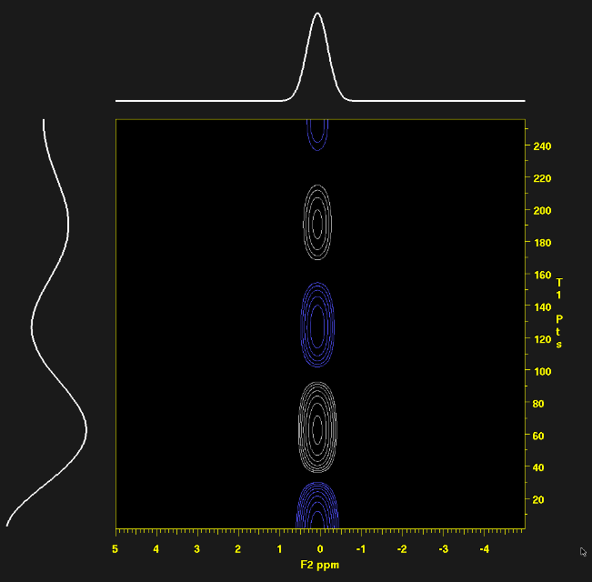
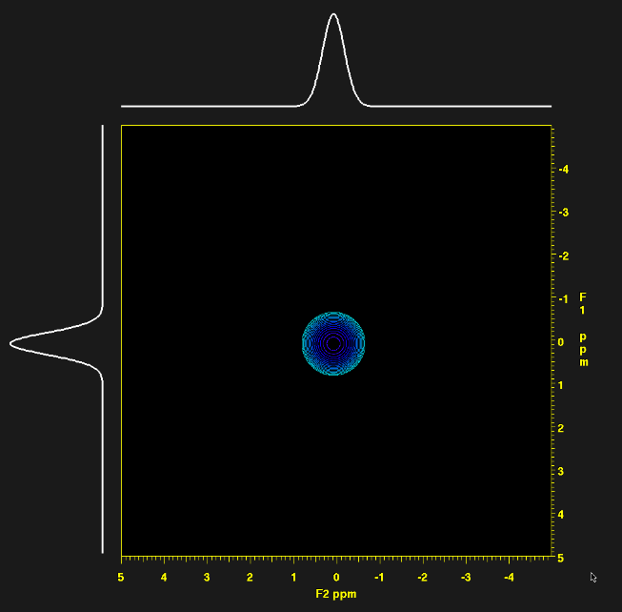
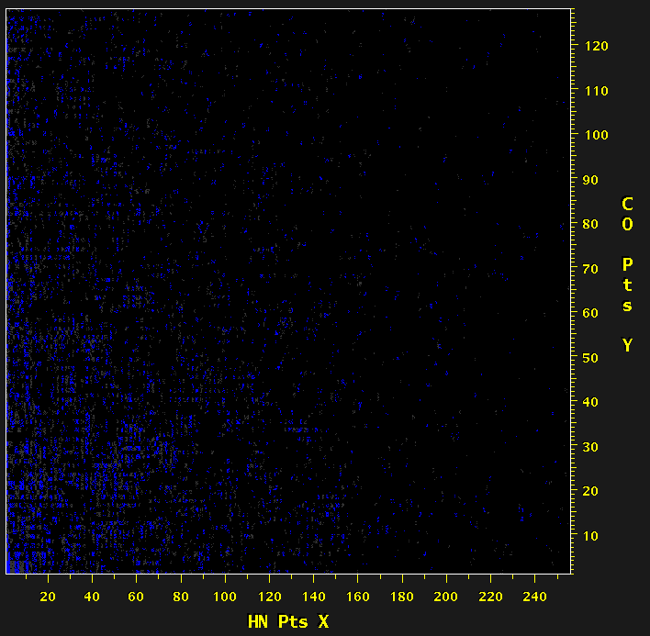
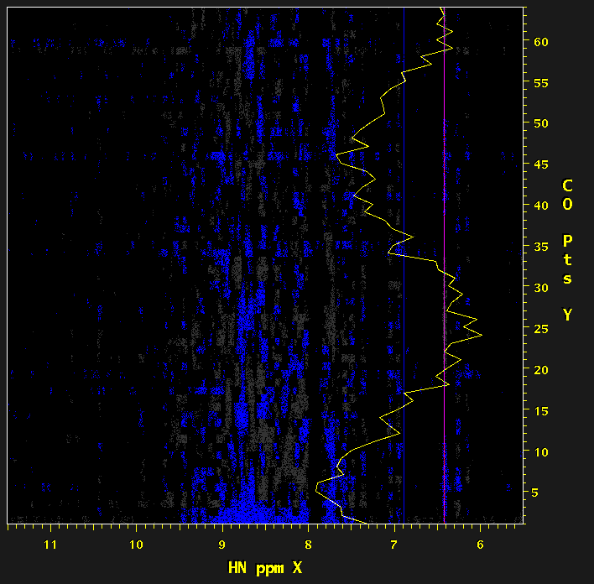
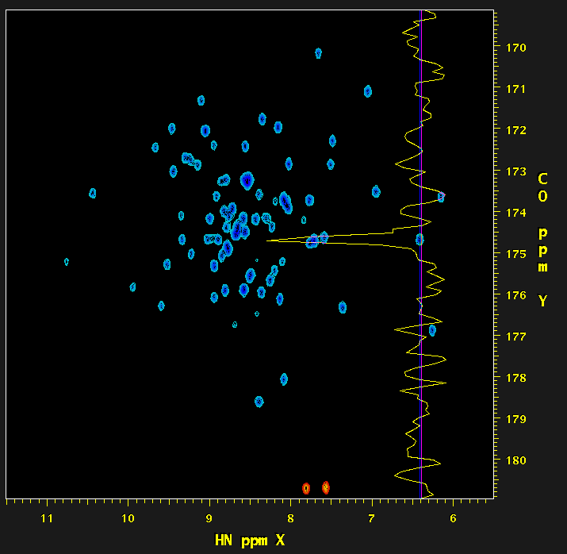
Points in a Multidimensional NMR Spectrum are Not Independent
Time-Domain Interferogram Frequency Domain
=
=

Slide 12
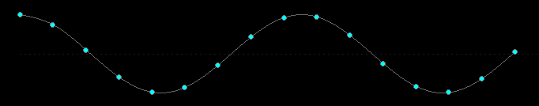
Sampling and Resolution
As a general rule, spectral width will be proportional to 1/dT, and resolution will be inversely proportional to the largest time coordinate acquired (that is, the greater the largest time, the better the resolution).
dT
N uniformly spaced samples, each separated by dT.
The time difference between first and last samples determines the spectral resolution. The time difference between adjacent samples determines the spectral width.

Slide 13
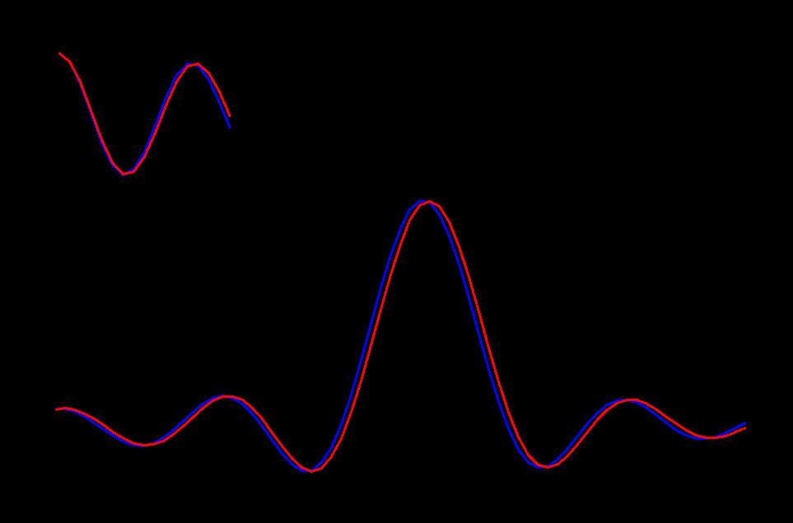
Sampling and Resolution
Time-Domain Data
Fourier Transform (Excerpt)

Slide 14
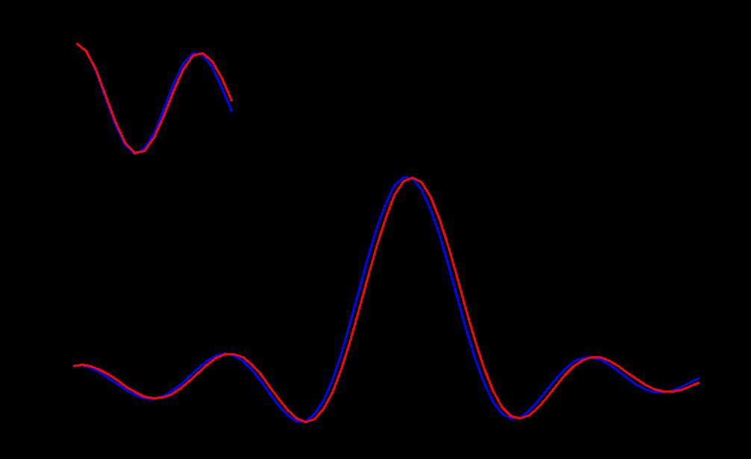
Sampling and Resolution
Time-Domain Data
Fourier Transform (Excerpt)

Slide 15
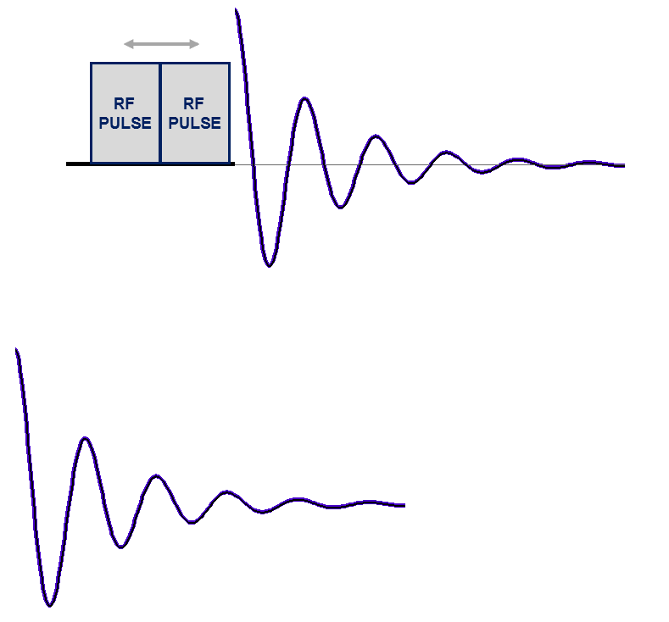
Two-Dimensional NMR with Non-Uniform Sampling (NUS)
Acquire 1D Data at Each Evolution Time …
But Only for Selected Increments …
Evolution Time
Incremented by Δ _{t1}
NUS retains resolution, and since fewer increments acquired, measurement time is reduced, but signal-to-noise is typically (but not always) decreased.

Slide 16
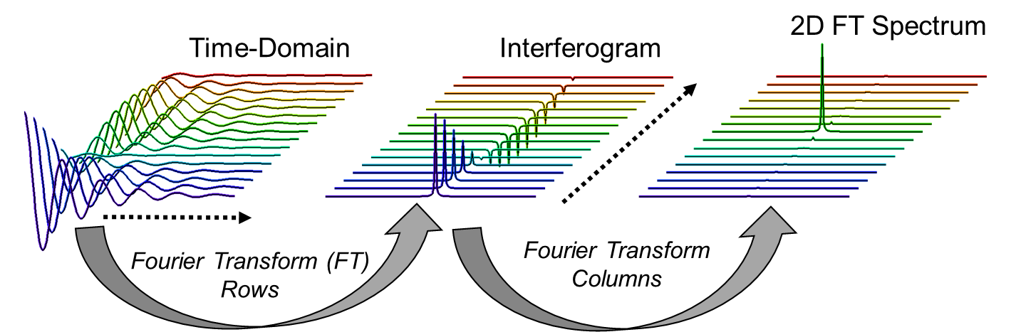

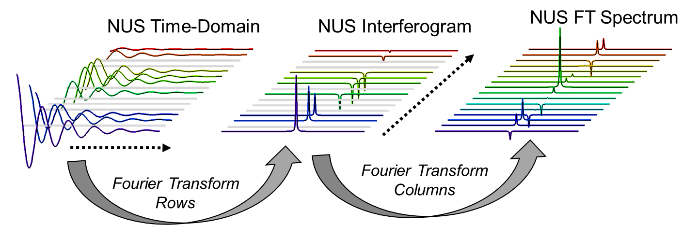

Fourier Transform is not Suitable for Non-Uniformly Sampled Data … Other Reconstruction Methods are Needed

Slide 17
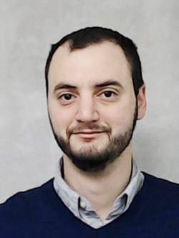
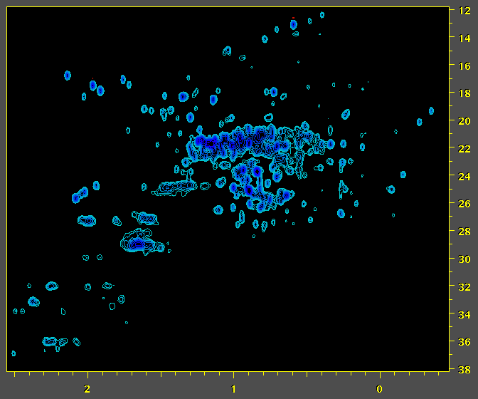
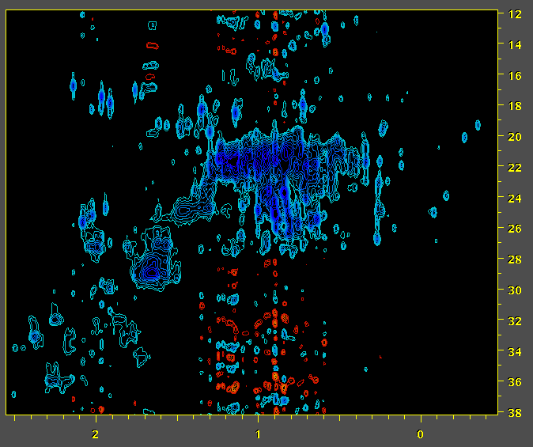
Fourier Transform is not Suitable for Non-Uniformly Sampled Data … Other Reconstruction Methods are Needed
NISTmAb – Natural Abundance ¹H / ¹³C
Conventional Uniformly Sampled (US) Data Fourier Spectrum
NISTmAb
50% Non-Uniformly Sampled (NUS) Data
Fourier Spectrum
Luke Arbogast
¹³C ppm
¹H ppm
¹H ppm
LW Arbogast, RG Brinson, and JP Marino: Mapping Monoclonal Antibody Structure by 2D 13C NMR at Natural Abundance. Anal. Chem., 87,3556–3561 (2015).

Slide 18
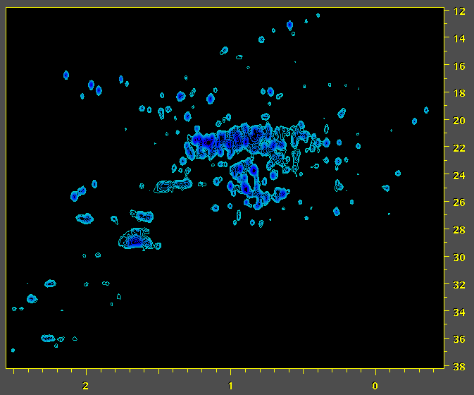
Fourier Transform is not Suitable for Non-Uniformly Sampled Data … Other Reconstruction Methods are Needed
NISTmAb – Natural Abundance ¹H / ¹³C
Conventional Uniformly Sampled (US) Data Fourier Spectrum
NISTmAb
50% Non-Uniformly Sampled (NUS) Data
IST Reconstruction – 2x Faster Measurement
Luke Arbogast
¹³C ppm
¹H ppm
¹H ppm
LW Arbogast, RG Brinson, and JP Marino: Mapping Monoclonal Antibody Structure by 2D 13C NMR at Natural Abundance. Anal. Chem., 87,3556–3561 (2015).

Slide 19
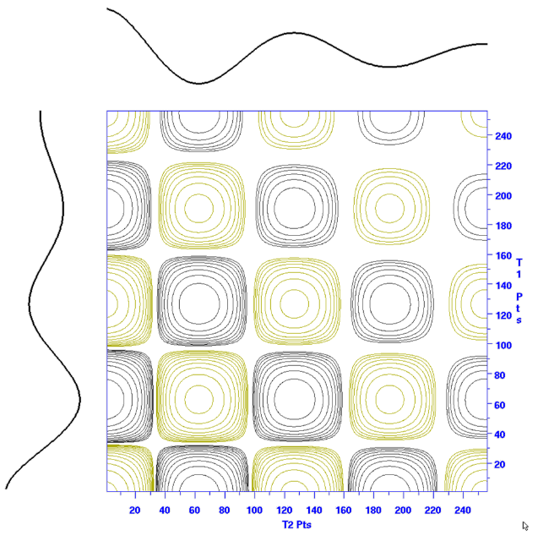
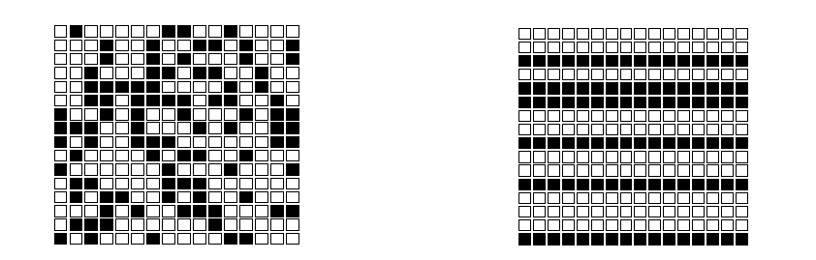
NMR Sampling and Signal Content is Different from Conventional Compressed Sensing (CS)
Conventional CS: samples can be placed at random grid points, and the underlying signal is uncorrelated.
2D NMR: entire rows are skipped, and the underling signals consist of 1D products.
Adapted from: Analysis of Undersampled Measurement Schemes, with Application to Magnetic Resonance Spectroscopy, Hatef Monajemi PhD Defense, Standford University 2016

Slide 20
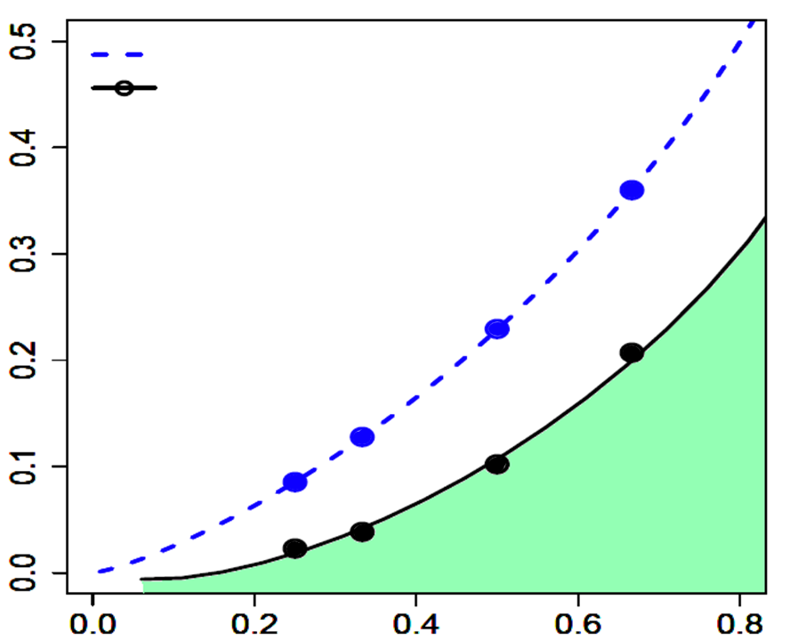
For NUS, the Signal Needs to be “Sparse” (More Empty Space Than Signal) 50% Sampling Density Requires ~5 to 10 x more Samples than Signals
Conventional Compressed Sensing
2D NMR
Ratio of Number of Signals to Final Size
For Example:
128 Points Sampled at 50% Density
(64 Samples) Allows for ~12 Signals Max per Column
Bad Reconstruction
Good Reconstruction
NUS Sampling Density
Adapted from: Analysis of Undersampled Measurement Schemes, with Application to Magnetic Resonance Spectroscopy, Hatef Monajemi PhD Defense, Stanford University 2016

Slide 21
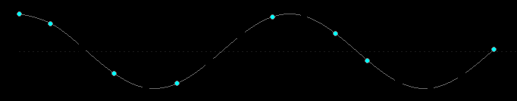
Sampling and Resolution
In a NUS experiment, some fraction of the intermediate increments in the indirect dimensions are skipped, which means that the measurement time will be shorter if other details are kept the same.
dT
M non-uniformly spaced samples, on a grid with positions separated by dT. The time difference between first and last samples is the same as for the fully sampled case, so that the spectral resolution is retained.

Slide 22
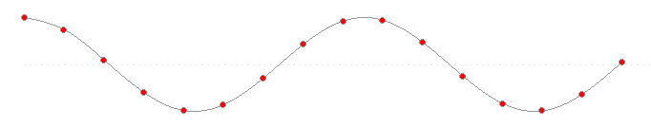
NUS Reconstruction
Conventional Uniformly Sampled Data
Zero Fill

Slide 23
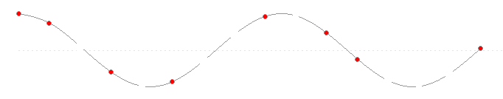
NUS Reconstruction
X
X
X
X
X
X
X
X
Non-Uniformly Sampled Data
Zero Fill

Slide 24
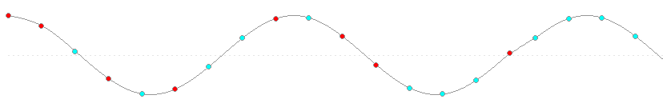
NUS Reconstruction
X
X
X
X
X
X
X
X
NUS Reconstruction
Directly or indirectly, NUS reconstruction replaces (interpolates) the missing values.

Slide 25
NUS Reconstruction
Missing Points are Interpolated During Reconstruction
Zero Fill Points are Extrapolated During Reconstruction
NUS Reconstruction
NUS reconstruction replaces (interpolates) missing values.
It can also replace zero-filled data, as an alternative to extrapolation methods such as Linear Prediction. The extrapolated values provide higher resolution.

Slide 26
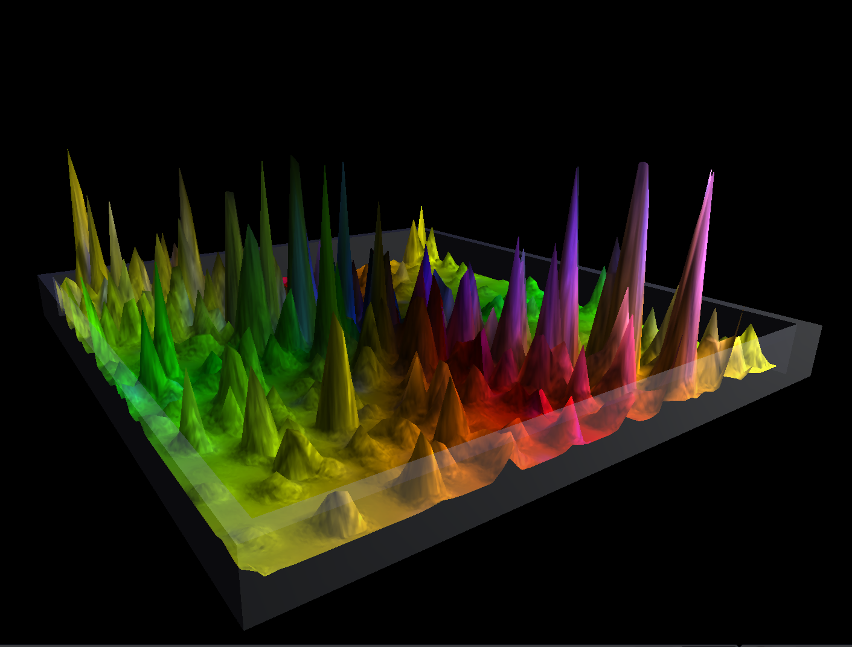
The Fourier Transform

Slide 27
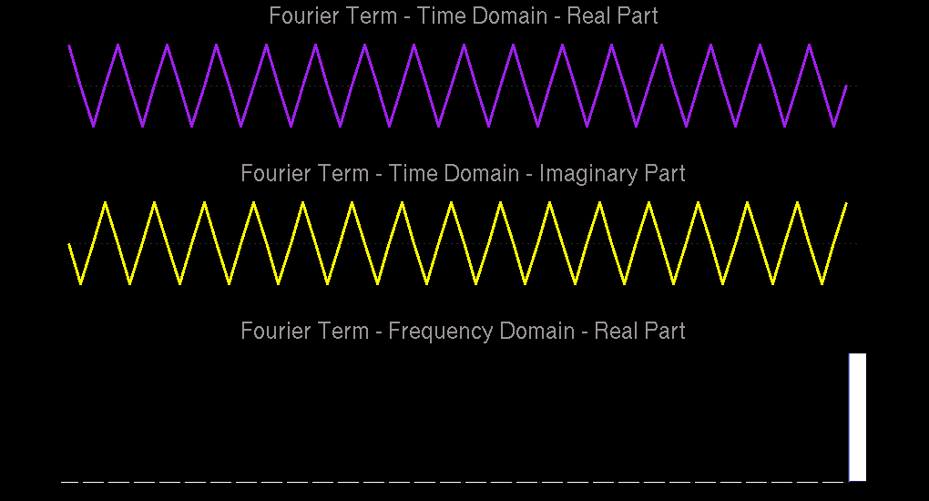
^{X( f ) =} Σ x( t ) [ cos( 2πft / N ) - i sin( 2πft / N ) ]
Each Fourier term corresponds to a point in the spectrum.

Slide 28
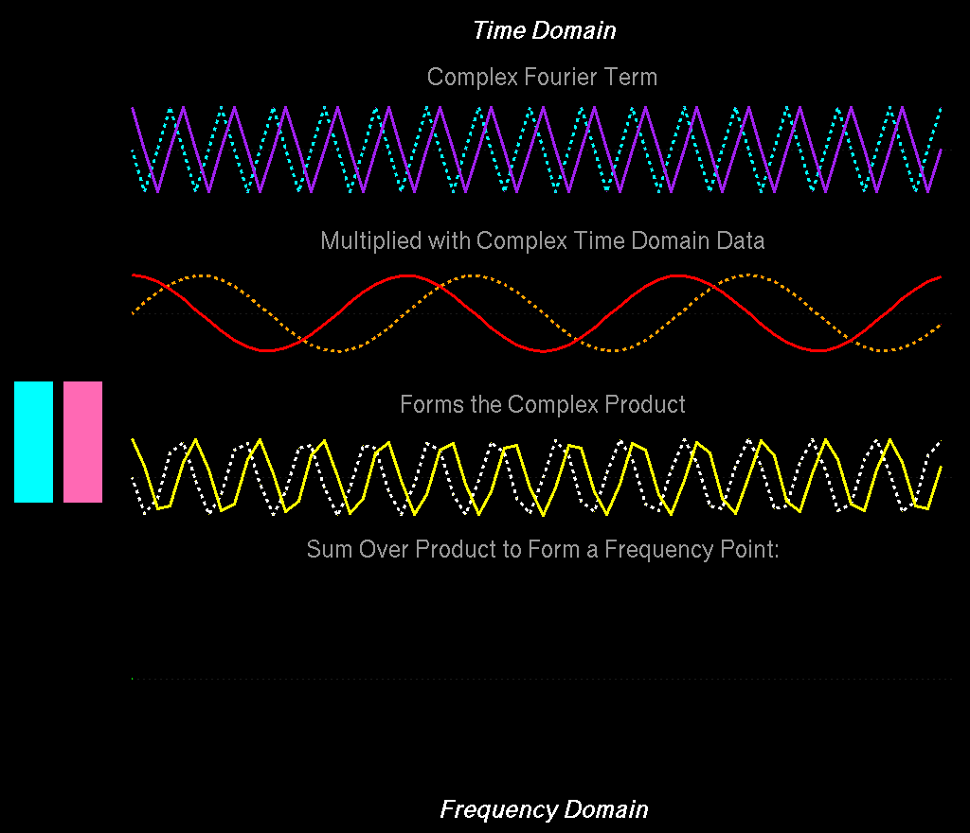
Σ+
Σ-

Slide 29
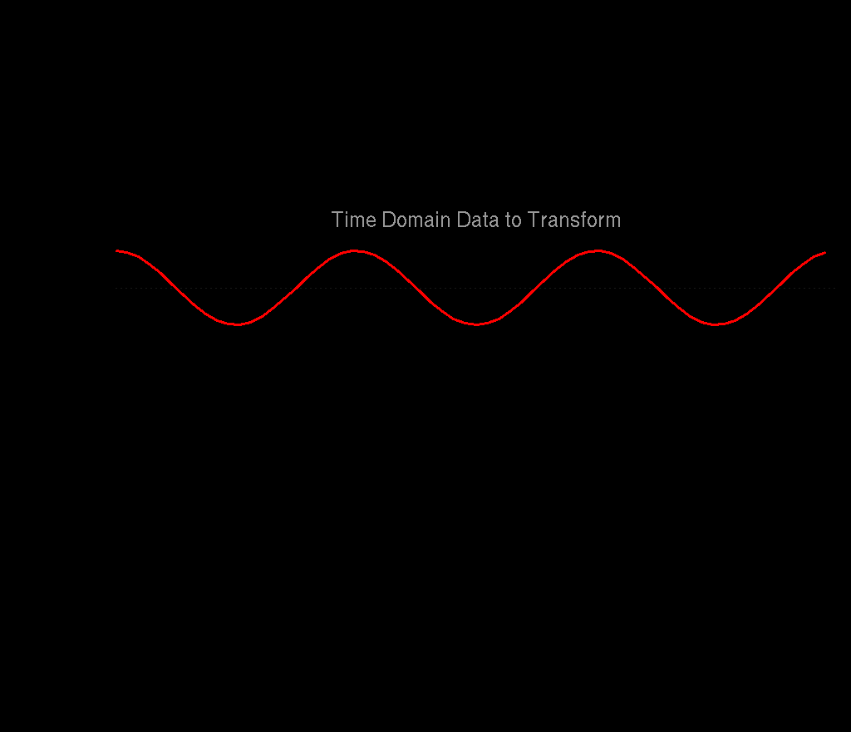
The Fourier Transform (with the Imaginary Parts Hidden)

Slide 30
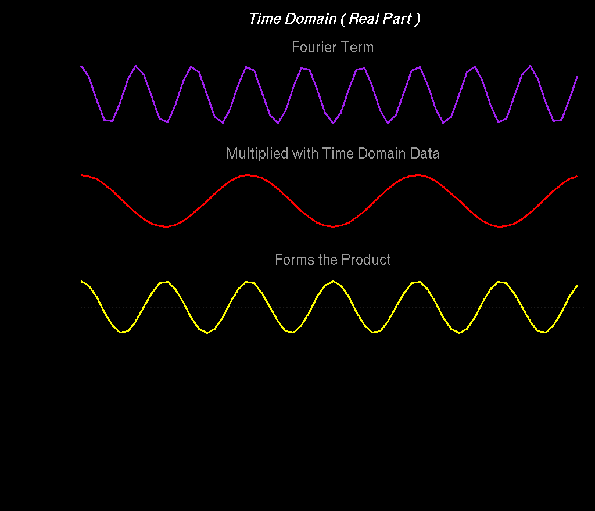

Slide 31
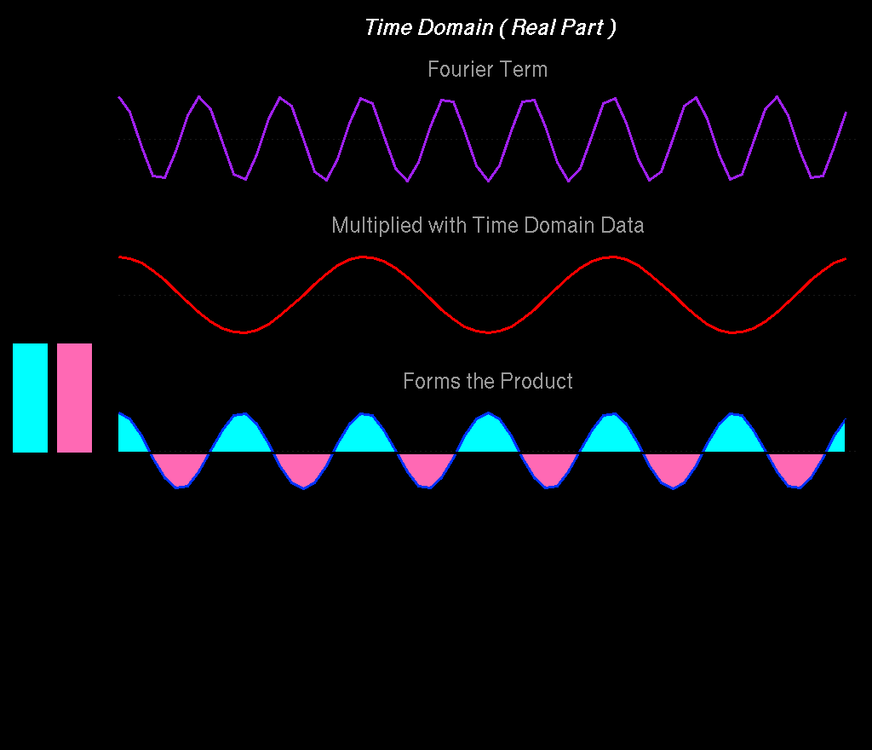
Σ+
Σ-
When the Fourier term does not match any frequency in the data, the product has balanced amounts of positive and negative intensity, and sums to zero.

Slide 32
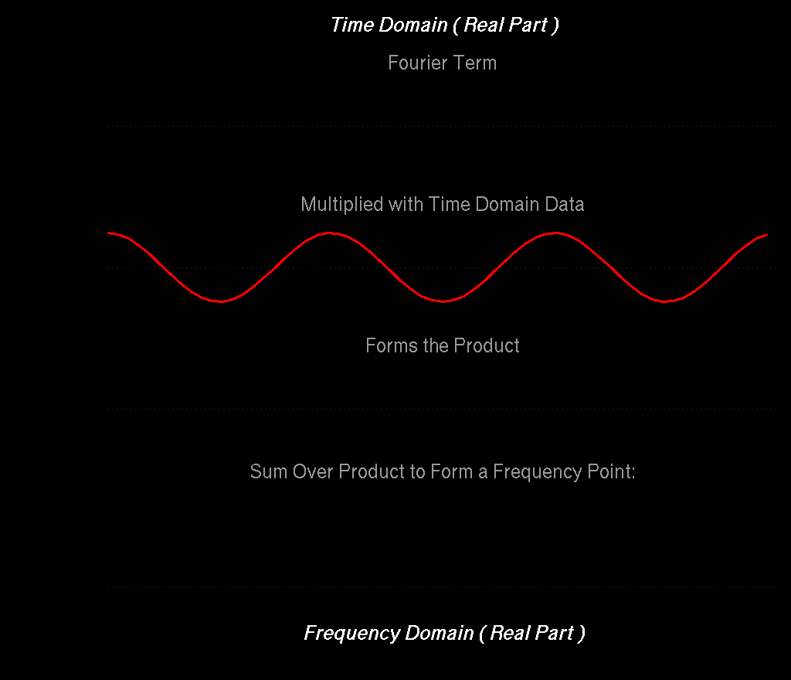
Σ+
Σ-

Slide 33
Σ+
Σ-

Slide 34
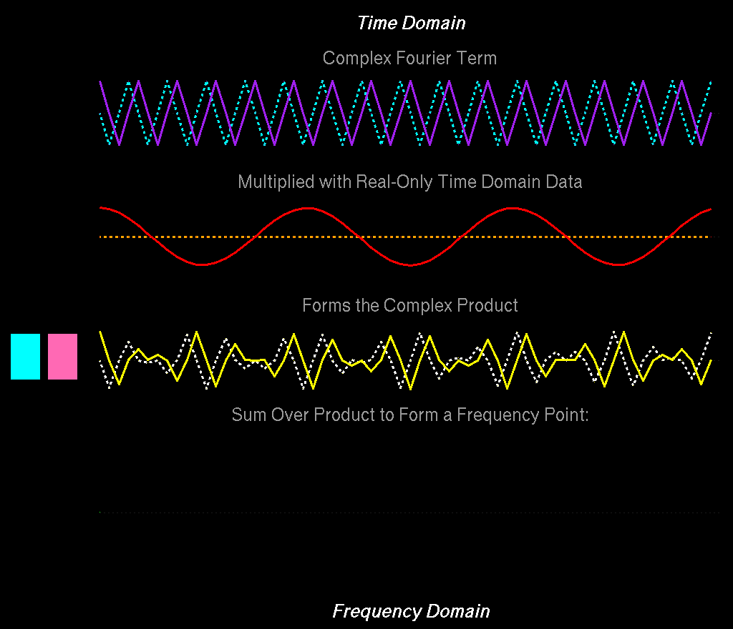
Σ+
Σ-

Slide 35
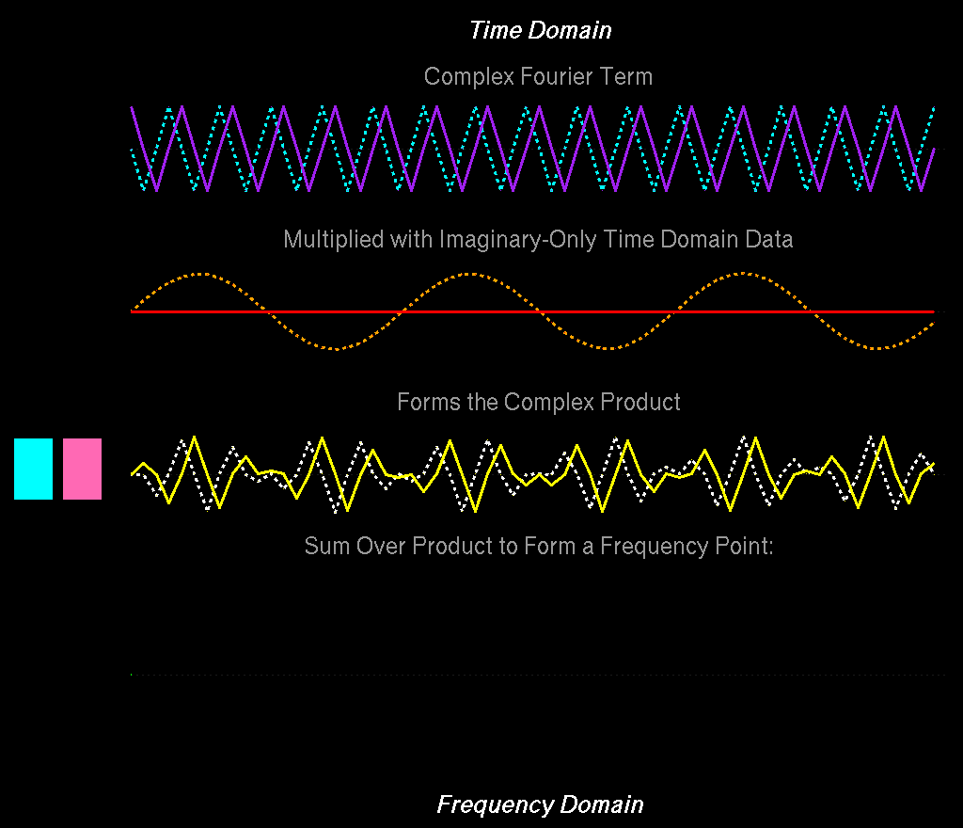
Σ+
Σ-

Slide 36
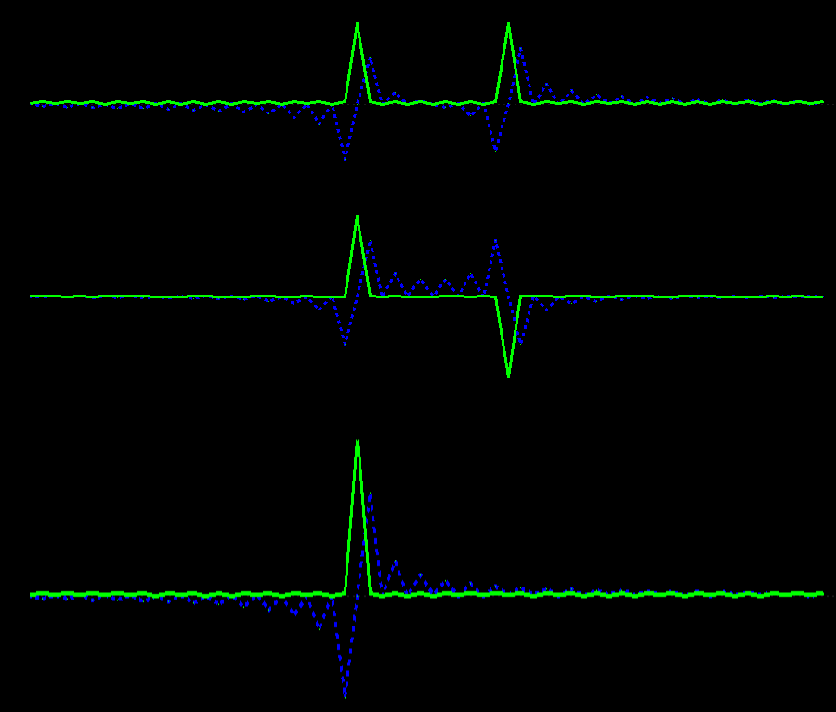
Combined, the Real and Imaginary Parts Distinguish Between Positive and Negative Frequencies …
+
=

Slide 37
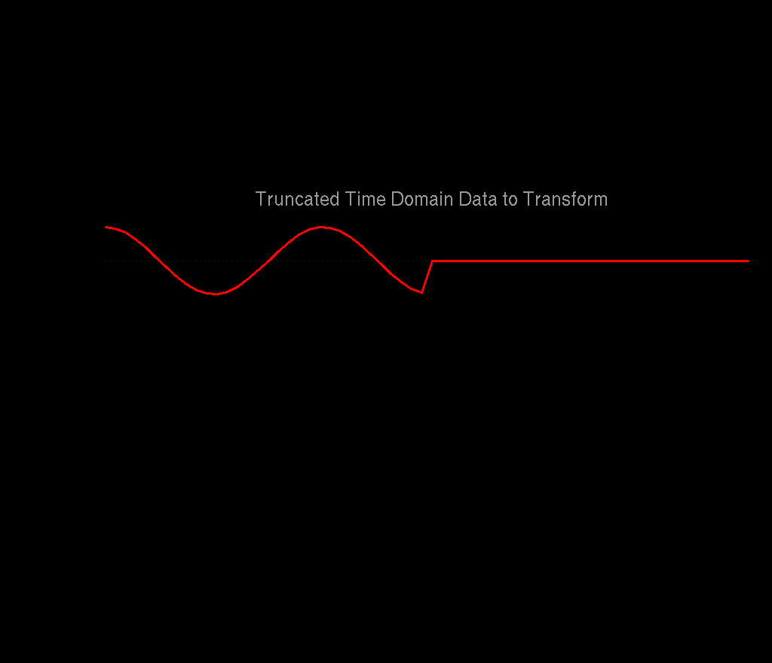
In Biomolecular NMR, Indirect Dimensions are Often Truncated and Have Limited Numbers of Points …

Slide 38
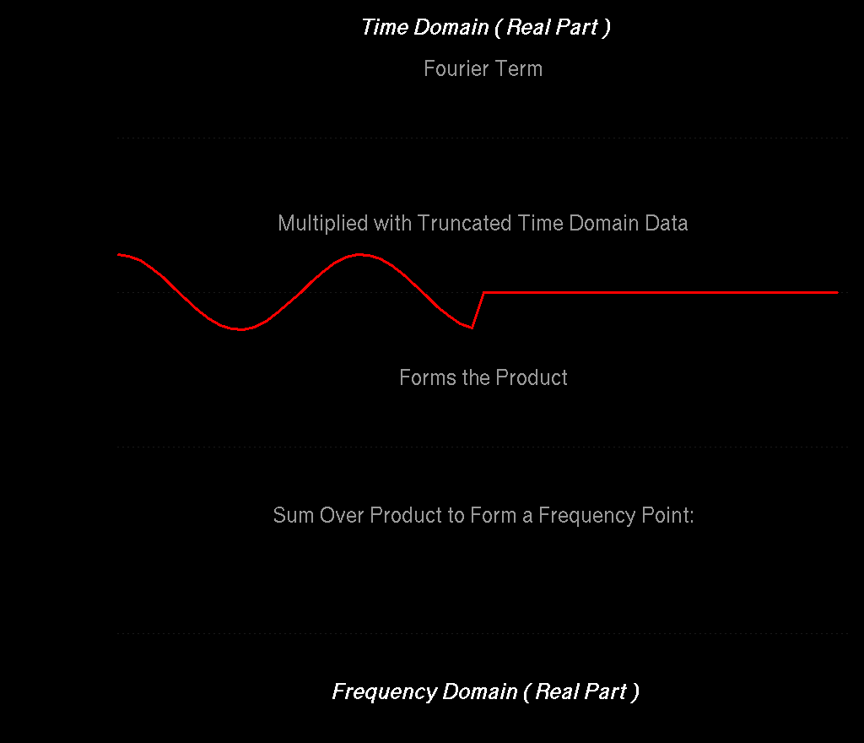
Σ+
Σ-
Since the Fourier product is truncated, there is no longer ideal cancelation of positive and negative intensities, giving broad lines and artifacts

Slide 39
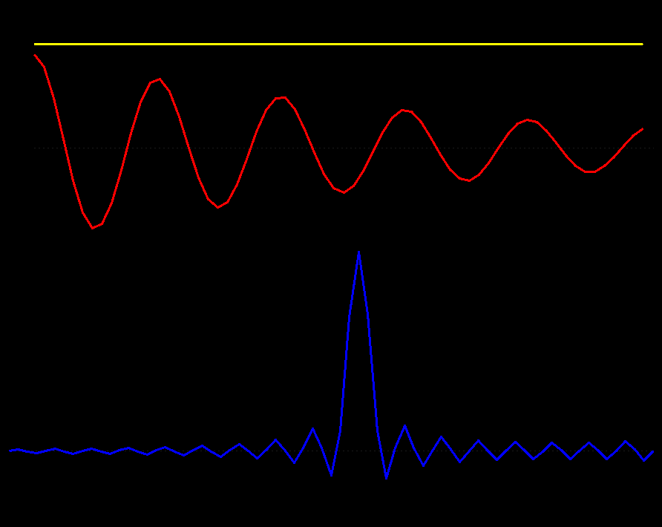
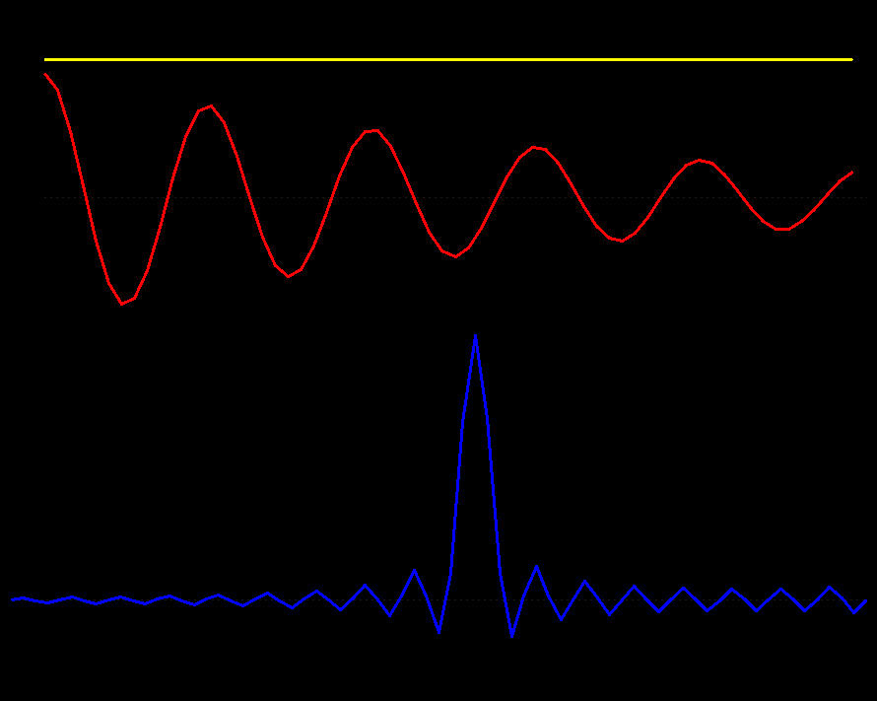
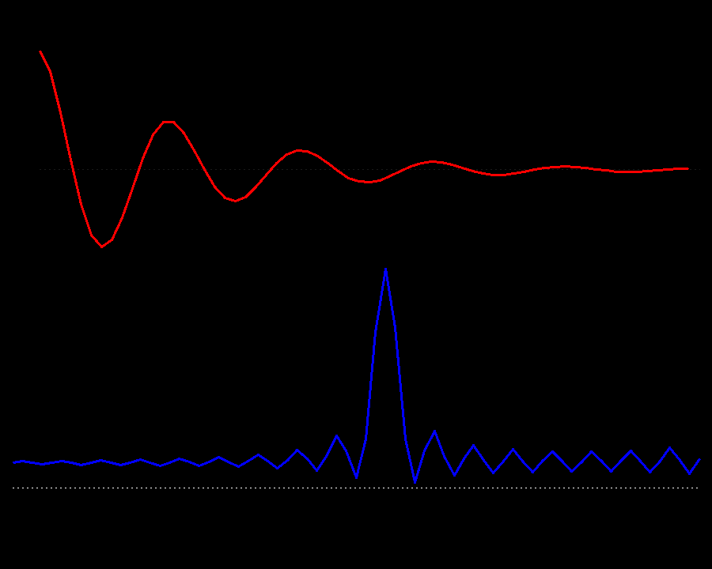
Line Broadening Window
Line Sharpening Window
First Point Scaling
Scaling the first point in the time-domain is equivalent to adding a constant in the frequency domain

Slide 40
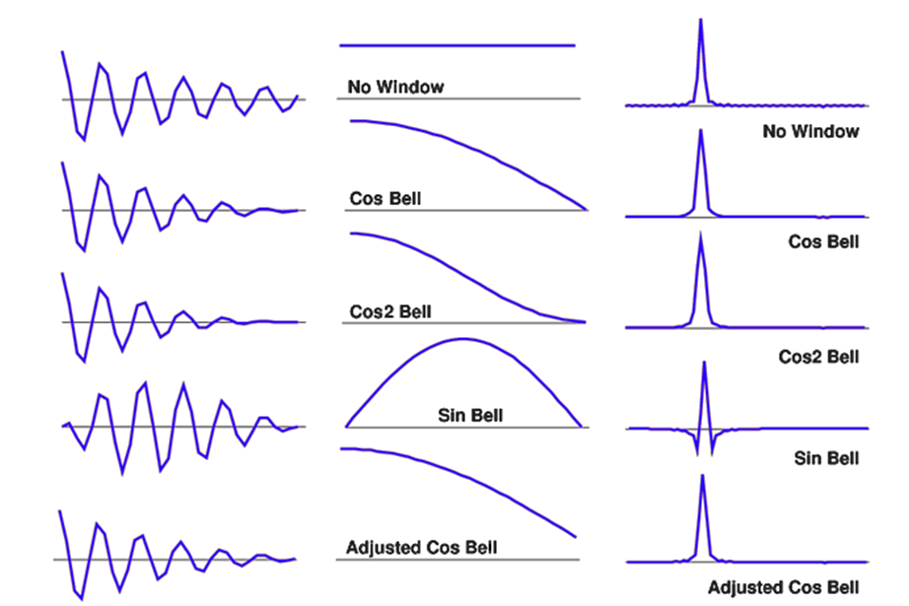
Apodization: Convolution of the Spectrum with the Fourier Transform of the Window Function
Window Functions are a Compromise Between Artifact Reduction and Resolution

Slide 41
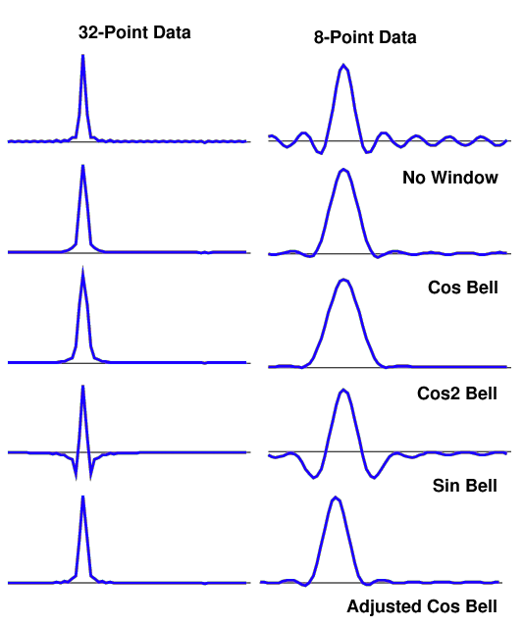
Even though the underlying signal is the same in all of these examples, and noise-free, Fourier transforms with small numbers of points give very broad lines and large artifacts.

Slide 42
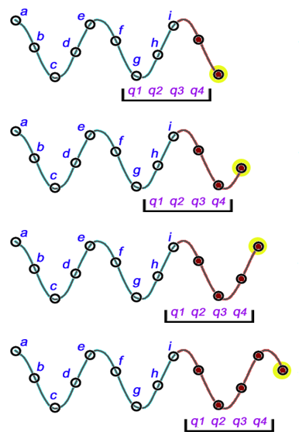
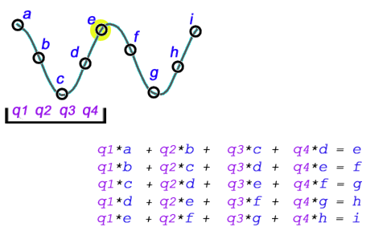
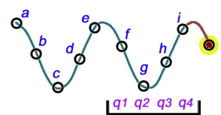
Linear Prediction (LP) – Build an LP Model, Use the LP Model Coefficients to Extrapolate the Time-Domain Data
Predict next point in series
Each LP Coefficient Can Model One Exponentially Decaying Sinusoid

Slide 43
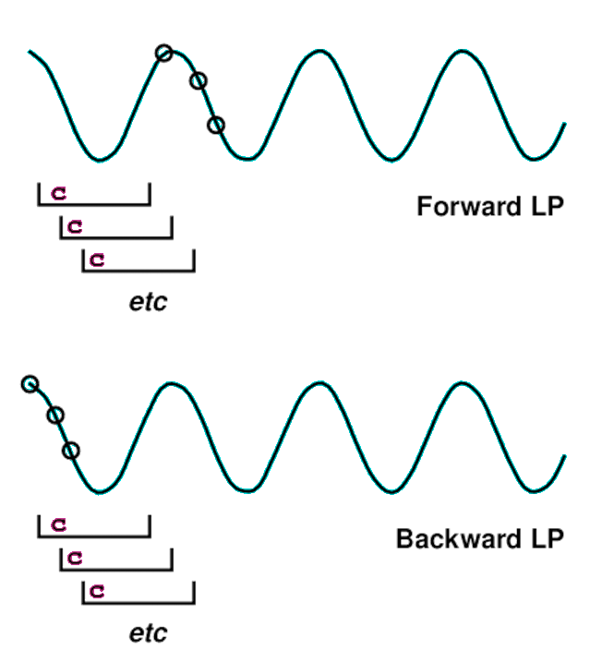

Forward Backward and Mirror Image Linear Prediction
Mirror Image LP
Zero Delay Data with No Decay
Predict next point in series
Predict previous point in series
Extending the Length of the Input Data Allows More LP Coefficients, Hence More Signals
Forward and Backward Coefficients Can be Averaged for Stability

Slide 44
Mirror Image LP Requires Non-Decaying Data with P0 = 0 or 180
Mixed Forward/Backward LP is Suitable for All Data
Predict next point in series
Mirror Image LP
Zero Delay Data with No Decay
Predict previous point in series
Forward/Backward LP is Suitable for All Data
Mirror Image LP is Only Suitable for Constant Time (No Decay) Data, with Phase P1=0 or P1=180

Slide 45

Fourier Transforming One Dimension Makes Significant Signal Content in the Remaining Dimensions More Sparse
So … Only Apply Linear Prediction When All Other
Dimensions Have Been Transformed …

Slide 46





Process X and Y
Linear Predict and Process Z
Inverse Process, Linear Predict, and Reprocess Y
¹³C Time
Extrapolated ¹³C Time
¹⁵N Time
¹⁵N Freq
FT
LP in ¹³C
LP in ¹³C and ¹⁵N

Slide 47


Linear Prediction (LP)
FT
LP
Original Spectrum
Inverse Transform
LP Extrapolated
Reprocessed

Slide 48

Important: In Practice, LP is Not Very Effective at Determining Signal Parameters, Which is Why We Use LP for Extrapolation Only

Slide 49
Reconstruction of Non-Uniformly Sampled Data

Slide 50




NUS Software from Our Friends
SMILE spin.niddk.nih.gov/bax/software/smile
NESTA nestanmr.com
SCRUB coggins.biochem.duke.edu/scrub
hmsIST gwagner.med.harvard.edu/intranet/istHMS
RNMRTK MaxEnt nmrbox.org
Find these methods and more on NMRbox
NMRbox.org

Slide 51

NUS Software from Our Friends
NMRPipe IST
hmsIST
MaxEnt
NESTA
SCRUB
SMILE
CAMERA
MDD
MDD-CS
Ubiquitin
3D 15N-NOE
Strips at:
8.02ppm HN
121.95ppm 15N
1H PPM
Find these methods and more on NMRbox
NMRbox.org

Slide 52
Some NUS Reconstruction Methods
Compressed Sensing Reconstruction Methods
  IST, IRLS, NESTA
Matrix Decomposition (Spectra as Product of 1D Vectors)
  Principal Component Analysis (PCA), MDD
Parametric Methods (Model of Spectral Signals)
  SMILE
Artifact Subtraction Methods (Transform of Sampling Schedule)
  CLEAN, SCRUB
Inverse Methods (Inverse Transform of “Ideal” Spectrum)
  Maximum Entropy Reconstruction

Slide 53

Reconstruction of NUS Data

Slide 54


Slide 55

Non-Uniform Sampling:
for Fourier Transform, Replace Missing Points with Zeros

Slide 56

Σ+
Σ-
Σ+
Σ-
For both truncated Uniform Sampling schedules and NUS, there is no longer ideal cancelation of positive and negative intensities. They both give rise to artifacts.

Slide 57

Fourier transform of Uniform versus Non-Uniform Sampling Schedules
Uniform Sampling Schedule:
Broad lines and periodic truncation wiggle artifacts
Non Uniform Sampling Schedule:
Narrow lines and random-noise-like artifacts
All peaks for a given schedule have the same artifacts, and the size of the artifacts is proportional to the size of the peaks.

Slide 58

NUS Reconstruction:
IST – Iterative Soft Thresholding
IST takes advantage of the fact that the size of sampling schedule artifacts is proportional to the size of the peaks.

Slide 59


NUS Reconstruction:
IST – Iterative Soft Thresholding
IST works by gradually moving intensity from the tops of the largest signals remaining and accumulating them in a reconstruction.

Slide 60

NUS Reconstruction:
IST – Iterative Soft Thresholding
At each iteration, the reduced spectrum is inverse transformed, and the parts that were originally skipped in the sampling schedule are set to zero again.

Slide 61

NUS Reconstruction:
IST – Iterative Soft Thresholding
Fourier Spectrum
IST Spectrum
At each IST iteration, the largest signals in the residual get smaller, and so do the corresponding artifacts.
Iterations conclude when the largest point remaining in the residual is below a target value.
When the IST iterations conclude, any remaining residual can be added to the reconstruction.

Slide 62









SMILE - Sparse Multidimensional Iterative Lineshape Enhanced NUS Reconstruction
5Hz
Establish Relationship Between Decay and Observed Linewidth
Multiply by Sampling Schedule and
Fourier Transform
10Hz
15Hz
Sampling Schedule, Pts
20Hz

Slide 63

SMILE:
Each Iteration Models the Largest Remaining Signals

Slide 64

Uniformly Sampled Data and 33% NUS Reconstructed by NMRPipe’s IST and By SMILE
Uniformly Sampled
NUS IST
NUS RIST
NUS IST + Extrapolation
NUS RIST + Extrapolation
NUS SMILE + Extrapolation

Slide 65



Extrapolation of Conventional Data as an Alternative to Linear Prediction (LP)
LP
SMILE

Slide 66

NUS Zero Fill as an Alternative to Linear Prediction for Conventional NMR Data (15N-NOE)
Conventional FT
4 sec
Linear Prediction
2 min 30 sec
NUS Zero Fill via NMRPipe-IST
20 min 21 sec
HN
8.929 ppm
N
122.2 ppm
HN
9.138 ppm
N
121.9 ppm

Slide 67

NUS Zero Fill as an Alternative to Linear Prediction for Conventional NMR Data (4D Methyl-Methyl NOE)
FT
LP
IST

Slide 68


NMRPipe IST
RNMRTK MaxEnt
US FT
US LP
SMILE
NESTA
hmsIST

Slide 69

Linearity of NMRPipe’s IST Reconstruction
FT vs NUS IST
Expanded View
FT vs FT
Scaled Intensity
Scaled Intensity
Scaled Intensity

Slide 70

An Example of NUS Applied to Small Molecule NMR
F. Delaglio, G.S. Walker, K.A. Farley, R. Sharma, J.C. Hoch, L.W. Arbogast, R.G. Brinson, and J.P. Marino: Non-Uniform Sampling for All: More NMR Spectral Quality, Less Measurement Time. American Pharmaceutical Review, 20, 56-60 (2017).

Slide 71



G-UDCA,Glycoursodeoxycholic acid
Formula: C26H43NO5
Sample Mass: ~6 mg
Solvent: 0.04 ml DMSO
Concentration: 333 mM
NMR Tube: 1.7mm
Console: Bruker Avance 600 MHz
NMR Probe: 1.7 mm TCI Cryoprobe.
Spectral Width 1H: 6600 Hz
Spectral Width 13C: 25000 Hz
Spectral Points 1H: 512 Complex
Spectral Points 13C: 1024 Complex
Total Recycle Time: ~7 s.
Measurement Time: 3 hours 43 min
600 MHz, US 1024 Complex Increments, Noise RMS 0.012%
G-UDCA Data Courtesy of Greg Walker and Kathleen Farley, Pfizer

Slide 72




G-UDCA, Conventional Uniformly-Sampled
1024 Complex Increments
G-UDCA, Conventional Uniformly-Sampled
128 Complex Increments
Measurement Time: 3 hours 43 min
Measurement Time: 28 min
Noise RMS 0.012%
Noise RMS 0.028%

Slide 73


G-UDCA, Conventional Uniformly-Sampled
1024 Complex Increments
G-UDCA, NUS Uniform Random
122 Complex Increments, IST and NUS Zero Fill
Processing Time: 3 min 40 sec
Measurement Time: 3 hours 43 min
Measurement Time: 27 min
Noise RMS 0.012%
Noise RMS 0.003%
Bruker Default NUST2 = 1

Slide 74

G-UDCA, Conventional Uniformly-Sampled
1024 Complex Increments
G-UDCA, NUS Uniform Random
122 Complex Increments, SMILE and NUS Zero Fill
Processing Time: 7 sec
Measurement Time: 3 hours 43 min
Measurement Time: 27 min
Noise RMS 0.012%
Noise RMS 0.039%
Bruker Default NUST2 = 1

Slide 75


G-UDCA, NUS HMS Poisson Gap 1
(Dense at Ends) 123 Complex Increments, IST and NUS Zero Fill
G-UDCA, Conventional Uniformly-Sampled
1024 Complex Increments
Measurement Time: 3 hours 43 min
Measurement Time: 27 min
Noise RMS 0.012%
Noise RMS 0.003%
gwagner.med.harvard.edu/intranet/hmsIST/gensched_new.html

Slide 76


G-UDCA, NUS HMS Poisson Gap 2
(Dense at Start) 122 Complex Increments
IST and NUS Zero Fill
G-UDCA, Conventional Uniformly-Sampled
1024 Complex Increments
Measurement Time: 3 hours 43 min
Measurement Time: 27 min
Noise RMS 0.012%
Noise RMS 0.004%
gwagner.med.harvard.edu/intranet/hmsIST/gensched_new.html

Slide 77

Reproducibility of Peak Volumes for G-UDCA Example
Linear Prediction RMS 2.4%
HMS Type 1 NUS IST RMS 3.0%
HMS Type 2 NUS IST RMS 1.4%
Random NUS IST RMS 3.1%
Random NUS SMILE RMS 2.5%
Relative Peak Volume in Related Spectrum
Relative Peak Volume in Uniformly Sampled Spectrum, 1024 Complex Increments

Slide 78


Reproducibility of Peak Positions for G-UDCA Example
¹H ppm Peak Position in Related Spectrum
¹³C ppm Peak Position in Related Spectrum
Linear Prediction RMS 0.001 ppm
Linear Prediction RMS 0.01 ppm
HMS Type 1 NUS RMS 0.003 ppm
HMS Type 1 NUS RMS 0.02 ppm
HMS Type 2 NUS RMS 0.002 ppm
HMS Type 2 NUS RMS 0.01 ppm
Random NUS RMS 0.003 ppm
Random NUS RMS 0.02 ppm
¹H ppm Peak Position
Uniformly Sampled Spectrum 1024 Complex Increments
¹³C ppm Peak Position
Uniformly Sampled Spectrum 1024 Complex Increments

Slide 79

Why are the Results for Different NUS Schedules Qualitatively Similar for the G-UDCA Example?
}
~66%
The indirect dimension does not decay much, and the signal to noise is high for this concentrated sample. So, all of the NUS schedules capture a sufficient amount of signal, with more than enough points to account for the number of peaks.

Slide 80

How Many Increments Should I Measure?
What’s the max number of signals expected in a band from the spectrum? The number of increments should be at least several times this number for any schedule, conventional or NUS. In the G-UDCA examples, which have ~8 signals in the most crowded bands, there were ~16x8 increments.

Slide 81
For NUS, the Signal Needs to be “Sparse” (More Empty Space Than Signal) 50% Sampling Density Requires ~5 to 10 x more Samples than Signals
Conventional Compressed Sensing
2D NMR
Ratio of Number of Signals to Final Size
For Example:
128 Points Sampled at 50% Density
(64 Samples) Allows for ~12 Signals Max per Column
Bad Reconstruction
Good Reconstruction
NUS Sampling Density
Adapted from: Analysis of Undersampled Measurement Schemes, with Application to Magnetic Resonance Spectroscopy, Hatef Monajemi PhD Defense, Stanford University 2016

Slide 82

2D Indirect Plane Simulations with Varying Numbers of Peaks and NUS Density

Slide 83

NUS IST Reconstructions Compared to “Ideal” Reconstruction Generated from the Sum of IST Reconstructions of Fully-Sampled Individual Peaks
378 Peaks
189 Peaks
94 Peaks
18 Peaks
Relative RMS Difference
(Higher is Worse)
NUS Sampling Density, Percent

Slide 84

NUS IST Reconstructions Compared to “Ideal” Reconstruction Generated from the Sum of IST Reconstructions of Fully-Sampled Individual Peaks
378 Peaks
189 Peaks
94 Peaks
18 Peaks
Relative RMS Difference
(Higher is Worse)
Ratio of Total Samples to Total Hypothetical Peak Parameters
(4*NUS Samples) / (5*Peak Count)

Slide 85
Other Applications of NUS Reconstruction Methods

Slide 86
The Forward and Inverse Fourier Transform are “the Same”
X(f) =
x(t) e – ^{2π i f t} dt
x(t) =
X(f) e ^{2π i f t} df
For Forward FT:
exp( -2πift ) = cos( 2πft ) - i sin( 2πft )
For Inverse FT:
exp( 2πift ) = cos( 2πft ) + i sin( 2πft )
The position of a point in one domain represents the frequency of a sinusoid in the other domain.
The amplitude of a point in one domain represents the amplitude of a sinusoid in the other domain.

Slide 87
The Time Domain and Frequency Domain Have
the Same Information Content … But Some Things are Easier to See or Do in One Domain
Signal Extends Over All Points
Signal is Localized in One Region
Noise Level is Easily Identified
Time
Frequency

Slide 88



Baseline Distortion: Replace Points in the Time Domain
Distortion Localized in Early Points of Time Domain
cos( 2πft ) f = 0
cos( 2πft ) f = 1
cos( 2πft ) f = 2
Time
Frequency

Slide 89


Baseline Distortion: Replace Points in the Time Domain
Baseline Distortion Extends Over All Points in the Frequency Domain
Distortion Localized in Early Points of Time Domain
Time
Frequency

Slide 90


Baseline Distortion Repaired with IST
Baseline correction by replacing the first 10 time-domain points:
tdBaseline.com -in test.ft1 -out corrected.ft1 –n 10
¹³C Metabolomics Data courtesy of Prof. Art Edison

Slide 91

SIERRA Pulse Sequence for Excipient Signal Suppression
Residual Excipient Signal Modeled and Subtracted by SMILE
LW Arbogast, F Delaglio, J Tolman, and JP Marino: Selective suppression of excipient signals in 2D 1H–13C methyl spectra of biopharmaceutical products. J. Biomol NMR (2018) doi:10.1007/s10858-018-0214-1
https://www.ibbr.umd.edu/sierra/home

Slide 92







Formulation of Protein Therapeutics
Most biologics are taken intravenously, and are provided as either solution or lyophilized (freeze dried) powder. Solutions may be viscous, in concentrations exceeding 100 mg/mL. Excipients are used to maintain stability during freeze drying, extend the shelf life of the biologic, and improve its half-life in the blood.
Excipients can include:
Other proteins
Polymers
Amino Acids
Surfactants
Preservatives
Salts
Histidine
Polysorbate
Polyethylene Glycol
Benzyl Alcohol
Bovine Serum Albumin
Trehalose

Slide 93

Original Spectrum with Polysorbate and Histidine Excipient Peaks

Slide 94
Original Spectrum with Polysorbate and Histidine Excipient Peaks
Histidine:
Not Included in Suppression

Slide 95

SIERRA NISTmAb Spectrum with Polysorbate Excipient Peaks Reduced
7.4%
Histidine:
Not Included in Suppression
9.9%
12.0%
18.7%

Slide 96

SIERRA Spectrum with Excipient Signals Subtracted by SMILE
Histidine:
Not Included in Suppression

Slide 97
Original SIERRA Spectrum with Polysorbate Excipient Peaks Reduced

Slide 98
SIERRA Spectrum with Excipient Signals Subtracted by SMILE

Slide 99

SMILE Excipient Signal Model

Slide 100

SMILE Excipient Signal Model Components
Measured
Model
Residual
Individual Signals Components at 5x Lower Contours

Slide 101

SMILE Excipient Signal Model Components
Measured
Model
Residual
Individual Signals Components at 5x Lower Contours

Slide 102
Comments and Conclusions
We’ve been living with the effects of sampling schedules for a long time. NUS gives us sampling schedules with different strengths and challenges.
NUS reconstruction provides options to enhance conventionally sampled data, by extrapolation, repair of bad or distorted points, or modeling and subtraction of unwanted signals.
Sampling density is a misleading measure. Density should be considered relative to the number of signals in the indirect dimensions. The number of increments must be sufficient for the number of signals. The measurement time must be sufficient to capture the desired signal to noise.
Within the above constraints, NUS gives us the opportunity to set the number of increments independently of the desired resolution. This means we can improve resolution with a given amount of measurement time or retain resolution with a shorter measurement time.
There are many NUS sampling schemes and reconstruction methods, but the differences between them are often more critical for extreme cases: high dynamic range, low signal to noise, high complexity, large size.

Slide 103
Spectral Processing and Analysis in NMRPipe
Special Cases
Key Steps of Spectral Processing
Gradient-Enhanced Data
Interleaved Experiments and Spectral Series
Non-Uniform Sampling and Alternatives to Fourier Transform
Correction of Bad Points
Window function and first point scaling
Zero Fill
Fourier Transform
Phase Correction
Post-Processing
Other Common Spectral Processing Tasks
Generating 2D Projections from 3D or 4D Spectra
Viewing 2D Strips from 3D Spectra
Peak Detection and Modeling (Quantification) of Spectra and Spectral Series
Extracting Chemical Shift Evolutions from Spectral Series
Extracting Structure from Chemical Shifts and Dipolar Couplings
Multivariate Analysis of Spectral Series
Solvent Subtraction
Baseline Correction
Linear Prediction
Hilbert Transform and Inverse Processing
NMRbox.org
frank.delaglio@nist.gov
www.nmrpipe.com

Slide 104

NMRDraw Graphical Interface
  Interactive Processing, Phasing and Peak Detection
  1D-4D Data

Slide 105

Graphical Interface for Processing Script Generation

Slide 106

scroll.tcl: Multi-Spectrum Strip Manipulation

Slide 107







Yang Shen, and Ad Bax, J. Biomol. NMR, 56, 227-241(2013).

Slide 108



SPARTA: Prediction of Protein Backbone Chemical Shifts
ΣΠΑΡΤΑ+
http://spin.niddk.nih.gov/bax/nmrserver/sparta
Yang Shen and Ad Bax, J. Biomol. NMR, 48, 13-22 (2010)

Slide 109




DC: Modules for Analysis of Dipolar Couplings
http://spin.niddk.nih.gov/bax/nmrserver/dc

Slide 110



PDB Utilities
Create Extended Structure
Add Protons
Align Coordinates of Two or More Structures
Transformations of PDB Coordinates
List Secondary Structure, H-Bonds
Mass, Volume, Surface Area
Simple simulated annealing
NMR Homology Search Utilities
Rotate PDB onto Tensor Frame
Molecular Fragment Replacement
Amino Acid Type by Chemical Shift
Estimate Alignment Tensor from NMR Homology Search

Slide 111




Protein Structure Analysis and Report Generation
Notes:
111

Slide 112



Extraction of and Fitting of Chemical Shift Titration Curves

Slide 113

Simultaneous Modeling of All Planes in Pseudo-3D Spectra:
Relaxation Series, J-Modulated Series, CEST
Measured Data
Model
Residual

Slide 114

Key Steps of Spectral Processing
Window function and first point scaling
Zero Fill
Fourier Transform
Phase Correction
Spectral Processing Function as a UNIX Filter
nmrPipe –fn FT < test.fid > test.ft1
… or …
nmrPipe –fn FT –in test.fid –out test.ft1
FT

Slide 115

Spectral Processing Scheme as a UNIX Pipeline
nmrPipe –in test.fid –fn SP | nmrPipe –fn FT –out test.ft1
… or …
nmrPipe –in test.fid \
| nmrPipe –fn SP \
| nmrPipe –fn FT \
-out test.ft1
SP
FT

Slide 116
Key Steps of Spectral Processing
Window function and first point scaling
Zero Fill
Fourier Transform
Phase Correction
nmrPipe –fn SP –off 0.5 –end 0.95 –pow 2 –c 0.5
nmrPipe –fn ZF –zf 2 -auto
nmrPipe –fn FT
nmrPipe –fn PS –p0 -90 –p1 180 -di

Slide 117
Other Important Functions in NMRPipe
Solvent Subtraction
Linear Prediction
Hilbert Transform (Restores Imaginary Part)
Extraction of a Region
Matrix Transpose (Exchange X and Y Dimensions)
Baseline Correction (Automated Version)
nmrPipe –fn SOL
nmrPipe –fn POLY -time
nmrPipe –fn LP –fb –ord …
nmrPipe –fn HT
nmrPipe –fn EXT
nmrPipe –fn TP
nmrPipe –fn POLY -auto

Slide 118




Multidimensional Spectral Processing Schemes as a UNIX Pipelines

Slide 119
Rearrangement of Dimensions
Transpose Functions Exchange Dimensions
nmrPipe –fn TP
X Y Z A
Y X Z A
Exchange X and Y
nmrPipe –fn ZTP
X Y Z A
Z Y X A
Exchange X and Z
nmrPipe –fn ATP
Exchange X and A
(usually not practical because of memory requirements)
X Y Z A
A Y Z X

Slide 120






Rearrangement of Dimensions
xyz2pipe Shifts the Order of Dimensions
xyz2pipe –x
X Y Z A
X Y Z A
No change
xyz2pipe –y
X Y Z A
Y X Z A
Same as TP
xyz2pipe –z
X Y Z A
Z X Y A
Not Same as ZTP
xyz2pipe –a
X Y Z A
A X Y Z
Not Same as ATP

Slide 121



Rearrangement of Dimensions
pipe2xyz Shifts the Order of Dimensions, Complementary to xyz2pipe
pipe2xyz –x
X Y Z A
X Y Z A
pipe2xyz –y
X Y Z A
Y X Z A
pipe2xyz –z
X Y Z A
Y Z X A
pipe2xyz –a
X Y Z A
Y Z A X

Slide 122
Rearrangement of Dimensions
xyz2pipe | pipe2xyz to Conserve the Order of Dimensions
xyz2pipe –x |
pipe2xyz –x
Final Order:
X Y Z A
X Y Z A
X Y Z A
xyz2pipe –y |
pipe2xyz –y
X Y Z A
Y X Z A
X Y Z A
xyz2pipe –z |
pipe2xyz –z
X Y Z A
Z X Y A
X Y Z A
xyz2pipe –a |
pipe2xyz –a
X Y Z A
A X Y Z
X Y Z A

Slide 123
New NMRPipe Commands for General Purpose Spectral Processing and Script Generation

Slide 124
Typical NMRPipe 3D Spectral Processing Scheme
Commonly Adjusted Parameters / X-Axis Processing / Y-Axis Processing / Z-Axis Processing
The Script Provides Reproducible Processing
#!/bin/csh
xyz2pipe -in fid/test%03d.fid -x -verb \ Read vectors from X-Axis
| nmrPipe -fn SOL \ Solvent Subtraction
| nmrPipe -fn SP -off 0.5 -end 0.98 -pow 2 -c 0.5 \ Window and First Point Scale
| nmrPipe -fn ZF \ Zero Fill
| nmrPipe -fn FT \ Fourier Transform
| nmrPipe -fn PS -p0 43.0 -p1 0.0 -di \ Phase Correction
| nmrPipe -fn EXT –x1 10.5ppm –xn 5.7ppm -sw \ Extract PPM Range
| nmrPipe -fn TP \ X/Y Transpose
| nmrPipe -fn SP -off 0.5 -end 0.98 -pow 1 -c 1.0 \ Window and First Point Scale
| nmrPipe -fn ZF \ Zero Fill
| nmrPipe -fn FT \ Fourier Transform
| nmrPipe -fn PS -p0 -90.0 -p1 180.0 -di \ Phase Correction
| nmrPipe -fn TP \ X/Y Transpose
| nmrPipe -fn POLY -auto \ Baseline Correction
| pipe2xyz -out ft/test%03d.ft2 –x Write vectors to X-Axis
xyz2pipe -in ft/test%03d.ft2 -z -verb \ Read vectors from Z-Axis
| nmrPipe -fn SP -off 0.5 -end 0.98 -pow 1 -c 0.5 \ Window and First Point Scale
| nmrPipe -fn ZF \ Zero Fill
| nmrPipe -fn FT \ Fourier Transform
| nmrPipe -fn PS -p0 0.0 -p1 0.0 -di \ Phase Correction
| pipe2xyz -out ft/test%03d.ft3 -z Write vectors to Z-Axis

Slide 125
New General-Purpose Processing and Script Generation: basicFT2.com basicFT3.com basicFT4.com
The latest version of NMRPipe includes several new general-purpose commands for automated script generation:
Default input file is based on the contents of the current directory, so you can get a quick and easy trial result just with a command like:
basicFT2.com –xP0 43
Default parameters change automatically for amide-detected data.
There are options for Linear Prediction and NUS Zero Fill (IST or SMILE reconstruction applied to extrapolate conventional data, described later).
First-point time-domain scaling is adjusted automatically according to first-order phase correction.
The commands can perform processing directly, or generate the NMRPipe script so that you can edit it yourself.
Command basicFT2.com can process a 2D spectrum, a 2D XY or XZ plane from 3D or 4D data, a 2D XA plane from 4D data, or a process an entire pseudo-3D series of 2D spectra.
basicFT3.com and basicFT4.com process 3D and 4D spectra.

Slide 126
New General-Purpose Processing and Script Generation: basicFT2.com basicFT3.com basicFT4.com
This:
basicFT2.com -xP0 13 -xP1 0 -xEXTX1 10.4ppm -xEXTXN 5.4ppm -yP0 -90 -yP1 180
Input (-in) determined automatically
takes the place of this:
nmrPipe -in fid/test001.fid \
| nmrPipe -fn SOL \
| nmrPipe -fn SP -off 0.5 -end 0.98 -pow 2 -c 0.5 \
| nmrPipe -fn ZF -auto \
| nmrPipe -fn FT \
| nmrPipe -fn PS -p0 13 -p1 0.0 -di \
| nmrPipe -fn EXT -x1 10.4ppm -xn 5.4ppm -sw \
| nmrPipe -fn TP \
| nmrPipe -fn SP -off 0.5 -end 0.98 -pow 1 -c 1.0 \
| nmrPipe -fn ZF -auto \
| nmrPipe -fn FT \
| nmrPipe -fn PS -p0 -90 -p1 180 -di \
| nmrPipe -fn TP \
| nmrPipe -fn POLY -auto \
-out test.ft2 -verb -ov
SOL default for HN data
First-Point Scale Factors (-c values) automatically calculated from P1
POLY -auto default for HN data
Output (-out) set by default

Slide 127
New: 3D Spectral Processing Scheme via a Single Command
basicFT3.com \
-xP0 43 -xP1 0 -xEXTX1 10.5ppm -xEXTXN 5.7ppm \
-yP0 -90 -yP1 180

Slide 128
New: 3D Spectral Processing Scheme via a Single Command
Adding P0 Autophasing in the Directly-Detected Dimension
basicFT3.com \
-xP0 Auto -xP1 0 -xEXTX1 10.5ppm -xEXTXN 5.7ppm \
-yP0 -90 -yP1 180

Slide 129
New: 3D Spectral Processing Scheme via a Single Command
Adding Linear Prediction with Inverse Processing
basicFT3.com \
-xP0 43 -xP1 0 -xEXTX1 10.5ppm -xEXTXN 5.7ppm \
-yP0 -90 -yP1 180 –yLP fb,ord=12 –zLP fb -inv

Slide 130
New: 3D Spectral Processing Scheme via a Single Command
This:
basicFT3.com -in fid/test%03d.fid -out lp/test%03d.ft3 \
-xP0 43 -xP1 0 -yP0 -135 -yP1 180 \
-yLP fb,ord=12 -zLP fb -inv
takes the place of this:
xyz2pipe -in fid/test%03d.fid -x -verb \
| nmrPipe -fn SOL \
| nmrPipe -fn SP -off 0.5 -end 0.95 -pow 2 -c 0.5 \
| nmrPipe -fn ZF -zf 1 -auto \
| nmrPipe -fn FT \
| nmrPipe -fn PS -p0 43 -p1 0 -di \
| nmrPipe -fn EXT -x1 3% -xn 47% -sw \
| nmrPipe -fn TP \
| nmrPipe -fn SP -off 0.50 -end 0.95 -pow 1 -c 1.0 \
| nmrPipe -fn ZF -zf 1 -auto \
| nmrPipe -fn FT \
| nmrPipe -fn PS -p0 -135 -p1 180 -di \
| nmrPipe -fn TP \
| nmrPipe -fn POLY -auto \
| pipe2xyz -out ft2/test%03d.ft2 -x –ov
xyz2pipe -in ft2/test%03d.ft2 -z -verb \
| nmrPipe -fn LP -fb \
| nmrPipe -fn SP -off 0.50 -end 0.95 -pow 1 -c 0.5 \
| nmrPipe -fn ZF -zf 1 -auto \
| nmrPipe -fn FT \
| nmrPipe -fn PS -p0 0.0 -p1 0.0 -di \
| pipe2xyz -out lp1/test%03d.lp1 -z -ov
xyz2pipe -in lp1/test%03d.lp1 -y -verb \
| nmrPipe -fn HT -auto \
| nmrPipe -fn PS -inv -hdr \
| nmrPipe -fn FT -inv \
| nmrPipe -fn ZF -inv \
| nmrPipe -fn SP -inv -hdr \
| nmrPipe -fn LP -fb -ord 12 \
| nmrPipe -fn SP -hdr \
| nmrPipe -fn ZF -zf 1 -auto \
| nmrPipe -fn FT \
| nmrPipe -fn PS -hdr -di \
| pipe2xyz -out lp/test%03d.ft3 -y -ov

Slide 131
New: 3D Spectral Processing Scheme via a Single Command
Conventional Uniformly-Sampled Data with
NUS-Style Extrapolation via IST
basicFT3.com \
-xP0 43 -xP1 0 -xEXTX1 10.5ppm -xEXTXN 5.7ppm \
-yP0 -90 -yP1 180 –nusZF -ist

Slide 132
New: 3D Spectral Processing Scheme via a Single Command
Conventional Uniformly-Sampled Data with
NUS-Style Extrapolation via SMILE
basicFT3.com \
-xP0 43 -xP1 0 -xEXTX1 10.5ppm -xEXTXN 5.7ppm \
-yP0 -90 -yP1 180 –nusZF -smile

Slide 133
New: 3D Spectral Processing Scheme via a Single Command
Process NUS Data with IST
(Includes Extrapolation by Default)
ist3D.com \
-xP0 43 -xP1 0 -xEXTX1 10.5ppm -xEXTXN 5.7ppm \
-yP0 -90 -yP1 180

Slide 134
New: 3D Spectral Processing Scheme via a Single Command
Process NUS Data with RIST*
(Includes Extrapolation by Default)
ist3D.com \
-xP0 43 -xP1 0 -xEXTX1 10.5ppm -xEXTXN 5.7ppm \
-yP0 -90 -yP1 180 -retain
*
By default, NMRPipe’s IST generates a spectrum directly, which “replaces” all of the original time-domain data. This generally gives the sharpest peaks.
The –retain option will generate a result which restores the original time-domain data, so that only the parts of the data which were not sampled are replaced. This can give slightly broader but more regular lineshapes. In NMRPipe, we call this option RIST.

Slide 135
New: 3D Spectral Processing Scheme via a Single Command
Process NUS Data with SMILE
(Includes Extrapolation by Default)
smile3D.com \
-xP0 43 -xP1 0 -xEXTX1 10.5ppm -xEXTXN 5.7ppm \
-yP0 -90 -yP1 180

Slide 136
New: Graphical Interface for Processing Script Generation

Slide 137
Processing 3D Spectra
The command basicFT2.com can be applied to extract and process the first XY or XZ plane of 3D data, and basicFT3.com can be used to process the complete 3D data, for example:
#!/bin/csh
basicFT2.com -xy \
-in fid/test%03d.fid -out xy.ft2 \
-xP0 -75 -xP1 0 -xEXTX1 10.4ppm -xEXTXN 5.4ppm
basicFT2.com -xz \
-in fid/test%03d.fid -out xz.ft2 \
-xP0 -75 -xP1 0 -xEXTX1 10.4ppm -xEXTXN 5.4ppm \
-yP0 -90 –yP1 180 -yFTARG alt
basicFT3.com \
-in fid/test%03d.fid -out ft/test%03d.ft3 \
-xP0 -75 -xP1 0 -xEXTX1 10.4ppm -xEXTXN 5.4ppm \
-zP0 -90 –zP1 180 -zFTARG alt
proj3D.tcl -in ft/test%03d.ft3 -abs
Process first XY plane of 3D
Process first XZ plane of 3D
Process complete 3D
Generate 2D projections from 3D

Slide 138
If You Prefer to Edit Scripts Yourself, Use the –noexec Flag to Create a Processing Script without Executing It:
% basicFT2.com -in test.fid -out test.ft2 \
-xP0 -16 -xP0 0 -xEXTX1 10.6ppm -xEXTXN 5.8ppm \
-yP0 -13 -yP1 180 -yZFARG zf=2,auto –noexec
#!/bin/csh
#
# Generated by basicFT2.com Version 2017.114.13.41
nmrPipe -in test.fid \
| nmrPipe -fn SOL \
| nmrPipe -fn SP -off 0.50 -end 0.95 -pow 2 -elb 0.0 -glb 0.0 -c 0.5 \
| nmrPipe -fn ZF -zf 1 -auto \
| nmrPipe -fn FT -verb \
| nmrPipe -fn PS -p0 -16 -p1 0.0 -di \
. . . etc . . .
Produces script file nmr.com:

Slide 139
% basicFT2.com –help
basicFT2.com 2018.277.14.31
Perform Basic Processing for 2D Phase-Sensitive Data:
-in inName [Auto] Phase-Sensitive Time-Domain Input.
-out outName [Auto] Spectrum Output.
-ft1 ft1Name [None] Optional Output for Interferogram Result.
-script sName [nmr.com] Processing Script Output.
Other Options:
-title title [None] Optional Title for Output.
-scaleTo maxVal [None] Scale to Given Max Value, or None for No Scaling.
-noexec Create Processing Script, Do Not Process Data.
-list Print Script Without Saving or Processing.
-append Append to Existing Script.
-noappend Create New Script (Default).
Intermediate Results:
-tmpPrefix prefix [Auto] Prefix for Temporary Files.
-clean Delete Intermediate Results (Default).
-noclean Retain Intermediate Results.
Processing Parameters (Use -x... -y...):
-xSOL sName [NULL] Solvent Function Name and Options (X-Axis Only).
-xAPOD aName [SP] Window Function Name.
-xQ1 q1 [0.50] Window Parameter Q1 (SP -off).
-xQ2 q2 [0.95] Window Parameter Q2 (SP -end).
-xQ3 q3 [2] Window Parameter Q3 (SP -pow, Default -yQ3 is 1).
-xELB elb [0.0] Exponential Line Broaden, Hz.
-xGLB glb [0.0] Gaussian Line Broaden, Hz.
-xGOFF goff [0.0] Gaussian Center Position, 0.0 to 1.0.
-xC1 c [Auto] First-Point Time-Domain Scale (0.5 1.0 Auto).
-xP0 p0 [0.0] Zero-Order Phase Correction (Or -xP0 Auto).
-xP1 p1 [0.0] First Order Phase Correction.
-xZFARG zfArgs [zf=1,auto] Zero Fill (ZF) Options.
-xFTARG ftArg [None] Fourier Transform (FT) Options (None neg alt).
… continued …

Slide 140
% basicFT2.com –help (continued)
-xEXTX1 x1 [0%] Extract Range Start (X-Axis Only) (% Hz ppm pts).
-xEXTXN xn [100%] Extract Range End (X-Axis Only) (% Hz ppm pts).
-xPREFT fnArgs [NULL] Function to Execute Before Any Other Processing.
-xPOSTFT fnArgs [NULL] Function to Execute After FT and Phase Correction.
-apodDF Adjust Window Function for Digital Oversampling.
-ssNMR Set Defaults for Solid-State NMR Data.
Auto Phasing Options (Currently Only For X-Axis Zero Order Phase, -xP0 Auto):
-apOrd ord [0] Auto-Phase Baseline Order (-1 for No Correction).
-apArgs apArgs [None] Other Options for basicAutoPhase.com Utility.
Magntude-Mode Options:
-noxDI Do Not Delete X-Axis Imaginary Data.
-noyDI Do Not Delete Y-Axis Imaginary Data.
-xMC Use X-Axis Magnitude Calculation.
-yMC Use Y-Axis Magnitude Calculation.
-mag Same As: -noxDI -yMC xQ1 0.1 -yQ1 0.1 -yQ3 2.
Baseline Correction Function Name and Options (Use -x... -y...):
-xBASEARG_FT1 bArgs [NULL] Interferogram Baseline Correction (X-Axis Only).
-xBASEARG bArgs [NULL] Spectrum Baseline Correction.
Processing Parameters for X-Axis Only:
-xBASEARG_INIT bArgs [NULL] Baseline Correction Before Region Extraction.
-xP0EXT p0Ext [0.0] Zero-Order Phase After Region Extraction.
-xP1EXT p1Ext [0.0] First Order Phase After Region Extraction.
NUS Zero-Fill (NUS-style Extrapolation of Conventional Uniformly Sampled Data):
-nusZF NUS Zero Fill Mode ON.
-yNUSZF zfArgs [zf=1] Amount of Y-Axis NUS Zero-Fill.
-ist Use IST Reconstruction (Default).
See ist2D.com -help for more.
-retain IST Retains Original Time-Domain Data Points.
-smile Use SMILE Reconstruction; Requires SMILE:
https://spin.niddk.nih.gov/bax/software/smile
-smileArgs sArgs [None] SMILE Arguments, or Keyword None;
See: nusPipe -help -fn SMILE for More.
… continued …

Slide 141
% basicFT2.com –help (continued)
Linear Prediction (Indirect Dimension Only, Not Used for -nusZF Result):
-yLP lpArgs [NULL] Linear Prediction Arguments.
Options for 2D Planes from 3D and 4D Data:
-zPlane zPlane [1] First Coord of Plane to Extract (3D-4D).
-aPlane aPlane [1] Second Coord of Plane to Extract (4D Only).
-xy Extract and Process XY Plane (Default for 3D-4D).
-xz Extract and Process XZ Plane.
-xa Extract and Process XA Plane (4D Only).
-pseudo3D Process Data as Pseudo-3D 2D Series.
Notes:
1. Options -xSOL -xBASEARG_INIT -xBASEARG_FT1 and -xBASEARG are expanded into
NMRPipe processing function names and command-line arguments. Options
should contain no spaces. Flags are separated by commas, and options
with values are given using = signs. For example, solvent filter:
-xSOL NULL Becomes: nmrPipe -fn NULL (No Solvent Filter)
-xSOL SOL Becomes: nmrPipe -fn SOL
-xSOL POLY,time Becomes: nmrPipe -fn POLY -time
For baseline correction:
-xBASEARG NULL Becomes: nmrPipe -fn NULL (No Correction)
-xBASEARG POLY,auto,ord=0 Becomes: nmrPipe -fn POLY -auto -ord 0
2. Options -xZFARG -xFTARG are expanded to command line arguments for ZF
and FT, for example:
-xZFARG zf=2,auto Becomes: nmrPipe -fn ZF -zf 2 -auto
-xFTARG neg Becomes: nmrPipe -fn FT -neg
-xFTARG neg,alt Becomes: nmrPipe -fn FT -neg -alt
… continued …

Slide 142
% basicFT2.com –help (continued)
3. When first-point time-domain scaling is set to Auto (-xC1 Auto etc),
the scaling value will be set to 0.5 if the first-order phase correction
for that dimension is 0+/-10 degrees, or to 1.0 otherwise.
4. Option -yLP is expanded to command line arguments for Linear Prediction:
-yLP NULL No Linear Prediction (Default).
-yLP fb,ord=12 Becomes: nmrPipe -fn LP -fb -ord 12
5. Option -smileArgs is expanded to command line arguments for SMILE:
-smileArgs maxMem=2.0,thresh=0.9
Becomes: nusPipe -fn SMILE -maxMem 2.0 -thresh 0.9
See 'nusPipe -fn SMILE -help' for more.
6. If the X-Axis label of the input spectrum starts with 'HN', the default
parameters will be adjusted as follows:
-xSOL SOL -xBASEARG POLY,auto -xEXTX1 3% -xEXTXN 47%
7. If the -ssNMR flag is used, default parameters will be:
-xSOL NULL -xBASEARG NULL
8. If Y-Axis P1 is 360 +/- 10 degrees, default Y-Axis baseline will be:
-yBASEARG POLY,auto,ord=0
9. When -pseudo3D mode if used, template output names will be used by
default, such as: ft/test%03d.ft2
… continued …

Slide 143
% basicFT2.com –help (continued)
10. Commonly, only region of interest, FT, and phase correction options
need to be provided. Typical example:
basicFT2.com \
-xP0 -16 -xP1 0 -xEXTX1 2.6ppm -xEXTXN -0.8ppm \
-yP0 -90 -yP1 180 -yZFARG zf=2,auto -yFTARG alt
11. Turn on NUS Zero Fill (NUS-style extrapolation of time-domain data)
with the -nusZF flag. Use -ist to choose IST as the reconstruction
method (default), or use -smile to choose SMILE as the reconstruction
method.
12. When using -nusZF -ist, all options on the basicFT2.com command line
will be passed to the ist2D.com IST reconstruction script. For example,
to set the IST option for -istTMult:
basicFT2.com -nusZF -ist -istTMult 0.9 ...
See 'ist2D.com -help' for more.
13. Auto phasing is available only for zero-order phase correction in the
direct-detected dimension (-xP0 Auto). The auto-phasing, which is performed
via the utility basicAutoPhase.com, might not be ideal for all cases. Auto
phasing parameters for this utility can be adjusted via the -apArgs option.
For example, to use the Y-Axis region 120.0 ppm to 114.0ppm for evaluating
phase correction:
basicFT2.com \
-xP0 Auto -xP1 0 -xEXTX1 10.6ppm -xEXTXN 5.5ppm \
-apArgs apy1=120.0ppm,apyn=114.0ppm
See 'basicAutoPhase.com -help' for more.

Slide 144
NUS Schedule Formats and Spectral Data Format Conversion

Slide 145
NUS Schedule Specification
In a conventional 2D experiment, the indirect dimension is uniformly sampled (US), or more specifically, it is acquired as a series of 1D measurements at N uniformly-spaced time increments in increasing order:
time coordinate of measurement k = k*dT + delay
where dT is the time increment, delay is the initial acquisition delay, and k is the increment number which goes from 0 to N - 1. As a general rule, spectral width will be proportional to 1/dT, and resolution will be inversely proportional to the largest time coordinate acquired (that is, the greater the largest time, the better the resolution).
N uniformly spaced samples, each separated by dT
The time difference between first and last samples determines the spectral resolution.
The time difference between adjacent samples determines the spectral width.

Slide 146
NUS Schedule Specification
time coordinate of measurement k = k*dT + delay
Given the description above, we can represent the measurement scheme for an indirect dimension of an NMR measurement as a list of values for the increment number, k. This list is called the sampling schedule. In the conventional uniformly sampled schedule, the increment numbers vary from 0 to N-1. In NUS, some fraction of the increments are randomly skipped:
Conventional Uniformly Sampled (US) Schedule
Non-Uniform Sampling Schedule
Non-Uniform Sampling Schedule in Random Order
0
1
2
3
4
5
6
7
8
9
10
11
12
13
14
15
0
1
3
5
8
10
11
15
0
1
11
5
8
3
15
10

Slide 147
NUS Schedule Specification
All of the schedules shown here represent data of the same spectral width (same 1/dT) and same resolution (same maximum time at k = 15). Since they contain only half the number of increments, the NUS versions here require half the actual spectrometer time to measure if other details are the same. But because of the missing increments, methods other than conventional Fourier transform are needed to generate ideal spectra from NUS data.
Conventional Uniformly Sampled (US) Schedule
Non-Uniform Sampling Schedule
Non-Uniform Sampling Schedule in Random Order
0
1
2
3
4
5
6
7
8
9
10
11
12
13
14
15
0
1
3
5
8
10
11
15
0
1
11
5
8
3
15
10

Slide 148
NUS Schedules in Random Order
NUS schedules may also be in random order. This allows data to retain higher resolution if the experiment is stopped early, since the resolution of the data depends on the maximum time coordinate measured. For example, if the following schedules were stopped after five increments, the Random Order schedule would have the largest time coordinate k = 11, and thus the highest resolution.
(US) Schedule
NUS Schedule
NUS in Random Order
0
1
2
3
4
5
6
7
8
9
10
11
12
13
14
15
0
1
3
5
8
10
11
15
0
1
11
5
8
3
15
10
Maximum k = 11
Maximum k = 4
Maximum k = 8

Slide 149
Converting NUS Data in NMRPipe
There are several ways to convert NUS data. One approach is to sort and expand the raw spectrometer-format data, so that it is organized like conventional data but with the missing parts filled with zeros. Then the data can be converted in the usual way, and trial processing can be performed with conventional Fourier transform schemes before more time-consuming reconstruction methods are used to generate ideal spectra. NMRPipe reconstruction tools also make use of mask data created during conversion.
Sorted and Expanded Data with Missing Parts Filled with Zeros
Corresponding Mask
Order of Raw Data as Measured in NUS
Data for increment 0
Data for increment 1
zeros
Data for increment 3
zeros
Data for increment 5
zeros
zeros
Data for increment 8
zeros
Data for increment 10
Data for increment 11
zeros
zeros
zeros
Data for increment 15
ones
ones
zeros
ones
zeros
ones
zeros
zeros
ones
zeros
ones
ones
zeros
zeros
zeros
ones
Data for increment 0
Data for increment 1
Data for increment 11
Data for increment 5
Data for increment 8
Data for increment 3
Data for increment 15
Data for increment 10
nusExpand.tcl
nusExpand.tcl

Slide 150
More About Sampling Schedule Formats
The NMRPipe NUS tools expect the following:
NUS schedules are plain text files with the same number of space-separated values on each line, and with no blank lines or other content. Increment numbers are always given as integers.
2D NUS schedules have one increment number per line.
3D NUS schedules have two increment numbers per line, one for the Y-Axis, and one for the Z-Axis.
4D schedules have three increment numbers per line, for the Y-Axis, Z-Axis, and A-Axis.
There is more than one convention for recording NUS sampling schedules. NMRPipe can directly accommodate the following:
Some schedules will use increment numbers which start at one for the first increment rather than zero.
Some schedules will include floating-point weighting factors along with the integer increment numbers.
By default, NMRPipe assumes that 3D and 4D schedules have the Y-Axis increment value listed first on each line. In some conventions, this order is reversed, so that the Y-Axis increment is last on each line.

Slide 151
Converting NUS Data in NMRPipe

Slide 152
How to Convert NUS Data in NMRPipe
Start the conversion interface with NUS Options:
bruker -nus
varian –nus
Options only adjustable from the command-line:
-nouseMask Suppress creation of mask files when not using
NMRPipe NUS reconstruction tools
-vdlist … Specify an additional sampling schedule file required
for older Bruker NUS formats

Slide 153

How to Convert NUS Data in NMRPipe
Select the binary spectrometer-format input data as usual.
Select the NUS Sampling Schedule Input File.
Choose options for best baseline.
Read Parameters
This will also read the NUS schedule, and extract information about sample count, dimension sizes, etc.

Slide 154

How to Convert NUS Data in NMRPipe
Reduce the NUS sample count for experiments stopped before completion.
Set Offset to 0 if the NUS increment values start at zero for the first increment.
Set Offset to 1 if the NUS increment values start at one instead.
Important: Set Reverse checkbox ON for 3D or 4D NUS schedules that list the Y-axis increment values last on each line rather than first.
Important: After changing any NUS parameter, use Read Parameters to update other values accordingly.

Slide 155
Script Created via bruker -nus
#!/bin/csh
nusExpand.tcl -mode bruker -sampleCount 2048 -off 0 \
-in ./ser -out ./ser_full -sample ./nuslist
bruk2pipe -in ./ser_full \
-bad 0.0 -aswap -AMX -decim 1680 -dspfvs 20 -grpdly 67.9866027832031 \
-xN 2048 -yN 64 -zN 320 \
-xT 1024 -yT 32 -zT 160 \
-xMODE DQD -yMODE Echo-AntiEcho -zMODE Complex \
-xSW 11904.762 -ySW 3846.154 -zSW 11904.762 \
-xOBS 950.204 -yOBS 96.294 -zOBS 950.204 \
-xCAR 4.773 -yCAR 118.579 -zCAR 4.773 \
-xLAB HN -yLAB 15N -zLAB 1H \
-ndim 3 -aq2D States \
-out ./fid/test%03d.fid -verb -ov
xyz2pipe -in ./fid/test%03d.fid \
| nusExpand.tcl -mask -noexpand -mode pipe -sampleCount 2048 -off 0 \
-in stdin -out ./mask/test%03d.fid -sample ./nuslist
Expand the Spectrometer-format Data / Convert Expanded Data / Create Mask

Slide 156
Script Created via varian -nus
#!/bin/csh
nusExpand.tcl -mode varian -sampleCount 455 -off 0 \
-in ./fid -out ./fid_full -sample ./sampling.sch
var2pipe -in ./fid_full \
-noaswap -aqORD 1 \
-xN 2404 -yN 140 -zN 52 \
-xT 1202 -yT 70 -zT 26 \
-xMODE Complex -yMODE Complex -zMODE Rance-Kay \
-xSW 12019.231 -ySW 7000.000 -zSW 1320.000 \
-xOBS 599.422 -yOBS 599.422 -zOBS 60.746 \
-xCAR 4.770 -yCAR 4.770 -zCAR 118.178 \
-xLAB HN -yLAB 1H -zLAB N15 \
-ndim 3 -aq2D States \
-out ./data/test%03d.fid -verb -ov
xyz2pipe -in ./data/test%03d.fid \
| nusExpand.tcl -mask -noexpand -mode pipe -sampleCount 455 -off 0 \
-in stdin -out ./mask/test%03d.fid -sample ./sampling.sch
Expand the Spectrometer-format Data / Convert Expanded Data / Create Mask

Slide 157
JEOL 3D NUS Conversion in NMRPipe
#!/bin/csh
delta2pipe -in ./3C15N_Ubq_hnco_20NUS-1-1.jdf -nusDim 3 \
-nodf -dfVal 19.687500 -trVal 8.000000e-01 \
-xN 2048 -yN 1004 -zN 1 \
-xT 1024 -yT 50 -zT 25 \
-xMODE Complex -yMODE Complex -zMODE Real \
-xSW 11261.261 -ySW 3018.594 -zSW 3041.363 \
-xORIG -2815.707 -yORIG 25428.789 -zORIG 5783.051 \
-xOBS 600.172 -yOBS 150.913 -zOBS 60.815 \
-xCAR 4.681 -yCAR 176.000 -zCAR 120.000 \
-xFT Time -yFT Time -zFT Time \
-xLAB HN -yLAB CO -zLAB 15N \
-ndim 2 -aq2D Complex \
-out nus.fid -verb -ov
nusExpand.tcl -in nus.fid -out fid/test%03d.fid \
-sample hnco_NUS.txt -sampleCount Auto
nusExpand.tcl -in nus.fid -out mask/test%03d.fid \
-sample hnco_NUS.txt -sampleCount Auto -mask
Convert Data as NUS 2D (Automated Parameter Extraction)
Expand the Converted Data to 3D / Create Mask

Slide 158

Output of NMRPipe NUS Conversion
Sorted, expanded time-domain data, arranged like conventional data but with the increments that were skipped filled in with zeros
Corresponding mask of ones and zeros, used as additional input for NMRPipe reconstruction tools

Slide 159
Other NUS Conversion Schemes

Slide 160
3D NUS Conversion without Expanding Data
# Example of 3D NUS conversion without expansion, as used by some NUS
# software such as hmsIST (http://gwagner.med.harvard.edu/intranet/istHMS/).
# In this example, the sample count in nuslist is 2048. The original NUS
# conversion scheme was changed in this way:
# Set: -nusDim 3 -ndim 2
# Set: -yMODE Complex -zMODE Real (Even for Echo-AntiEcho data).
# Set: -zN 1
# Set: -out to a 2D filename output.
# Set: -yN to total number of vectors acquired:
# 2*sampleCount for 2D, 4*sampleCount for 3D.
# A useful tool for extracting this info: getNUSInfo.tcl
#
# If Y-Axis is Echo-AntiEcho, use: bruk_ranceN.M -var nShuf 1
# If Z-Axis is Echo-AntiEcho, use: bruk_ranceN.M -var nShuf 2
bruk2pipe –in ./ser -nusDim 3 -ndim 2 \
-bad 0.0 -aswap -AMX -decim 1680 -dspfvs 20 -grpdly 67.9866027832031 \
-xN 2048 -yN 8192 -zN 1 \
-xT 1024 -yT 32 -zT 160 \
-xMODE DQD -yMODE Complex -zMODE Real \
-xSW 11904.762 -ySW 3846.154 -zSW 11904.762 \
-xOBS 950.204 -yOBS 96.294 -zOBS 950.204 \
-xCAR 4.773 -yCAR 118.579 -zCAR 4.773 \
-xLAB HN -yLAB 15N -zLAB 1H \
-aq2D States \
| nmrPipe -fn MAC -macro $NMRTXT/bruk_ranceN.M -var nShuf 1 -noRd -noWr \
-out nus.fid -verb -ov

Slide 161
Conventional, Older and Newer NUS Data
Formats … What’s the Difference?
Conventional Bruker data, and older Bruker NUS data are organized with time and phase loops interleaved. NMRPipe data is organized this way, too:
    loop for Z-Axis time increment
    loop for Z-Axis phase
    loop for Y-axis time increment
    loop for Y-Axis phase
    record complex X-Axis data
In all Varian/Agilent data, and newer Bruker NUS data, phase loops are inside the time loops and not interleaved:
loop for Z-Axis time increment
    loop for Y-axis time increment
    loop for Z-Axis phase
    loop for Y-Axis phase
    record complex X-Axis data

Slide 162
Conventional, Older and Newer NUS Data
Formats … What’s the Difference?
When phase loops are innermost and not interleaved …
loop for Z-Axis time increment
loop for Y-axis time increment
loop for Z-Axis phase
loop for Y-Axis phase
record complex X-Axis data
… it is easier to acquire NUS schemes, because the inner loops are unchanged, and the separate time loops can be combined into one NUS schedule loop:
loop for all Y-axis/Z-Axis time increment pairs in NUS schedule
loop for Z-Axis phase
loop for Y-Axis phase
record complex X-Axis data

Slide 163
Converting Older-Format Bruker NUS Data
Non-uniform sampling as implemented by M. Karra, C. Fares, A. Gutmanas, and C. H. Arrowsmith, University of Toronto.
Examples are given in: demo/nus/bruker_nus/vd_format
These experiments are organized with time and phase interleaved, and have NUS schedules redundantly recorded in two file formats instead of just one.
One schedule file is in the “usual” format of increment numbers. The other schedule file “vdlist” must be specified at the command line when starting the conversion interface. Also, the NUS schedules for this particular 3D demo data give the Y-Axis and Z-Axis increments in “reverse” order on each line; the can be accommodated by the “Reverse NUS Column Order” checkbox in the interface, or via the “-rev” option on the command line:
bruker –nus –vdlist vdlist -rev
This data format is expanded via the application “vdExpand.tcl” rather than “nusExpand.tcl” …

Slide 164
Script via bruker –nus –vdlist …
#!/bin/csh
vdExpand.tcl -vCount Auto \
-in ./ser -out ./ser_full -sample vdlist
bruk2pipe -in ./ser_full \
-bad 0.0 -noaswap -AMX -decim 16 -dspfvs 12 -grpdly -1 \
-xN 1024 -yN 32 -zN 64 \
-xT 512 -yT 16 -zT 32 \
-xMODE DQD -yMODE Echo-AntiEcho -zMODE Complex \
-xSW 9615.385 -ySW 2920.561 -zSW 2415.459 \
-xOBS 800.134 -yOBS 81.086 -zOBS 201.228 \
-xCAR 4.772 -yCAR 118.583 -zCAR 175.704 \
-xLAB HN -yLAB 15N -zLAB CO \
-ndim 3 -aq2D States \
-out ./fid/test%03d.fid -verb -ov
xyz2pipe -in ./fid/test%03d.fid \
| nusExpand.tcl -mask -noexpand -mode pipe -sampleCount 169 -off 0 \
-in stdin -out ./mask/test%03d.fid -sample ./schedule31 -rev
Expand the Spectrometer-format Data / Convert Expanded Data / Create Mask

Slide 165
NUS Conversion and Processing Workflows in NMRPipe

Slide 166
NMRPipe Command-Line Workflow for NUS Data
Prepare a conversion script with the usual tools, including options which sort and expand the NUS time-domain data with zeros. Commands:
    bruker -nus / varian –nus / delta -nus
Perform ordinary Fourier processing on the NUS fid, to confirm phase correction values, Fourier transform options, etc. This can be done via the new general-purpose processing scripts:
    basicFT2.com / basicFT3.com / basicFT4.com
In the case of 3D or 4D data, inspect the ordinary Fourier transform result by preparing projections. Commands:
    proj3D.tcl / proj4D.tcl
Use NMRPipe’s IST reconstruction scripts to generate a final spectrum:
    ist2D.com / ist3D.com / ist4D.com

Slide 167
How to Process NUS Data in NMRPipe
It is recommended to apply trial processing of the expanded time-domain NUS data using ordinary Fourier transform (FT) schemes, to confirm details such as phase correction before more time-consuming reconstruction is used. General-purpose scripts basicFT2.com … are provided to help with this step, and for convenience, the IST scripts ist2D.com … use similar arguments. For 3D and 4D NUS data, viewing 2D projections of the trial FT result is helpful for evaluating processing parameters.
Trial Fourier processing of complete NUS 3D:
basicFT3.com \
-in fid/test%03d.fid -out ft/test%03d.ft3 \
-xP0 -75 -xP1 0 -xEXTX1 10.4ppm -xEXTXN 5.4ppm \
-zFTARG alt
Generate and inspect 2D projections from 3D FT to confirm processing parameters:
proj3D.tcl -in ft/test%03d.ft3 -abs
Process with IST using the verified processing parameters:
ist3D.com \
-in fid/test%03d.fid -mask mask/test%03d.fid -out ist/test%03d.ft3 \
-xP0 -75 -xP1 0 -xEXTX1 10.4ppm -xEXTXN 5.4ppm \
-zFTARG alt

Slide 168
How to Process NUS Data with NMRPipe’s Iterative Soft Thresholding (IST)
After processing parameters have been confirmed using ordinary Fourier transform schemes, use the NMRPipe IST script (ist2D.com ist3D.com ist4D.com) to reconstruct a spectrum.
For convenience, the NMRPipe IST scripts have similar arguments to scripts basicFT2.com etc. NMRPipe’s IST takes the expanded time-domain data and corresponding mask as input, and produces a spectrum as output.
The option -istMaxRes defines the convergence condition for IST, specified as a percentage of the largest value in the starting spectrum. Convergence is achieved when the largest value in the residual is below this percentage. The default value of Auto will generate an automated estimate. All of the examples shown in this presentation use these automated settings.
ist3D.com \
-in fid/test%03d.fid -mask mask/test%03d.fid -out ist/test%03d.ft3 \
-xP0 -75 -xP1 0 -xEXTX1 10.4ppm -xEXTXN 5.4ppm \
-zFTARG alt

Slide 169
Automated Estimate of Convergence Parameter istMaxRes for NMRPipe’s IST
A practical choice for convergence is to stop IST iterations when the expected sampling schedule artifacts for the largest remaining signals would be about the same size as the random noise in the spectrum. This is estimated using the ordinary Fourier transform of the NUS data.
The utility specStat.com is used to form this estimate automatically. While in practice it might be necessary to adjust this value to get a good reconstruction, all of the examples in this presentation use the automated estimate.
% basicFT3.com -in fid/test%03d.fid -out ft/test%03d.ft3 \
-xP0 -75 -xP1 0 -xEXTX1 10.4ppm -xEXTXN 5.4ppm \
-zFTARG alt
% specStat.com -in ft/test%03d.ft3 -stat istMaxRes
istMaxRes 0.32451416
The istMaxRes value is calculated from an automated estimate of the noise relative to the largest absolute value intensity in the spectrum:
istMaxRes = 3.0*100.0*vNoiseEst/vMaxAbs

Slide 170

Estimating the Convergence Parameter istMaxRes for NMRPipe’s IST
Common values for istMaxRes are around 1.0 to 5.0 for spectra with limited dynamic range (such as a typical 3D HNCO experiment on a protein), to lower values of 0.1 or less for data with greater dynamic range (such as NOE experiments).
If istMaxRes is set too high, the reconstruction will still contain NUS artifact bands, while if it is set too low, noise speckles will tend to be over-emphasized:

Slide 171
Auto Mode for the Convergence Parameter of NMRPipe’s IST
If option –istMaxRes Auto is used (this is the default), the IST calculation will automatically use the specStat.com mechanism to generate an estimate for the convergence parameter:
ist3D.com –istMaxRes Auto \
-in fid/test%03d.fid -mask mask/test%03d.fid -out ist/test%03d.ft3 \
-xP0 -75 -xP1 0 -xEXTX1 10.4ppm -xEXTXN 5.4ppm \
-zFTARG alt
All of the NMRPipe-IST examples shown in this presentation use automatically determined convergence values.

Slide 172
An Important Limitation of NMRPipe’s IST
NMRPipe’s implementation of IST uses a Hilbert transform to reconstruct imaginary data at each iteration.
The Hilbert transform is only exact for cases where the first-order phase P1 is zero or a multiple of 180. Other first-order phase corrections yield baseline distortions.
As a result, NMRPipe’s IST will only yield good results when the indirect dimensions have first order phase corrections P1 of 0, 180, or 360.

Slide 173
Zero Filling

Slide 174


Zero Filling – Always Zero Fill at Least Once
Append Zeros to Give 2N Real Points + 2N Imaginary Points
N Real Points + N Imaginary Points = 2N Total Points

Slide 175


Zero Filling – Always Zero Fill at Least Once
Append Zeros to Give 2N Real Points + 2N Imaginary Points
N Real Points + N Imaginary Points = 2N Total Points
Fourier Transform
2N Real Points + 2N Imaginary Points
Delete
Imaginary Part
Real-Only Spectrum, 2N Total Points

Slide 176
Zero Filling – Always Zero Fill at Least Once
Append Zeros to Give 2N Real Points + 2N Imaginary Points
N Real Points + N Imaginary Points = 2N Total Points
Fourier Transform
2N Real Points + 2N Imaginary Points
For Inverse Processing, Restore
Imaginary Part
Via Hilbert Transform
Delete
Imaginary Part
Real-Only Spectrum, 2N Total Points

Slide 177
Convolution and the Fourier Transform

Slide 178




Solvent Subtraction
Polynomial Subtraction: nmrPipe –fn POLY –time
Original Data
Polynomial Fit (4th Order)
Corrected Result
Convolution Difference: nmrPipe –fn SOL
Original Data
Moving Average (Convolution)
Corrected Result
Polynomial solvent subtraction (POLY –time) is only suitable for “simple” solvent signals.
SOL is general-purpose, but often gives worse baseline near the residual solvent signal.
Both functions require the solvent signal to be in the center of the spectrum.
If needed, the solvent position can be moved by temporarily shifting the data.

Slide 179

Convolution: A Moving Average

Slide 180

Convolution: the Kernel is a Sum of Impulses

Slide 181

Convolution: Each Impulse in the Kernel is a Fourier Term

Slide 182
^{X( f ) =} Σ x( t ) [ cos( 2πft / N ) - i sin( 2πft / N ) ]
Each Fourier term corresponds to a point in the spectrum.

Slide 183
Analysis of NUS Data without Special Reconstruction: an Application to Chemical Exchange Saturation Transfer (CEST)

Slide 184
Direct Analysis of Interferograms Allows NUS Data to be Used without the Need for Special Non-Linear Reconstruction Methods …
Time-Domain Interferogram Frequency Domain
=
=

Slide 185
Hybrid Time-Domain / Frequency Domain Analysis
=
=
Information content is the same in all Fourier domains …

Slide 186
Hybrid Time-Domain / Frequency Domain Analysis
=
=
So, if we wish to extract information by fitting spectral signals, in addition to the usual approach of fitting a small region from a spectrum, we can also obtain the same information by fitting the entire time-domain signal, or, and more easily, fitting a band from the interferogram.

Slide 187
Hybrid Time-Domain / Frequency Domain Analysis
For reference, the first plane of a 2D series is fully sampled, and subsequent planes are NUS. Fitting a time-domain signal in the indirect dimension does not require uniformly sampled data.

Slide 188

D Long, F Delaglio, A Sekhar, and LE Kay: Probing Invisible, Excited Protein States by Non-Uniformly Sampled Pseudo-4D CEST Spectroscopy. Angew Chem Int Ed Engl., 54,10507-10511 (2015).
Notes:
188

Slide 189

Notes:
189

Slide 190

Notes:
190

Slide 191
The Mystery of First Point Scaling Explained, Vaguely

Slide 192

First Point Scaling in the Time-Domain – Same as Adding a Constant in the Frequency Domain
-c 1.0
-c 0.5
| nmrPipe -fn SP -off 0.5 -end 0.98 -pow 1 –c 0.5 \
| nmrPipe -fn ZF -auto \
| nmrPipe -fn FT \
| nmrPipe -fn PS -p0 0 -p1 0 -di \

Slide 193

Forward Fourier Transform: exp( -i 2πft ) = cos( 2πft ) - i sin( 2πft )
Inverse Fourier Transform: exp( i 2πft ) = cos( 2πft ) + i sin( 2πft )
t = 0
f = 0

Slide 194

The Discrete Fourier Transform is Cyclic …

Slide 195

The Discrete Fourier Transform is Cyclic …
As Signals Get Faster Than The Sampling Frequency …

Slide 196

The Discrete Fourier Transform is Cyclic …
As Signals Get Faster Than the Sampling Frequency …
They Look Like Low Frequencies Again

Slide 197
t = 0
f = 0

Slide 198

t = 0
. . .
. . .
. . .
. . .
f = 0

Slide 199




First Order Phase Correction (P1)

Slide 200
First Order Phase Correction (P1)

Slide 201



Delay Relative to Interval Between Samples (dT)
No Delay
P1 = 0
½ dT Delay
P1 = 180
¼ dT Delay
P1 = 90

Slide 202






No Delay
P1 = 0: All the intervals are dT, but the t=0 point occurs twice. Remedy: scale the t=0 point by ½.
½ dT Delay
P1 = 180: All the intervals are dT, and t = ½ matches its partner t = -½. All is well!
Other Delay, for example ¼ dT
One interval is ½ dT, but the others are dT. Baseline distortion results. Hilbert transform is imperfect.

Slide 203
The Discrete Fourier Transform and its Inverse
X(f) =
x(t) e – ^{2π i f t} dt
Frequency f and time t are continuous variables.
N - 1
Frequency f and time t are integers.
X(f) =
Σ
x(t) e ^{–2π i f t / N}
f = 0
N - 1
X(f) =
Σ
x(t) [ cos( 2π f t / N ) - i sin( 2π f t / N ) ]
f = 0
N - 1
Σ
X(f) [ cos( 2π f t / N ) + i sin( 2π f t / N ) ]
x(t) =
1
N
f = 0
The Discrete FT is often written with k and n instead of f and t. In practice, Discrete Inverse FT is often scaled by 1/N so that it is exactly reversible.

Slide 204
Important Attributes of the Fourier Transform
F( a_{t} ) = A_{f}
the Fourier Transform of a_{t} is A_{f}
F( b_{t} ) = B_{f}
the Fourier Transform of b_{t} is B_{f}
F( a_{t}+ b_{t} ) = A_{f} + B_{f}
Linearity
F( c ● a_{t} ) = c ● A_{f}
Scaling
F( a_{t = 0} ) = ΣA_{f}
First Point Theorem
Σ| a_{t}|² ∝ Σ| A_{f} |²
Parseval’s Theorem
F( a_{t+Δ} ) = exp( -i 2πΔ ) A_{f}
Shift Theorem (Phasing)
F( a_{t} ● b_{t} ) = A_{f} * B_{f}
Convolution Theorem

Slide 205
Important Attributes of the Fourier Transform
The Fourier Transform of a Product of Two Series is the Convolution of the Fourier Transforms of the Two Series
F( a_{t} ) = A_{f}
the Fourier Transform of a_{t} is A_{f}
F( b_{t} ) = B_{f}
the Fourier Transform of b_{t} is B_{f}
Convolution Theorem:
Forming a product in one domain is equivalent to forming a convolution in the other.
F( a_{t} ● b_{t} ) = A_{f} * B_{f}
N - 1
Σ
A_{f} B_{(f-m) mod N}
A_{f} * B_{f} =
m = 0
Each point in the convolution is a sum over a product of the entire series, with one series shifted with respect to the other. The shifted series is often called the convolution kernel.

Slide 206
Important Attributes of the Fourier Transform
The Sum of the Fourier Transforms is the Fourier Transform of the Sum
F( a_{t} ) = A_{f}
The Fourier Transform of a_{t} is A_{f}
F( b_{t} ) = B_{f}
The Fourier Transform of b_{t} is B_{f}
F( a_{t}+ b_{t} ) = A_{f} + B_{f}
Linearity
F( c ● a_{t} ) = c ● A_{f}
Scaling
N - 1
X(f) =
Σ
x(t) e ^{–2π i f t / N}
f = 0
x(t) = a(t) + b(t)
x(t) = c ● a(t)

Slide 207
Important Attributes of the Fourier Transform
The First Point in the Time Domain is Equal to the Sum of
Points in the Frequency Domain
x_{t = 0} = ΣX_{f}
First Point Theorem
N - 1
Σ
X(f) [ cos( 2π f t / N ) + i sin( 2π f t / N ) ]
x(t) =
f = 0
N - 1
Σ
X(f) [ cos( 0 ) + i sin( 0) ]
x(0) =
f = 0
N - 1
Σ
X(f)
x(0) =
f = 0

Slide 208
Important Attributes of the Fourier Transform
The Total Magnitude of the Time Domain is Proportional to the Total Magnitude of the Frequency Domain
Σ| a_{t}|² ∝ Σ| A_{f}|²
Parseval’s Theorem
N - 1
X(f) =
Σ
x(t) [ cos( 2π f t / N ) - i sin( 2π f t / N ) ]
f = 0
Every term added together to give X(f) in the FT is of this form.
c [ cos( r ) - i sin( r ) ]
| c² | |[ cos( r ) - i sin( r ) ] |²
The squared absolute value of these Fourier terms will always be 1.

Slide 209


Slide 210


