Slide 1
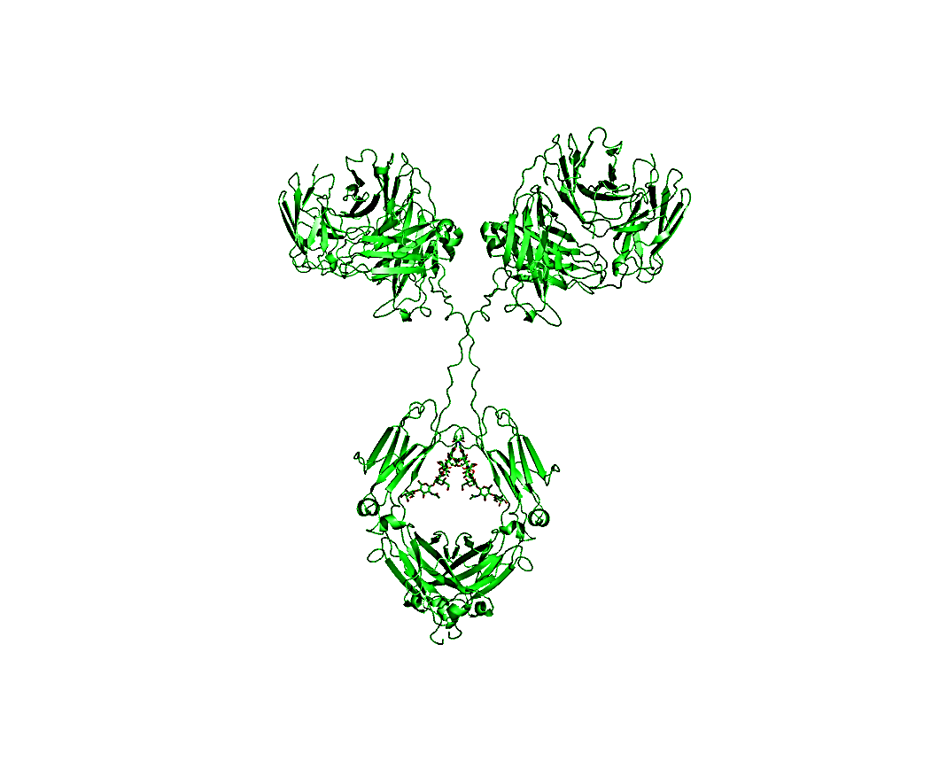


NMR Interlaboratory Study
Update: Version I
June 2017

Slide 2
Slide Deck Version I
June 2017
This slide deck contains
  authors and acknowledgements
  Breakdown of magnets employed in study
  Breakdown of Experiments Performed
  Selected ¹H,¹⁵N and ¹H,¹³C Spectral overlays
  Selection criteria for peak lists
  CCSD analysis for ¹H,¹³C and ¹H,¹⁵N chemical shifts
  PCA analysis on ¹H,¹³C weighted peak positions

Slide 3
Authors
NIST/IBBR
John Marino
Frank Delaglio
Robert Brinson
Luke Arbogast
John Schiel
Health Canada
Yves Aubin
Geneviève Gingras
Houman Ghasriani
Medical Products Agency (MPA-Sweden)
Andreas Blomgren
Torgny Rundlӧf
Genentech
Ken Skidmore
Hoffmann-La Roche Ltd.
Alfred Ross
Bruker BioSpin Corporation
Donna M. Baldisseri
Amgen
Mats Wikstrӧm
John B. Jordan
*If any additional staff contribute to the manuscript, they may be added to the author list

Slide 4
Authors
Biogen, Inc
Julie Yu Wei
Baxter Healthcare
Carlos A. Amezcua
Christina M. Szabo
Pfizer Essential Health
Edward R. Zartler
Stockhom University
Gӧran Widmalm
Jonas Ståhle
Momenta Pharmaceuticals
Desiree Tsao
EN-FIST Centra of Excellence
Janez Plavec
Gregor Ilc
Brazilian Center for Research in Energy and Materials (CNPEM)
Ana Carolina de Mattos Zeri
Mauricio Luis Sforça
Universitaet Bayreuth
Kristian Schweimer
Pacific Northwest National Laboratory (PNNL)
John R. Cort
Patrick N. Reardon
Chad W. Lawrence

Slide 5
Authors
National Research Council of Canada
Feng Ni
Ping Xu
Leibniz-Institut für molekulare Phamakologie (FMP-Berlin)
Peter Schmieder
Nils Trieloff
ETH-Zurich
Prof. Dr. Gerhard Wider
Thea Suter-Stahel
The University of Melbourne
David W. Keizer
Hamish G. Grant
Eli Lilly and Company
Scott A. Bradley
FDA-CBER
Darón Freedberg
FDA-CDER
Kang Chen
David Keire
The University of Queensland
Mehdi Mobli
Xinying Jia
Gregory K. Pierens
Medical University of South Carolina
Stuart Parnham
National Institutes of Natural Sciences (NINS)
Saeko Yanaka
Koichi Kato

Slide 6
Additional Acknowledgements
National Association of Proficiency Testing
Chuck Ellis
NIST-Gaithersburg
Anthony Kearsley
Ryan Evans
William Wallace
Bruker BioSpin Corporation
Clemens Anklin
Kim Colson
Genentech
Yung-Hsiang Kao
Harvard Medical School
Gerhard Wagner
Haribabu Arthanari
Sven Hyberts
Biogen
JC Hus
Leibniz-Institut für molekulare Phamakologie
Monika Beerbaum

Slide 7
Location of Collaborators
8 Pharmaceutical companies 1 vendor
8 Government Laboratories 9 academic labs
→ including 4 Regulatory Labs (2 FDA labs submitted data separately)
26 total laboratories from 25 total Institutions

Slide 8
Fields represented in the Study
Field Strength Number of Magnets
500 MHz 3
600 MHz 16
700 MHz 6
750 MHz 2
800 MHz 6
850 MHz 3
900 MHz 3
Total: 39 magnets
Manufacturers: Bruker and Agilent/Varian
Both room temperature and cold probes were used by participants

Slide 9
Total Number of Spectra
Number of Data Submissions: 28
(some partners submitted more than one data package)
Total Spectra: 451
  ¹H,¹⁵N Spectra: 76
  ¹H,¹³C Spectra: 375
  See next slide for breakdown of experiments

Slide 10
Final Breakdown of Experiments
EXPERIMENT CODE | Number of spectra | Tables fom NMR Study documentation Version 5
D1A | 36 | 1H,15N-gsHSQC | SSS | US, field dependent (Table 4)
D2A | 39 | 1H,13C-gsHSQC | SSS | US, 128 pts
D2B | 32 | 1H,13C-gsHSQC | SSS | 50% NUS
D2C | 41 | 1H,13C-gsHSQC | SSS | US, field dependent, 25ms acquisition (Table 6)
D2D | 31 | 1H,13C-gsHSQC | SSS | 50% NUS
D2E | 26 | 1H,13C-gsHSQC | SSS | 50% NUS, NS 2x of D2D
D3A | 47 | 1H,13C-gsHSQC | NIST-Fab | US, field dependent (Table 6)
D3B | 36 | 1H,13C-gsHSQC | NIST-Fab | 50% NUS, 25ms acquisition
E1 | 7 | 1H,13C-gsHSQC | one parameter change from experiments D; if NUS, NIST NUS schedule used
E1A | 45 | 1H,13C-gsHSQC | custom NUS schedule
E1B | 48 | 1H,13C-gsHSQC | Temperature change
E1C | 23 | 1H,13C-sfHMQC | sfhmqc
E2 | 5 | 1H,15N-gsHSQC | one parameter change from D1A, US only
E2N | 2 | 1H,15N-gsHSQC | custom NUS schedule
E2A | 14 | 1H,15N-gsHSQC | Temperature change
E2B | 8 | 1H,15N-pHSQC | phase sensitive HSQC
E2C | 11 | 1H,15N-sfHMQC | sfhmqc
Total 1H,13C Spectra |  | 375
Total 1H,15N Spectra |  | 76
TOTAL SPECTRA |  | 451

Slide 11
Experimental Identification and Catalog
See Catalog File: FINAL DATA SPREADSHEET_RELEASE.xlsx
  Spectra catalog will be released at the same time as the data
Participant ID + Experimental Number (e.g., 2461-002) will be displayed throughout slide deck
  Other details help NIST to quickly identify the type of experiment
Example of full experimental ID: D2A-S-U-800-2461-002-37C
  D2A Experimental ID from study documentation, Section D, Exp. 2A
  The NIST NMR Interlaboratory Study Documentation V5.pdf
  -S Which sample? –S = system suitability sample (SSS); -F = NIST-Fab
  -U What type of sampling? –U = uniform; -N = NUS
  -800 Field
  -2461 Participant ID
  -002 Participant experiment number
  -37C Temperature
Notes:
Any questions?

Slide 12
Sample Descriptions
100% Methanol-d4, in a sealed tube. This sample was used for temperature calibration.
429 µM Unlabeled NIST-Fab
  Derived from papain cleavage of intact NISTmAb
  Prepared at NIST/IBBR in Rockville, MD
53 µM U-¹⁵N, 20%-¹³C NIST-Fab, System Suitability Sample (SSS)
  Expressed in Pichia pastoris in the laboratory of Health Canada in Ottawa, Ontario, Canada
  This sample will serve as the benchmark for all measurements.
  Contains an extra 4 amino acid signal peptide (EAEA) on both the light and heavy chains that did not get cleaved as expected.
    This afforded a few extra peaks on the spectrum of the system suitability sample
  Health Canada shipped two batches of the SSS to NIST-IBBR. NIST mixed these batches and will distribute to all partners.
Buffer: 25 mM bis-tris-d19 pH 6.0, 5% D₂O

Slide 13
Do these extra residues compromise the purpose of the samples? NO!
The purpose SSS was to assess measurement performance on a high sensitivity sample
This was also fortuitous. The difference from the unlabeled NIST-Fab allowed for robust testing of chemometric analyses

Slide 14
Processing Work Flow for Analysis of Peak Positions
1) Manual Phasing
- can copy phasing for same HSQC-type per magnet
2) Autoprocessing using an adaption of Frank’s NMRPipe scripts
  - Extract out phasing from manual processing files.
  This process allows facile adjustment of other processing parameters.
  - Set max intensity to 100.
  - Convert to UCSF format.
3) Peak Analysis
  - software: NMRFam-Sparky
  - Primary Peak list: determined arbitrary peak list by comparison of lowest resolution data and 900 MHz data.
  - Aligned all spectra to a specific cross peak on 900 MHz spectrum.
  - Copied primary peak list and checked.
  - Exported peak lists to excel.
4) Excel Processing
- determined weighted peak lists
- Performed CCSD analysis
- For PCA analyses of peak positions, Matlab can read excel file
Notes:
Any questions?

Slide 15
Field Comparison:
System Suitability Sample
¹H,¹⁵N Amide Spectral Map
¹H,¹³C Methyl Spectral Map
Black = D1A-S-U-500-3897-009-37C
Red = D1A-S-U-900-8822-007-37C
Black = D2C-S-U-500-3897-012-37C
Red = D2C-S-U-900-8495-012-37C

Slide 16
Fingerprint Comparison at 900 MHz:
System Suitability Sample vs. NIST-Fab
Amide Spectral Map*
Methyl Spectral Map*
E2C-F-N-900-8822-030-37C red, NIST-Fab
E2N-S-N-900-8822-071-37C black, SSS
Both collected with SOFAST-HMQC, 50% NUS
D3A-S-U-900-7425-015-37C red, NIST-Fab
D2C-S-U-900-7425-012-37C black, SSS
Black = System Suitability Sample
Red = Unlabeled NIST-Fab
*Spectra displayed to maximize visual differences.
Notes:
• Reminder: Sequence difference between SSS and unlabeled NIST-Fab
• Common peak list was developed for both samples at all temperatures. The statistical separation that will be presented later is therefore due to the subtle shifts in peak position.

Slide 17
Additional Notes on SSS
Incorrect assumption stated during March 2017 conference calls: 20% ¹³C incorporation was completely random
Houman Ghasriani of Health Canada informed NIST that he ran a series of CT-HSQC experiment and compared these results to the gHSQC. For some peaks, he could measure 40 Hz splitting.
NIST confirmed Health Canada’s results in March 2017.
Conclusion:
  Yeast incorporation of ¹³C is non-random, especially for certain amino acids
  A subset of cross peaks clearly show some splitting, likely due to a higher incorporation of two ¹³C nuclei next to each other

Slide 18
Comparison of Selected Cross Peaks from D2B Spectra
D2B-S-N-600-5422-103-37C
Application of softer ¹³C apodization blurred many splittings and afforded more robust peak lists

Slide 19
Apodization Comparison of 3897-011, 500 MHz
(D2B-S-N-500-3897-011-37C)
¹H apodization 0.3 SP 0.3 SP 0.5 SP
¹³C apodization 0.3 SP 0.5 SP 0.5 SP
Previous processing for data presented in March 2017 conference calls (left panel)
  For both ¹³C and ¹H, 54 degree shifted sine squared window function followed by zero filling and FT. For US spectra, LP was used to the ¹³C dimension as well.
  This processing enhanced the observed splitting.
Updated processing to generate spectra for peak lists (center panel)
  ¹³C: 90 degree shifted sine squared window function followed by zero filling and FT
    This softer apodization blurred some of the splitting observed in D2B spectra.
  ¹H: 54 degree shifted sine squared window function followed by zero filling and FT.
    A 90 degree shifted window function in the ¹H dimension afforded the loss of too much resolution for spectra recorded at 500 MHz (right panel).

Slide 20
Updated Peak List: Defined from ¹H,¹³C spectrum at 500 MHz
Arbitrary peak list for both samples and all temperatures:
  953 cross peaks (41 % coverage)
  Peak list defined from lowest resolution data.
Peaks, in red, were removed from peak list due to poor resolution or poor S/N in a subset of gHSQC spectra.
Peaks, in green, are not resolved in many sfHMQC spectra.
354 ¹H,¹³C spectra were used in PCA peak analysis
338 ¹H,¹³C spectra were used in CCSD analysis
  See next two slides for details
Spectrum: D2C-S-U-500-3897-012-37C

Slide 21
¹H,¹³C Spectra Not Used in Peak Analysis Due to Poor Resolution, Artifacts and/or Signal-to-Noise
3676-102*
3676-104*
3676-105*
3676-106*
4233-180
6211-403
6324-016
7244-005
7244-015
8543-003
8822-024
8822-025
8822-049
1247-004
1247-005
1894-102
1894-103
1894-104
1894-105
1894-106
2461-107
The spectra will still be used in total point-by-point chemometric analysis
*all 3676 ¹H,¹³C spectra have doublets in the ¹H dimension.

Slide 22
Additional ¹H,¹³C Spectra not used in benchmark CCSD due to inability to phase CH2 resonances
All 800 MHz NUS spectra from 6272
All 800 MHz and 600 MHz NUS spectra 6211
SSS 800 MHz NUS spectra from 2146
  CH2 resonances are in-phase for D3B-F-N-800-2146-008-37C
All peaks from these spectra exhibited a slight systematic shift from benchmark US spectra
Common element to these spectra? All were collected using Topspin 2 and a vclist. The problem was determined to be a pulse program error by Feng Ni of NRC-Canada
  The standard gHSQC pulse program was pulled the Topspin pulse program library and modified for NUS acquisition using Topspin 2.
  The ¹⁵N decoupling pulse was not properly centered during ¹³C evolution.
  During testing, NIST tested NUS acquisition but did not use the ¹⁵N channel. Hence, this problem was unfortunately not discovered.
Peak Lists from these spectra included in PCA peak analysis

Slide 23
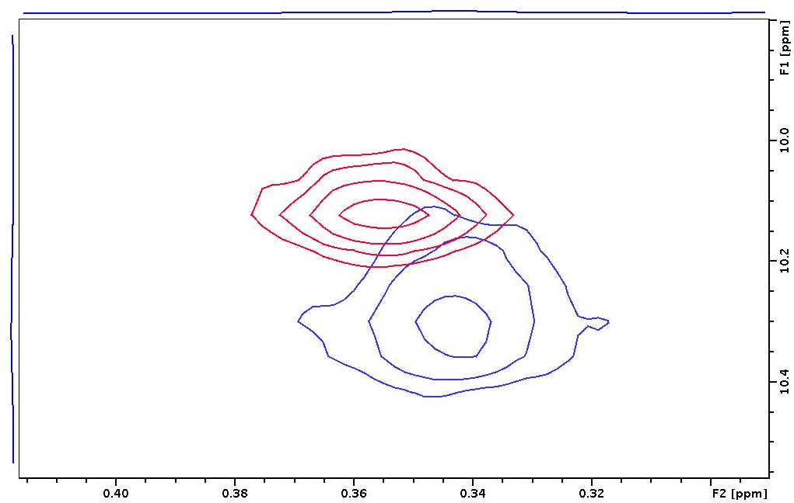
Precision of the Measurement:
Combined Chemical Shift Deviation
CCSD= “combined chemical shift difference”
√[0.5*((δ_{H1}-δ_{H2})²+(α *(δ_{C1} – δ_{C2})²)]
α = 0.251
¹³C(ppm)
Δδ_{C}
Δδ_{H}
¹H(ppm)
All spectra are benchmarked against D2A and D2C spectra
Notes:
Traditionally CCSD has been used to map spectral differences, in particular ligand binding. It can also be used to provide a weighted precision.

Slide 24
The majority of resonances in the arbitrary peak table have highly similar chemical shifts as compared to the system suitability sample. Only a small subset of peaks shifted significantly.
Data are benchmarked against D2A and D2C spectra

Slide 25
6324 also collected a gHSQC at 15 °C. Peak picking was problematic at 15 °C. All 15 °C data will be analyzed by different chemometric methods
Data are benchmarked against D2A and D2C spectra

Slide 26
*See next slide for comments*
Data are benchmarked against D2A and D2C spectra

Slide 27
CCSD Comments
The benchmark spectra (D2A & D2C) give a highly precise CCSD value of 2.8 ppm with the 95 % confidence interval less than 8 ppb.
The CCSD for NUS spectra (D2B, D2D, and D2E) is 3.5 ppb with a slightly larger confidence interval
The NIST-Fab spectra (D3A & D3B) also have highly precise CCSD values, 5.0 ppb and 5.6 ppb, respectively. This is consistent , since most resonances have highly similar chemical shifts as compared to the system suitability sample. Due to the shifts of a few resonances, the confidence intervals are enormous. See slide 24 for details.
Many custom NUS schedules (E1A-S-N), most of which were generated within Topspin, afforded a CCSD value with a large confidence interval.

Slide 29
¹H,¹⁵N CCSD
CCSD= “combined chemical shift difference”
√[0.5*((δ_{H1}-δ_{H2})²+(α *(δ_{C1} – δ_{C2})²)]
α = 0.1
Only 37 °C spectra used for CCSD calculation.
  Only a few spectra collected at difference temperatures
  Even fewer collected on the NIST-Fab
Total Spectra in ¹H,¹⁵N CCSD: 43
  D1A-S-U: 26
  E2-S-U*: 5
  E2B-S-U: 4
  E2C-S-U: 6
  E2N-S-N: 2
  * Different sweep widths were employed from NIST specifications.

Slide 30
¹H,¹⁵N Spectra Not Used in Peak Analysis Due to Poor Resolution, Artifacts and/or Signal-to-Noise
1894-101
2461-101
3655-101
6211-401
7244-005
7244-014
8179-310
All spectra on this slide will be used in total point-by-point chemometric analysis

Slide 32
Principal Component Analysis (PCA)
Dimensionality reduction
Background is given in “extra slides” at end of slide deck
  See tutorial review cited on those slides for details of how PCA is performed
Notes:
A straight line is drawn through the data to maximize the variation. A second orthogonal line is drawn to maximize the remaining variation. This process is repeated until all variation is explained.

Slide 33
PCA on Peak Position
Mean centered against traditional gsHSQC experiments D2A (128 total points in t₁) and D2C (25 ms in t₁) at all fields
  Each peak position in each spectrum was subtracted from mean position of that peak
  The mean was determined from all D2A & D2C data

Slide 34
PCA on ¹H,¹³C Weighted Peak Tables
Pro:
  1) do not need spectral assignments
  2) better to compare across multiple fields
  3) more robust with different acquisition methods (e.g., pulse programs, US, NUS, etc. are used)
Con:
  1) limited to resolved peaks
  2) Requires a degree of manual analysis, which can lead to subjectivity
  3) will miss new cross peaks

Slide 35
Clustering of Spectra within PCA space
Brief Definitions [taken directly from www.mathworks.com]
  K-medoids is similar to k-means, and the goal of both methods is to divide a set of measurements or observations into k subsets or clusters so that the subsets minimize the sum of distances between a measurement and a center of the measurement's cluster. In the k-means algorithm, the center of the subset is the mean of measurements in the subset, often called a centroid. In the k-medoids algorithm, the center of the subset is a member of the subset, called a medoid.
  Silhouette values range from -1 to +1. A high silhouette value indicates that is well-matched to its own cluster, and poorly-matched to neighboring clusters. If most points have a high silhouette value, then the clustering solution is appropriate. If many points have a low or negative silhouette value, then the clustering solution may have either too many or too few clusters.
The appropriate number of clusters, k, is determined, in part, by taking the mean silhouette value for each k.

Slide 36
PCA Plots of ¹H,¹³C Weighted chemical Shifts: 37 °C spectra

Slide 37
PCA Plots: ¹H,¹³C Weighted chemical Shifts: 37 °C
SSS
NIST-Fab
Two clusters: NIST-Fab and SSS
Red points: spectra collected in Topspin 2.X with uncompensated pulse program. These red points were manually labeled.
E1A-S-N-600-5479-103-37C is separated in PC3 & PC4. Many cross peaks were shifted.
Mean centered against traditional gsHSQC experiments D2A and D2C at all fields

Slide 38
Overlay of 5479-103 with 7425-012
Black = D2C-S-U-900-7425-012-37C
Red = E1A-S-N-500-5479-103-37C
E1A is a spectrum run with a custom NUS schedule. The schedule for 5479-102 was generated in Topspin and contained a lot of holes at the beginning.
See next slide for CCSD analysis of these two spectra

Slide 40
37 °C Spectra clustered using k-medoids with Silhouette Values
Mean(silh) = 0.7105
Mean(silh) = 0.729
Mean(silh) = 0.7535
NIST-Fab
SSS
5479-103
See next slide for comments

Slide 41
Comments on K-medoid Clustering of Spectra at 37 °C
Evaluated k = 2:6 with 6 principal components. Clusters of 2, 3, and 4 were plotted on the previous slide. Each color on the PCA plots represents a different cluster.
k = 2
  This is the simplest clustering, SSS and NIST-Fab
k = 3
  The SSS spectra are divided into two main clusters.
  The top cluster loosely correlates with the Topspin 2.X uncompensated spectra.
k = 4
  The “4th” magenta cluster separates out the 5479-103 spectrum.

Slide 42
Clustered PCA Plots with Confidence Intervals
Mostly pp error
9963-003
NIST-Fab
8179-308
6211-412
7244-011
5417-108
9966-003
1247-011
SSS
6211-408
4233-176
3897-016
4233-184
5479-103
4233-183
9966-005
Internal rings = 95 % confidence (2*σ)
External rings = 99.7 % confidence (3*σ)
Magenta spectrum = outside all confidence intervals, separated in PC3
Evaluated k = 2:5 with 6 principal components. Clusters of 2 and 4 are plotted. Each color represents a different cluster
The difference in confidence intervals for NIST-Fab is due to the use of k-medoids clustering. Maybe the use of k-means would provide a more robust measure?
k =2. This is the most basic clustering of SSS and NIST-Fab.
k =4. The SSS cluster is broken down into two clusters. The cluster in blue is loosely correlated with the spectra collected with the uncompensated pulse program.
Mean centered against traditional gsHSQC experiments D2A and D2C at all fields

Slide 43
99.7 % NIST-Fab Outlier Comments for Slide 42
Why may these spectra be outside the 99.7% confidence intervals?
E1A-F-N-500-8179-308-37C – subsequent analysis indicated temperature miscalibration. See later in slide deck
D3B-F-N-600-7244-011-37C – reason unknown; subset of signals slighted shifted when compared to 900 MHz D3A spectrum
E1A-F-N-800-6211-408-37C – pp error
D3B-F-N-800-6211-412-37C – pp error
D3B-F-N-600-5417-108-37C – reason unknown
E1C-F-N-600-4233-176-37C – sfHMQC; subset of signals slighted shifted when compared to
900 MHz D3A spectrum
E1A-F-N-600-4233-183 & -184 – use of SineBurst algorithm to generate custom NUS schedule
D3B-F-N-500-3897-016-37C – reason unknown
E1-F-U-600-1247-011-37C – power outage during acquisition, only 115 total points collected

Slide 44
99.7 % SSS Outlier Comments for Slide 42
Why may these spectra be outside the 99.7% confidence intervals?
Most outlier spectra are the result of the pulse program error. See slide 37.
D2B-S-N-600-9963-003-37C – reason unknown
E1A-S-N-500-9966-003&-005 – custom NUS schedules, subset of cross peaks shifted slightly
E1A-S-N-500-5479-103-37C – custom NUS schedule. See slide 38.

Slide 45
PCA Plots of ¹H,¹³C Weighted Chemical Shifts:
25 °C, 37 °C, 45 °C, 50 °C

Slide 46
PCA Plots of ¹H,¹³C Weighted chemical Shifts: All Temperatures
SSS
5479-103
50 °C
45 °C
37 °C
25 °C
NIST-Fab
7 clusters: NIST-Fab and SSS
Red points: spectra collected in Topspin 2.X with uncompensated pulse program. These red points were manually labeled.
E1A-S-N-600-5479-103-37C is separated in PC4. Many cross peaks were shifted.
5479-103
Mean centered against traditional gsHSQC experiments D2A and D2C at all fields

Slide 47
All Spectra clustered using k-medoids with Silhouette Values
k = 5; 7 PCs
Mean(silh) = 0.7189
k = 6; 7 PCs
Mean(silh) = 0.7227
k = 7; 7 PCs
Mean(silh) = 0.7436
SSS
50 °C
45 °C
37 °C
25 °C
NIST-Fab
See next slide for comments

Slide 48
Comments on K-medoid Clustering of All Spectra
Evaluated k = 4:8 with 7 principal components. Clusters of 5, 6, and 7 were plotted on the previous slide. Each color on the PCA plots represents a different cluster.
k = 5
  The magenta cluster represents the subcluster previously identified in the PCA of 37 °C spectra
  All 45 °C and 50 °C for both the NIST-Fab and SSS were put in one cluster. Five clusters are therefore not enough.
k=6
  The NIST-Fab and SSS are now separated out as two separate clusters for both 45 °C and 50 °C.
k=7
  The outlier, 5479-103 (in green), is identified as its own cluster
k=8 (not shown)
  An additional sub-cluster of the 37 °C SSS is created. However, the 45C and 50C spectra are still grouped together (SSS-45C/SSS-50C in gray and NIST-Fab-45C/NIST-Fab-50C in cyan) like the k=7 analysis.

Slide 49
Comments on K-medoid Clustering of All Spectra
Not enough spectra were collected at 45 °C and 50 °C for the k-medoids clustering with silhouette values to separate out these two temperatures.
Ryan Evans and Anthony Kearsley of NIST are working on additional chemometric methods for statistical clustering of these spectra.
For now, the data have been clustered manually (next slide)

Slide 50
Manually Clustered PCA Plot: PC1 vs. PC2
4533-004
8822-065
6272-017
6211-405
8822-061
8822-062
8822-063
All 8179
4533-007
1247-011
8179-312
4233-176
6272-013
6272-014
8179-308
8179-307
1894-108
1894-107
Internal rings = 95 % confidence (2*σ)
External rings = 99.7 % confidence (3*σ)
Centroid computed with K-means algorithm for each manual cluster (k=1)
See next slides for comments

Slide 51
99.7 % SSS Outlier Comments for Slide 49
50 °C SSS
  One outlier: E1B-S-U-4533-004-50C
    Very subtle shifts; See Slide 52 for temperature calibration data
37 °C SSS
  Pulse program error: 6272-017, 6211-405
  8822 spectra(-061, -062,-063, & -065) are likely due to temperature. This is 600 MHz magnet #2 for this lab. See next slide for illustration.
  Many 8179 500 MHz spectra are outside of 99.7% confidence interval, also likely due to a system temperature error.
25 °C SSS
  8179-312 is shifted due to temperature

Slide 52
8822-065 overlay
The highlighted peaks from 8822-065 (in red) falls between known spectra at 37 °C and 45 °C, suggesting that temperature control was mis-set or warmer than calculated from 8822-065.
6
30
34
35
D2C-S-U-600-8822-036-37C black
D2E-S-N-600-8822-065-37C red
D2C-S-U-600-8822-051-45C green

Slide 53
Temperature Calibration Curves
Temperature calibration curves were calculated separately for ¹H and ¹³C chemical shifted for peaks 6, 30*, 34, 35.
The calculated temperatures for each chemical shift were then averaged. See next slide.
*The ¹³C chemical shift was not used due to no observed deviation

Slide 54
Corrected Temperatures (°C)
D2B-S-N-600-9963-003-37C
D2A-S-U-600-8822-061-37C
D2B-S-N-600-8822-062-37C
D2C-S-U-600-8822-063-37C
D2D-S-N-600-8822-064-37C
D2E-S-N-600-8822-065-37C
D2A-S-U-500-8179-302-37C
E1A-S-N-500-8179-303-37C
D2C-S-U-500-8179-304-37C
E1A-S-U-500-8179-305-37C
E1A-S-U-500-8179-306-37C
E1B-S-U-500-8179-312-25C
E1B-S-U-600-4533-004-50C
35.9
39.1
39.6
39.5
39.0
42.9
35.0
34.6
34.6
34.6
35.4
22.7
48.3
These spectra were outside the 99.7% confidence intervals. Their deviation can, in part, be attributed to temperature deviation .

Slide 55
99.7 % NIST-Fab Outlier Comments for Slide 50
A temperature calibration curve was not calculated for NIST-Fab spectra
50 °C NIST-Fab
  4533-007. The only other ¹H,¹³C spectrum submitted, 4533-004, was collected at 48 °C instead of 50 °C (see slide 54). The trajectory of this spectrum in PCA space in consistent with a 2 °C deviation.
37 °C NIST-Fab
  8179-308 and -307 are likely shifted due to temperature deviation. See slide 54 for SSS temperature calibration
  6272-014 used the uncompensated pulse sequence.
  For both 6272-013 and -014, peaks 6, 30, 34, and 35 exhibit shifts consistent with a slightly higher temperature
  It is unknown why 4233-176 (a sfhmqc spectrum) is slightly shifted, although a subset of crosspeaks are indeed shifted.
  For 1247-011, a power outage occurred after 115 total points.
  It is unknown why both 1894-107 and -108 are shifted, although there are indeed slight shifts.

Slide 56
Manually Clustered PCA Plot: PC3 vs. PC4
Internal rings = 95 % confidence (2*σ)
External rings = 99.7 % confidence (3*σ)
Centroid computed with k-means algorithm for all spectra in PC3 & PC4
5479-103 falls outside the confidence intervals. See slide 38 for overlay.
Mean centered against traditional gsHSQC experiments D2A and D2C at all fields

Slide 57
Summary and What’s Next?
High precision observed, <4 ppb, for standard acquisition
Manual clustering of peak positions currently required
In general, it must be emphasized that most ‘outlier’ spectra are still highly precise. This is driven home by the CCSD analysis.
  Exceptions:
    Those not considered for peak position analysis (Slide 21)
    Spectra with the pulse program error (slide 22)
    Some custom NUS schedules, such as for 5479-103
Confidence intervals give statistical precision of how well method is performing

Slide 58
Future
PCA of total point-by-point spectral regions – will be released in a future update
Ryan Evans and Anthony Kearsley are actively working on statistical clustering methods, with the eye towards generating spectral loading plots

Slide 59
Release of Data
We have decided that processing scripts will be released with the data. This has delayed the data release, but will allow easier manipulation of all spectra by partners.
Once ready, NIST will release the data on the online forum

Slide 60
Public Presentation of Data
First presentation of data was given by Robert Brinson on March 15,2017. Only data submitted by 02/12/2017 was used.
Keystone Symposia: Frontiers of NMR in Life Sciences
https://www.keystonesymposia.org/17C5
- This study was incorporated as part of a broader talk of NIST’s NMR program in biomanufacturing.
-The following disclaimer was used:
The data presented herein are preliminary results of a large study with ~25 partnering institutions. Any conclusions or implications represent the opinion of NIST authors and not the consensus of all partners in the study.
Suggested presentation guidelines
  Goal: group consensus
  Until 1st publication: slide deck emailed to all partners 2 weeks in advance?

Slide 61
Extra Slides

Slide 62
Excursus: Introduction to
Principal Component Analysis
Raw Data
1) Draw Straight line:
Maximize variation
2) Draw orthogonal 2nd line:
Maximize remaining variation
Adbi, H.; Williams, L.J. WIREs Computational Statistics, 2010, 2, 433-459.
Notes:
Raw data input as data matrix

Slide 63
Excursus: Introduction to
Principal Component Analysis
Raw Data
PC1
PC2
Adbi, H.; Williams, L.J. WIREs Computational Statistics, 2010, 2, 433-459.

Slide 64
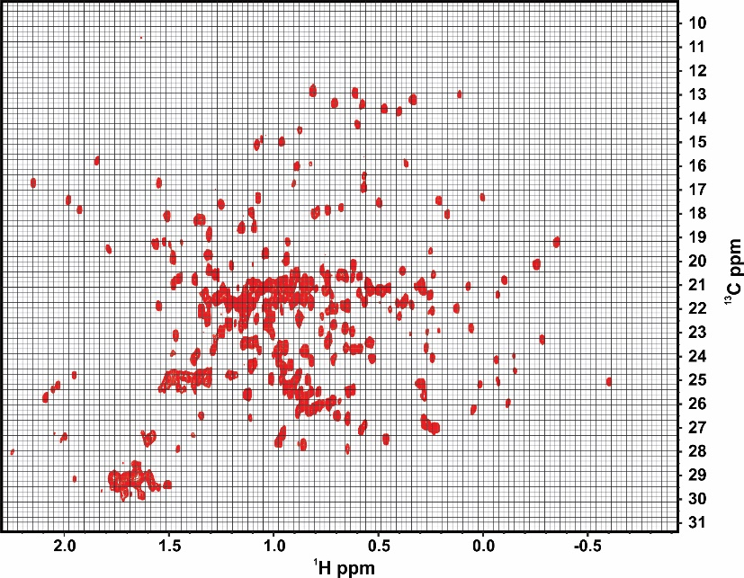
PCA on Total-point-by-Point Matrix
Total point-by-point matrix of a Fingerprint region
  Pro: 1) do not need spectral assignments
  2) able to catch appearance of new cross peaks
  3) more ability to automate processing and analysis, leading to less subjectivity
  Con:
    1) field dependent spectral effects hinder comparability across fields
    2) differences in pulse sequence performance
Notes:
For method #1, can create spectral loading plot.
Frank is working on alignment within NMRPipe. PCA on fingerprint region will be performed once this is accomplished.

