Slide 1
NIST Published data
Please cite:
1) 13C data
Arbogast, L.W.; Brinson, R.G.; Marino, J.P. Mapping Monoclonal Antibody Structure by 2D ¹³C NMR at Natural Abundance. Analytical Chemistry, 2015, 87, 3556 – 3561.
2) 15N data
Arbogast, L.W.; Brinson, R.G.; Marino, J.P. 2D ¹H^{N}, ¹⁵N Correlated NMR Methods at Natural Abundance for Obtaining Structural Maps and Statistical Comparability of Monoclonal Antibodies. Pharmaceutical Research, 2016, 33,462-475

Slide 2
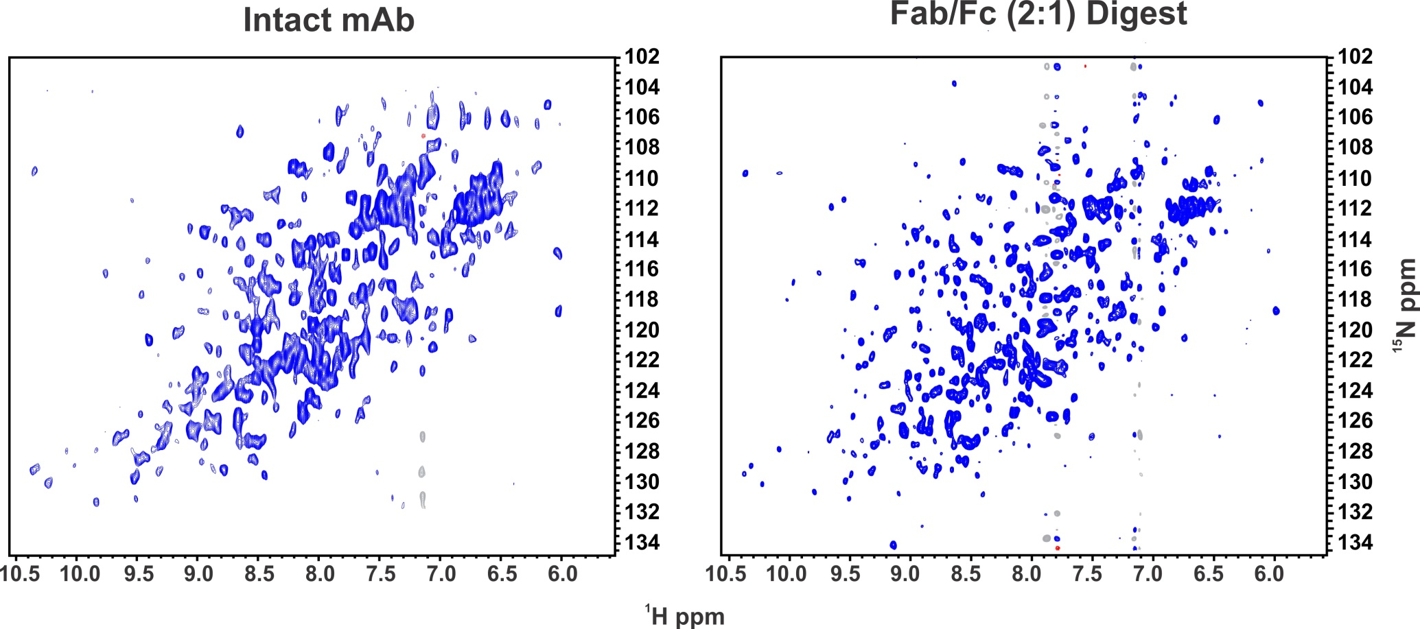
900 MHz mAb Amide Spectra
64 hrs
32 hrs
Arbogast, L.W.; Brinson, R.G.; Marino, J.P. 2D ¹H^{N}, ¹⁵N Correlated NMR Methods at Natural Abundance for Obtaining Structural Maps and Statistical Comparability of Monoclonal Antibodies. Pharmaceutical Research, 2016, 33,462-475

Slide 3
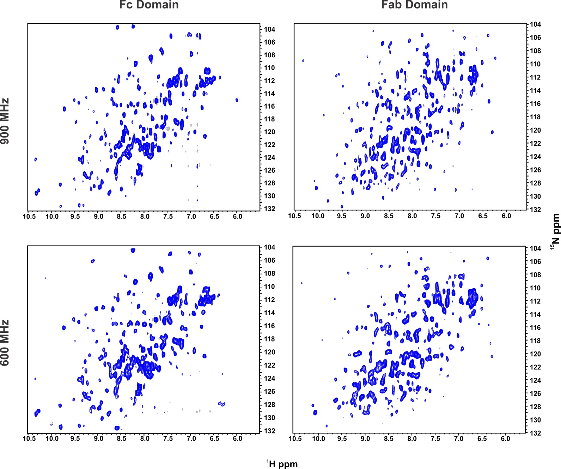
mAb Domain Amide Spectra
32 hrs
32 hrs
64 hrs
64 hrs
Arbogast, L.W.; Brinson, R.G.; Marino, J.P. 2D ¹H^{N}, ¹⁵N Correlated NMR Methods at Natural Abundance for Obtaining Structural Maps and Statistical Comparability of Monoclonal Antibodies. Pharmaceutical Research, 2016, 33,462-475

Slide 4
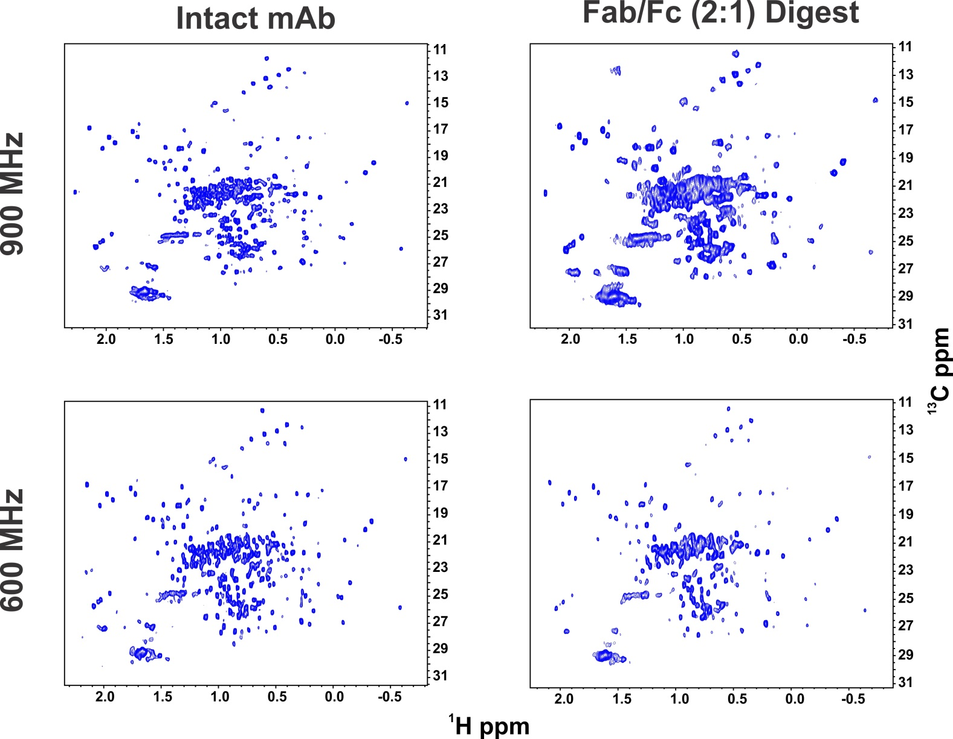
NISTmAb Methyl Spectra
9 hrs
4.5hrs
9 hrs
9 hrs
Arbogast, L.W.; Brinson, R.G.; Marino, J.P. Mapping Monoclonal Antibody Structure by 2D ¹³C NMR at Natural Abundance. Analytical Chemistry, 2015, 87, 3556 – 3561.

Slide 5
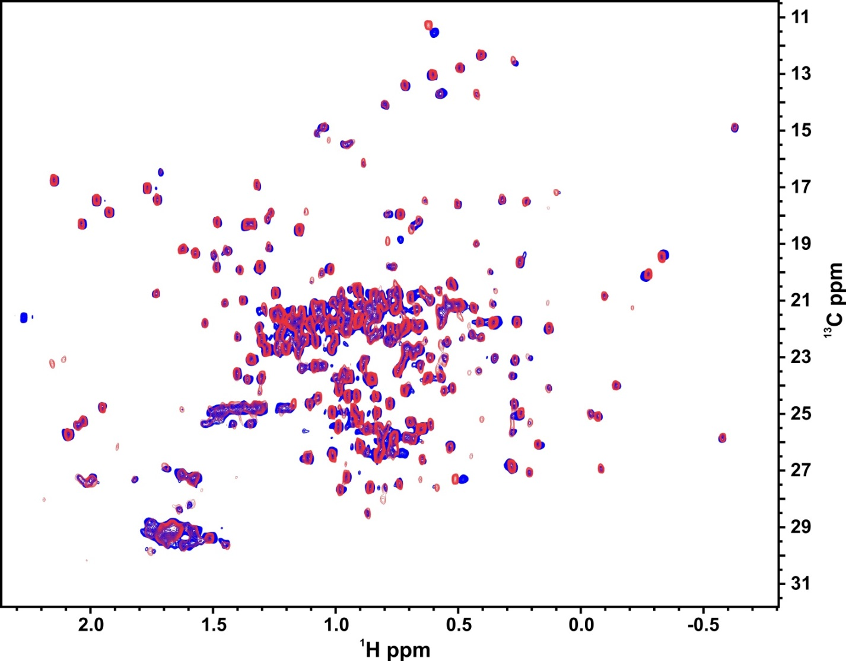
Domain Cleavage does not alter HOS
Red= Fab/Fc (2:1)
Blue=Full length
Overlay spectrum of the full length NISTmAb (blue) and
the Fab/Fc (2:1) digest product (red).
Arbogast, L.W.; Brinson, R.G.; Marino, J.P. Mapping Monoclonal Antibody Structure by 2D ¹³C NMR at Natural Abundance. Analytical Chemistry, 2015, 87, 3556 – 3561.

Slide 6
Interlaboratory Study: Goals
To harmonize and to validate NMR structural fingerprinting measurements for the assessment of higher order structure of large protein biologics and/or domains from these proteins. The validation of NMR methods for the characterization of the higher order structure of mAbs is specifically targeted due to the large interest of the pharmaceutical industry in using mAbs as platforms for therapeutic development.
Samples
U-¹⁵N, 20%-¹³C NIST-Fab system suitability sample. This NIST-Fab sample was expressed in P. pastoris at Health Canada in Ottawa, Ontario, Canada. This sample is serving as the benchmark for all measurements.
Unlabeled NIST-Fab. This NIST-Fab sample was derived from the NISTmAb candidate reference material #8670. The unlabeled fragment was generated at NIST-IBBR in Rockville, MD, USA.
A total of 30 collaborating institutions from 10 countries, with equal participation from industry, academia, and government.
Notes:
Goal of Conference Call:
Emphasize a few salient points
Take questions and comments
I will pause every so often to take questions/comments

