Slide 1
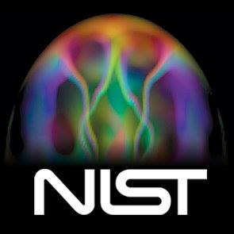

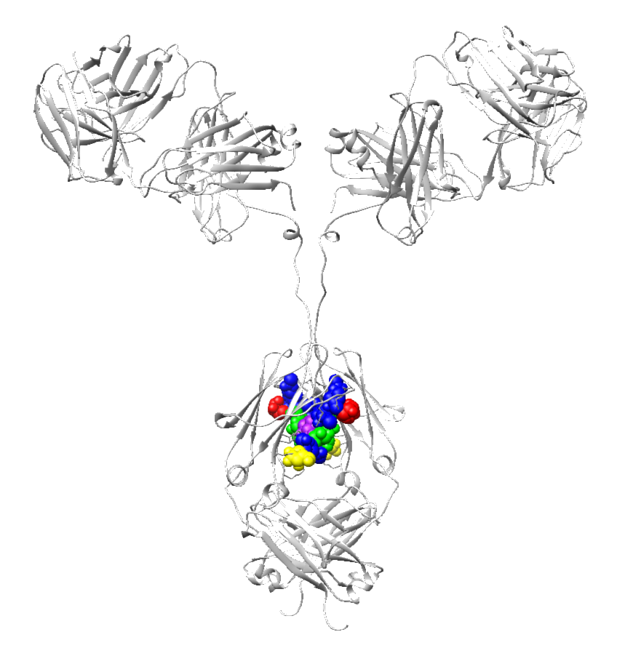

The NISTmAb Interlaboratory NMR Study
¹H / ¹³C Data Release 3, May 2018
Study Lead: Dr. Robert Brinson
robert.brinson@nist.gov
Introduction
About the Study Samples
How the Time-Domain Data Files are Organized
Experiment Codes
About the Meta Data Table meta.tab
Columns in the Meta Data Table meta.tab
How the Processed Spectra are Organized
How the Spectra Were Processed
Baseline Correction
How the Spectra Were Auto-Phased in the ¹H Dimension
Update on Chemical Shift Calibration
How Chemical Shift Calibrations Were Aligned
Web-Based Viewing of the Study Data Collection
Example Spectra, and All Spectra as an Animation
Some Principal Component Analysis (PCA) Results
Future Data Releases
Installing NMRPipe
How to Use the Master Processing Script to Re-Process Data
Study Authors
Acknowledgements
NIST Disclaimer
Prepared by frank.delaglio@nist.gov
Updated May 25 2018 v3

Slide 2
The NISTmAb Interlaboratory NMR Study ¹H / ¹³C Data Release 3
Introduction
The NISTmAb Interlaboratory NMR Study is a joint effort between 25 organizations to evaluate the performance of two-dimensional (2D) heteronuclear NMR as used to characterize the high order structure (HOS) of proteins, with the aim of supporting the use of NMR to characterize biologic therapeutics.
The study was organized and led at NIST by Dr. Robert Brinson.
In the study, each participating lab measured a series of NMR spectra on two kinds of solution-state protein samples, both based on the NISTmAb.
The NISTmAb is a monoclonal antibody reference material available from NIST. It is intended to provide a representative molecule for testing and development of methods for therapeutic protein characterization:
https://www.nist.gov/programs-projects/nist-monoclonal-antibody-reference-material-8671
This presentation describes the collection of ¹H / ¹³C 2D NMR data produced by the study, so that the data can be distributed to the participants. The collection contains all the original time-domain data as measured by the participants, converted to a common format. It also includes corresponding spectra as processed at NIST, and the software scripts and processing parameters that were used to generate the spectra.
This third version of the ¹H / ¹³C spectra, Data Release 3, supersedes the previous releases. This new release changes chemical shift calibrations to a DSS standard. Release 3 also includes adjustments to processing and alignment for some spectra, including a new method of baseline correction. The changes are detailed in the update log of the metadata table provided with the data. Some updated Principal Component Analysis results are reported here as well.

Slide 3
The NISTmAb Interlaboratory NMR Study ¹H / ¹³C Data Release 3
About the Study Samples
429 µM Unlabeled NIST-Fab (Fab)
  Derived from papain cleavage of intact NISTmAb
  Prepared at NIST/IBBR in Rockville, MD
53 µM U-¹⁵N, 20%-¹³C NIST-Fab, System Suitability Sample (SSS)
  Based on the amino acid sequence of the NISTmAb Fab domain.
  Expressed in Pichia pastoris in the laboratory of Health Canada in Ottawa, Ontario, Canada
  Contains an extra 4 amino acid signal peptide (EAEA) on both the light and heavy chains that did not get cleaved as expected.
Buffer: 25 mM bis-tris-d19 pH 6.0, 5% D₂O

Slide 4
The NISTmAb Interlaboratory NMR Study ¹H / ¹³C Data Release 3
How the Time-Domain Data Files are Organized
All data are in a master directory named “study”.
Data are stored in NMRPipe format (https://www.ibbr.umd.edu/nmrpipe).
Data are either uniformly-sampled (US) or Non-Uniformly Sampled (NUS).
The data are described by a text table “meta.tab” which includes measurement details, chemical shift calibration information, and processing parameters.
Each participating lab has an anonymous 4-digit Lab ID number, and all the data from that lab is in a directory with that 4-digit ID.
Within data from a given lab, each spectrum from that lab has a 3-digit Measurement ID.
The file names associated with a given spectrum have names with the Lab ID and Measurement ID. For example, lab 8822 has these files associated with measurement 37 from that lab:
  study / 8822 / 8822-037.info Text file with acquisition information
  study / 8822 / 8822-037.fid Time-domain data, NMRPipe format
  study / 8822 / 8822-037.nus NUS sampling schedule text file, if any
  study / 8822 / 8822-037_mask.fid NMRPipe-format NUS mask data, if any
  study / 8822 / 8822-037.com NMRPipe processing script

Slide 5
The NISTmAb Interlaboratory NMR Study ¹H / ¹³C Data Release 3
Experiment Codes
The type of measurement for each spectrum is described by a two or three letter experiment code. The codes for ¹H / ¹³C spectra are:
  D2A gsHSQC Uniformly-Sampled (US), 64 complex points.
  D2B gsHSQC 50% Non-Uniformly Sampled (NUS).
  D2C gsHSQC US, field dependent, 25ms acquisition.
  D2D gsHSQC 50% NUS.
  D2E gsHSQC 50% NUS, 2x scans of D2D.
  D3A gsHSQC US, field dependent.
  D3B gsHSQC 50% NUS, 25ms acquisition.
  E1 gsHSQC One parameter change from experiments D;
  For NUS measurements, the NIST NUS schedule was used.
  E1A gsHSQC Custom NUS schedule.
  E1B gsHSQC Temperature change.
  E1C sfHMQC sofast HMQC.

Slide 6
The NISTmAb Interlaboratory NMR Study ¹H / ¹³C Data Release 3
About the Meta Data Table meta.tab
The text table “meta.tab” includes measurement details, chemical shift calibration information, and processing parameters for all the ¹H / ¹³C spectra in the study.
Each spectrum is described by one line in the table.
There are 375 spectra listed.
The VARS line names the columns of the table.
The FORMAT line encodes what kind of information is stored in a column, either integer (%d) text (%s) or floating point values (%f).
Excerpt:
VARS INDEX DIR_NAME CODE TITLE XP0 XP1 Y_FTARG YP0 YP1 XBASE_FRAC XBASE_ORD BASE_IST YBASE_ORD DX_PPM DY_PPM COLOR NOTE
FORMAT %3d %4s %8s %26s %6.1f %6.1f %7s %6.1f %6.1f %.3f %4s %s %7s %8.5f %8.5f %s %s
1 8822 8822-010 D2C-S-U-900-8822-010-37C 45.5 -77.1 None 90.0 0.0 0.050 4 1 Default -0.01170 2.51098 #00ffff “Reference”
2 7425 7425-010 D2A-S-U-900-7425-010-37C 53.9 -100.5 None -90.0 0.0 0.050 4 1 Default 0.00625 2.51299 #00ffff None
3 7425 7425-012 D2C-S-U-900-7425-012-37C 43.1 -83.4 None -90.0 0.0 0.050 4 1 Default 0.00568 2.51071 #00ffff None
4 7425 7425-015 D3A-F-U-900-7425-015-37C 37.3 -75.6 None -90.0 0.0 0.050 4 1 Default 0.00582 2.50717 #00ffff None
5 8495 8495-010 D2A-S-U-900-8495-010-37C 84.0 -60.8 None -90.0 0.0 0.050 4 1 Default -0.05918 2.50389 #00ffff None
6 8495 8495-012 D2C-S-U-900-8495-012-37C 92.0 -71.7 None -90.0 0.0 0.050 4 1 Default -0.05943 2.50366 #00ffff None
7 8495 8495-015 E1-F-U-900-8495-015-37C 92.3 -69.3 None -90.0 0.0 0.050 4 1 Default -0.05895 2.49908 #ffff00 None
8 8495 8495-017 D3A-F-U-900-8495-017-37C 89.4 -65.4 None -90.0 0.0 0.050 4 1 Default -0.05928 2.50861 #00ffff None

Slide 7
The NISTmAb Interlaboratory NMR Study ¹H / ¹³C Data Release 3
Columns in the Meta Data Table meta.tab
INDEX A unique index number for the spectrum, from 1 to 375.
DIR_NAME The directory containing the spectrum; the directory name is the same as the Lab ID, such as “8822”.
CODE A unique code name for the spectrum, consisting of the Lab ID and Measurement ID,
such as “8822-037”.
TITLE A text title for the spectrum, such as “D2C-S-U-900-8822-010-37C”. The title fields are:
type of measurement (experiment code), sample type (S for System Suitability Sample, F for
NISTmAb Fab), sampling scheme (U for uniform, N for non-uniform), spectrometer frequency in
MHz, Lab ID, Measurement ID, and temperature.
XP0 XP1 Zero and first order phase correction for the directly-detected (¹H) dimension.
Y_FTARG Sign adjustments needed to Fourier transform the indirect dimension, either “None”
(no adjustment), “neg” (negate imaginaries), or “alt” (change sign of alternating points).
YP0 YP1 Zero and first order phase correction for the indirect (¹³C) dimension.
XBASE_FRAC If this value is 1.0, baseline correction was applied to all ¹H vectors. If it is less than one, only that
fraction of vectors at either edge of the spectrum were corrected.
XBASE_ORD Polynomial order used for baseline correction of the directly-detected dimension.
YBASE_ORD Polynomial order used for baseline correction of the indirect dimension.
BASE_IST Additional baseline correction via Iterative Soft Thresholding (IST), 0 = no additional correction,
1 = full X-Axis, 2 = full Y-Axis, 3 = both X-Axis and Y-Axis.
DX_PPM Adjustment needed to calibrate the chemical shifts in the directly-detected dimension, ppm.
DY_PPM Adjustment needed to calibrate the chemical shifts in the indirect dimension, ppm.
COLOR Used to associate a color with a given spectrum, either as a name (like “red”) or
Red-Green-Blue (RGB) hex code (like “#ff0000”).
NOTE Comment about the spectrum; if there are spaces, the comment is surrounded by quotes.

Slide 8
The NISTmAb Interlaboratory NMR Study ¹H / ¹³C Data Release 3
How the Processed Spectra are Organized
The original processed spectra are in the directory “study/ft”.
All spectra were processed with NMRPipe, and are in NMRPipe format.
The file names in directory “study/ft” consist of the index number, the Lab ID, and the Measurement ID. The first spectrum is named “001-8822-010.ft2” and the last is named “375-9966-007.ft2”.
Because a variety of acquisition details were used, the spectra in the directory “study/ft” have different sizes and chemical shift ranges.
Directory “study/interp” contains versions of the original spectra interpolated via bi-linear interpolation, so that they all have the exact same size and chemical shift range as the first spectrum in the collection.
The file names in directory “study/interp” are based on the index number for the spectrum. The first spectrum is named “001.ft2” and the last is named “375.ft2”.
The files in directory “study/interp” are saved as an NMRPipe-format pseudo-3D data set. This means that the entire spectral collection can be accessed and viewed at once in NMRPipe’s “nmrDraw” spectral display interface, and the mouse scroll wheel can be used to move through the spectral series:
nmrDraw –in interp/%03d.ft2

Slide 9
The NISTmAb Interlaboratory NMR Study ¹H / ¹³C Data Release 3
How the Spectra Were Processed
The original time-domain data and header parameters were not modified.
Solvent signal was subtracted in the time-domain by convolution difference.
Cosine-squared bell windows were used in the ¹H dimension, and cosine bell windows were used in the ¹³C dimension. The cosine bells go from sin(0.5π) to sin(0.95π).
The ¹H dimension was zero filled to 4096 complex points, and the ¹³C dimension to 1024 complex points.
During processing, only the region from ¹H = 3.6ppm to -1.0ppm was retained.
Zero and first order phase corrections for the ¹H dimension were determined automatically for ~90% of the spectra.
In cases where visual inspection indicated that the ¹H dimension needed additional phase correction, phase correction was determined interactively; these cases are noted in the NOTE column of table “meta.tab”.
In most cases, the ¹³C dimension needed only “canonical” phase corrections, either: (P0 = +/- 90, P1 = 0) (P0 = +/- 90, P1 = 180) or (P0 = -180 +/- 90, P1 = 360).
In cases where visual inspection indicated that the ¹³C dimension needed additional phase correction, phase correction was determined interactively (~5% of spectra).
NUS data were reconstructed with NMRPipe’s implementation of Iterative Soft Thresholding (IST).
Each spectrum was rescaled so that the maximum intensity is 100.0.

Slide 10
The NISTmAb Interlaboratory NMR Study ¹H / ¹³C Data Release 3
Baseline Correction
An attempt was made to minimize the use of baseline correction in the ¹H dimension, because many results were better without it.
Because of the measurement and instrument variations, we found no single baseline correction scheme suitable for all spectra. Therefore, schemes were varied to allow only a portion of the data to be corrected, and to choose the polynomial order for correction (usually 4, 2, 1, or 0) that gave visually good results for a given spectrum.
In Data Release 3, we introduced an additional baseline correction method based on Iterative Soft Thresdholding (IST), a method also used to reconstruct Non-Uniformly Sampled (NUS) spectra. IST baseline correction works by replacing the first points of the time-domain data in a given dimension. In the majority of spectra, two-point IST baseline correction was applied in the ¹H dimension.
By default, no baseline correction was applied in the ¹³C dimension.
In ~3 cases where the ¹³C dimension had a first order phase correction of P1 = 360, zero-order baseline correction was applied.
In ~14 other cases, visual inspection indicated that additional baseline correction in the ¹³C dimension was needed, and zero-order baseline correction was applied.
In about ~8 other cases, one-point IST baseline correction was applied in the ¹³C dimension.

Slide 11
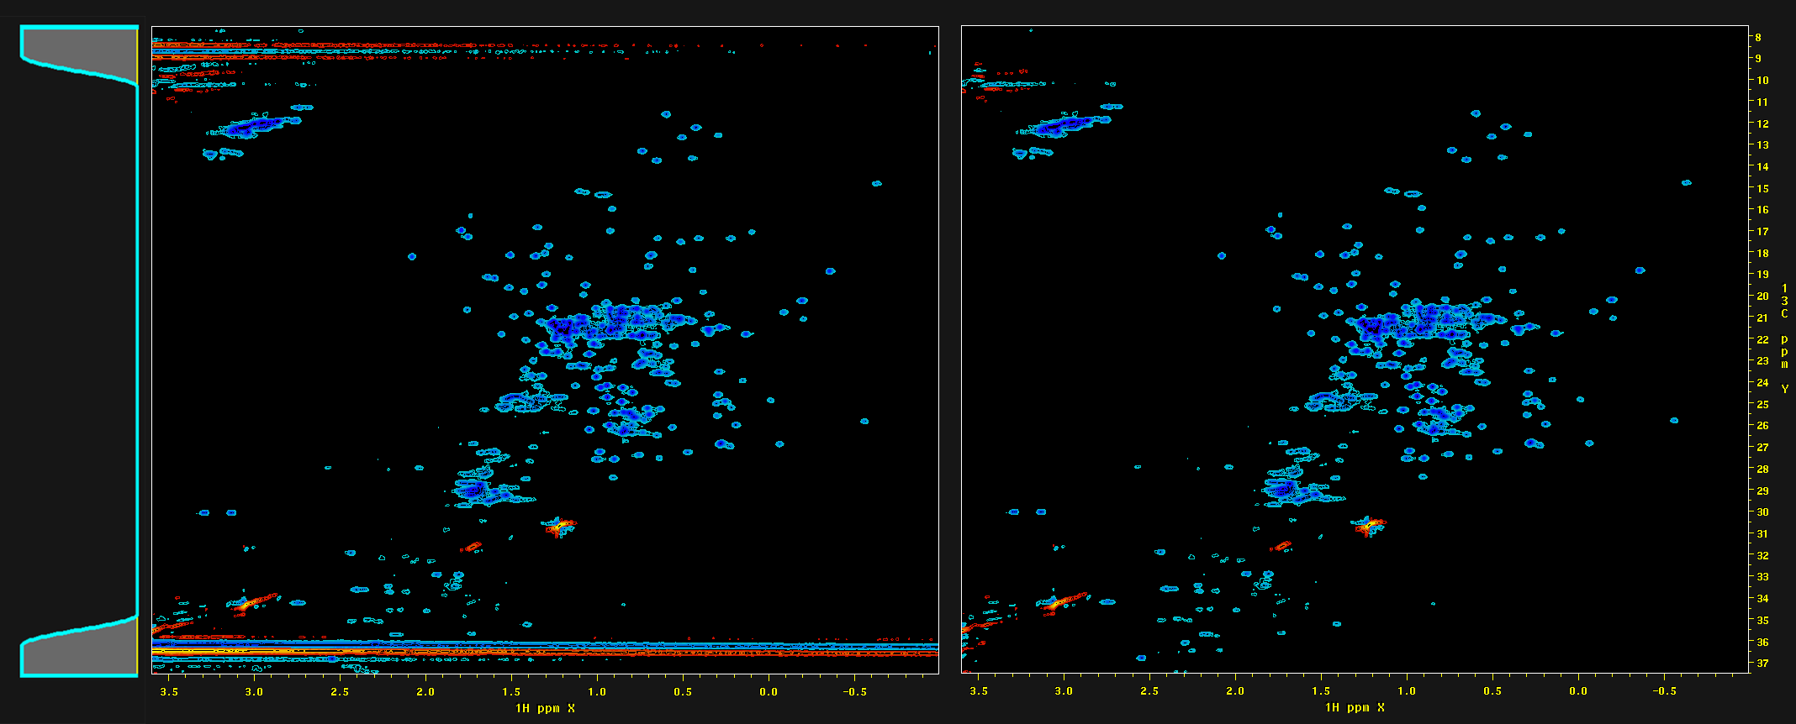
The NISTmAb Interlaboratory NMR Study ¹H / ¹³C Data Release 3
¹H Selective Baseline Correction
Many spectra had strong axial artifacts at either edge of the ¹³C chemical shift range. So, a baseline correction scheme was used where only 5% of the ¹H vectors at either edge of the spectrum were fully corrected, followed by 5% of vectors corrected according to a cosine-square roll-off scheme that applied decreasing amount of correction further from the edge.
8822-070.ft2 Before Correction
After 4th Order Correction
Correction
Roll-Off Profile
(XBASE_FRAC = 0.05)
5% of Spectral Width
Roll-Off Correction
5% of Spectral Width
Fully Corrected

Slide 12
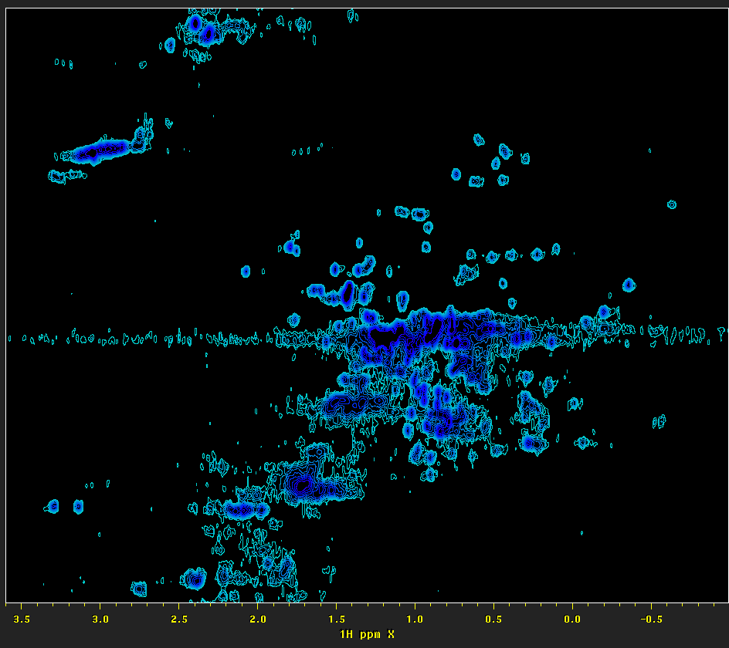
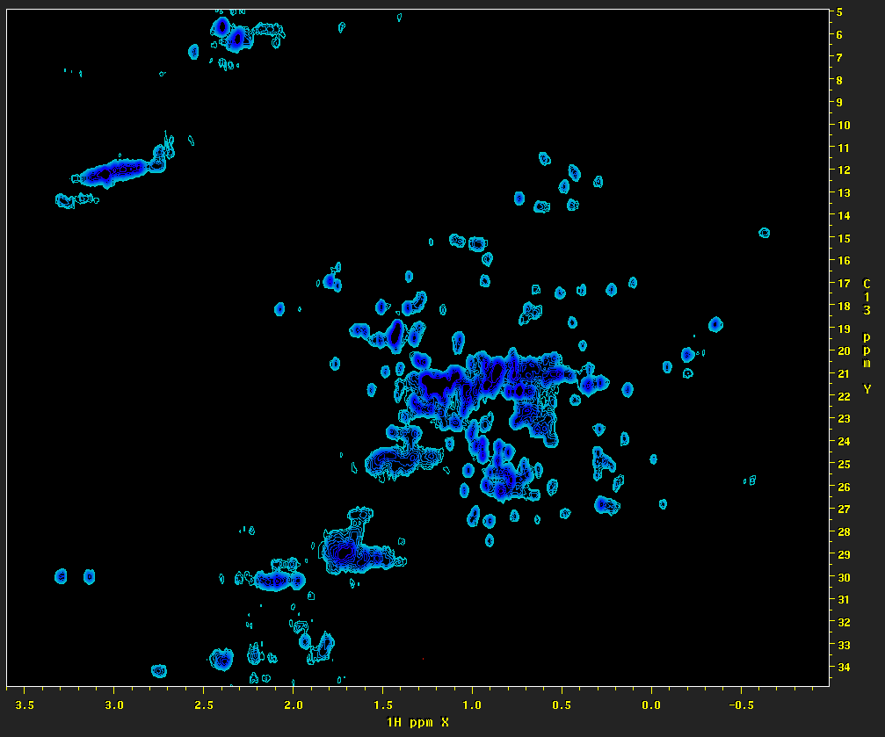
The NISTmAb Interlaboratory NMR Study ¹H / ¹³C Data Release 3
Iterative Soft Thresholding (IST) Baseline Correction
IST is used to replace “missing” points in NUS data. In a spectrum, baseline offset is due to a distortion in the first point of the corresponding time-domain data, and baseline curvature is due to the second and higher points in the time-domain. So, baseline correction can be achieved by inverse transforming the spectral region of interest, and then using IST to replace the first one or more points in the time-domain.
2461-102 Before Correction
After Two-Point IST Correction

Slide 13
The NISTmAb Interlaboratory NMR Study ¹H / ¹³C Data Release 3
Update on Chemical Shift Calibration
In Data Release 3, the chemical shift calibration reference was changed to DSS (4,4-dimethyl-4-silapentane-1-sulfonic acid).
Additional 1D and 2D spectra were collected on samples which included DSS, to establish the position of 0.0ppm in the ¹H dimension, with the indirect dimensions calibrated accordingly. The spectra and scripts used for this calibration are stored in the “study/calib” directory, with results as follows:
¹H / ¹³C Calibration:
Data: 51 Study Master Peak 29 ¹H: 0.5120 ppm, ¹³C: 17.4962 ppm (folded)
Data: 52 Study Master Peak 29 ¹H: 0.5139 ppm, ¹³C: 17.4926 ppm
Average (as used to calibrate study): ¹H: 0.513, ¹³C: 17.494 ppm
¹H / ¹⁵N Calibration:
Data: 111 Study Master Peak 68 ¹H: 7.546 ppm, ¹⁵N: 118.978 ppm

Slide 14
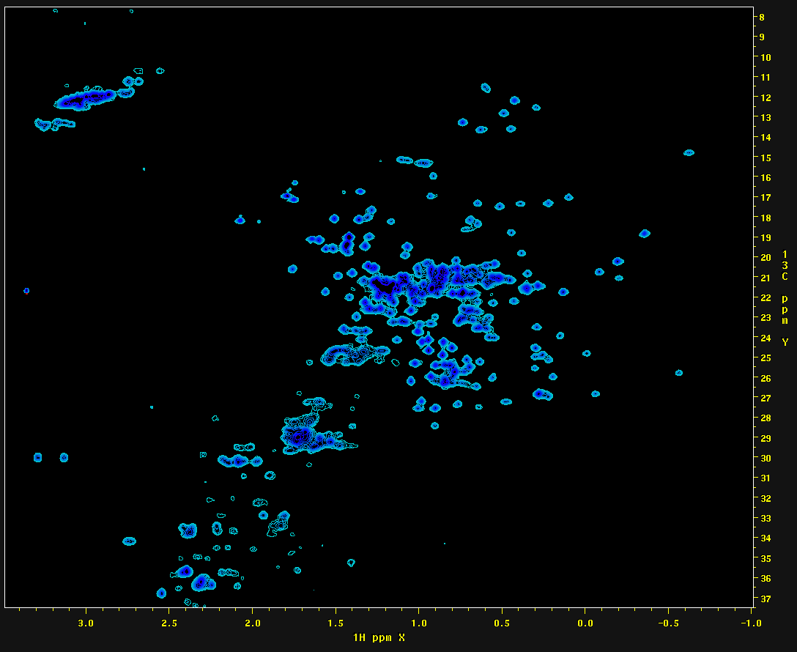
The NISTmAb Interlaboratory NMR Study ¹H / ¹³C Data Release 3
How the Spectra Were Auto-Phased in the ¹H Dimension
Spectrum 001-8822-010.ft2 (reference for spectral alignment) shown:
First Order Phase:
Minimize left side/right side difference in the region ¹H 3.535 ppm to 2.535 ppm, within ¹³C +/- 0.25 ppm of the largest peak.
Zero Order Phase:
Minimize sum squared of negative intensities in the region ¹³C 24.5 ppm to 18.5 ppm.

Slide 15
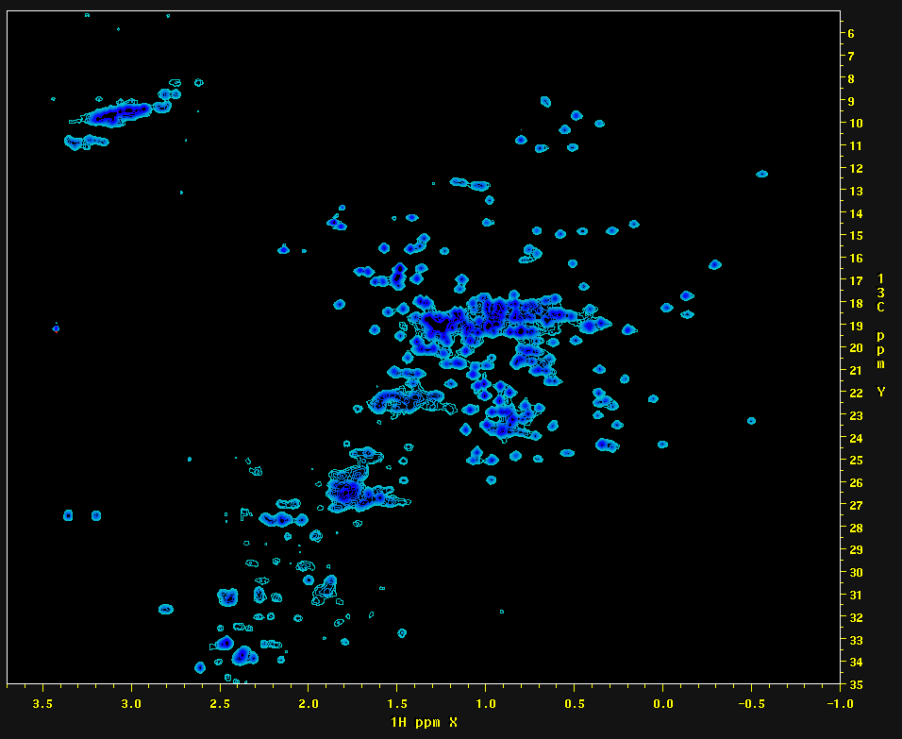
The NISTmAb Interlaboratory NMR Study ¹H / ¹³C Data Release 3
How Chemical Shift Calibrations Were Aligned
Spectrum 001-8822-010.ft2 was used as reference for spectral alignment.
Initial alignments were determined automatically according to ¹H and ¹³C 1D projections. Alignments were found that minimized the sum square difference between the projection from the reference and the shifted projection from a given spectrum.
According to the new DSS chemical shift calibration scheme, final alignment values are determined automatically by detecting peaks in the region (¹H 0.640 ppm to 0.510ppm), (¹³C 15.70 ppm to 14.30ppm), and setting the largest peak there to (¹H 0.513 ppm, ¹³C 17.494 ppm).
Reference Peak:
¹H: 0.513 ppm
¹³C: 17.494 ppm
Change from Previous Reference Scheme:
Δ ¹H -0.065 ppm
Δ ¹³C 2.498 ppm

Slide 16
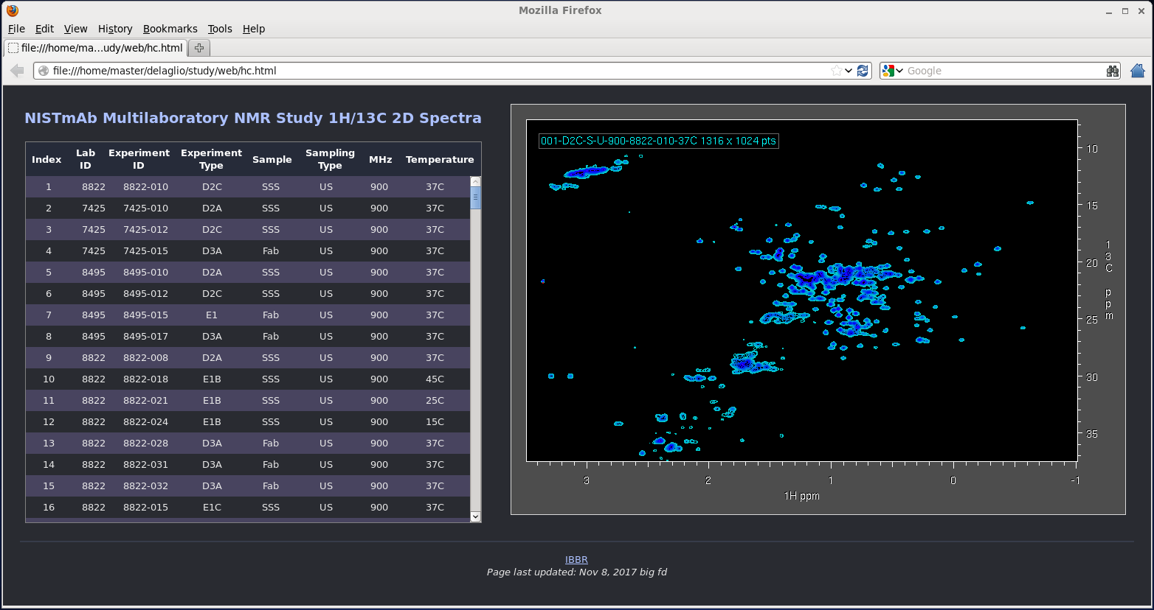
The NISTmAb Interlaboratory NMR Study ¹H / ¹³C Data Release 3
Web-Based Viewing of the Data Collection
The data distribution includes a simple web page (web/hc.html) for viewing pre-generated images of all the spectra. The interface contains a sortable scrolling list of the spectra. Clicking on a given row in the list will display the image of that spectrum. Clicking on a given column name at the top of the list will sort the list according to the values in that column.

Slide 17
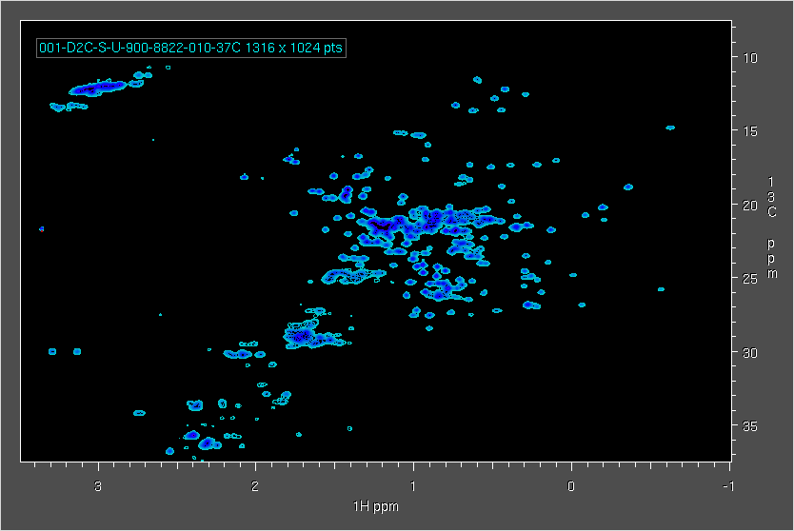
The NISTmAb Interlaboratory NMR Study ¹H / ¹³C Data Release 3
Example Spectra – The Good, The Bad, and The Ugly …
900 MHz System Suitability Sample

Slide 18
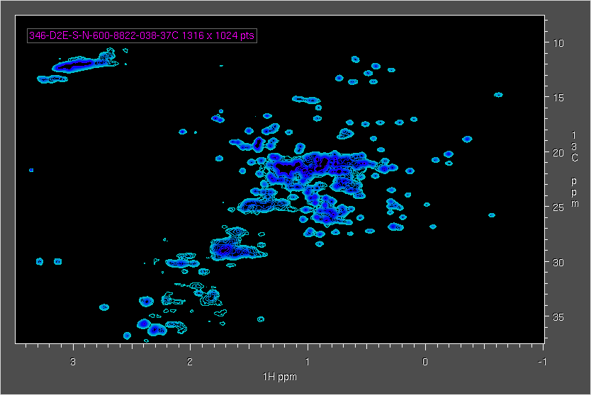
The NISTmAb Interlaboratory NMR Study ¹H / ¹³C Data Release 3
Example Spectra – The Good, The Bad, and The Ugly …
600 MHz System Suitability Sample

Slide 19
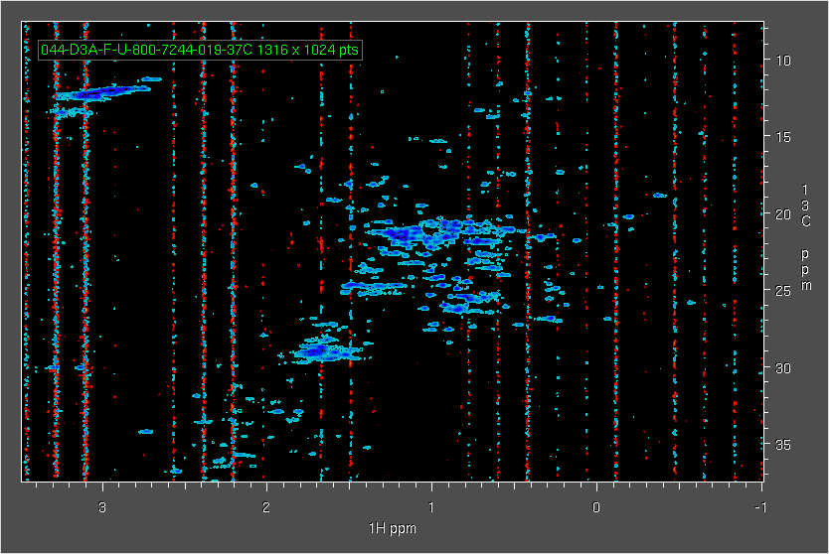
The NISTmAb Interlaboratory NMR Study ¹H / ¹³C Data Release 3
Example Spectra – The Good, The Bad, and The Ugly …
Hardware-Related Artifacts

Slide 20
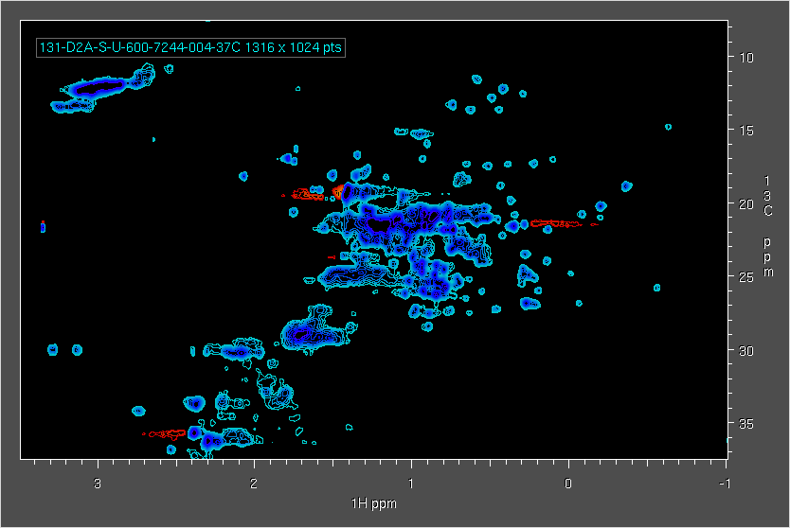
The NISTmAb Interlaboratory NMR Study ¹H / ¹³C Data Release 3
Example Spectra – The Good, The Bad, and The Ugly …
Unphaseable Signals in ¹H

Slide 21
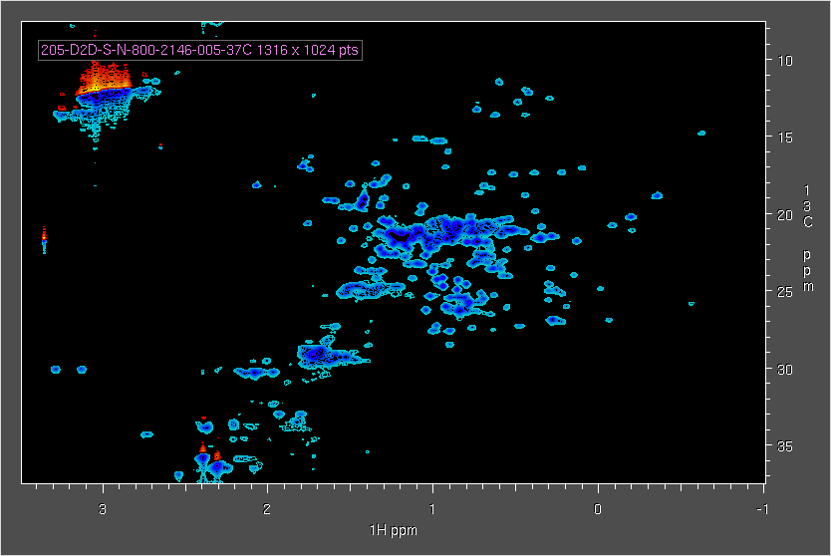
The NISTmAb Interlaboratory NMR Study ¹H / ¹³C Data Release 3
Example Spectra – The Good, The Bad, and The Ugly …
Unphaseable Signals in ¹³C

Slide 22
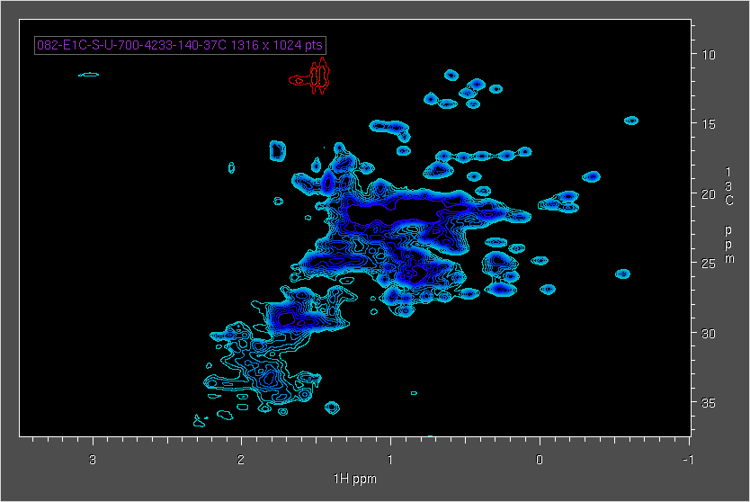
The NISTmAb Interlaboratory NMR Study ¹H / ¹³C Data Release 3
Example Spectra – The Good, The Bad, and The Ugly …
Broad Signals

Slide 23
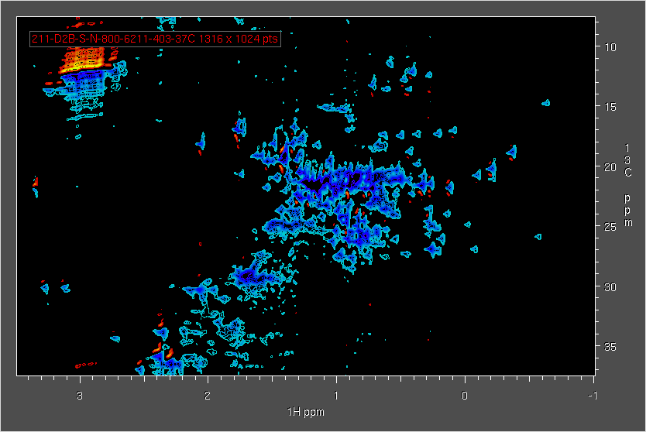
The NISTmAb Interlaboratory NMR Study ¹H / ¹³C Data Release 3
Example Spectra – The Good, The Bad, and The Ugly …
Distorted Lineshapes

Slide 24
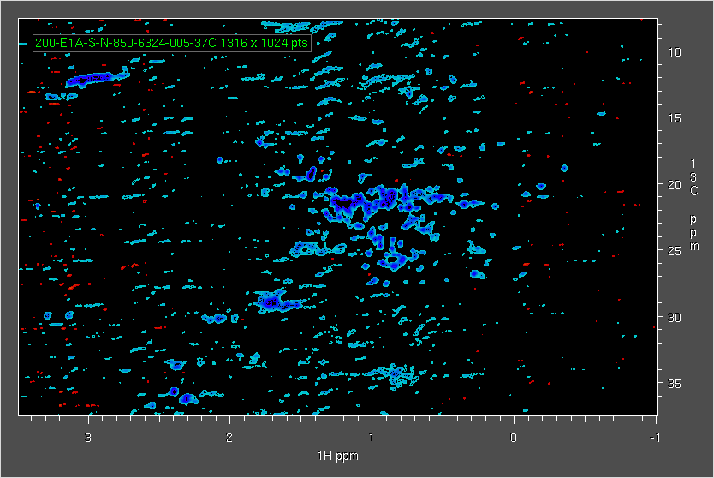
The NISTmAb Interlaboratory NMR Study ¹H / ¹³C Data Release 3
Example Spectra – The Good, The Bad, and The Ugly …
Pervasive Artifacts

Slide 25
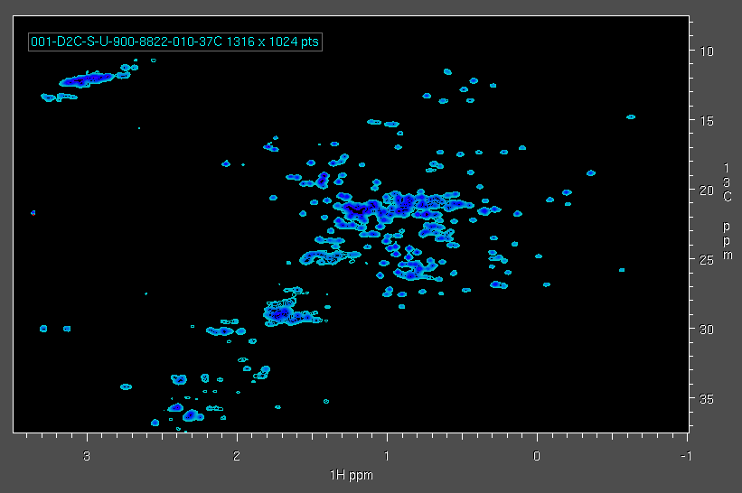
The NISTmAb Interlaboratory NMR Study ¹H / ¹³C Data Release 3
Animation of All 113 System Suitability US Spectra

Slide 26
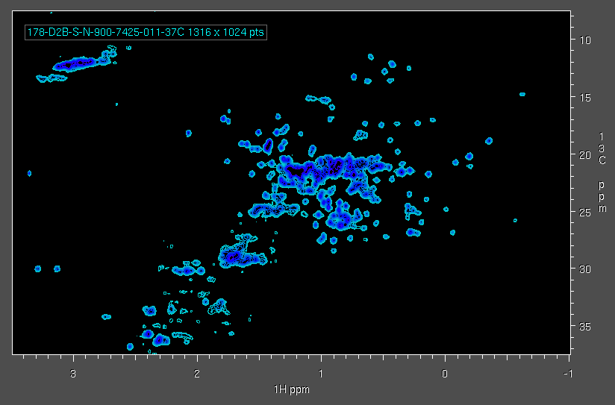
The NISTmAb Interlaboratory NMR Study ¹H / ¹³C Data Release 3
Animation of All 135 System Suitability NUS Spectra

Slide 27
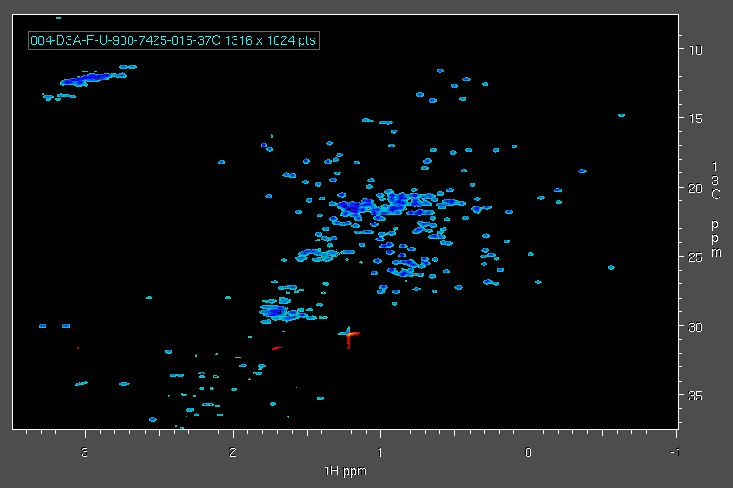
The NISTmAb Interlaboratory NMR Study ¹H / ¹³C Data Release 3
Animation of All 64 Fab US Spectra

Slide 28
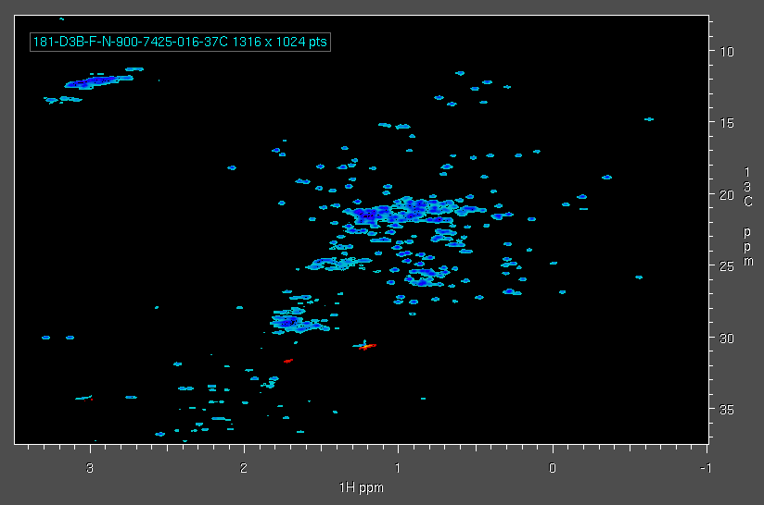
The NISTmAb Interlaboratory NMR Study ¹H / ¹³C Data Release 3
Animation of All 63 Fab NUS Spectra

Slide 29
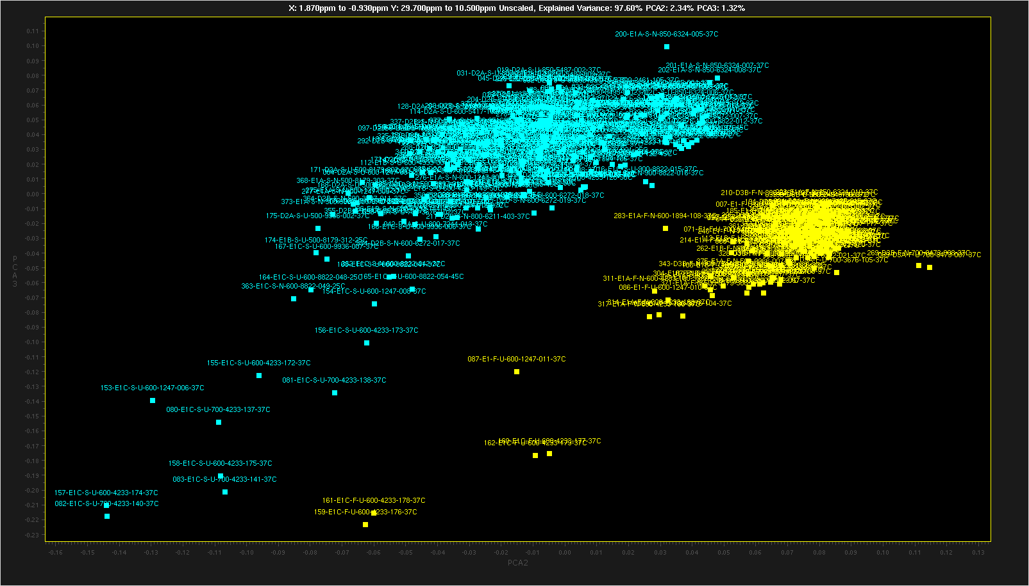
The NISTmAb Interlaboratory NMR Study ¹H / ¹³C Data Release 3
Some PCA Results
All 375 Spectra - Direct PCA on ¹H 1.87 ppm to -0.93 ppm ¹³C 29.7 ppm to 10.5 ppm
Component 2 vs 3 Colored by Sample Type
System Suitability Sample
NISTmAb Fab

Slide 30
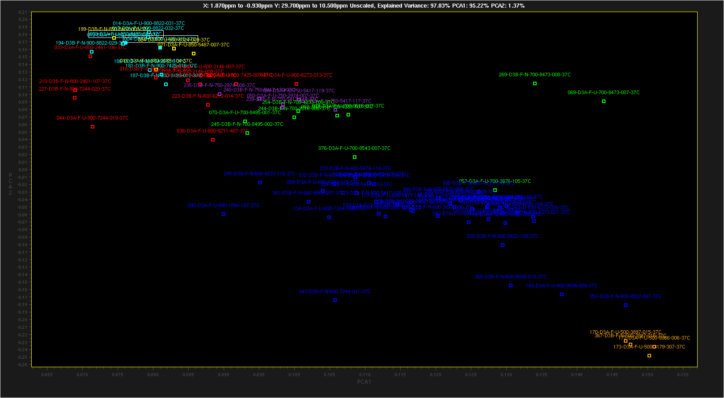
The NISTmAb Interlaboratory NMR Study ¹H / ¹³C Data Release 3
Some PCA Results
Fab Spectra / D Experiments Only
Direct PCA on ¹H 1.87 ppm to -0.93 ppm ¹³C 29.7 ppm to 10.5 ppm
Component 1 vs 2 Colored by Spectrometer Frequency

Slide 31
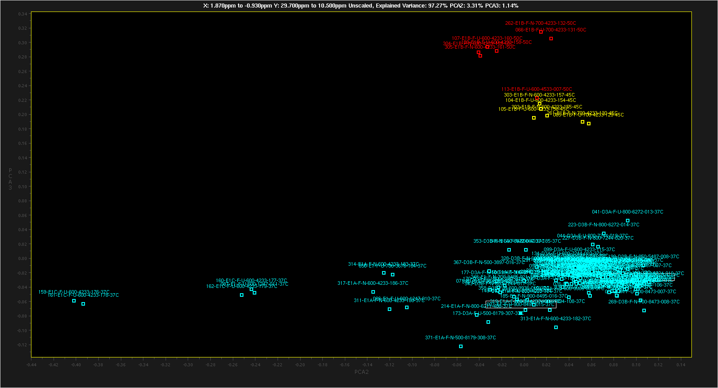
The NISTmAb Interlaboratory NMR Study ¹H / ¹³C Data Release 3
Some PCA Results
Fab Spectra - Direct PCA on ¹H 1.87 ppm to -0.93 ppm ¹³C 29.7 ppm to 10.5 ppm
Component 2 vs 3 Colored by Temperature

Slide 32
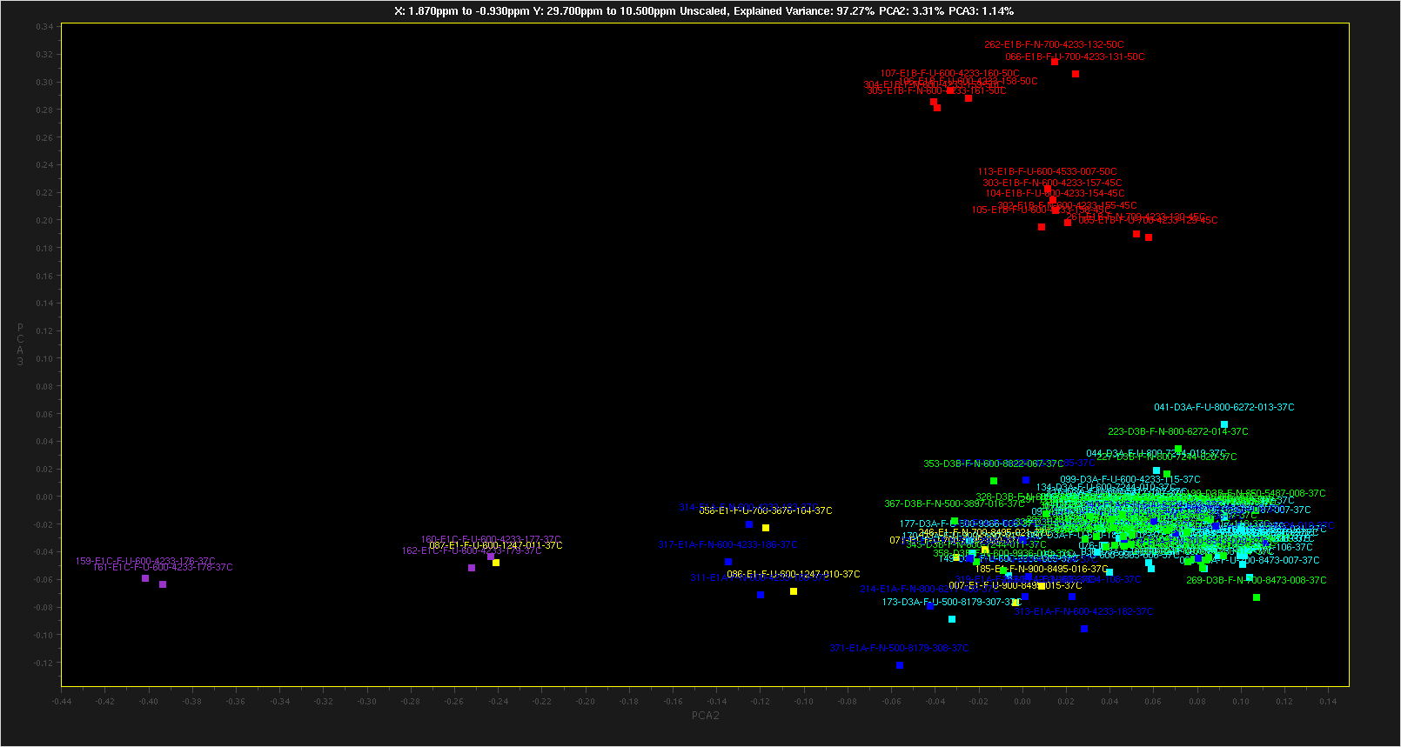
The NISTmAb Interlaboratory NMR Study ¹H / ¹³C Data Release 3
Some PCA Results
Fab Spectra Only - Direct PCA on ¹H 1.87 ppm to -0.93 ppm 13C 29.7 ppm to 10.5 ppm
Component 2 vs 3 Colored by Experiment Type

Slide 33
The NISTmAb Interlaboratory NMR Study ¹H / ¹³C Data Release 3
Future Data Releases
Some spectra have systematic distortions due to hardware problems. There might be data updates to improve these spectra via processing.
Additional PCA results will be released, including updated software for performing PCA.
Scripts for the ¹H / ¹⁵N data will be released separately.

Slide 34
The NISTmAb Interlaboratory NMR Study ¹H / ¹³C Data Release 3
Installing NMRPipe
If you wish to use the NMRPipe processing scripts provided with the study data, you must use NMRPipe Version 9.6 or later, downloaded 5/24/2018 or after.
The NMRPipe installation page is here (www.nmrpipe.com redirects here):
https://www.ibbr.umd.edu/nmrpipe/install.html
If you already have NMRPipe installed, you should perform a clean reinstallation, following all of these steps:
  Rename or delete the existing NMRPipe installation.
  Edit the .cshrc file in your login directory to remove all NMRPipe-related initializations. If the .cshrc file is empty, delete it (it will be recreated automatically during installation).
  Log out before continuing.
For any questions about NMRPipe, contact: frank.delaglio@nist.gov

Slide 35
The NISTmAb Interlaboratory NMR Study ¹H / ¹³C Data Release 3
How to Use the Master Processing Script to Re-Process Data
If you wish to use the NMRPipe processing scripts provided with the study data, you must use NMRPipe Version 9.6 or higher, downloaded 5/24/2018 or after.
The script clean.com will delete previous processed results.
The script proc.com will process the entire spectral series. If it is invoked with no other arguments, it will use the processing parameters in meta.tab, recreating the spectra in the original study data distribution. The processed results will be saved in directory study/ft as described previously.
Running proc.com will also recreate the individual processing scripts for each spectra (such as study/8822/8822-010.com). These scripts are saved along with the time-domain data, as described previously. The scripts can be edited or executed directly to make local versions of individual spectra.
The script interp.com will interpolate the processed results in the study/ft directory. The interpolated results will be saved in directory study/interp as described previously.
The script show.com will run the nmrDraw graphical interface to display the interpolated results.
For any questions about processing, contact: frank.delaglio@nist.gov

Slide 36
The NISTmAb Interlaboratory NMR Study ¹H / ¹³C Data Release 3
How to Use the Master Processing Script to Re-Process Data
The script proc.com can also be used to process a subset of the data, or to process the data using different parameters such as different window functions. This will require familiarity with NMRPipe software.
To process a subset of the data, prepare a version of table meta.tab containing only the entries for the subset of spectra desired. Then use the new table as input via the –in option, for example:
  proc.com –in my_meta.tab
Use the proc.com –procArgs option to override the default processing options, to change solvent filter details, window functions, etc. Use basicFT2.com –help for more details about processing parameters.
The –procArgs options should be the last items on the command line. The default settings are:
  proc.com –procArgs -xEXTX1 3.7ppm -xEXTXN -1.0ppm \
  -xZFARG size=4096 -yZFARG size=1024 -xSOL SOL
As an example, to process the data with an additional 15Hz Gaussian line broadening in the ¹H dimension:
  proc.com –procArgs –xGLB 15

Slide 37
The NISTmAb Interlaboratory NMR Study ¹H / ¹³C Data Release 3
Study Authors
NIST/IBBR
John Marino
Frank Delaglio
Robert Brinson
Luke Arbogast
John Schiel
Health Canada
Yves Aubin
Geneviève Gingras
Houman Ghasriani
Medical Products Agency (MPA-Sweden)
Andreas Blomgren
Torgny Rundlӧf
Genentech
Ken Skidmore
Hoffmann-La Roche Ltd.
Alfred Ross
Amgen
Mats Wikstrӧm
John B. Jordan
Biogen, Inc
Julie Yu Wei
EN-FIST Centra of Excellence
Janez Plavec
Gregor Ilc
Brazilian Center for Research in Energy and Materials (CNPEM)
Ana Carolina de Mattos Zeri
Mauricio Luis Sforça
Universitaet Bayreuth
Kristian Schweimer
Pacific Northwest National Laboratory (PNNL)
John R. Cort
Patrick N. Reardon
Chad W. Lawrence
Baxter Healthcare
Carlos A. Amezcua
Christina M. Szabo
Pfizer Essential Health
Edward R. Zartler
Stockhom University
Gӧran Widmalm
Jonas Ståhle
Momenta Pharmaceuticals
Desiree Tsao

Slide 38
The NISTmAb Interlaboratory NMR Study ¹H / ¹³C Data Release 3
Study Authors
ETH-Zurich
Prof. Dr. Gerhard Wider
Thea Suter-Stahel
The University of Queensland
Mehdi Mobli
Xinying Jia
Gregory K. Pierens
Eli Lilly and Company
Scott A. Bradley
Medical University of South Carolina
Stuart Parnham
National Institutes of Natural Sciences (NINS)
Saeko Yanaka
Koicki Kato
NIST Gaithersburg
Anthony Kearsley
Ryan Evans
National Research Council of Canada
Feng Ni
Ping Xu
Leibniz-Institut für molekulare Phamakologie (FMP-Berlin)
Peter Schmieder
Nils Trieloff
Bruker BioSpin Corporation
Donna M. Baldisseri
The University of Melbourne
David W. Keizer
Hamish G. Grant
FDA-CBER
Darón Freedberg
FDA-CDER
Kang Chen
David Keire

Slide 39
The NISTmAb Interlaboratory NMR Study ¹H / ¹³C Data Release 3
Acknowledgements
National Association of Proficiency Testing
Chuck Ellis
Bruker BioSpin Corporation
Clemens Anklin
Kim Colson
Genentech
Yung-Hsiang Kao
NIST Gaithersburg
William Wallace
Harvard Medical School
Gerhard Wagner
Haribabu Arthanari
Sven Hyberts
Biogen
JC Hus
Leibniz-Institut für molekulare Phamakologie
Monika Beerbaum

Slide 40
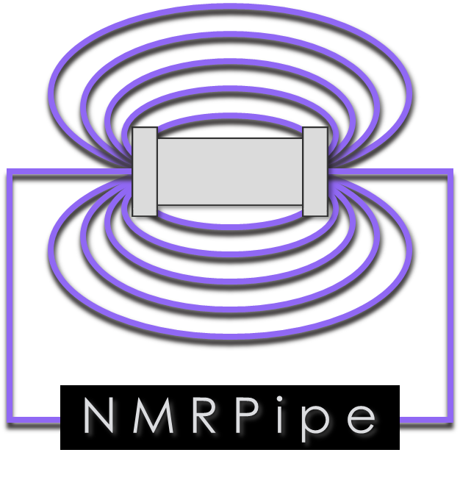



NMRPipe is Provided by the National Institute of Standards and Technology in Partnership with the National Institutes of Health
www.nmrpipe.com
NMRPipe: a multidimensional spectral processing system based on UNIX pipes. Frank Delaglio, Stephan Grzesiek, Geerten. W. Vuister, Guang Zhu, John Pfeifer, and Ad Bax, J. Biomol. NMR. 6, 277-293 (1995).

Slide 41
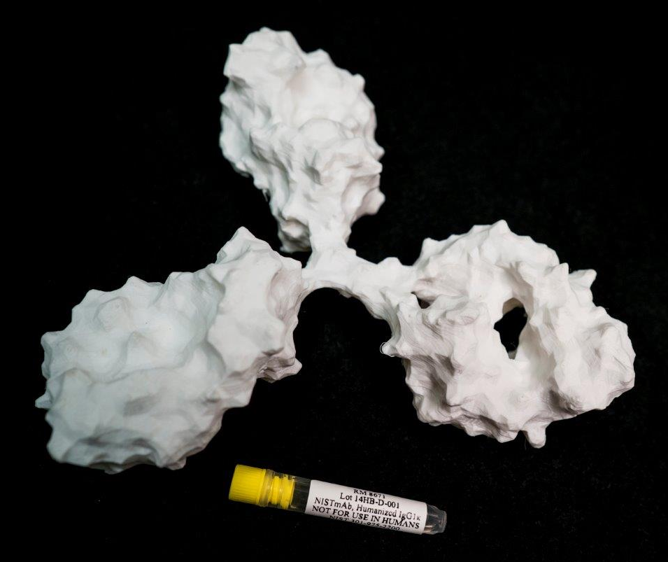
NIST Disclaimer: Certain commercial equipment, instruments, and materials are identified in this presentation in order to specify the experimental procedure. Such identification does not imply recommendation or endorsement by the National Institute of Standards and Technology, nor does it imply that the material or equipment identified is necessarily the best available for the purpose.

